Slide 1
Weekly Report
程文胜 2019.11.30-12.7

Slide 2
Weekly Report
Abstract
Content
End

Slide 3
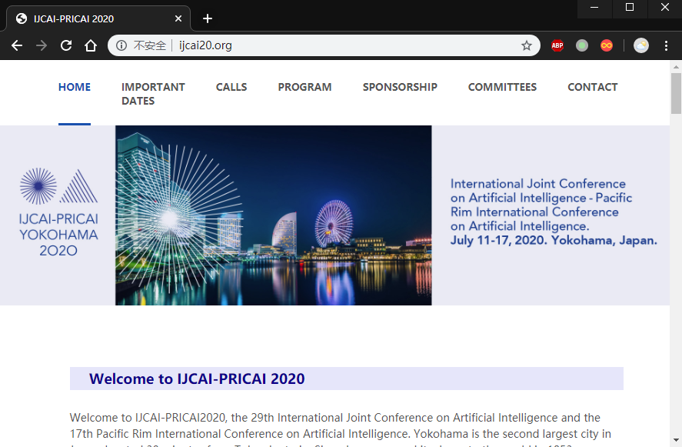
Abstract
This week I mainly put my effort on discussing IJCAI 2020 paper with Lei Xu.

Slide 4
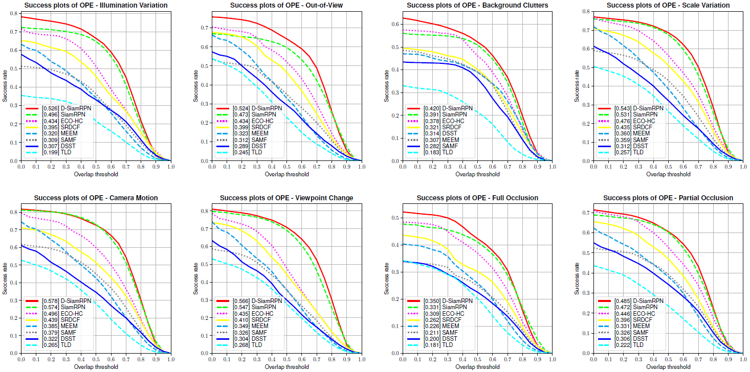
Content
Since we have finished experiments during CVPR period, we mainly focus on how to tell a story and make the motivation and performance more convincing.

Slide 5
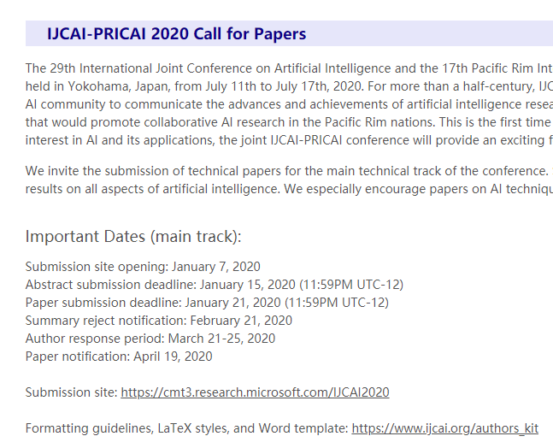
Content
We think that concept is more important than accuracy. We need to show that we address some problem, rather than improve the accuracy only. If we demonstrate that we find a problem and solve it, it would be a meaningful work even the accuracy is not SOTA. We would try to finish the manuscript as soon as possible.

Slide 6
Report End
程文胜 VIPG

