Slide 1
Weekly Report
程文胜 2019.3.23-2019.3.30

Slide 2
Weekly Report
Abstract
Content
Discussion

Slide 3
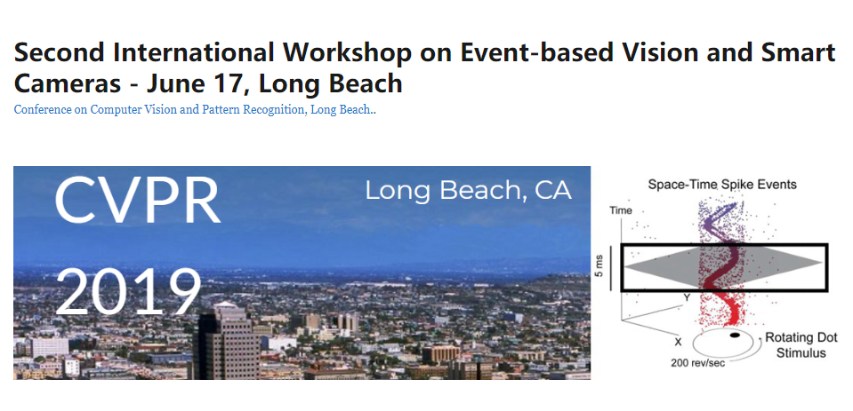
Abstract
This week I mainly put my effort on writing CVPR event-based vision workshop paper.

Slide 4
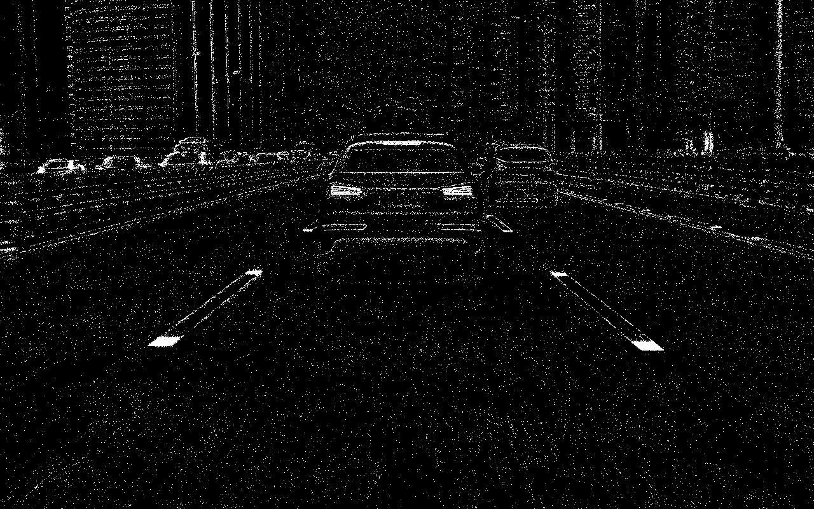
Content
Firstly, Luo Hao and other undergraduates annotate about 3000 DVS images with instance segmentation label. To augment our dataset, we sample extra frames which are adjacent to annotated frames, so we expand the dataset to 5000 images without extra labels.
DVS sample image

Slide 5

Content
To benchmark baselines, Luo Hao tested specialized lane extraction models, SCNN and LaneNet. I tested semantic segmentation models, including FCN, DeepLabv3, RefineNet.
SCNN prediction result

Slide 6

Discussion
This is the first time we build our own dataset. We went through the whole procedure. We also made some mistakes and learned a lot from them.
The key point is to ensure label quality. Although some undergraduates helped us, since they were not so familiar, there exist some problems in their labels. It took us some time to correct them.
For baselines, it’s necessary to guarantee experimental settings are same before experiment. In fact, because we adjusted dataset partition, we trained these models twice, which cost some time.

Slide 7
Report End
程文胜 VIPG

