Slide 1
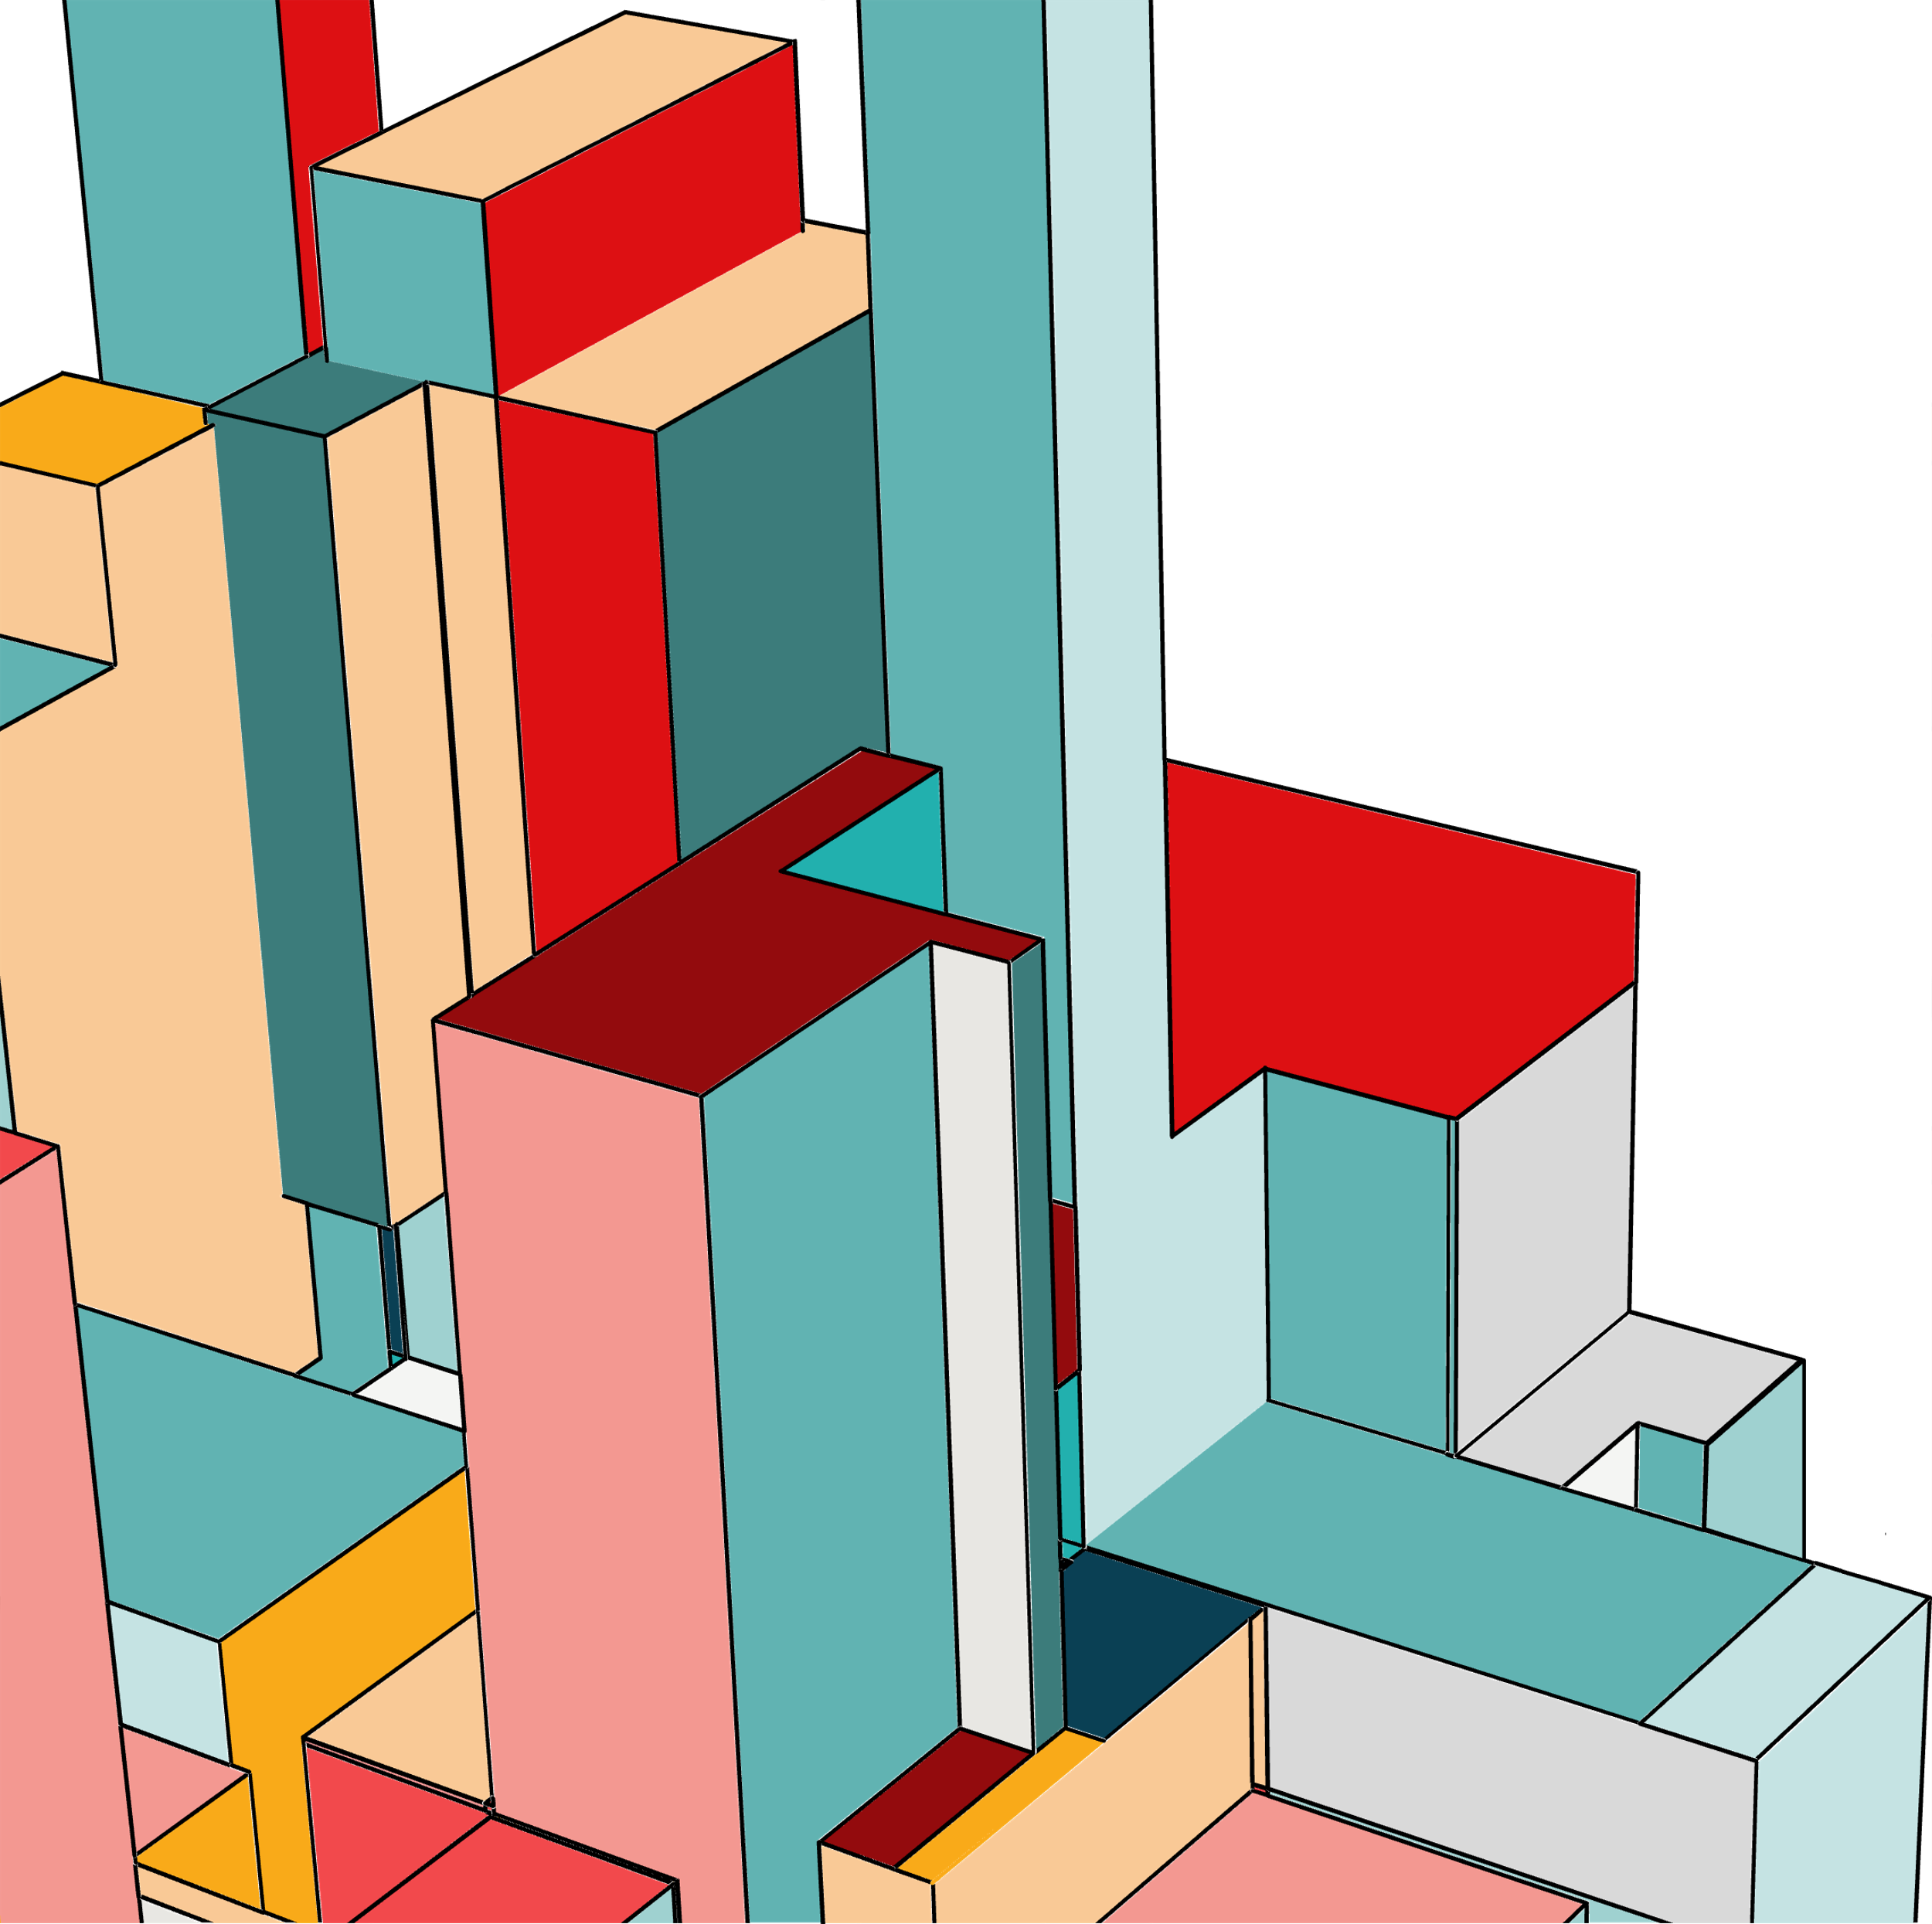
01
PROJECT 1
DATASET: MELBOURNE HOUSING SNAPSHOT
SOURCE: Kaggle.com
ANALYSES PERFORMED:
Correlation between latitude/longitude and property prices to identify high-demand areas.
Chi Square test of Property Type vs. Sale Method
Bar Charts showing the average Price by Month and Average Price by Quarter.
Property count trends over time in booming regions.

Slide 2
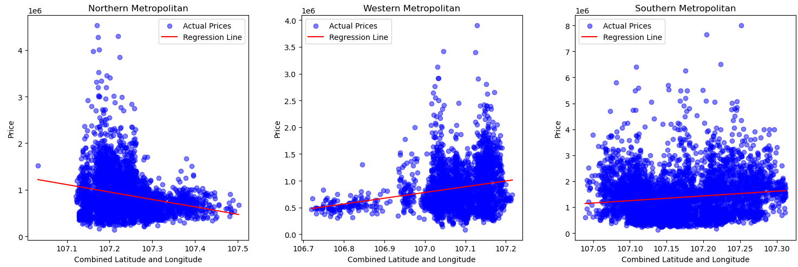
Correlation between latitude/longitude and property prices to identify high-demand areas.
TOP 5 AGENTS BY REVENUE
BOTTOM 5 AGENTS BY REVENUE
TOP 5 AGENTS BY HOUSE VOLUME SOLD
BOTTOM 5 AGENTS BY HOUSE VOLUME SOLD

Slide 3
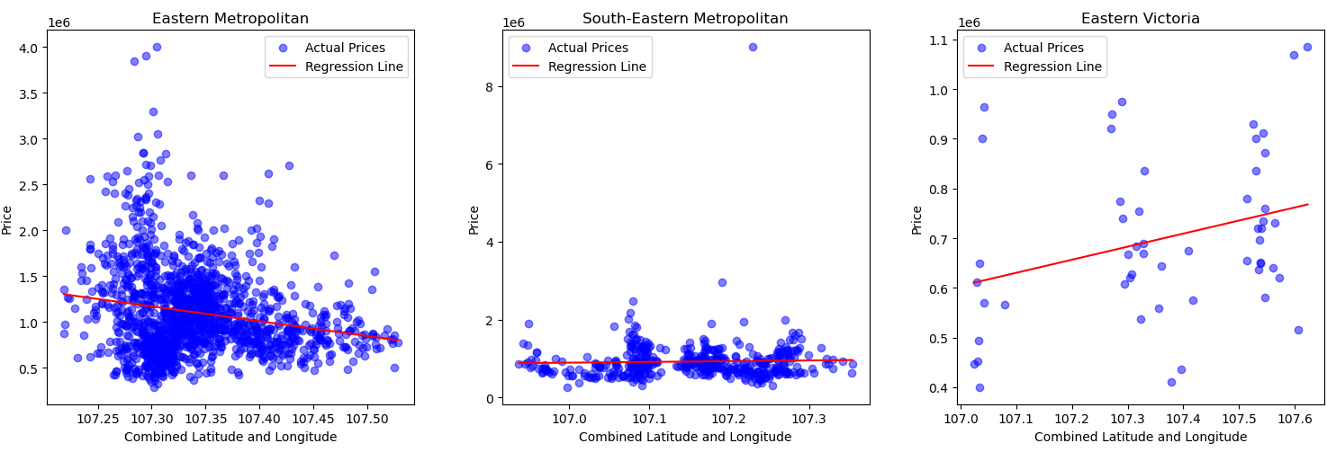

Slide 4
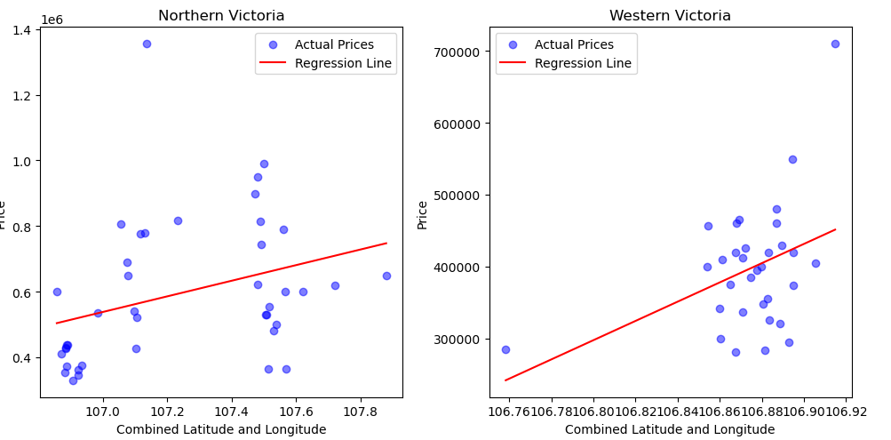

Slide 5
Insight:
The analysis shows how location, as represented by the combined latitude and longitude values, impacts property prices. Properties clustered in the represented geographical areas exhibited higher prices, indicating premium locations.

Slide 6
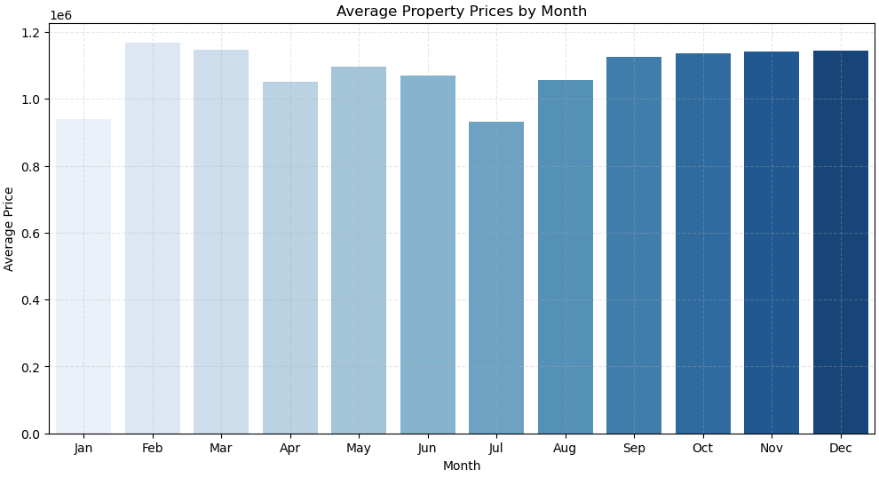
Effect of the sale date on price- Average property price against month and quarter

Slide 7
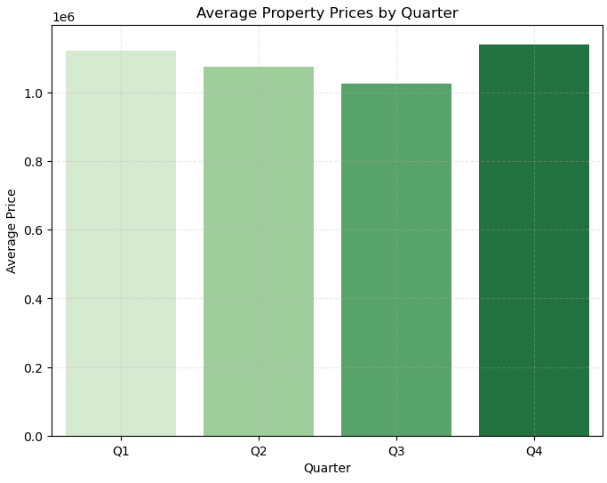

Slide 8
Insight:
The bar charts show that the Melbourne real estate market follows a pattern, where certain times of the year see more activity and higher prices, while others are quieter and more stable. This can help real estate agents, developers, and investors understand annual trends and plan marketing strategies accordingly.

Slide 9
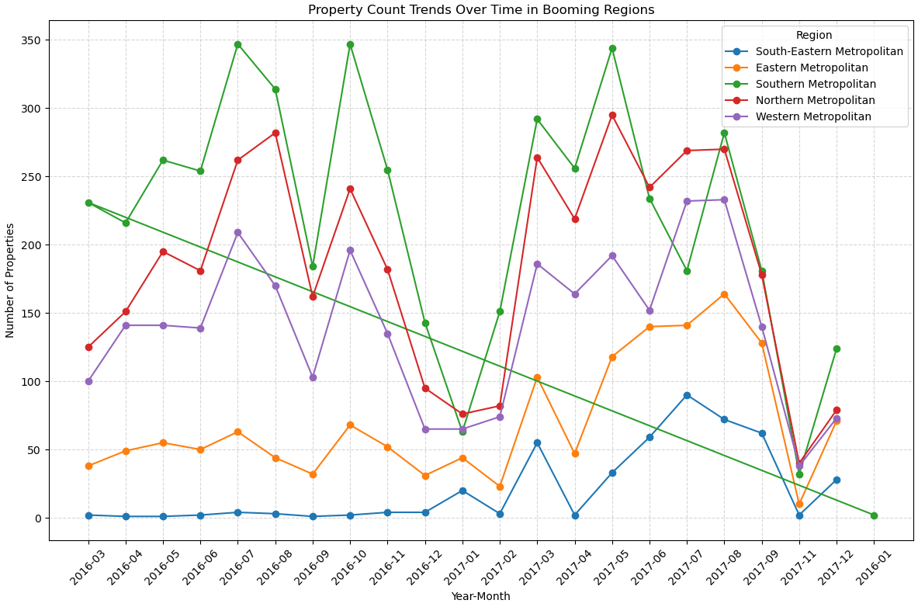
Plot of year and month against number of properties sold to see the trend

Slide 10
Insight:
The peaks and troughs in the line chart showing booming regions indicate high and low activity months or periods, respectively.
Southern Metropolitan shows relatively high and steady counts compared to other regions, suggesting it might be experiencing a more consistent development boom.
Northern Metropolitan also has several peaks, indicating periods of high activity, but it fluctuates more than others.

Slide 11
Thank You!

