Slide 1
Scan: HTHH
S0
S1
S3
S2

Slide 2
X/Y
2/2
1/2
2/1
1/1
0/2
2/0
1/0
0/1
0/0

Slide 3
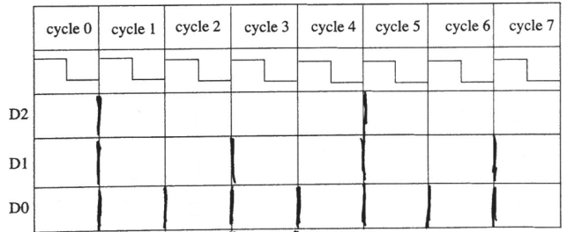
cycle0 | cycle1 | cycle2 | cycle3 | cycle4 | cycle5 | cycle6 | cycle7
0 | 1 | 1 | 1 | 1 | 0 | 0 | 0
0 | 1 | 1 | 0 | 0 | 1 | 1 | 0
0 | 1 | 0 | 1 | 0 | 1 | 0 | 1

