Slide 1
Great Idea #1 Turing Machine （Computataional Model)
Fetch instruction from memory
Decode instruction
Tadd, Tmul
U
Evaluate address
a,b,c
c(a+b)
Fetch operands from memory
Universal Turing Machine
Execute operation
Store result

Slide 2
Instruction Processing: State Transtion
_{PC}
F
F
F
F
F
F
F
IR
Fetch instruction from memory
D
D
D
D
D
D
D
Decode instruction
EA
EA
EA
EA
EA
EA
EA
Evaluate address
OP
OP
OP
OP
OP
OP
OP
Fetch operands from memory
EX
EX
EX
EX
EX
EX
EX
Execute operation
S
S
S
S
S
S
S
Store result
Notes:
2

Slide 3
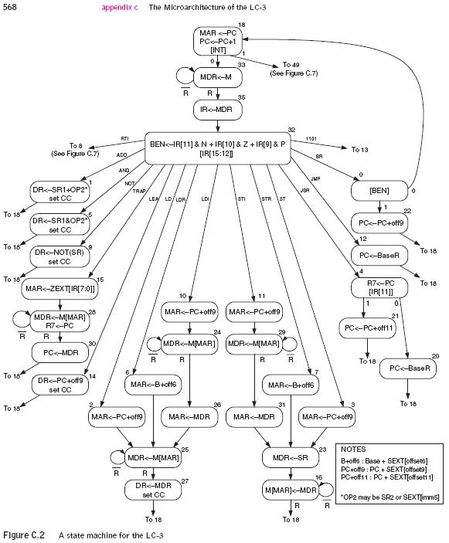
Instruction Processing: Finite State Automata
F
F
D
D
EA
EA
OP
OP
EX
EX
S
S
Notes:
3

Slide 4
LC-3 Overview: Memory Map
0x0000
Trap Vector Table
0x00FF
0x0100
Interrupt Vector Table
0x01FF
0x0200
Operating System
and Supervisor Stack
0x2FFF
0x3000
Program Text
PC
Global data section
R4(Global pointer)
Function1
R6
Heap (for dynamically
allocated memory)
R5
Function2
R6
R5
Run-time stack
R6 (stack pointer)
0xFDFF
R5 (frame pointer)
Function3
R6
0xFE00
Device Register
Addresses
0xFFFF
R5

Slide 5
LC-3 ISA Overview
_{运算指令(Operate Instructions)}
₁₅
₁₄
₁₃
₁₂
₁₁
₁₀
₉
₈
₇
₆
₅
₄
₃
₂
₁
₀
_{数据移动指令}
_{(Data Movement Instructions)}
_{ADD}
₀
₀
₀
₁
_{DR}
_{SR1}
₀
₀
₀
_{SR2}
_{ADD}
₀
₀
₀
₁
_{DR}
_{SR1}
₁
_{Imm5}
_{取数指令(Load)}
_{AND}
₀
₁
₀
₁
_{DR}
_{SR1}
₀
₀
₀
_{SR2}
_{AND}
₀
₁
₀
₁
_{DR}
_{SR1}
₁
_{Imm5}
₁₅
₁₄
₁₃
₁₂
₁₁
₁₀
₉
₈
₇
₆
₅
₄
₃
₂
₁
₀
_{LD}
₀
₀
₁
₀
_{DR}
_{PCoffset9}
_{NOT}
₁
₀
₀
₁
_{DR}
_{SR1}
₁
₁
₁
₁
₁
₁
_{LDR}
₀
₁
₁
₀
_{DR}
_{BaseR}
_{PCoffset6}
_{Reserved}
₁
₁
₀
₁
_{LDI}
₁
₀
₁
₀
_{DR}
_{PCoffset9}
_{控制指令(Control Instructions)}
_{LEA}
₁
₁
₁
₀
_{DR}
_{PCoffset9}
₁₅
₁₄
₁₃
₁₂
₁₁
₁₀
₉
₈
₇
₆
₅
₄
₃
₂
₁
₀
_{存数指令(Store)}
_{BR}
₀
₀
₀
₀
_{n}
_{z}
_{p}
_{PCoffset9}
_{JSR}
₀
₁
₀
₀
₁
_{PCoffset11}
₁₅
₁₄
₁₃
₁₂
₁₁
₁₀
₉
₈
₇
₆
₅
₄
₃
₂
₁
₀
_{JSRR}
₀
₁
₀
₀
₀
₀
₀
_{BaseR}
₀
₀
₀
₀
₀
₀
_{ST}
₀
₀
₁
₁
_{SR}
_{PCoffset9}
_{RTI}
₁
₀
₀
₀
₀
₀
₀
₀
₀
₀
₀
₀
₀
₀
₀
₀
_{STR}
₀
₁
₁
₁
_{SR}
_{BaseR}
_{PCoffset6}
_{JMP}
₁
₁
₀
₀
₀
₀
₀
_{BaseR}
₀
₀
₀
₀
₀
₀
_{STI}
₁
₀
₁
₁
_{SR}
_{PCoffset9}
_{RET}
₁
₁
₀
₀
₀
₀
₀
₁
₁
₁
₀
₀
₀
₀
₀
₀
_{TRAP}
₁
₁
₁
₁
₀
₀
₀
₀
_{TrapVector8}

Slide 6
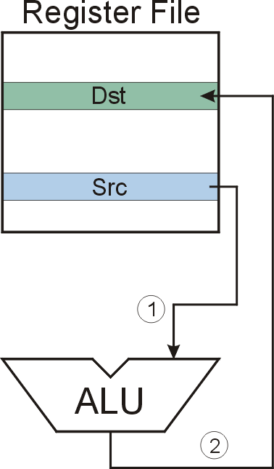
NOT (Register)
NOT
Note: Src and Dst could be the same register.
Notes:
6

Slide 7
F
D
EA
NOT (Register):
OP
₁₆
GatePC
₁₆
GateMARMUX
EX
LD.PC
PC
DR
₃
MARMUX
+1
REG FILE
₁₆
₂
PCMUX
₁₆
₁₆
₁₆
₁₆
₁₆
LD.REG
S
[7:0]
SR2
SR2
OUT
SR1
OUT
SR1
SEXT
₊
₃
₃
ADDR2MUX
MUX
MUX
ADDR1MUX
₁₆
₁₆
[10:0]
₁₆
₁₆
₁₆
₁₆
₁₆
SEXT
[8:0]
LD.CC
₁₆
SEXT
FINITE STATE MACHINE
SR2MUX
[5:0]
SEXT
₁₆
N
Z
P
ALUK
_{A}
_{B}
[4:0]
SEXT
₂
ALU
LD.IR
IR
LOGIC
…
₁₆
₁₆
₁₆
RUN
GateALU
₁₆
GateMDR
₁₆
LD.MDR
MDR
MEMORY
MAR
LD.MAR
₁₆
INPUT
OUTPUT
MIO.EN
MUX
₁₆
MEM.EN,R,W

Slide 8
F
D
EA
NOT (Register):
OP
₁₆
GatePC
₁₆
GateMARMUX
EX
LD.PC
PC
DR
₃
MARMUX
+1
REG FILE
₁₆
₂
PCMUX
₁₆
₁₆
₁₆
₁₆
₁₆
LD.REG
S
[7:0]
SR2
SR2
OUT
SR1
OUT
SR1
SEXT
₊
₃
₃
ADDR2MUX
MUX
MUX
ADDR1MUX
₁₆
₁₆
[10:0]
₁₆
₁₆
₁₆
₁₆
₁₆
SEXT
[8:0]
LD.CC
₁₆
SEXT
FINITE STATE MACHINE
SR2MUX
[5:0]
SEXT
₁₆
N
Z
P
ALUK
_{A}
_{B}
[4:0]
SEXT
₂
ALU
LD.IR
IR
LOGIC
…
₁₆
₁₆
₁₆
RUN
GateALU
₁₆
GateMDR
₁₆
LD.MDR
MDR
MEMORY
MAR
LD.MAR
₁₆
INPUT
OUTPUT
MIO.EN
MUX
₁₆
MEM.EN,R,W

Slide 9
F
D
EA
NOT (Register):
OP
₁₆
GatePC
₁₆
GateMARMUX
EX
LD.PC
PC
DR
₃
MARMUX
+1
REG FILE
₁₆
₂
PCMUX
₁₆
₁₆
₁₆
₁₆
₁₆
LD.REG
S
[7:0]
SR2
SR2
OUT
SR1
OUT
SR1
SEXT
₊
₃
₃
ADDR2MUX
MUX
MUX
ADDR1MUX
₁₆
₁₆
[10:0]
₁₆
₁₆
₁₆
₁₆
₁₆
SEXT
[8:0]
LD.CC
₁₆
SEXT
FINITE STATE MACHINE
SR2MUX
[5:0]
SEXT
₁₆
N
Z
P
ALUK
_{A}
_{B}
[4:0]
SEXT
₂
ALU
LD.IR
IR
LOGIC
…
₁₆
₁₆
₁₆
RUN
GateALU
₁₆
GateMDR
₁₆
LD.MDR
MDR
MEMORY
MAR
LD.MAR
₁₆
INPUT
OUTPUT
MIO.EN
MUX
₁₆
MEM.EN,R,W

Slide 10
NOT (Register):
F
D
EA
OP
EX
S
₁₆
GatePC
₁₆
GateMARMUX
LD.PC
PC
DR
₃
MARMUX
+1
REG FILE
₁₆
₂
PCMUX
₁₆
₁₆
₁₆
₁₆
₁₆
LD.REG
[7:0]
SR2
SR2
OUT
SR1
OUT
SR1
SEXT
₊
₃
₃
ADDR2MUX
MUX
MUX
ADDR1MUX
₁₆
₁₆
[10:0]
₁₆
₁₆
₁₆
₁₆
₁₆
SEXT
[8:0]
LD.CC
₁₆
SEXT
FINITE STATE MACHINE
SR2MUX
[5:0]
SEXT
₁₆
N
Z
P
NOT
_{A}
_{B}
[4:0]
SEXT
₂
ALU
LD.IR
IR
LOGIC
…
₁₆
₁₆
₁₆
RUN
GateALU
₁₆
GateMDR
₁₆
LD.MDR
MDR
MEMORY
MAR
LD.MAR
₁₆
INPUT
OUTPUT
MIO.EN
MUX
₁₆
MEM.EN,R,W

Slide 11
NOT (Register):
F
D
EA
OP
EX
S
₁₆
GatePC
₁₆
GateMARMUX
LD.PC
PC
DR
₃
MARMUX
+1
REG FILE
₁₆
₂
PCMUX
₁₆
₁₆
₁₆
₁₆
₁₆
LD.REG
[7:0]
SR2
SR2
OUT
SR1
OUT
SR1
SEXT
₊
₃
₃
ADDR2MUX
MUX
MUX
ADDR1MUX
₁₆
₁₆
[10:0]
₁₆
₁₆
₁₆
₁₆
₁₆
SEXT
[8:0]
LD.CC
₁₆
SEXT
FINITE STATE MACHINE
SR2MUX
[5:0]
SEXT
₁₆
N
Z
P
NOT
_{A}
_{B}
[4:0]
SEXT
₂
ALU
LD.IR
IR
LOGIC
…
₁₆
₁₆
₁₆
RUN
GateALU
₁₆
GateMDR
₁₆
LD.MDR
MDR
MEMORY
MAR
LD.MAR
₁₆
INPUT
OUTPUT
MIO.EN
MUX
₁₆
MEM.EN,R,W

Slide 12
NOT (Register):
F
D
EA
OP
EX
S
₁₆
GatePC
₁₆
GateMARMUX
LD.PC
PC
DR
₃
MARMUX
+1
REG FILE
₁₆
₂
PCMUX
₁₆
₁₆
₁₆
₁₆
₁₆
LD.REG
[7:0]
SR2
SR2
OUT
SR1
OUT
SR1
SEXT
₊
₃
₃
ADDR2MUX
MUX
MUX
ADDR1MUX
₁₆
₁₆
[10:0]
₁₆
₁₆
₁₆
₁₆
₁₆
SEXT
[8:0]
LD.CC
₁₆
SEXT
FINITE STATE MACHINE
SR2MUX
[5:0]
SEXT
₁₆
N
Z
P
NOT
_{A}
_{B}
[4:0]
SEXT
₂
ALU
LD.IR
IR
LOGIC
…
₁₆
₁₆
₁₆
RUN
GateALU
₁₆
GateMDR
₁₆
LD.MDR
MDR
MEMORY
MAR
LD.MAR
₁₆
INPUT
OUTPUT
MIO.EN
MUX
₁₆
MEM.EN,R,W

Slide 13
NOT (Register):
F
D
EA
OP
EX
S
₁₆
GatePC
₁₆
GateMARMUX
LD.PC
PC
DR
₃
MARMUX
+1
REG FILE
₁₆
₂
PCMUX
₁₆
₁₆
₁₆
₁₆
₁₆
LD.REG
[7:0]
SR2
SR2
OUT
SR1
OUT
SR1
SEXT
₊
₃
₃
ADDR2MUX
MUX
MUX
ADDR1MUX
₁₆
₁₆
[10:0]
₁₆
₁₆
₁₆
₁₆
₁₆
SEXT
[8:0]
LD.CC
₁₆
SEXT
FINITE STATE MACHINE
SR2MUX
[5:0]
SEXT
₁₆
N
Z
P
NOT
_{A}
_{B}
[4:0]
SEXT
₂
ALU
LD.IR
IR
LOGIC
…
₁₆
₁₆
₁₆
RUN
GateALU
₁₆
GateMDR
₁₆
LD.MDR
MDR
MEMORY
MAR
LD.MAR
₁₆
INPUT
OUTPUT
MIO.EN
MUX
₁₆
MEM.EN,R,W

Slide 14
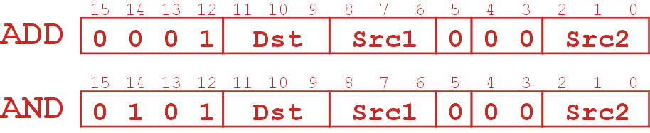
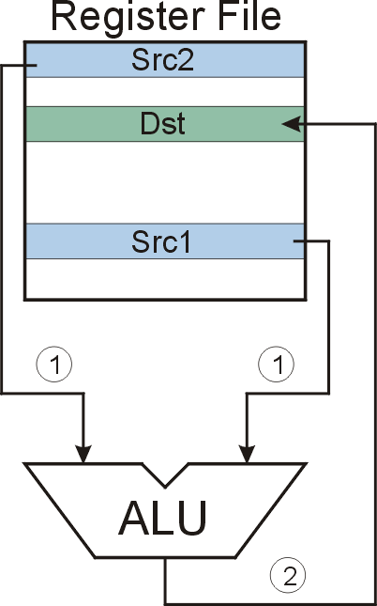
ADD/AND (Register)
this zero means “register mode”
ADD/AND
Notes:
14

Slide 15
F
D
EA
ADD/AND (Register)
OP
₁₆
GatePC
₁₆
GateMARMUX
EX
LD.PC
PC
DR
₃
MARMUX
+1
REG FILE
₁₆
₂
PCMUX
₁₆
₁₆
₁₆
₁₆
₁₆
LD.REG
S
[7:0]
SR2
SR2
OUT
SR1
OUT
SR1
SEXT
₊
₃
₃
ADDR2MUX
MUX
MUX
ADDR1MUX
₁₆
₁₆
[10:0]
₁₆
₁₆
₁₆
₁₆
₁₆
SEXT
[8:0]
LD.CC
₁₆
SEXT
FINITE STATE MACHINE
SR2MUX
[5:0]
SEXT
₁₆
N
Z
P
ALUK
_{A}
_{B}
[4:0]
SEXT
₂
ALU
LD.IR
IR
LOGIC
…
₁₆
₁₆
₁₆
RUN
GateALU
₁₆
GateMDR
₁₆
LD.MDR
MDR
MEMORY
MAR
LD.MAR
₁₆
INPUT
OUTPUT
MIO.EN
MUX
₁₆
MEM.EN,R,W

Slide 16
F
D
EA
ADD/AND (Register)
OP
₁₆
GatePC
₁₆
GateMARMUX
EX
LD.PC
PC
DR
₃
MARMUX
+1
REG FILE
₁₆
₂
PCMUX
₁₆
₁₆
₁₆
₁₆
₁₆
LD.REG
S
[7:0]
SR2
SR2
OUT
SR1
OUT
SR1
SEXT
₊
₃
₃
ADDR2MUX
MUX
MUX
ADDR1MUX
₁₆
₁₆
[10:0]
₁₆
₁₆
₁₆
₁₆
₁₆
SEXT
[8:0]
LD.CC
₁₆
SEXT
FINITE STATE MACHINE
SR2MUX
[5:0]
SEXT
₁₆
N
Z
P
ALUK
_{A}
_{B}
[4:0]
SEXT
₂
ALU
LD.IR
IR
LOGIC
…
₁₆
₁₆
₁₆
RUN
GateALU
₁₆
GateMDR
₁₆
LD.MDR
MDR
MEMORY
MAR
LD.MAR
₁₆
INPUT
OUTPUT
MIO.EN
MUX
₁₆
MEM.EN,R,W

Slide 17
F
D
EA
ADD/AND (Register)
OP
₁₆
GatePC
₁₆
GateMARMUX
EX
LD.PC
PC
DR
₃
MARMUX
+1
REG FILE
₁₆
₂
PCMUX
₁₆
₁₆
₁₆
₁₆
₁₆
LD.REG
S
[7:0]
SR2
SR2
OUT
SR1
OUT
SR1
SEXT
₊
₃
₃
ADDR2MUX
MUX
MUX
ADDR1MUX
₁₆
₁₆
[10:0]
₁₆
₁₆
₁₆
₁₆
₁₆
SEXT
[8:0]
LD.CC
₁₆
SEXT
FINITE STATE MACHINE
SR2MUX
[5:0]
SEXT
₁₆
N
Z
P
ALUK
_{A}
_{B}
[4:0]
SEXT
₂
ALU
LD.IR
IR
LOGIC
…
₁₆
₁₆
₁₆
RUN
GateALU
₁₆
GateMDR
₁₆
LD.MDR
MDR
MEMORY
MAR
LD.MAR
₁₆
INPUT
OUTPUT
MIO.EN
MUX
₁₆
MEM.EN,R,W

Slide 18
ADD/AND (Register)
F
D
EA
OP
EX
S
₁₆
GatePC
₁₆
GateMARMUX
LD.PC
PC
DR
₃
MARMUX
+1
REG FILE
₁₆
₂
PCMUX
₁₆
₁₆
₁₆
₁₆
₁₆
LD.REG
[7:0]
SR2
SR2
OUT
SR1
OUT
SR1
SEXT
₊
₃
₃
ADDR2MUX
MUX
MUX
ADDR1MUX
₁₆
₁₆
[10:0]
₁₆
₁₆
₁₆
₁₆
₁₆
SEXT
[8:0]
LD.CC
₁₆
SEXT
FINITE STATE MACHINE
SR2MUX
[5:0]
SEXT
₁₆
N
Z
P
ADD/AND
_{A}
_{B}
[4:0]
SEXT
₂
ALU
LD.IR
IR
LOGIC
…
₁₆
₁₆
₁₆
RUN
GateALU
₁₆
GateMDR
₁₆
LD.MDR
MDR
MEMORY
MAR
LD.MAR
₁₆
INPUT
OUTPUT
MIO.EN
MUX
₁₆
MEM.EN,R,W

Slide 19
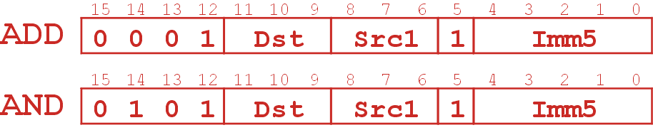
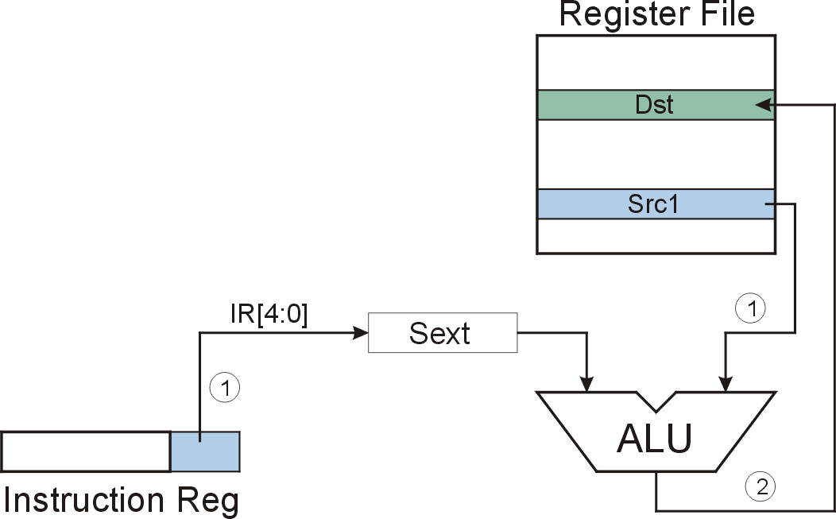
ADD/AND (Immediate)
this one means “immediate mode”
Note: Immediate field is sign-extended.
ADD/AND
Notes:
19
.

Slide 20
F
D
EA
ADD/AND (Immediate)
OP
₁₆
GatePC
₁₆
GateMARMUX
EX
LD.PC
PC
DR
₃
MARMUX
+1
REG FILE
₁₆
₂
PCMUX
₁₆
₁₆
₁₆
₁₆
₁₆
LD.REG
S
[7:0]
SR2
SR2
OUT
SR1
OUT
SR1
SEXT
₊
₃
₃
ADDR2MUX
MUX
MUX
ADDR1MUX
₁₆
₁₆
[10:0]
₁₆
₁₆
₁₆
₁₆
₁₆
SEXT
[8:0]
LD.CC
₁₆
SEXT
FINITE STATE MACHINE
SR2MUX
[5:0]
SEXT
₁₆
N
Z
P
ALUK
_{A}
_{B}
[4:0]
SEXT
₂
ALU
LD.IR
IR
LOGIC
…
₁₆
₁₆
₁₆
RUN
GateALU
₁₆
GateMDR
₁₆
LD.MDR
MDR
MEMORY
MAR
LD.MAR
₁₆
INPUT
OUTPUT
MIO.EN
MUX
₁₆
MEM.EN,R,W

Slide 21
F
D
EA
ADD/AND (Immediate)
OP
₁₆
GatePC
₁₆
GateMARMUX
EX
LD.PC
PC
DR
₃
MARMUX
+1
REG FILE
₁₆
₂
PCMUX
₁₆
₁₆
₁₆
₁₆
₁₆
LD.REG
S
[7:0]
SR2
SR2
OUT
SR1
OUT
SR1
SEXT
₊
₃
₃
ADDR2MUX
MUX
MUX
ADDR1MUX
₁₆
₁₆
[10:0]
₁₆
₁₆
₁₆
₁₆
₁₆
SEXT
[8:0]
LD.CC
₁₆
SEXT
FINITE STATE MACHINE
SR2MUX
[5:0]
SEXT
₁₆
N
Z
P
ALUK
_{A}
_{B}
[4:0]
SEXT
₂
ALU
LD.IR
IR
LOGIC
…
₁₆
₁₆
₁₆
RUN
GateALU
₁₆
GateMDR
₁₆
LD.MDR
MDR
MEMORY
MAR
LD.MAR
₁₆
INPUT
OUTPUT
MIO.EN
MUX
₁₆
MEM.EN,R,W

Slide 22
F
D
EA
ADD/AND (Immediate)
OP
₁₆
GatePC
₁₆
GateMARMUX
EX
LD.PC
PC
DR
₃
MARMUX
+1
REG FILE
₁₆
₂
PCMUX
₁₆
₁₆
₁₆
₁₆
₁₆
LD.REG
S
[7:0]
SR2
SR2
OUT
SR1
OUT
SR1
SEXT
₊
₃
₃
ADDR2MUX
MUX
MUX
ADDR1MUX
₁₆
₁₆
[10:0]
₁₆
₁₆
₁₆
₁₆
₁₆
SEXT
[8:0]
LD.CC
₁₆
SEXT
FINITE STATE MACHINE
SR2MUX
[5:0]
SEXT
₁₆
N
Z
P
ALUK
_{A}
_{B}
[4:0]
SEXT
₂
ALU
LD.IR
IR
LOGIC
…
₁₆
₁₆
₁₆
RUN
GateALU
₁₆
GateMDR
₁₆
LD.MDR
MDR
MEMORY
MAR
LD.MAR
₁₆
INPUT
OUTPUT
MIO.EN
MUX
₁₆
MEM.EN,R,W

Slide 23
ADD/AND (Immediate)
F
D
EA
OP
EX
S
₁₆
GatePC
₁₆
GateMARMUX
LD.PC
PC
DR
₃
MARMUX
+1
REG FILE
₁₆
₂
PCMUX
₁₆
₁₆
₁₆
₁₆
₁₆
LD.REG
[7:0]
SR2
SR2
OUT
SR1
OUT
SR1
SEXT
₊
₃
₃
ADDR2MUX
MUX
MUX
ADDR1MUX
₁₆
₁₆
[10:0]
₁₆
₁₆
₁₆
₁₆
₁₆
SEXT
[8:0]
LD.CC
₁₆
SEXT
FINITE STATE MACHINE
SR2MUX
[5:0]
SEXT
₁₆
N
Z
P
ADD/AND
_{A}
_{B}
[4:0]
SEXT
₂
ALU
LD.IR
IR
LOGIC
…
₁₆
₁₆
₁₆
RUN
GateALU
₁₆
GateMDR
₁₆
LD.MDR
MDR
MEMORY
MAR
LD.MAR
₁₆
INPUT
OUTPUT
MIO.EN
MUX
₁₆
MEM.EN,R,W

