Slide 1
Data Movement Instructions
取数指令
15
14
13
12
11
10
9
8
7
6
5
4
3
2
1
0
LD
0
0
1
0
DR
PCoffset9
LDR
0
1
1
0
DR
BaseR
PCoffset6
LDI
1
0
1
0
DR
PCoffset9
LEA
1
1
1
0
DR
PCoffset9
存数指令
15
14
13
12
11
10
9
8
7
6
5
4
3
2
1
0
ST
0
0
1
1
SR
PCoffset9
STR
0
1
1
1
SR
BaseR
PCoffset6
STI
1
0
1
1
SR
PCoffset9

Slide 2
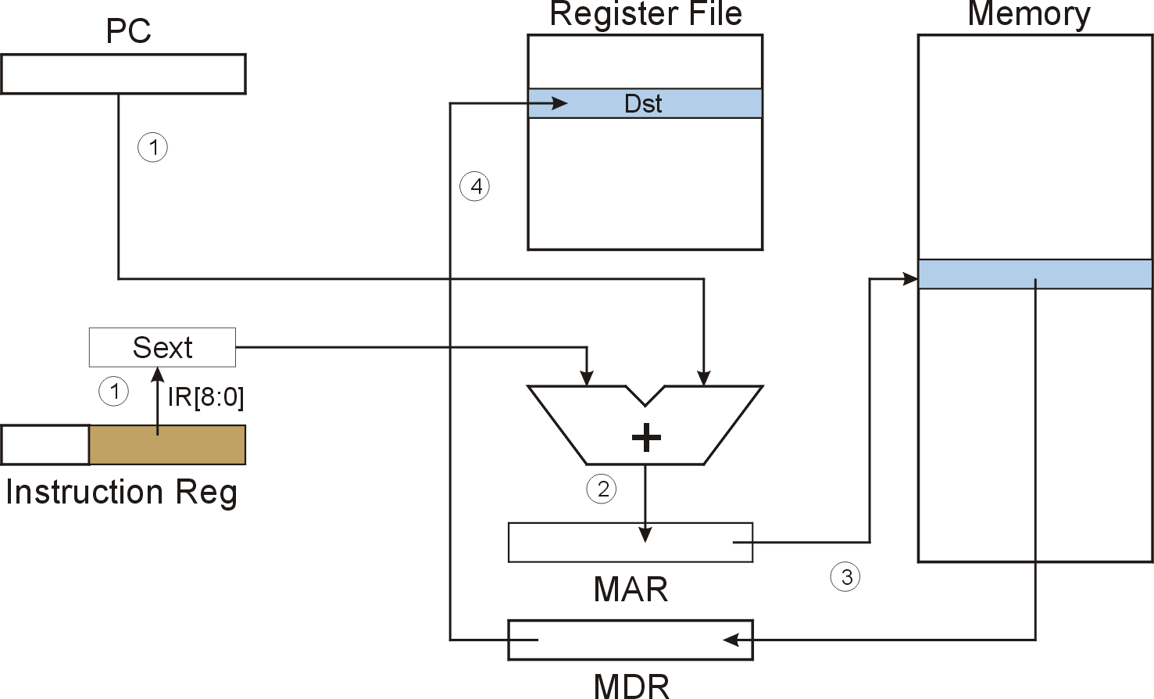
LD (PC-Relative) LD DR, PCoffset9
LD
Notes:
2

Slide 3
F
D
EA
LD (PC-Relative)
OP
16
GatePC
16
GateMARMUX
EX
LD.PC
PC
DR
3
MARMUX
+1
REG FILE
16
2
PCMUX
16
16
16
16
16
LD.REG
S
[7:0]
SR2
SR2
OUT
SR1
OUT
SR1
SEXT
+
3
3
ADDR2MUX
MUX
MUX
ADDR1MUX
16
16
[10:0]
16
16
16
16
16
SEXT
[8:0]
LD.CC
16
SEXT
FINITE STATE MACHINE
SR2MUX
[5:0]
SEXT
16
N
Z
P
ALUK
A
B
[4:0]
SEXT
2
ALU
LD.IR
IR
LOGIC
…
16
16
16
RUN
GateALU
16
GateMDR
16
LD.MDR
MDR
MEMORY
MAR
LD.MAR
16
INPUT
OUTPUT
MIO.EN
MUX
16
MEM.EN,R,W

Slide 4
F
D
EA
LD (PC-Relative)
OP
16
GatePC
16
GateMARMUX
EX
LD.PC
PC
DR
3
MARMUX
+1
REG FILE
16
2
PCMUX
16
16
16
16
16
LD.REG
S
[7:0]
SR2
SR2
OUT
SR1
OUT
SR1
SEXT
+
3
3
ADDR2MUX
MUX
MUX
ADDR1MUX
16
16
[10:0]
16
16
16
16
16
SEXT
[8:0]
LD.CC
16
SEXT
FINITE STATE MACHINE
SR2MUX
[5:0]
SEXT
16
N
Z
P
ALUK
A
B
[4:0]
SEXT
2
ALU
LD.IR
IR
LOGIC
…
16
16
16
RUN
GateALU
16
GateMDR
16
LD.MDR
MDR
MEMORY
MAR
LD.MAR
16
INPUT
OUTPUT
MIO.EN
MUX
16
MEM.EN,R,W

Slide 5
F
D
EA
LD (PC-Relative)
OP
16
GatePC
16
GateMARMUX
EX
LD.PC
PC
DR
3
MARMUX
+1
REG FILE
16
2
PCMUX
16
16
16
16
16
LD.REG
S
[7:0]
SR2
SR2
OUT
SR1
OUT
SR1
SEXT
+
3
3
ADDR2MUX
MUX
MUX
ADDR1MUX
16
16
[10:0]
16
16
16
16
16
SEXT
[8:0]
LD.CC
16
SEXT
FINITE STATE MACHINE
SR2MUX
[5:0]
SEXT
16
N
Z
P
ALUK
A
B
[4:0]
SEXT
2
ALU
LD.IR
IR
LOGIC
…
16
16
16
RUN
GateALU
16
GateMDR
16
LD.MDR
MDR
MEMORY
MAR
LD.MAR
16
INPUT
OUTPUT
MIO.EN
MUX
16
MEM.EN,R,W

Slide 6
LD (PC-Relative)
F
D
EA
OP
EX
S
16
GatePC
16
GateMARMUX
LD.PC
PC
DR
3
MARMUX
+1
REG FILE
16
2
PCMUX
16
16
16
16
16
LD.REG
[7:0]
SR2
SR2
OUT
SR1
OUT
SR1
SEXT
+
3
3
ADDR2MUX
MUX
MUX
ADDR1MUX
16
16
[10:0]
16
16
16
16
16
SEXT
[8:0]
LD.CC
16
SEXT
FINITE STATE MACHINE
SR2MUX
[5:0]
SEXT
16
N
Z
P
ALUK
A
B
[4:0]
SEXT
2
ALU
LD.IR
IR
LOGIC
…
16
16
16
RUN
GateALU
16
GateMDR
16
LD.MDR
MDR
MEMORY
MAR
LD.MAR
16
INPUT
OUTPUT
MIO.EN
MUX
16
MEM.EN,R,W

Slide 7
D
EA
LD (PC-Relative)
F
OP
16
GatePC
16
GateMARMUX
EX
LD.PC
PC
DR
3
MARMUX
+1
REG FILE
16
2
PCMUX
16
16
16
16
16
LD.REG
S
[7:0]
SR2
SR2
OUT
SR1
OUT
SR1
SEXT
+
3
3
ADDR2MUX
MUX
MUX
ADDR1MUX
16
16
[10:0]
16
16
16
16
16
SEXT
[8:0]
LD.CC
16
SEXT
FINITE STATE MACHINE
SR2MUX
[5:0]
SEXT
16
N
Z
P
ALUK
A
B
[4:0]
SEXT
2
ALU
LD.IR
IR
LOGIC
…
16
16
16
RUN
GateALU
16
GateMDR
16
LD.MDR
MDR
MEMORY
MAR
LD.MAR
16
INPUT
OUTPUT
MIO.EN
MUX
16
MEM.EN,R,W

Slide 8
D
EA
LD (PC-Relative)
F
EX
OP
16
GatePC
16
GateMARMUX
LD.PC
PC
DR
3
MARMUX
+1
REG FILE
16
2
PCMUX
16
16
16
16
16
LD.REG
S
[7:0]
SR2
SR2
OUT
SR1
OUT
SR1
SEXT
+
3
3
ADDR2MUX
MUX
MUX
ADDR1MUX
16
16
[10:0]
16
16
16
16
16
SEXT
[8:0]
LD.CC
16
SEXT
FINITE STATE MACHINE
SR2MUX
[5:0]
SEXT
16
N
Z
P
ALUK
A
B
[4:0]
SEXT
2
ALU
LD.IR
IR
LOGIC
…
16
16
16
GateALU
RUN
16
GateMDR
16
LD.MDR
MDR
MEMORY
MAR
LD.MAR
16
INPUT
OUTPUT
MIO.EN
MUX
16
MEM.EN,R,W

Slide 9
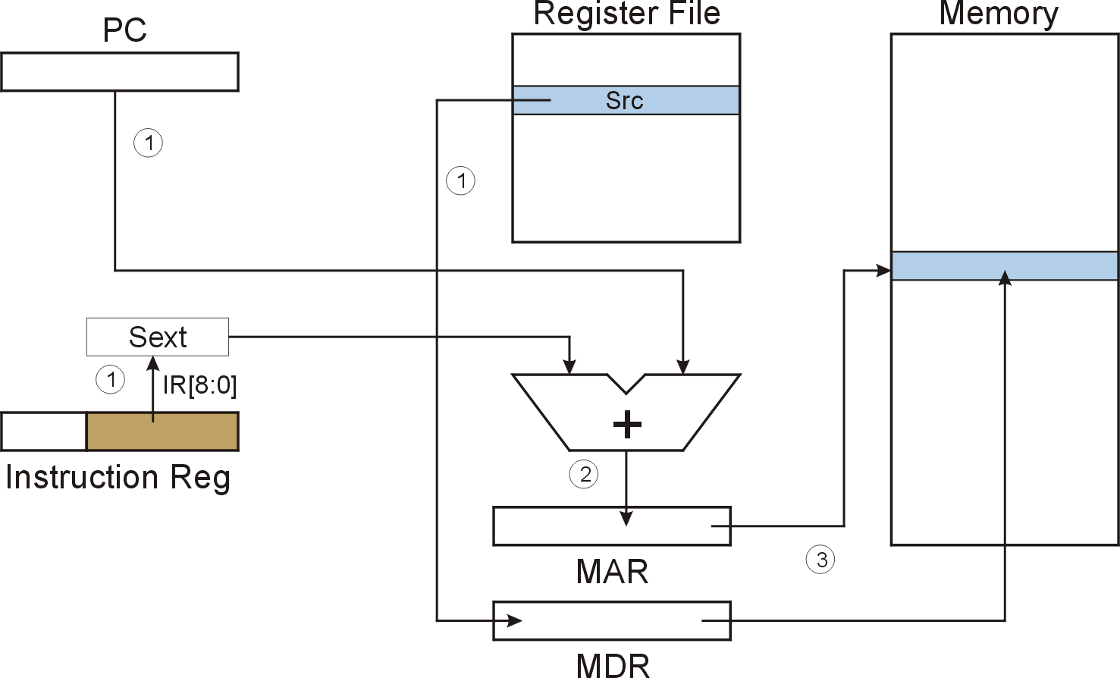
ST (PC-Relative) ST SR, PCoffset9
4
ST
Notes:
9

Slide 10
F
D
EA
ST (PC-Relative)
OP
16
GatePC
16
GateMARMUX
EX
LD.PC
PC
DR
3
MARMUX
+1
REG FILE
16
2
PCMUX
16
16
16
16
16
LD.REG
S
[7:0]
SR2
SR2
OUT
SR1
OUT
SR1
SEXT
+
3
3
ADDR2MUX
MUX
MUX
ADDR1MUX
16
16
[10:0]
16
16
16
16
16
SEXT
[8:0]
LD.CC
16
SEXT
FINITE STATE MACHINE
SR2MUX
[5:0]
SEXT
16
N
Z
P
ALUK
A
B
[4:0]
SEXT
2
ALU
LD.IR
IR
LOGIC
…
16
16
16
RUN
GateALU
16
GateMDR
16
LD.MDR
MDR
MEMORY
MAR
LD.MAR
16
INPUT
OUTPUT
MIO.EN
MUX
16
MEM.EN,R,W

Slide 11
F
D
EA
ST (PC-Relative)
OP
16
GatePC
16
GateMARMUX
EX
LD.PC
PC
DR
3
MARMUX
+1
REG FILE
16
2
PCMUX
16
16
16
16
16
LD.REG
S
[7:0]
SR2
SR2
OUT
SR1
OUT
SR1
SEXT
+
3
3
ADDR2MUX
MUX
MUX
ADDR1MUX
16
16
[10:0]
16
16
16
16
16
SEXT
[8:0]
LD.CC
16
SEXT
FINITE STATE MACHINE
SR2MUX
[5:0]
SEXT
16
N
Z
P
ALUK
A
B
[4:0]
SEXT
2
ALU
LD.IR
IR
LOGIC
…
16
16
16
RUN
GateALU
16
GateMDR
16
LD.MDR
MDR
MEMORY
MAR
LD.MAR
16
INPUT
OUTPUT
MIO.EN
MUX
16
MEM.EN,R,W

Slide 12
F
D
EA
ST (PC-Relative)
OP
16
GatePC
16
GateMARMUX
EX
LD.PC
PC
DR
3
MARMUX
+1
REG FILE
16
2
PCMUX
16
16
16
16
16
LD.REG
S
[7:0]
SR2
SR2
OUT
SR1
OUT
SR1
SEXT
+
3
3
ADDR2MUX
MUX
MUX
ADDR1MUX
16
16
[10:0]
16
16
16
16
16
SEXT
[8:0]
LD.CC
16
SEXT
FINITE STATE MACHINE
SR2MUX
[5:0]
SEXT
16
N
Z
P
ALUK
A
B
[4:0]
SEXT
2
ALU
LD.IR
IR
LOGIC
…
16
16
16
RUN
GateALU
16
GateMDR
16
LD.MDR
MDR
MEMORY
MAR
LD.MAR
16
INPUT
OUTPUT
MIO.EN
MUX
16
MEM.EN,R,W

Slide 13
ST (PC-Relative)
F
D
EA
OP
EX
S
16
GatePC
16
GateMARMUX
LD.PC
PC
DR
3
MARMUX
+1
REG FILE
16
2
PCMUX
16
16
16
16
16
LD.REG
[7:0]
SR2
SR2
OUT
SR1
OUT
SR1
SEXT
+
3
3
ADDR2MUX
MUX
MUX
ADDR1MUX
16
16
[10:0]
16
16
16
16
16
SEXT
[8:0]
LD.CC
16
SEXT
FINITE STATE MACHINE
SR2MUX
[5:0]
SEXT
16
N
Z
P
ALUK
A
B
[4:0]
SEXT
2
ALU
LD.IR
IR
LOGIC
…
16
16
16
RUN
GateALU
16
GateMDR
16
LD.MDR
MDR
MEMORY
MAR
LD.MAR
16
INPUT
OUTPUT
MIO.EN
MUX
16
MEM.EN,R,W

Slide 14
D
EA
ST (PC-Relative)
F
EX
S
OP
16
GatePC
16
GateMARMUX
LD.PC
PC
DR
3
MARMUX
+1
REG FILE
16
2
PCMUX
16
16
16
16
16
LD.REG
[7:0]
SR2
SR2
OUT
SR1
OUT
SR1
SEXT
+
3
3
ADDR2MUX
MUX
MUX
ADDR1MUX
16
16
[10:0]
16
16
16
16
16
SEXT
[8:0]
LD.CC
16
SEXT
FINITE STATE MACHINE
SR2MUX
[5:0]
SEXT
16
N
Z
P
ALUK
A
B
[4:0]
SEXT
2
ALU
LD.IR
IR
LOGIC
…
16
16
16
GateALU
RUN
16
GateMDR
16
LD.MDR
MDR
MEMORY
MAR
LD.MAR
16
INPUT
OUTPUT
MIO.EN
MUX
16
MEM.EN,R,W

Slide 15
D
EA
ST (PC-Relative)
F
EX
OP
16
GatePC
16
GateMARMUX
LD.PC
PC
DR
3
MARMUX
+1
REG FILE
16
2
PCMUX
16
16
16
16
16
LD.REG
S
[7:0]
SR2
SR2
OUT
SR1
OUT
SR1
SEXT
+
3
3
ADDR2MUX
MUX
MUX
ADDR1MUX
16
16
[10:0]
16
16
16
16
16
SEXT
[8:0]
LD.CC
16
SEXT
FINITE STATE MACHINE
SR2MUX
[5:0]
SEXT
16
N
Z
P
ALUK
A
B
[4:0]
SEXT
2
ALU
LD.IR
IR
LOGIC
…
16
16
16
RUN
GateALU
16
GateMDR
16
LD.MDR
MDR
MEMORY
MAR
LD.MAR
16
INPUT
OUTPUT
MIO.EN
MUX
16
MEM.EN,R,W

Slide 16
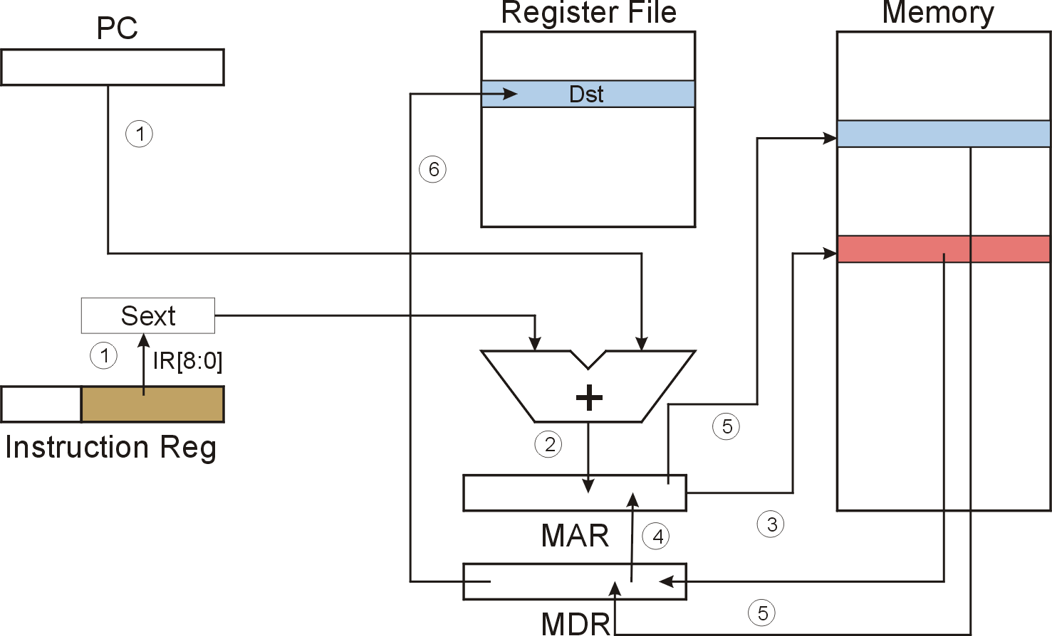
LDI (Indirect) LDI DR, PCoffset9
LDI
Notes:
16

Slide 17
F
D
EA
LDI (Indirect)
OP
16
GatePC
16
GateMARMUX
EX
LD.PC
PC
DR
3
MARMUX
+1
REG FILE
16
2
PCMUX
16
16
16
16
16
LD.REG
S
[7:0]
SR2
SR2
OUT
SR1
OUT
SR1
SEXT
+
3
3
ADDR2MUX
MUX
MUX
ADDR1MUX
16
16
[10:0]
16
16
16
16
16
SEXT
[8:0]
LD.CC
16
SEXT
FINITE STATE MACHINE
SR2MUX
[5:0]
SEXT
16
N
Z
P
ALUK
A
B
[4:0]
SEXT
2
ALU
LD.IR
IR
LOGIC
…
16
16
16
RUN
GateALU
16
GateMDR
16
LD.MDR
MDR
MEMORY
MAR
LD.MAR
16
INPUT
OUTPUT
MIO.EN
MUX
16
MEM.EN,R,W

Slide 18
F
D
EA
LDI (Indirect)
OP
16
GatePC
16
GateMARMUX
EX
LD.PC
PC
DR
3
MARMUX
+1
REG FILE
16
2
PCMUX
16
16
16
16
16
LD.REG
S
[7:0]
SR2
SR2
OUT
SR1
OUT
SR1
SEXT
+
3
3
ADDR2MUX
MUX
MUX
ADDR1MUX
16
16
[10:0]
16
16
16
16
16
SEXT
[8:0]
LD.CC
16
SEXT
FINITE STATE MACHINE
SR2MUX
[5:0]
SEXT
16
N
Z
P
ALUK
A
B
[4:0]
SEXT
2
ALU
LD.IR
IR
LOGIC
…
16
16
16
RUN
GateALU
16
GateMDR
16
LD.MDR
MDR
MEMORY
MAR
LD.MAR
16
INPUT
OUTPUT
MIO.EN
MUX
16
MEM.EN,R,W

Slide 19
F
D
EA
LDI (Indirect)
OP
16
GatePC
16
GateMARMUX
EX
LD.PC
PC
DR
3
MARMUX
+1
REG FILE
16
2
PCMUX
16
16
16
16
16
LD.REG
S
[7:0]
SR2
SR2
OUT
SR1
OUT
SR1
SEXT
+
3
3
ADDR2MUX
MUX
MUX
ADDR1MUX
16
16
[10:0]
16
16
16
16
16
SEXT
[8:0]
LD.CC
16
SEXT
FINITE STATE MACHINE
SR2MUX
[5:0]
SEXT
16
N
Z
P
ALUK
A
B
[4:0]
SEXT
2
ALU
LD.IR
IR
LOGIC
…
16
16
16
RUN
GateALU
16
GateMDR
16
LD.MDR
MDR
MEMORY
MAR
LD.MAR
16
INPUT
OUTPUT
MIO.EN
MUX
16
MEM.EN,R,W

Slide 20
LDI (Indirect)
F
D
EA
OP
EX
S
16
GatePC
16
GateMARMUX
LD.PC
PC
DR
3
MARMUX
+1
REG FILE
16
2
PCMUX
16
16
16
16
16
LD.REG
[7:0]
SR2
SR2
OUT
SR1
OUT
SR1
SEXT
+
3
3
ADDR2MUX
MUX
MUX
ADDR1MUX
16
16
[10:0]
16
16
16
16
16
SEXT
[8:0]
LD.CC
16
SEXT
FINITE STATE MACHINE
SR2MUX
[5:0]
SEXT
16
N
Z
P
ALUK
A
B
[4:0]
SEXT
2
ALU
LD.IR
IR
LOGIC
…
16
16
16
RUN
GateALU
16
GateMDR
16
LD.MDR
MDR
MEMORY
MAR
LD.MAR
16
INPUT
OUTPUT
MIO.EN
MUX
16
MEM.EN,R,W

Slide 21
D
LDI (Indirect)
F
EA
OP
16
GatePC
16
GateMARMUX
EX
LD.PC
PC
DR
3
MARMUX
+1
REG FILE
16
2
PCMUX
16
16
16
16
16
LD.REG
S
[7:0]
SR2
SR2
OUT
SR1
OUT
SR1
SEXT
+
3
3
ADDR2MUX
MUX
MUX
ADDR1MUX
16
16
[10:0]
16
16
16
16
16
SEXT
[8:0]
LD.CC
16
SEXT
FINITE STATE MACHINE
SR2MUX
[5:0]
SEXT
16
N
Z
P
ALUK
A
B
[4:0]
SEXT
2
ALU
LD.IR
IR
LOGIC
…
16
16
16
RUN
GateALU
16
GateMDR
16
LD.MDR
MDR
MEMORY
MAR
LD.MAR
16
INPUT
OUTPUT
MIO.EN
MUX
16
MEM.EN,R,W

Slide 22
D
EA
LDI (Indirect)
F
OP
16
GatePC
16
GateMARMUX
EX
LD.PC
PC
DR
3
MARMUX
+1
REG FILE
16
2
PCMUX
16
16
16
16
16
LD.REG
S
[7:0]
SR2
SR2
OUT
SR1
OUT
SR1
SEXT
+
3
3
ADDR2MUX
MUX
MUX
ADDR1MUX
16
16
[10:0]
16
16
16
16
16
SEXT
[8:0]
LD.CC
16
SEXT
FINITE STATE MACHINE
SR2MUX
[5:0]
SEXT
16
N
Z
P
ALUK
A
B
[4:0]
SEXT
2
ALU
LD.IR
IR
LOGIC
…
16
16
16
RUN
GateALU
16
GateMDR
16
LD.MDR
MDR
MEMORY
MAR
LD.MAR
16
INPUT
OUTPUT
MIO.EN
MUX
16
MEM.EN,R,W

Slide 23
D
LDI (Indirect)
F
EA
OP
16
GatePC
16
GateMARMUX
EX
LD.PC
PC
DR
3
MARMUX
+1
REG FILE
16
2
PCMUX
16
16
16
16
16
LD.REG
S
[7:0]
SR2
SR2
OUT
SR1
OUT
SR1
SEXT
+
3
3
ADDR2MUX
MUX
MUX
ADDR1MUX
16
16
[10:0]
16
16
16
16
16
SEXT
[8:0]
LD.CC
16
SEXT
FINITE STATE MACHINE
SR2MUX
[5:0]
SEXT
16
N
Z
P
ALUK
A
B
[4:0]
SEXT
2
ALU
LD.IR
IR
LOGIC
…
16
16
16
RUN
GateALU
16
GateMDR
16
LD.MDR
MDR
MEMORY
MAR
LD.MAR
16
INPUT
OUTPUT
MIO.EN
MUX
16
MEM.EN,R,W

Slide 24
D
EA
LDI (Indirect)
F
EX
OP
16
GatePC
16
GateMARMUX
LD.PC
PC
DR
3
MARMUX
+1
REG FILE
16
2
PCMUX
16
16
16
16
16
LD.REG
S
[7:0]
SR2
SR2
OUT
SR1
OUT
SR1
SEXT
+
3
3
ADDR2MUX
MUX
MUX
ADDR1MUX
16
16
[10:0]
16
16
16
16
16
SEXT
[8:0]
LD.CC
16
SEXT
FINITE STATE MACHINE
SR2MUX
[5:0]
SEXT
16
N
Z
P
ALUK
A
B
[4:0]
SEXT
2
ALU
LD.IR
IR
LOGIC
…
16
16
16
GateALU
RUN
16
GateMDR
16
LD.MDR
MDR
MEMORY
MAR
LD.MAR
16
INPUT
OUTPUT
MIO.EN
MUX
16
MEM.EN,R,W

Slide 25
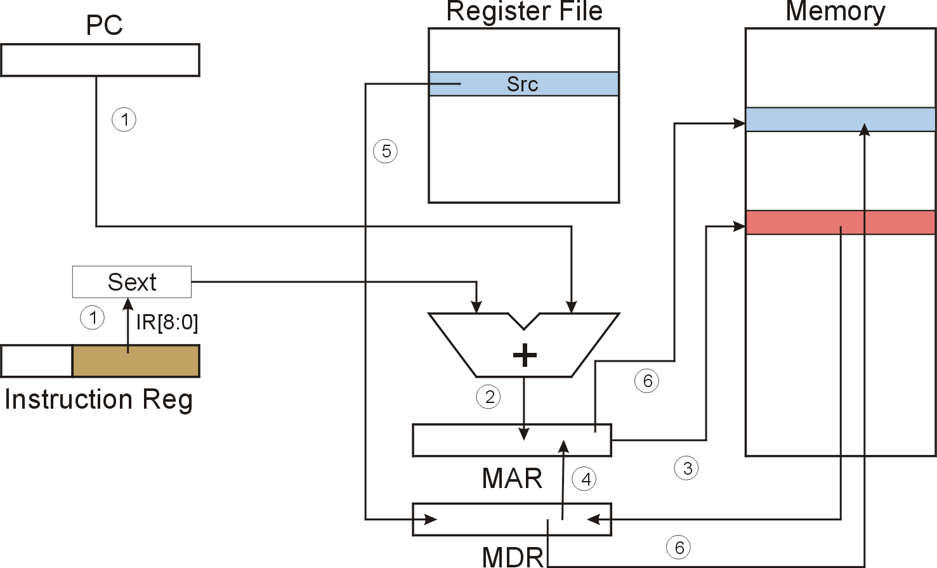
STI (Indirect) STI SR, PCoffset9
STI
Notes:
25

Slide 26
F
D
EA
STI (Indirect)
OP
16
GatePC
16
GateMARMUX
EX
LD.PC
PC
DR
3
MARMUX
+1
REG FILE
16
2
PCMUX
16
16
16
16
16
LD.REG
S
[7:0]
SR2
SR2
OUT
SR1
OUT
SR1
SEXT
+
3
3
ADDR2MUX
MUX
MUX
ADDR1MUX
16
16
[10:0]
16
16
16
16
16
SEXT
[8:0]
LD.CC
16
SEXT
FINITE STATE MACHINE
SR2MUX
[5:0]
SEXT
16
N
Z
P
ALUK
A
B
[4:0]
SEXT
2
ALU
LD.IR
IR
LOGIC
…
16
16
16
RUN
GateALU
16
GateMDR
16
LD.MDR
MDR
MEMORY
MAR
LD.MAR
16
INPUT
OUTPUT
MIO.EN
MUX
16
MEM.EN,R,W

Slide 27
F
D
EA
STI (Indirect)
OP
16
GatePC
16
GateMARMUX
EX
LD.PC
PC
DR
3
MARMUX
+1
REG FILE
16
2
PCMUX
16
16
16
16
16
LD.REG
S
[7:0]
SR2
SR2
OUT
SR1
OUT
SR1
SEXT
+
3
3
ADDR2MUX
MUX
MUX
ADDR1MUX
16
16
[10:0]
16
16
16
16
16
SEXT
[8:0]
LD.CC
16
SEXT
FINITE STATE MACHINE
SR2MUX
[5:0]
SEXT
16
N
Z
P
ALUK
A
B
[4:0]
SEXT
2
ALU
LD.IR
IR
LOGIC
…
16
16
16
RUN
GateALU
16
GateMDR
16
LD.MDR
MDR
MEMORY
MAR
LD.MAR
16
INPUT
OUTPUT
MIO.EN
MUX
16
MEM.EN,R,W

Slide 28
F
D
EA
STI (Indirect)
OP
16
GatePC
16
GateMARMUX
EX
LD.PC
PC
DR
3
MARMUX
+1
REG FILE
16
2
PCMUX
16
16
16
16
16
LD.REG
S
[7:0]
SR2
SR2
OUT
SR1
OUT
SR1
SEXT
+
3
3
ADDR2MUX
MUX
MUX
ADDR1MUX
16
16
[10:0]
16
16
16
16
16
SEXT
[8:0]
LD.CC
16
SEXT
FINITE STATE MACHINE
SR2MUX
[5:0]
SEXT
16
N
Z
P
ALUK
A
B
[4:0]
SEXT
2
ALU
LD.IR
IR
LOGIC
…
16
16
16
RUN
GateALU
16
GateMDR
16
LD.MDR
MDR
MEMORY
MAR
LD.MAR
16
INPUT
OUTPUT
MIO.EN
MUX
16
MEM.EN,R,W

Slide 29
STI (Indirect)
F
D
EA
OP
EX
S
16
GatePC
16
GateMARMUX
LD.PC
PC
DR
3
MARMUX
+1
REG FILE
16
2
PCMUX
16
16
16
16
16
LD.REG
[7:0]
SR2
SR2
OUT
SR1
OUT
SR1
SEXT
+
3
3
ADDR2MUX
MUX
MUX
ADDR1MUX
16
16
[10:0]
16
16
16
16
16
SEXT
[8:0]
LD.CC
16
SEXT
FINITE STATE MACHINE
SR2MUX
[5:0]
SEXT
16
N
Z
P
ALUK
A
B
[4:0]
SEXT
2
ALU
LD.IR
IR
LOGIC
…
16
16
16
RUN
GateALU
16
GateMDR
16
LD.MDR
MDR
MEMORY
MAR
LD.MAR
16
INPUT
OUTPUT
MIO.EN
MUX
16
MEM.EN,R,W

Slide 30
D
EA
STI (Indirect)
F
OP
16
GatePC
16
GateMARMUX
EX
LD.PC
PC
DR
3
MARMUX
+1
REG FILE
16
2
PCMUX
16
16
16
16
16
LD.REG
S
[7:0]
SR2
SR2
OUT
SR1
OUT
SR1
SEXT
+
3
3
ADDR2MUX
MUX
MUX
ADDR1MUX
16
16
[10:0]
16
16
16
16
16
SEXT
[8:0]
LD.CC
16
SEXT
FINITE STATE MACHINE
SR2MUX
[5:0]
SEXT
16
N
Z
P
ALUK
A
B
[4:0]
SEXT
2
ALU
LD.IR
IR
LOGIC
…
16
16
16
RUN
GateALU
16
GateMDR
16
LD.MDR
MDR
MEMORY
MAR
LD.MAR
16
INPUT
OUTPUT
MIO.EN
MUX
16
MEM.EN,R,W

Slide 31
D
EA
STI (Indirect)
F
OP
16
GatePC
16
GateMARMUX
EX
LD.PC
PC
DR
3
MARMUX
+1
REG FILE
16
2
PCMUX
16
16
16
16
16
LD.REG
S
[7:0]
SR2
SR2
OUT
SR1
OUT
SR1
SEXT
+
3
3
ADDR2MUX
MUX
MUX
ADDR1MUX
16
16
[10:0]
16
16
16
16
16
SEXT
[8:0]
LD.CC
16
SEXT
FINITE STATE MACHINE
SR2MUX
[5:0]
SEXT
16
N
Z
P
ALUK
A
B
[4:0]
SEXT
2
ALU
LD.IR
IR
LOGIC
…
16
16
16
RUN
GateALU
16
GateMDR
16
LD.MDR
MDR
MEMORY
MAR
LD.MAR
16
INPUT
OUTPUT
MIO.EN
MUX
16
MEM.EN,R,W

Slide 32
D
EA
STI (Indirect)
F
EX
OP
OP
16
GatePC
16
GateMARMUX
LD.PC
PC
DR
3
MARMUX
+1
REG FILE
16
2
PCMUX
16
16
16
16
16
LD.REG
[7:0]
SR2
SR2
OUT
SR1
OUT
SR1
SEXT
+
3
3
ADDR2MUX
MUX
MUX
ADDR1MUX
16
16
[10:0]
16
16
16
16
16
SEXT
[8:0]
LD.CC
16
SEXT
FINITE STATE MACHINE
SR2MUX
[5:0]
SEXT
16
N
Z
P
ALUK
A
B
[4:0]
SEXT
2
ALU
LD.IR
IR
LOGIC
…
16
16
16
GateALU
RUN
16
GateMDR
16
LD.MDR
MDR
MEMORY
MAR
LD.MAR
16
INPUT
OUTPUT
MIO.EN
MUX
16
MEM.EN,R,W

Slide 33
D
EA
STI (Indirect)
F
OP
EX
S
16
GatePC
16
GateMARMUX
LD.PC
PC
DR
3
MARMUX
+1
REG FILE
16
2
PCMUX
16
16
16
16
16
LD.REG
[7:0]
SR2
SR2
OUT
SR1
OUT
SR1
SEXT
+
3
3
ADDR2MUX
MUX
MUX
ADDR1MUX
16
16
[10:0]
16
16
16
16
16
SEXT
[8:0]
LD.CC
16
SEXT
FINITE STATE MACHINE
SR2MUX
[5:0]
SEXT
16
N
Z
P
ALUK
A
B
[4:0]
SEXT
2
ALU
LD.IR
IR
LOGIC
…
16
16
16
RUN
GateALU
16
GateMDR
16
LD.MDR
MDR
MEMORY
MAR
LD.MAR
16
INPUT
OUTPUT
MIO.EN
MUX
16
MEM.EN,R,W

Slide 34
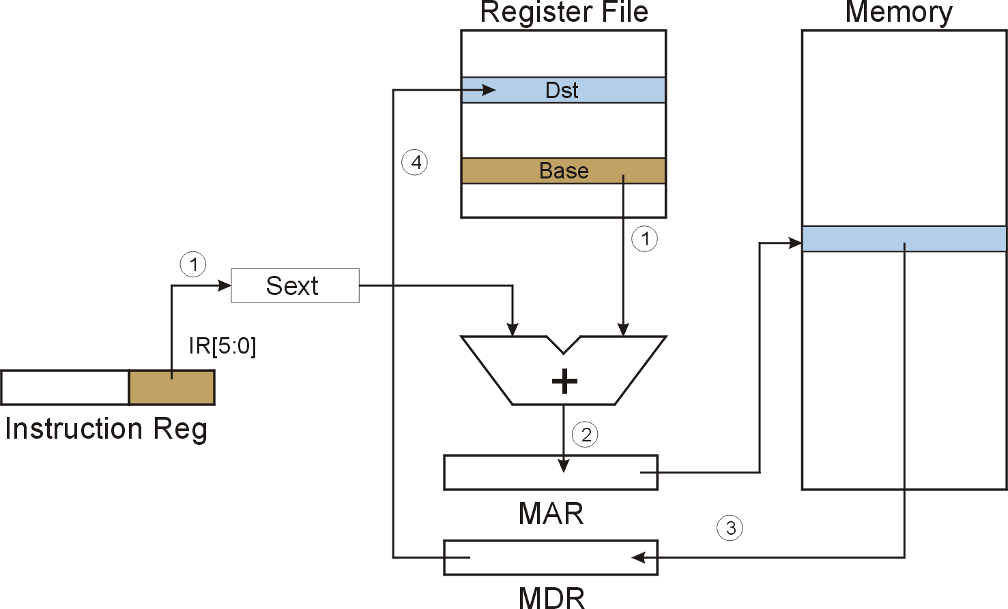
LDR (Base+Offset) LDR DR, BaseR, offset6
LDR
Notes:
34

Slide 35
F
D
EA
LDR (Base+Offset)
OP
16
GatePC
16
GateMARMUX
EX
LD.PC
PC
DR
3
MARMUX
+1
REG FILE
16
2
PCMUX
16
16
16
16
16
LD.REG
S
[7:0]
SR2
SR2
OUT
SR1
OUT
SR1
SEXT
+
3
3
ADDR2MUX
MUX
MUX
ADDR1MUX
16
16
[10:0]
16
16
16
16
16
SEXT
[8:0]
LD.CC
16
SEXT
FINITE STATE MACHINE
SR2MUX
[5:0]
SEXT
16
N
Z
P
ALUK
A
B
[4:0]
SEXT
2
ALU
LD.IR
IR
LOGIC
…
16
16
16
RUN
GateALU
16
GateMDR
16
LD.MDR
MDR
MEMORY
MAR
LD.MAR
16
INPUT
OUTPUT
MIO.EN
MUX
16
MEM.EN,R,W

Slide 36
F
D
EA
LDR (Base+Offset)
OP
16
GatePC
16
GateMARMUX
EX
LD.PC
PC
DR
3
MARMUX
+1
REG FILE
16
2
PCMUX
16
16
16
16
16
LD.REG
S
[7:0]
SR2
SR2
OUT
SR1
OUT
SR1
SEXT
+
3
3
ADDR2MUX
MUX
MUX
ADDR1MUX
16
16
[10:0]
16
16
16
16
16
SEXT
[8:0]
LD.CC
16
SEXT
FINITE STATE MACHINE
SR2MUX
[5:0]
SEXT
16
N
Z
P
ALUK
A
B
[4:0]
SEXT
2
ALU
LD.IR
IR
LOGIC
…
16
16
16
RUN
GateALU
16
GateMDR
16
LD.MDR
MDR
MEMORY
MAR
LD.MAR
16
INPUT
OUTPUT
MIO.EN
MUX
16
MEM.EN,R,W

Slide 37
F
D
EA
LDR (Base+Offset)
OP
16
GatePC
16
GateMARMUX
EX
LD.PC
PC
DR
3
MARMUX
+1
REG FILE
16
2
PCMUX
16
16
16
16
16
LD.REG
S
[7:0]
SR2
SR2
OUT
SR1
OUT
SR1
SEXT
+
3
3
ADDR2MUX
MUX
MUX
ADDR1MUX
16
16
[10:0]
16
16
16
16
16
SEXT
[8:0]
LD.CC
16
SEXT
FINITE STATE MACHINE
SR2MUX
[5:0]
SEXT
16
N
Z
P
ALUK
A
B
[4:0]
SEXT
2
ALU
LD.IR
IR
LOGIC
…
16
16
16
RUN
GateALU
16
GateMDR
16
LD.MDR
MDR
MEMORY
MAR
LD.MAR
16
INPUT
OUTPUT
MIO.EN
MUX
16
MEM.EN,R,W

Slide 38
LDR (Base+Offset)
F
D
EA
OP
EX
S
16
GatePC
16
GateMARMUX
LD.PC
PC
DR
3
MARMUX
+1
REG FILE
16
2
PCMUX
16
16
16
16
16
LD.REG
[7:0]
SR2
SR2
OUT
SR1
OUT
SR1
SEXT
+
3
3
ADDR2MUX
MUX
MUX
ADDR1MUX
16
16
[10:0]
16
16
16
16
16
SEXT
[8:0]
LD.CC
16
SEXT
FINITE STATE MACHINE
SR2MUX
[5:0]
SEXT
16
N
Z
P
ALUK
A
B
[4:0]
SEXT
2
ALU
LD.IR
IR
LOGIC
…
16
16
16
RUN
GateALU
16
GateMDR
16
LD.MDR
MDR
MEMORY
MAR
LD.MAR
16
INPUT
OUTPUT
MIO.EN
MUX
16
MEM.EN,R,W

Slide 39
D
EA
LDR (Base+Offset)
D
OP
16
GatePC
16
GateMARMUX
EX
LD.PC
PC
DR
3
MARMUX
+1
REG FILE
16
2
PCMUX
16
16
16
16
16
LD.REG
S
[7:0]
SR2
SR2
OUT
SR1
OUT
SR1
SEXT
+
3
3
ADDR2MUX
MUX
MUX
ADDR1MUX
16
16
[10:0]
16
16
16
16
16
SEXT
[8:0]
LD.CC
16
SEXT
FINITE STATE MACHINE
SR2MUX
[5:0]
SEXT
16
N
Z
P
ALUK
A
B
[4:0]
SEXT
2
ALU
LD.IR
IR
LOGIC
…
16
16
16
RUN
GateALU
16
GateMDR
16
LD.MDR
MDR
MEMORY
MAR
LD.MAR
16
INPUT
OUTPUT
MIO.EN
MUX
16
MEM.EN,R,W

Slide 40
D
EA
LDR (Base+Offset)
F
EX
OP
16
GatePC
16
GateMARMUX
LD.PC
PC
DR
3
MARMUX
+1
REG FILE
16
2
PCMUX
16
16
16
16
16
LD.REG
S
[7:0]
SR2
SR2
OUT
SR1
OUT
SR1
SEXT
+
3
3
ADDR2MUX
MUX
MUX
ADDR1MUX
16
16
[10:0]
16
16
16
16
16
SEXT
[8:0]
LD.CC
16
SEXT
FINITE STATE MACHINE
SR2MUX
[5:0]
SEXT
16
N
Z
P
ALUK
A
B
[4:0]
SEXT
2
ALU
LD.IR
IR
LOGIC
…
16
16
16
GateALU
RUN
16
GateMDR
16
LD.MDR
MDR
MEMORY
MAR
LD.MAR
16
INPUT
OUTPUT
MIO.EN
MUX
16
MEM.EN,R,W

Slide 41

STR (Base+Offset) STR SR, BaseR, offset6
STR
Notes:
41

Slide 42
F
D
EA
STR (Base+Offset)
OP
16
GatePC
16
GateMARMUX
EX
LD.PC
PC
DR
3
MARMUX
+1
REG FILE
16
2
PCMUX
16
16
16
16
16
LD.REG
S
[7:0]
SR2
SR2
OUT
SR1
OUT
SR1
SEXT
+
3
3
ADDR2MUX
MUX
MUX
ADDR1MUX
16
16
[10:0]
16
16
16
16
16
SEXT
[8:0]
LD.CC
16
SEXT
FINITE STATE MACHINE
SR2MUX
[5:0]
SEXT
16
N
Z
P
ALUK
A
B
[4:0]
SEXT
2
ALU
LD.IR
IR
LOGIC
…
16
16
16
RUN
GateALU
16
GateMDR
16
LD.MDR
MDR
MEMORY
MAR
LD.MAR
16
INPUT
OUTPUT
MIO.EN
MUX
16
MEM.EN,R,W

Slide 43
F
D
EA
STR (Base+Offset)
OP
16
GatePC
16
GateMARMUX
EX
LD.PC
PC
DR
3
MARMUX
+1
REG FILE
16
2
PCMUX
16
16
16
16
16
LD.REG
S
[7:0]
SR2
SR2
OUT
SR1
OUT
SR1
SEXT
+
3
3
ADDR2MUX
MUX
MUX
ADDR1MUX
16
16
[10:0]
16
16
16
16
16
SEXT
[8:0]
LD.CC
16
SEXT
FINITE STATE MACHINE
SR2MUX
[5:0]
SEXT
16
N
Z
P
ALUK
A
B
[4:0]
SEXT
2
ALU
LD.IR
IR
LOGIC
…
16
16
16
RUN
GateALU
16
GateMDR
16
LD.MDR
MDR
MEMORY
MAR
LD.MAR
16
INPUT
OUTPUT
MIO.EN
MUX
16
MEM.EN,R,W

Slide 44
F
D
EA
STR (Base+Offset)
OP
16
GatePC
16
GateMARMUX
EX
LD.PC
PC
DR
3
MARMUX
+1
REG FILE
16
2
PCMUX
16
16
16
16
16
LD.REG
S
[7:0]
SR2
SR2
OUT
SR1
OUT
SR1
SEXT
+
3
3
ADDR2MUX
MUX
MUX
ADDR1MUX
16
16
[10:0]
16
16
16
16
16
SEXT
[8:0]
LD.CC
16
SEXT
FINITE STATE MACHINE
SR2MUX
[5:0]
SEXT
16
N
Z
P
ALUK
A
B
[4:0]
SEXT
2
ALU
LD.IR
IR
LOGIC
…
16
16
16
RUN
GateALU
16
GateMDR
16
LD.MDR
MDR
MEMORY
MAR
LD.MAR
16
INPUT
OUTPUT
MIO.EN
MUX
16
MEM.EN,R,W

Slide 45
STR (Base+Offset)
F
D
EA
OP
EX
S
16
GatePC
16
GateMARMUX
LD.PC
PC
DR
3
MARMUX
+1
REG FILE
16
2
PCMUX
16
16
16
16
16
LD.REG
[7:0]
SR2
SR2
OUT
SR1
OUT
SR1
SEXT
+
3
3
ADDR2MUX
MUX
MUX
ADDR1MUX
16
16
[10:0]
16
16
16
16
16
SEXT
[8:0]
LD.CC
16
SEXT
FINITE STATE MACHINE
SR2MUX
[5:0]
SEXT
16
N
Z
P
ALUK
A
B
[4:0]
SEXT
2
ALU
LD.IR
IR
LOGIC
…
16
16
16
RUN
GateALU
16
GateMDR
16
LD.MDR
MDR
MEMORY
MAR
LD.MAR
16
INPUT
OUTPUT
MIO.EN
MUX
16
MEM.EN,R,W

Slide 46
D
EA
STR (Base+Offset)
F
EX
OP
OP
16
GatePC
16
GateMARMUX
LD.PC
PC
DR
3
MARMUX
+1
REG FILE
16
2
PCMUX
16
16
16
16
16
LD.REG
[7:0]
SR2
SR2
OUT
SR1
OUT
SR1
SEXT
+
3
3
ADDR2MUX
MUX
MUX
ADDR1MUX
16
16
[10:0]
16
16
16
16
16
SEXT
[8:0]
LD.CC
16
SEXT
FINITE STATE MACHINE
SR2MUX
[5:0]
SEXT
16
N
Z
P
ALUK
A
B
[4:0]
SEXT
2
ALU
LD.IR
IR
LOGIC
…
16
16
16
GateALU
RUN
16
GateMDR
16
LD.MDR
MDR
MEMORY
MAR
LD.MAR
16
INPUT
OUTPUT
MIO.EN
MUX
16
MEM.EN,R,W

Slide 47
D
EA
STR (Base+Offset)
F
OP
EX
S
16
GatePC
16
GateMARMUX
LD.PC
PC
DR
3
MARMUX
+1
REG FILE
16
2
PCMUX
16
16
16
16
16
LD.REG
[7:0]
SR2
SR2
OUT
SR1
OUT
SR1
SEXT
+
3
3
ADDR2MUX
MUX
MUX
ADDR1MUX
16
16
[10:0]
16
16
16
16
16
SEXT
[8:0]
LD.CC
16
SEXT
FINITE STATE MACHINE
SR2MUX
[5:0]
SEXT
16
N
Z
P
ALUK
A
B
[4:0]
SEXT
2
ALU
LD.IR
IR
LOGIC
…
16
16
16
RUN
GateALU
16
GateMDR
16
LD.MDR
MDR
MEMORY
MAR
LD.MAR
16
INPUT
OUTPUT
MIO.EN
MUX
16
MEM.EN,R,W

Slide 48
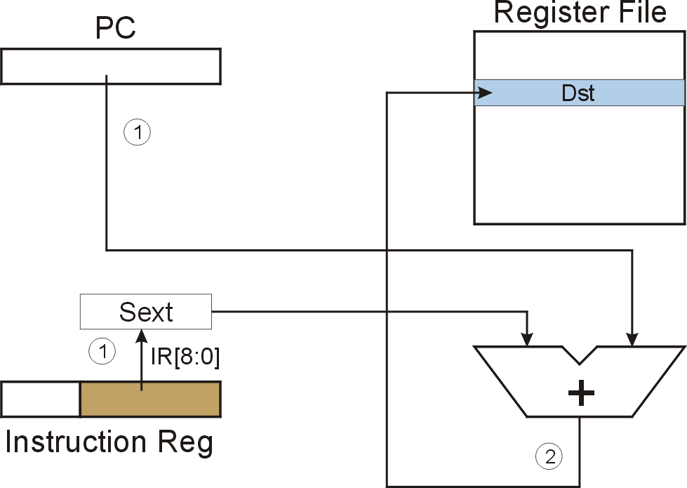
LEA (Immediate) LD DR, PCoffset9
LEA
Notes:
48

Slide 49
LEA (Immediate): LEA R1, x1AF
Register File
PC
0
1
0
0
0
0
0
0
0
0
0
1
1
0
0
1
R0
R1
0
0
1
1
1
1
1
1
1
0
1
1
1
0
0
0
R2
IR
0
0
1
0
0
0
1
1
1
0
1
0
1
1
1
1
R3
①
①
R4
IR[8:0]=110101111
R5
SEXT
R6
1111111110101111 = xFFAF
R7
x4019
A
B
+
PC = x4018
PC+1 = x4019
X4019 + xFFAF = x3FC8
②
x3FC8
Notes:
49

Slide 50
F
D
EA
LEA (Immediate)
OP
16
GatePC
16
GateMARMUX
EX
LD.PC
PC
DR
3
MARMUX
+1
REG FILE
16
2
PCMUX
16
16
16
16
16
LD.REG
S
[7:0]
SR2
SR2
OUT
SR1
OUT
SR1
SEXT
+
3
3
ADDR2MUX
MUX
MUX
ADDR1MUX
16
16
[10:0]
16
16
16
16
16
SEXT
[8:0]
LD.CC
16
SEXT
FINITE STATE MACHINE
SR2MUX
[5:0]
SEXT
16
N
Z
P
ALUK
A
B
[4:0]
SEXT
2
ALU
LD.IR
IR
LOGIC
…
16
16
16
RUN
GateALU
16
GateMDR
16
LD.MDR
MDR
MEMORY
MAR
LD.MAR
16
INPUT
OUTPUT
MIO.EN
MUX
16
MEM.EN,R,W

Slide 51
F
D
EA
LEA (Immediate)
OP
16
GatePC
16
GateMARMUX
EX
LD.PC
PC
DR
3
MARMUX
+1
REG FILE
16
2
PCMUX
16
16
16
16
16
LD.REG
S
[7:0]
SR2
SR2
OUT
SR1
OUT
SR1
SEXT
+
3
3
ADDR2MUX
MUX
MUX
ADDR1MUX
16
16
[10:0]
16
16
16
16
16
SEXT
[8:0]
LD.CC
16
SEXT
FINITE STATE MACHINE
SR2MUX
[5:0]
SEXT
16
N
Z
P
ALUK
A
B
[4:0]
SEXT
2
ALU
LD.IR
IR
LOGIC
…
16
16
16
RUN
GateALU
16
GateMDR
16
LD.MDR
MDR
MEMORY
MAR
LD.MAR
16
INPUT
OUTPUT
MIO.EN
MUX
16
MEM.EN,R,W

Slide 52
F
D
EA
LEA (Immediate)
OP
16
GatePC
16
GateMARMUX
EX
LD.PC
PC
DR
3
MARMUX
+1
REG FILE
16
2
PCMUX
16
16
16
16
16
LD.REG
S
[7:0]
SR2
SR2
OUT
SR1
OUT
SR1
SEXT
+
3
3
ADDR2MUX
MUX
MUX
ADDR1MUX
16
16
[10:0]
16
16
16
16
16
SEXT
[8:0]
LD.CC
16
SEXT
FINITE STATE MACHINE
SR2MUX
[5:0]
SEXT
16
N
Z
P
ALUK
A
B
[4:0]
SEXT
2
ALU
LD.IR
IR
LOGIC
…
16
16
16
RUN
GateALU
16
GateMDR
16
LD.MDR
MDR
MEMORY
MAR
LD.MAR
16
INPUT
OUTPUT
MIO.EN
MUX
16
MEM.EN,R,W

Slide 53
LEA (Immediate)
F
D
EA
OP
EX
S
16
GatePC
16
GateMARMUX
LD.PC
PC
DR
3
MARMUX
+1
REG FILE
16
2
PCMUX
16
16
16
16
16
LD.REG
[7:0]
SR2
SR2
OUT
SR1
OUT
SR1
SEXT
+
3
3
ADDR2MUX
MUX
MUX
ADDR1MUX
16
16
[10:0]
16
16
16
16
16
SEXT
[8:0]
LD.CC
16
SEXT
FINITE STATE MACHINE
SR2MUX
[5:0]
SEXT
16
N
Z
P
ALUK
A
B
[4:0]
SEXT
2
ALU
LD.IR
IR
LOGIC
…
16
16
16
RUN
GateALU
16
GateMDR
16
LD.MDR
MDR
MEMORY
MAR
LD.MAR
16
INPUT
OUTPUT
MIO.EN
MUX
16
MEM.EN,R,W

