Slide 1
Bblr
Xavier de Gunten
David Spruill
Elder Yoshida

Slide 2
Last Week
Troubleshooting
Not enough airflow, bad solenoids, bad check valves

Slide 3
Air supply
Pump Rated at 25Nl/min
How fast can we switch all 24 without running out of air?
Rails | 24 | units
Raw Airflow | 25 | Lpm
Bubble Diameter | 1.4 | cm
Bubble Volume | 1.1494E-05 | m^3
Bubbles Frequency | 1.510444598 | Hz

Slide 4
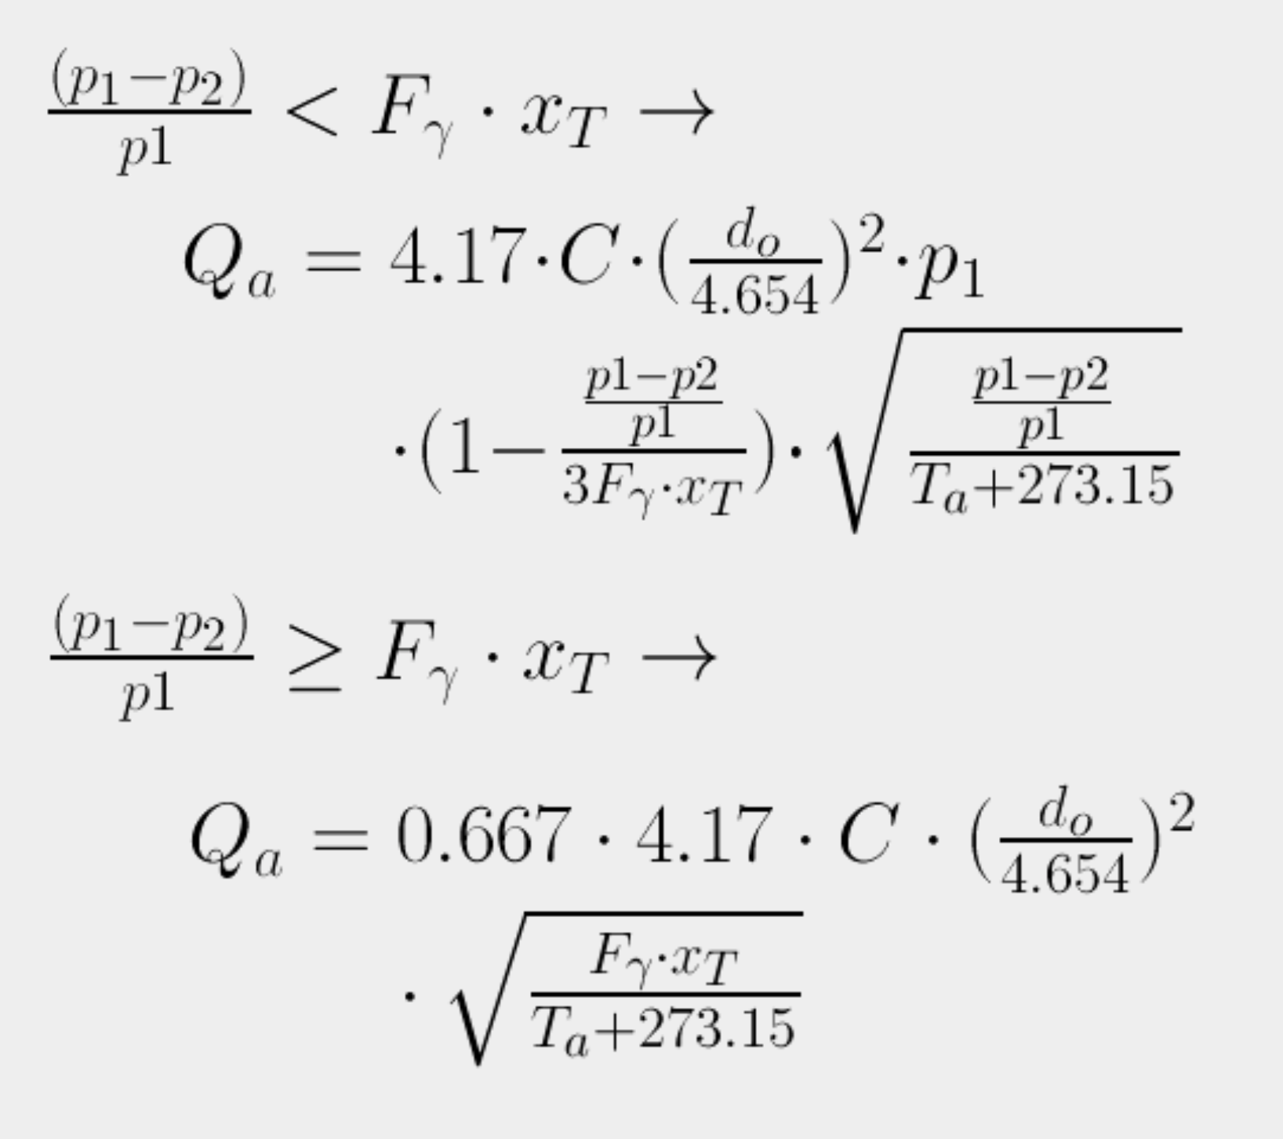
Airflow through orifice
Ta : Air Temperature (°C)
p1 : Primary Pressure (kPa abs)
p2 : Secondary Pressure (kPa abs)
do : Diameter of Orifice (mm)
C : Discharge Coefficient
Qa : Air Flow Rate (Normal) (Nm³/min)
Fγ : Specific heat ratio factor
xT : Pressure differential ratio factor (=0.72)

Slide 5
Airflow through orifice
Diff. Pressure of 2psi, 0.17”ID tube => 31.08 Nl/min
Need to account for tube length, T-Joint, etc...

Slide 6
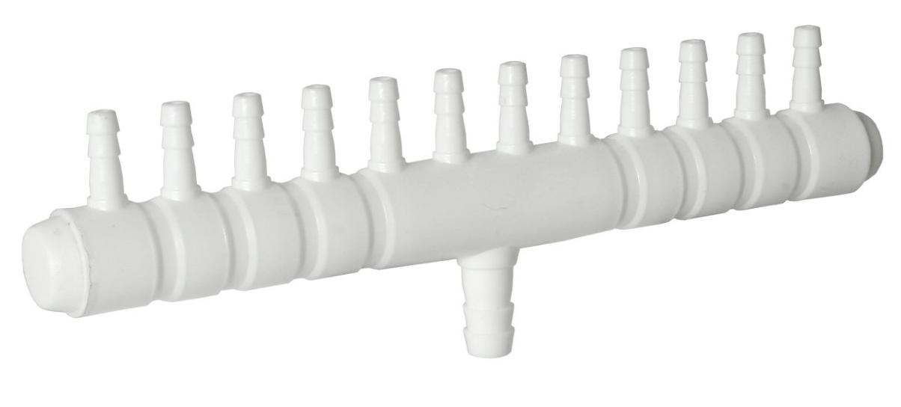
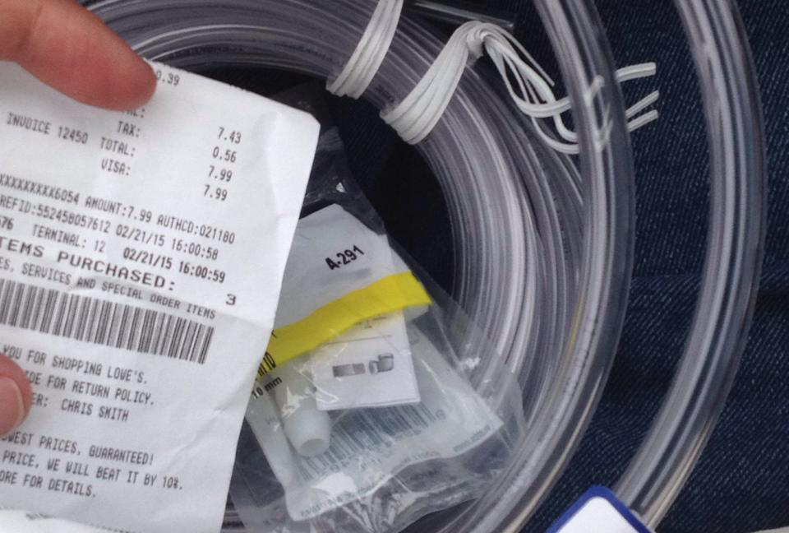
Ensuring proper air distribution
Properly sized tubing and divider (2x12)
0.17”ID and 5/16”ID tubing
5/16”ID => 444.128Nl/min of airflow

Slide 7
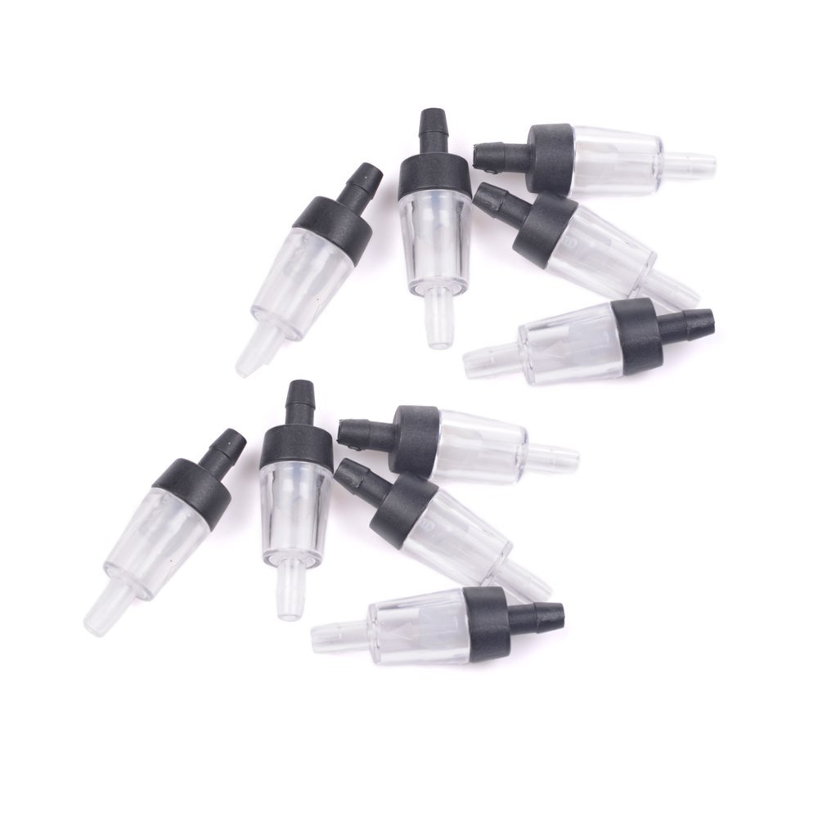
New check valves…
Not very good
Need high input pressure
Makes noise when open
Prone to leakages (bad seal)

Slide 8
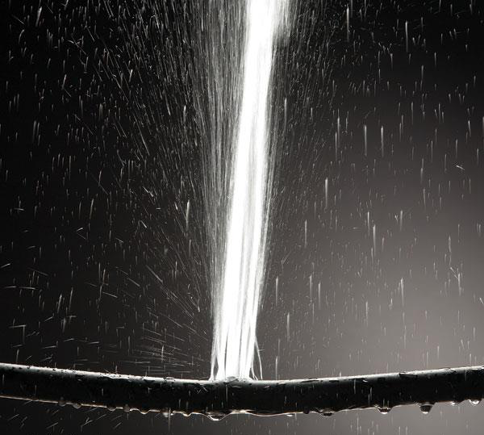
On the current display…
Tried to clean it up so that we could work on it in the lab with water (less messy)
Frozen and broken hose…
Ordered 10 replacement solenoids

