Slide 1
Bblr
Xavier de Gunten
David Spruill
Elder Yoshida

Slide 2
Progress this week
Cleaned the 24-wide Bbrl
Replaced airlines
Testing
Bubble detection

Slide 3
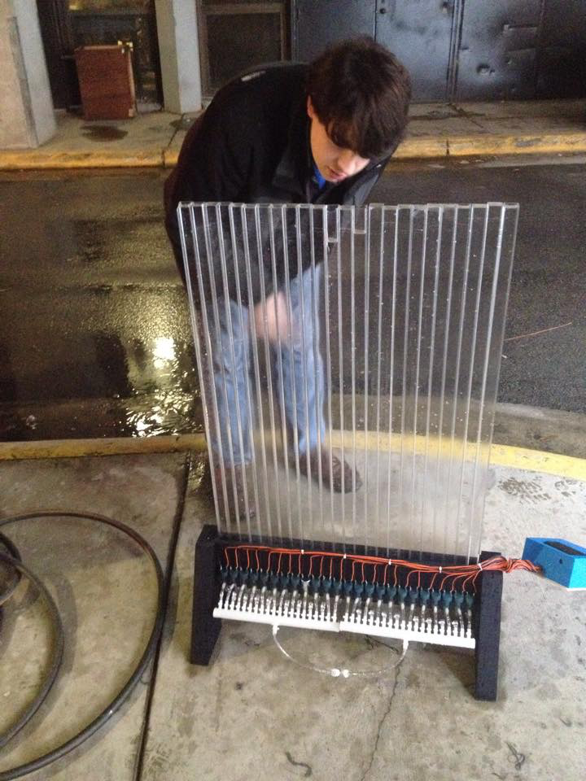
Cleaning
Verified that 2 tubes were leaking
One has a crack at the bottom
The other at the top
We don’t want to make the prototype lab sticky
It is easier to identify leaks with water

Slide 4
Replacing air lines

