Slide 1


CABLE DID NOT LOSE THE HOME — IT LOST THE TV NARRATIVE
Private Home ORB
A local-only household AI appliance each cable provider can install, service, and own as the next generation of home infrastructure.
NO FAANG AI DEPENDENCY
LOCAL MEMORY
FAMILY ORBS
Confidential concept pitch · Bryan Spruk / Spruked Systems

Slide 2
WHY NOW
Cable needs a new reason to be in the home.
Old battleground
New battleground
TV bundles and streaming competition.
Private intelligence inside the home.
Cord-cutting and fixed wireless pressure are making the old bundle weaker. The strongest remaining asset is still physical presence: broadband, gateways, technicians, billing, and trust.
Cable advantage
Strategic shift
Installed hardware + field service + network relationship.
From content distributor to household AI infrastructure provider.
Sources: Leichtman/Benton on broadband mix and fixed-wireless gains; Apprupt/Omdia on pay-TV shift; Reuters on Charter/Cox consolidation.

Slide 3
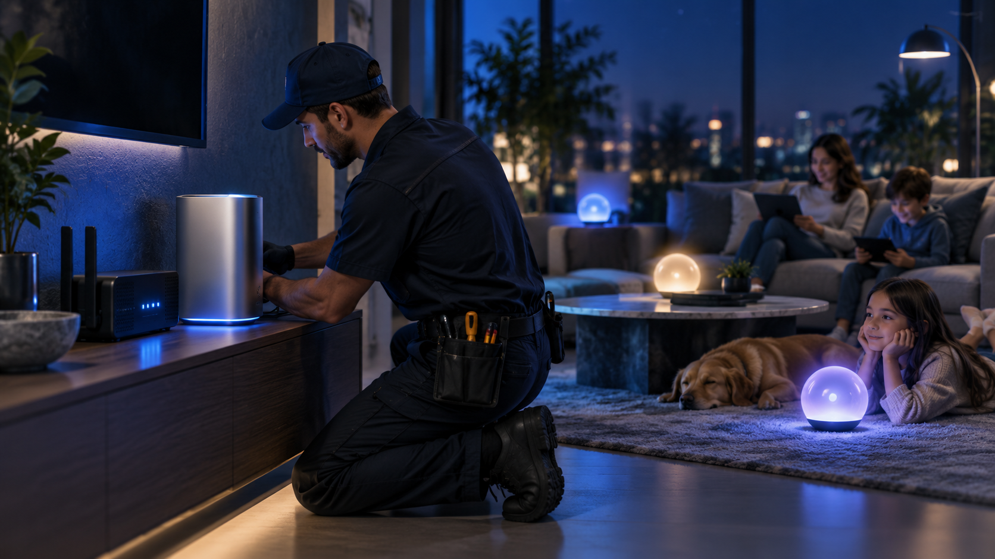
THE OFFER
A private AI server the cable provider can install.
Local inference. Local memory. Local voice. Separate household personas. The provider owns installation, support, updates, replacement logistics, and recurring service packaging.
Not a smart speaker
Not a cloud app
Not another TV bundle
A household compute appliance, not a cloud mic.
Works under local authority first.
A new home infrastructure layer.
Spruked Systems · Private Home ORB · Cable Provider Concept

Slide 4
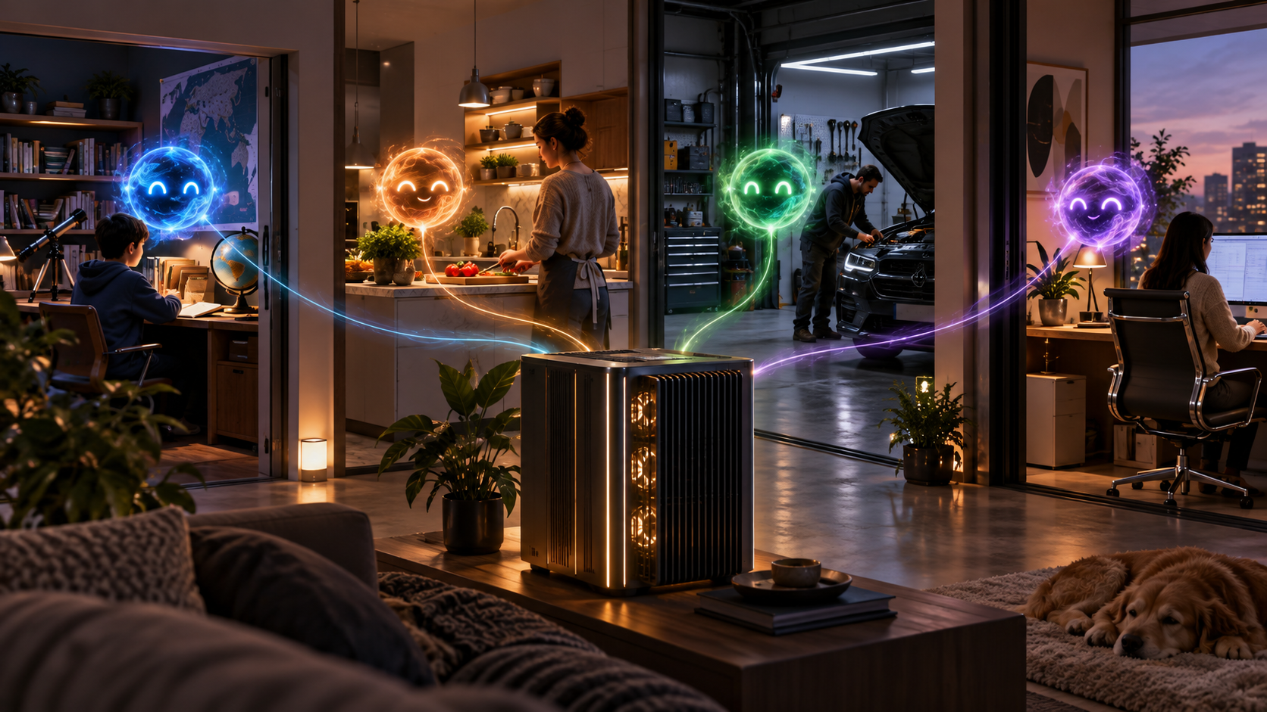
WHAT THE HOUSEHOLD BUYS
One server. A separate ORB for each person.
Jimmy
Mom
Tutor, homework helper, learning continuity.
Recipes, household routines, meal planning, reminders.
Dad
Home
Vehicle records, repair manuals, diagnostics, project help.
Shared device control, schedules, support, local knowledge.
The household shares infrastructure. The people do not share one generic personality.
Spruked Systems · Private Home ORB · Cable Provider Concept

Slide 5
DURABLE ARCHITECTURE
The ORB travels with the person.
The intelligence is not trapped in one surface. Desktop appliance, phone, earbud, browser, vehicle, and VR/metaverse are embodiment adapters around one local personal ORB.
Home Server
Phone
Earbud
Vehicle
VR / Horizon
Website ORB
Design rule
Platforms provide worlds and interfaces. They do not own the companion.
Spruked Systems · Private Home ORB · Cable Provider Concept

Slide 6
WHY CABLE CAN WIN
Privacy becomes the product category.
Local inference
Local memory
Everyday assistance runs on the home appliance.
Family knowledge stays inside the household vault.
Most AI assistants teach customers to send home life into distant platforms. Cable can sell the opposite: private local autonomy, installed and supported by the home-network provider.
Separate personas
Provider service
Each family member gets a distinct ORB.
Installation, updates, support, replacement logistics.
Strategic wedge
Start with local household assistance; expand into service diagnostics, managed Wi‑Fi support, senior care, family learning, and small-business add-ons.
Spruked Systems · Private Home ORB · Cable Provider Concept

Slide 7
PILOT STRUCTURE
Propose a limited, measurable home-ORB pilot.
The ask is not a national rollout. It is a controlled field trial with one regional operator, a small number of homes, and proof gates before scale.
Phase 1
Phase 2
Phase 3
Phase 4
Demo package + technical review
2–4 weeks
10–25 internal/staff homes
60 days
100 customer homes
measured beta
Regional launch packaging
service tier
Success metrics
Provider economics
Risk control
Activation, retention signal, support load, household usage, service attach, owner trust.
Hardware margin, monthly service add-on, support differentiation, churn reduction hypothesis.
Local-only design; clear data boundary; no blind cloud dependency.
Spruked Systems · Private Home ORB · Cable Provider Concept

Slide 8
OUTREACH TARGET LOGIC
Target hungry regional operators.
Throw out first
Comcast/Xfinity, Charter/Spectrum, Cox, Altice/Optimum, Mediacom.
Exclude the biggest incumbents for first contact. The next tier is more likely to evaluate a field pilot.
Provider
Why target
Public outreach route
Cable One / Sparklight
Phoenix-based; >1M customers across 24 states
investor_relations@cableone.biz
Breezeline / Cogeco US
Top-10 / eighth-largest cable operator
awalton@breezeline.com
Astound Broadband
Regional brands; reported sixth-largest operator
zcushman@matternow.com
WOW!
Midwest/Southeast broadband operator
debra.havins@wowinc.com
Midco
Regional provider; 1.2M homes/businesses passed
Paige.Pearson@Midco.com
Contact routes are public business/media/IR contacts; verify deliverability before outreach.

Slide 9
COLD EMAIL POSITION
Subject: A private local AI appliance for cable homes
Email spine
Meeting ask
Cable companies already have the home-network relationship, field technicians, equipment logistics, and customer billing.
Spruked Systems is developing a local-only household AI appliance that gives each family member a private ORB/persona without depending on FAANG cloud AI.
I would like to show a short demo and discuss a limited field pilot: staff homes first, then a controlled regional beta.
Request a 20-minute technical/business review with innovation, product, broadband services, or CPE/home-network leadership.
Bring: demo deck, 1-page brief, device economics hypothesis, privacy/local-only claims boundary, and pilot plan.
Spruked Systems · Private Home ORB · Cable Provider Concept

Slide 10
CLAIM DISCIPLINE
Boundary: concept pitch, not a rollout claim.
This deck intentionally pitches a field-pilot opportunity. It does not claim finished cable integration, universal compatibility, approved regulatory posture, final hardware BOM, or signed provider demand.
Use as
Do not use as
Next artifact
Opening deck for cable innovation/product/business development.
Final commercial contract, regulatory brief, or hardware certification claim.
One-page executive memo + pilot economics worksheet.
Core sources: Leichtman/Benton broadband provider summaries; Reuters Charter/Cox acquisition coverage; Cable One IR profile; Breezeline corporate/press pages; Astound Business/PR; WOW!/DigitalBridge release; Midco press/contact pages; Spruked ORB metaverse/vessel concept.
Source-backed where market/contact facts are used; all product future-state claims are framed as pilot/proposal.

