Slide 1
Psuedocode

Slide 2
What is Pseudocode?
It is the plain English representation of a computer program or algorithm specifying its flow and operation.
It is generally used to represent the structural flow of a program and is independent of any specific programming language.
The same quality makes it a perfect tool for representing algorithms for various problems.

Slide 3
Key Points To Note
A pseudocode is not bound to a programming language but is subjective and non-standard.
It is just a learning and reasoning tool that programmers and developers use to underline how to write the actual code.
You can compile or execute it by any assembler, compiler and interpreter .
Unlike a programming language code, it does not follow a strict structure and syntax.

Slide 4
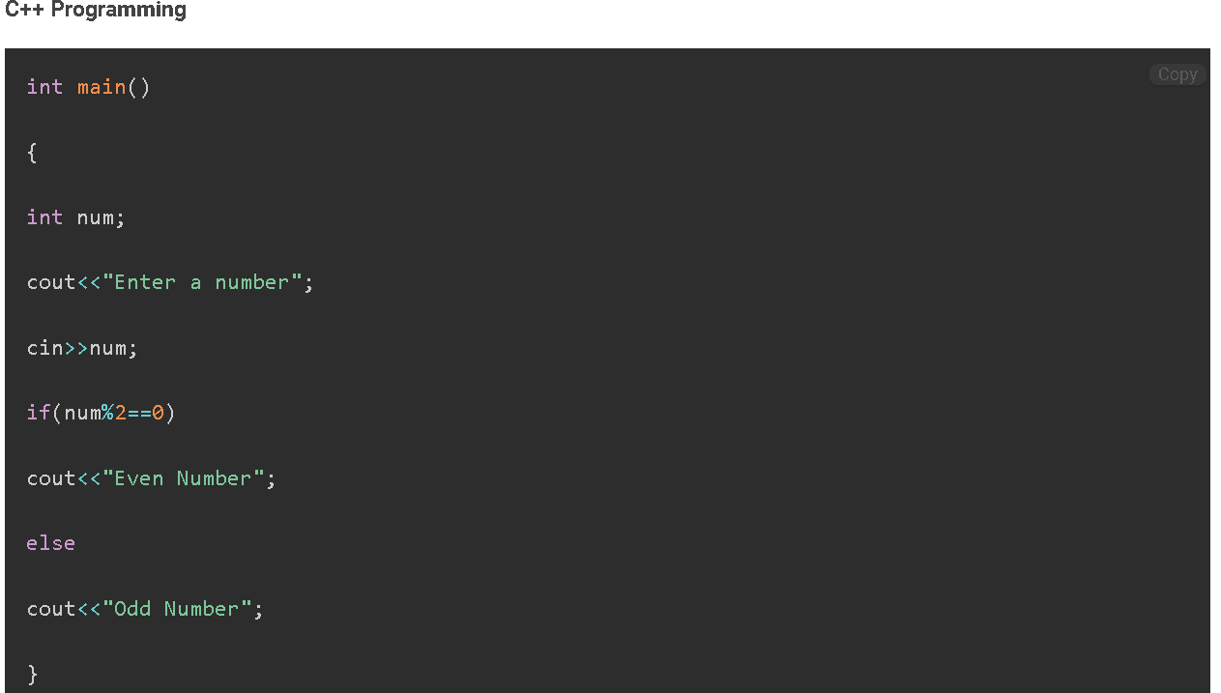
Pseudocode Vs Actual Code
Let us understand this using an example.
Consider we need to check whether the given number is odd or even.
Code to check if the user entered number is odd or even:

Slide 5
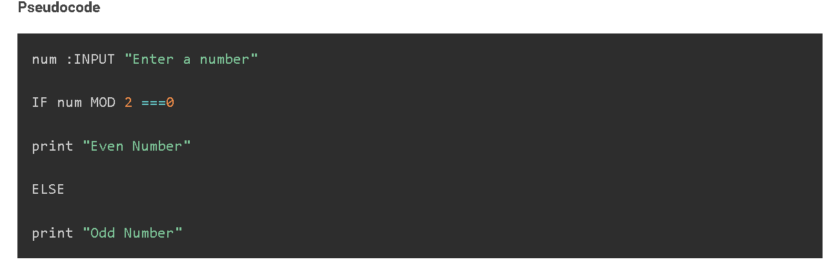
Pseudocode Vs Actual Code

Slide 6
Why Use Pseudocode?
Easier to read:
Developers often work closely with other professionals, such as product owners, managers, etc., with little to no programming knowledge. However, using pseudocode makes it easy for them to understand the flow and mechanics of a program’s, website’s, or app’s source code. It facilitates easy communication between different professionals.
Simplifies code construction:
Code generation becomes extremely easy and quick with pseudocode.
Middle point:
A middle point between an algorithm and the actual code.
Quick bug detection:
As it is written in simple English, uncovering bugs without writing code becomes more effortless. Also, you can make changes to it anytime quickly.

Slide 7
How to Write Pseudocode?
You must leverage the same logic and conventions analogous to programming code to write pseudocode.
The only difference is that pseudocode eliminates the need to use a strict syntax of a programming language for the computer system to compile it.

Slide 8
How to Write Pseudocode?
Define the Purpose or Goal of the Process
The first step is clearly defining the goal or purpose of writing a pseudocode. Simply put, define the problem statement for the program you are trying to implement.
This will help other people understand the purpose of the process.
Outline the Steps in a Logical Sequence
Enlist all the steps sequentially required to implement the program. Ensure to write one action in one line.
Likewise, list all tasks in the form of pseudocode, making it easy for developers to translate them into the actual code.
Use White Space and Indentation
Use white spaces and indentation with conditional statements and code blocks to make your pseudocode more readable and clean.
For instance, consider you started an ‘if’ block. Use indentation and write a set of the required instructions. This helps people understand that these instructions belong to the ‘if’ block.

Slide 9
How to Write Pseudocode?
Capitalize Key Commands
Capitalizing that commands will remain the same in the actual code, making it easy for developers during code construction.
In our example, we can capitalize “IF” and “ELSE,” as these commands will remain the same in the actual code.
Use Simple Terminology
While writing the pseudocode, keep the terminology simple and easy to understand, as we did in our example. This makes it easy for beginners to understand a program’s flow. Also, we have used essential programming constructs like “IF” and “ELSE.”
Describe the Process Completely
Describe everything taking place in the process. Avoid using shortcuts, as novices may not grasp them. This means avoiding variables and operators; describe the condition or expression in simple English, as we did in our example.
Organize into Sections
Organizing your pseudocode into sections using curly brackets is better if it is lengthy. This prevents any confusion while reading. In addition, you can add comments using “//” to help others know what the code does.
Cross Verify
Once you complete writing, cross-verify whether you have covered every condition, operation, printing statement, etc. Ensure that it is understood by anyone unfamiliar with it is easy to translate into code, describes the complete process and every object used is defined and described well.

Slide 10
Standard Conventions to Write Pseudocode
Use capital words for reserved commands or keywords. For example, if you are writing IF…ELSE statements, then make sure IF and ELSE be in capital letters.
Write only one statement per line.
Use indentation for the block body. It keeps the body of every component isolated, and indenting different pieces of each block will indicate that those pieces of pseudocode go under a less intended section.
Be specific while writing a statement. Use plain English to provide a detailed description.

Slide 11
Pseudocode for Different Statements
Operators
Assignment Operator:
=, <- or :=
Comparison Operator:
== , !=, <, >, <= , and >=
Arithmetic Operator:
+,-, *, /, MOD(%)
Logical Operator:
AND, NOT and OR
Sum, Product:
? ?

Slide 12
Pseudocode for Different Statements
Special Keyword
START: To begin the pseudocode.
INPUT : Take input from the user.
PRINT: To print the output on the screen.
READ/GET: Input format while reading data from the file.
SET, INIT: Initialize a value.
INCREMENT, BUMP: Increase the value of the variable, equivalent to a++.
DECREMENT: Decrease the value of the variable, equivalent to a--.
COMPUTE, CALCULATE, DETERMINE: To calculate the expression result.

Slide 13
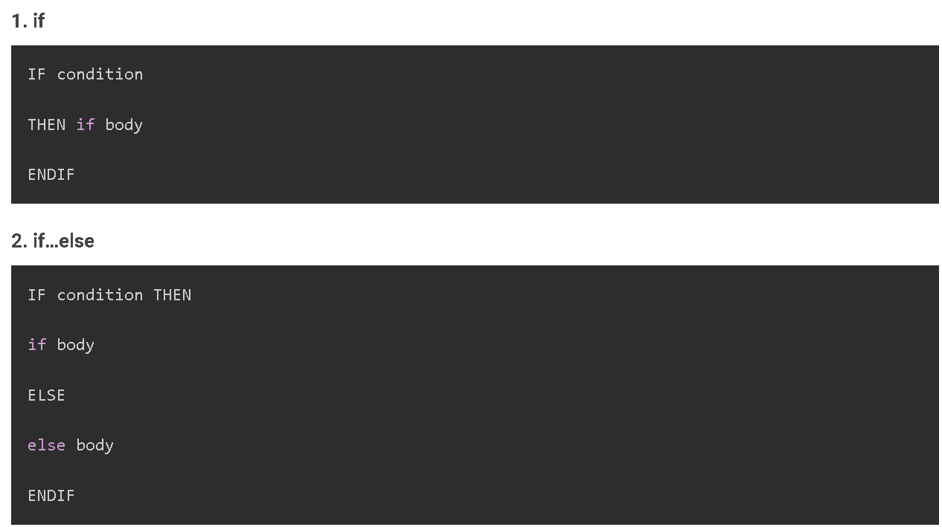
Pseudocode for Different Statements
Conditional Statements

Slide 14
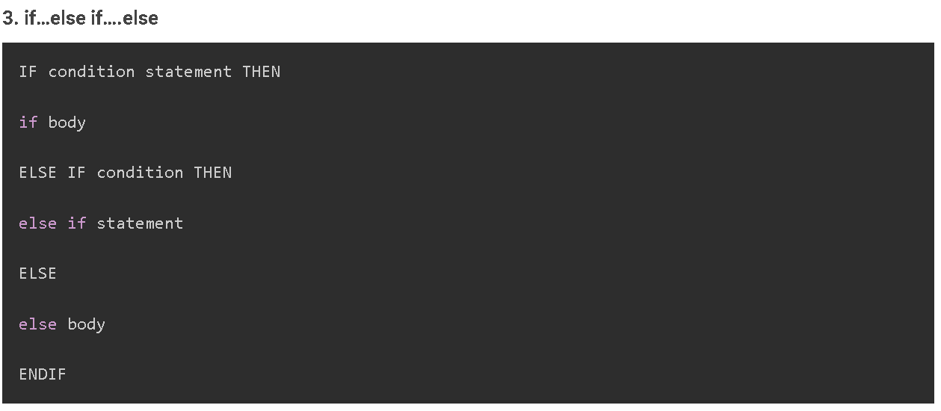
Pseudocode for Different Statements
Conditional Statements

Slide 15
Pseudocode for Different Statements
Conditional Statements
Example 1
age = INPUT : "Enter your age"
IF age is greater than 18
PRINT "adult"
ELSE
PRINT "Under age"

Slide 16
Pseudocode for Different Statements
Conditional Statements
Example 2
age = INPUT : "Enter Your age"
IF age is equal to 18 THEN
PRINT "under check"
ELSE IF age is greater than 18
PRINT "Give entry"
ELSE
PRINT "under age"
ENDIF

Slide 17
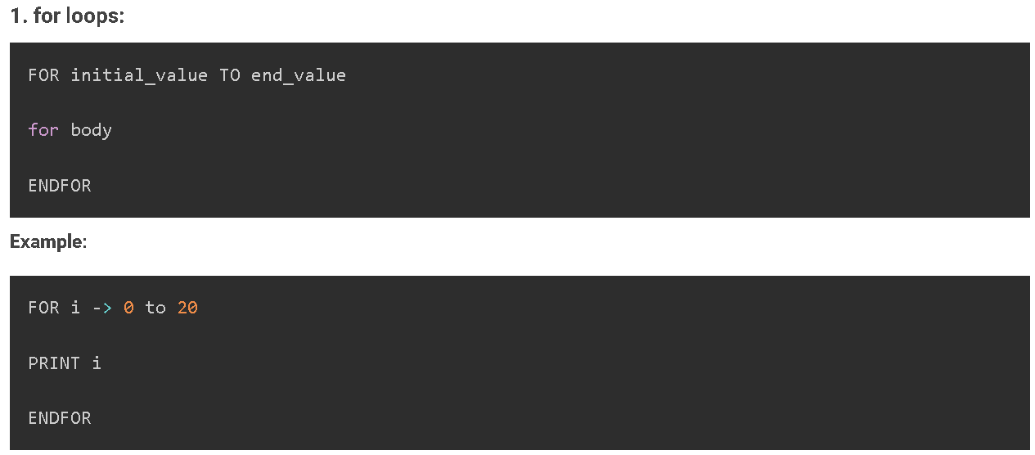
Pseudocode for Different Statements
Iterators

Slide 18
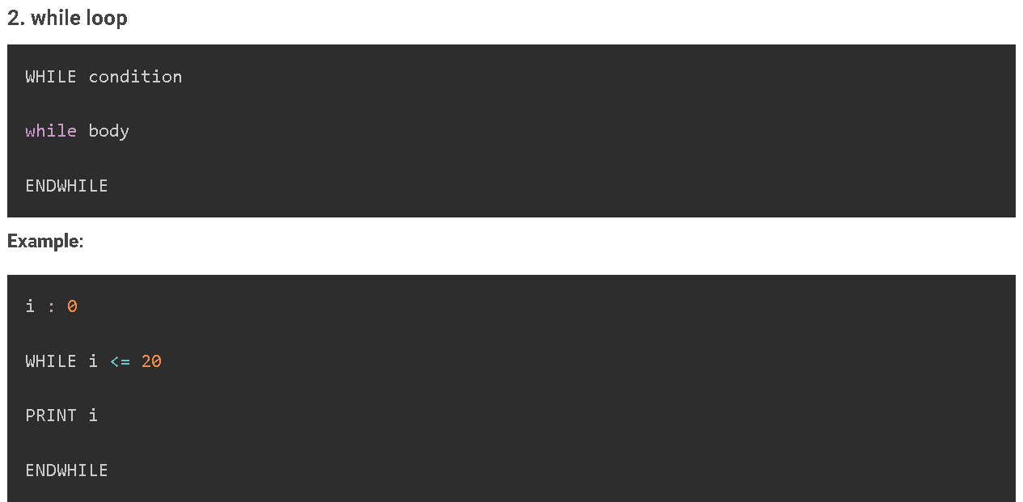
Pseudocode for Different Statements
Iterators

Slide 19
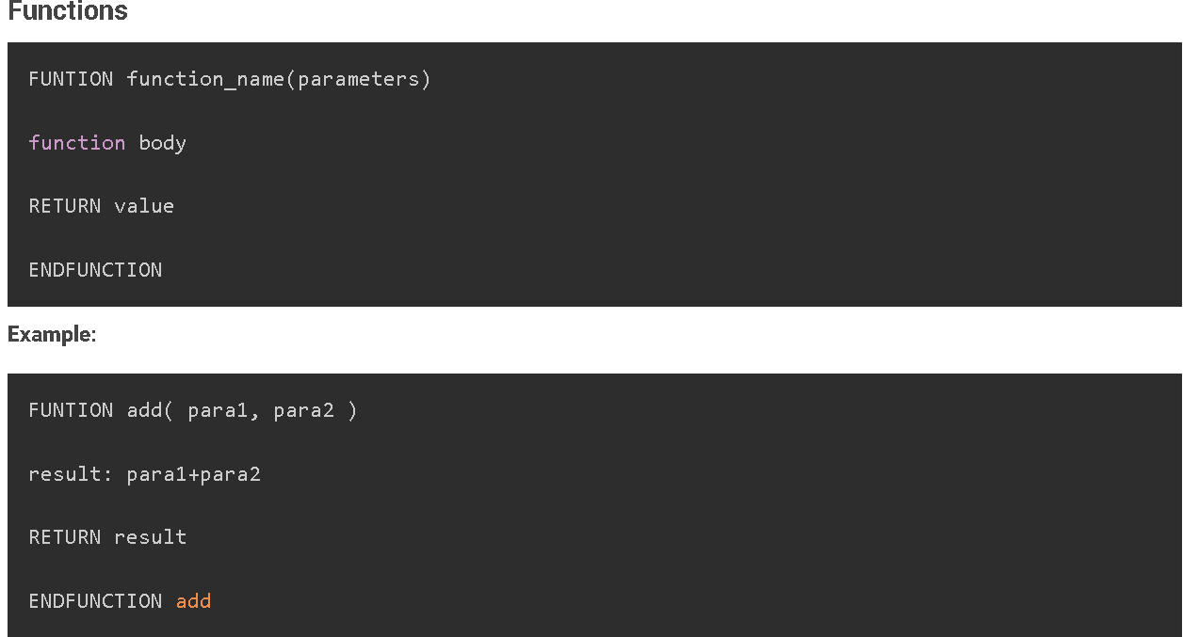
Pseudocode for Different Statements

Slide 20
Write the FizzBuzz Algorithm Using Pseudocode
FizzBuzz is a standard coding and interview problem in which we must write a code to print Fizz, Buzz, and FizzBuzz when the multiple of 3 and 5 occurs. The problem states:
Write a code that prints each number from 1 to 30 in a new line.
Print "Fizz" if the number is the multiple of 3.
Print "Buzz" if the number is a multiple of 5.
For a number that is a multiple of both 3 and 5, print “FizzBuzz.”

Slide 21
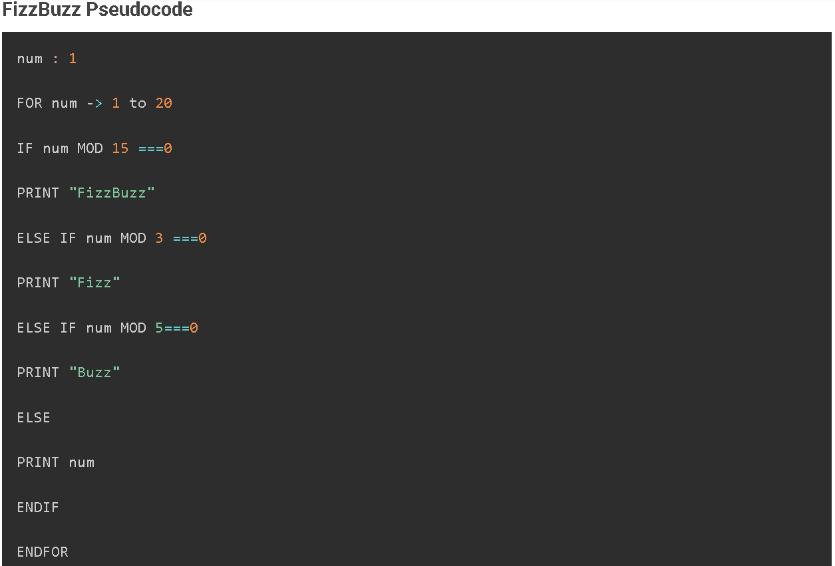
Write the FizzBuzz Algorithm Using Pseudocode

Slide 22
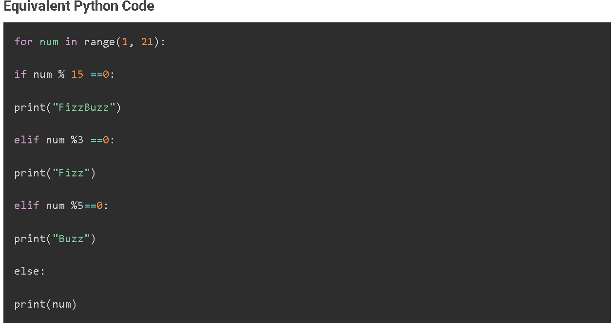
Write the FizzBuzz Algorithm Using Pseudocode

