Slide 1

PROJECT WARDROBE
Or “Honey, do I have any clean socks?”
MySQL project by Anna Korzeniowska

Slide 2
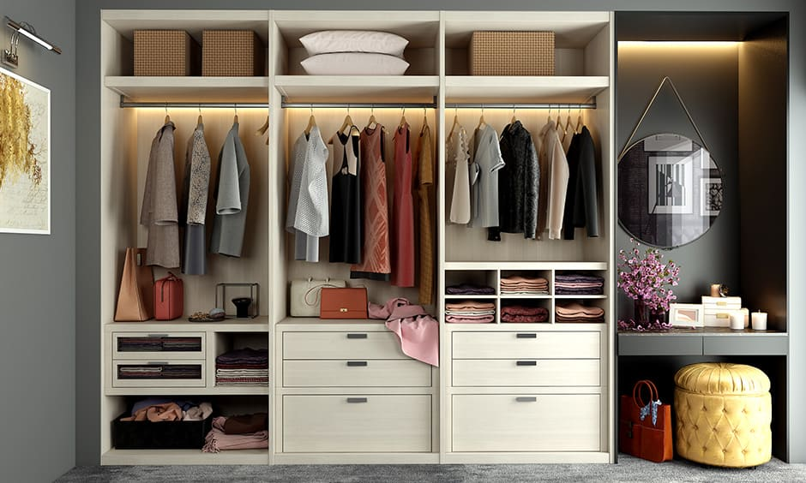
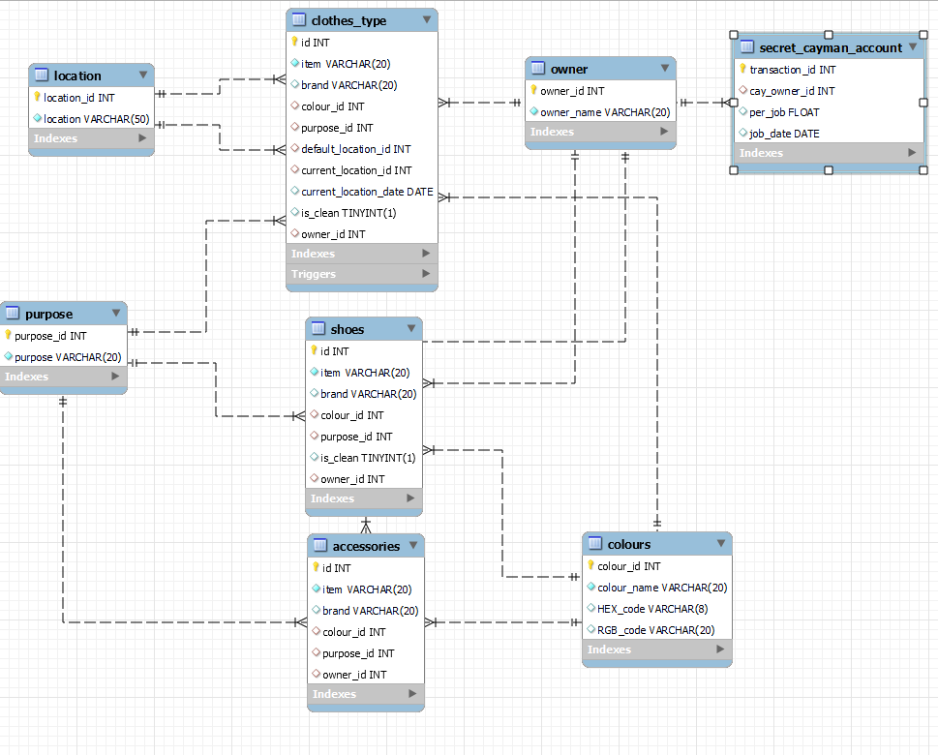
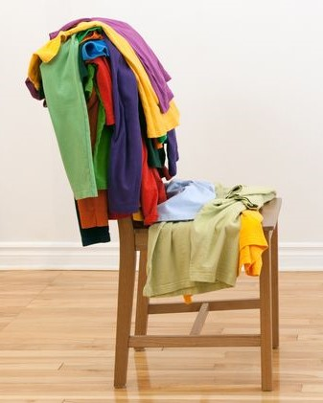
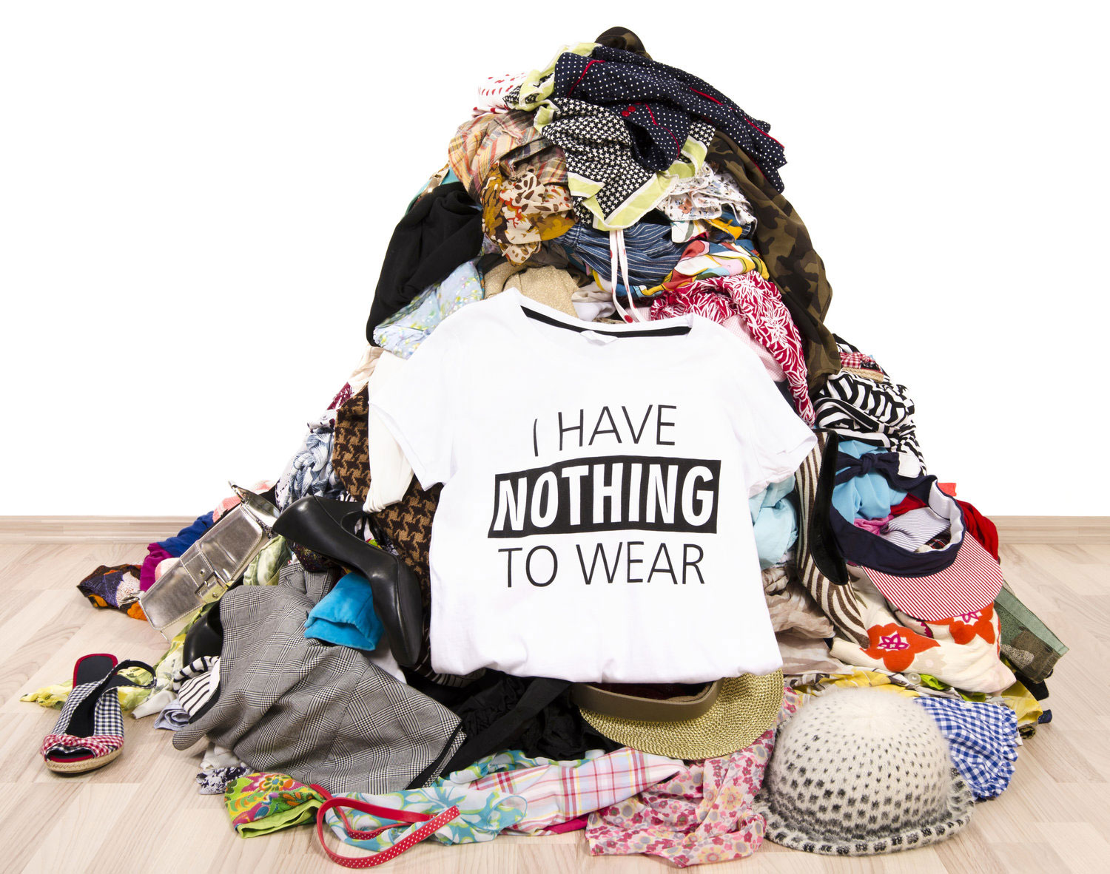
WARDROBE
CHAIRDROBE
FLOORDROBE

Slide 3
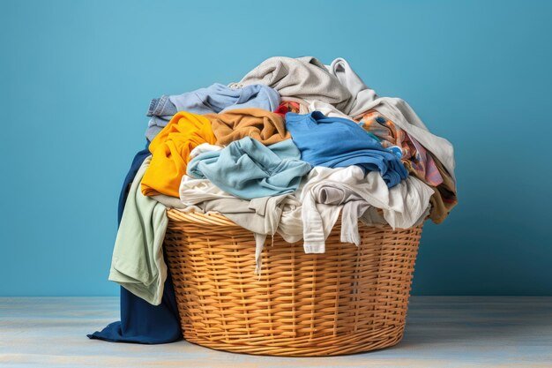
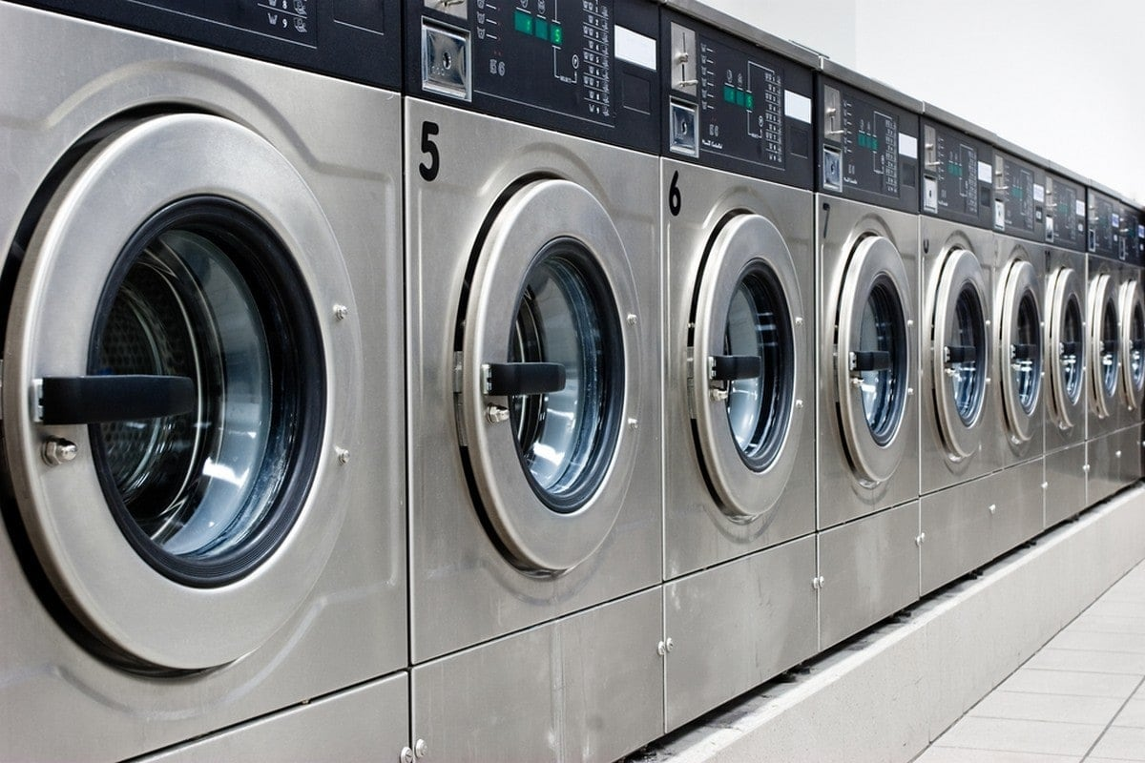

Is it time yet?

Slide 4
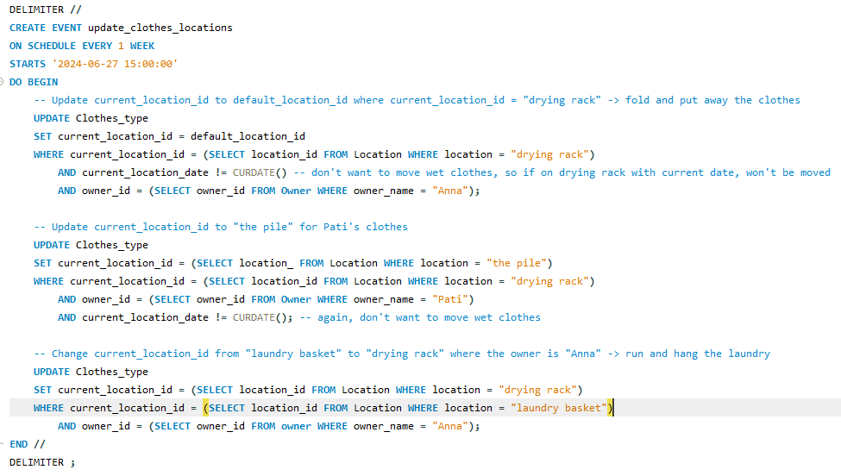
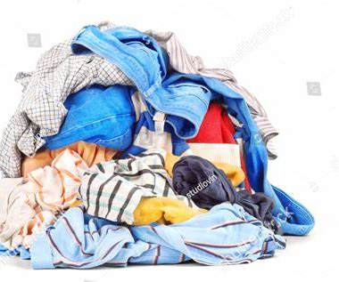
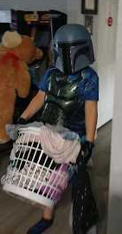
Every Thursday is a laundry day
“This is the way”
- Mandalaundrian

Slide 5
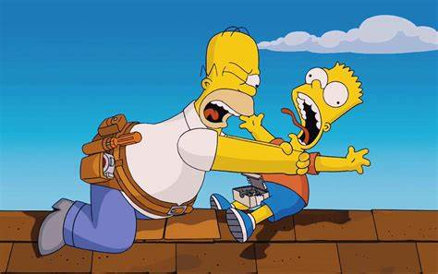
And they lived happily ever after…
The End

