Slide 1
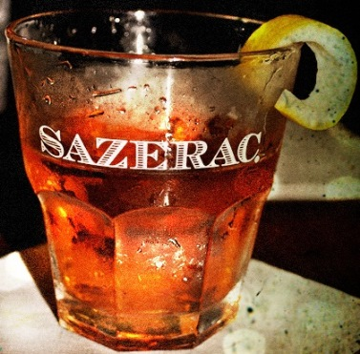
Team Sazerac
A Drunk Bird Project
(NOT another flappy bird project)
JavaScript DOM and UI Teamwork
Telerik Software Academy 2015-2016

Slide 2
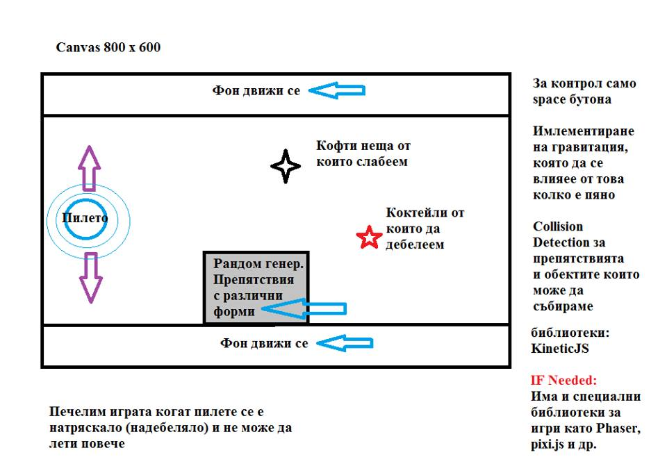

Initial Idea

Slide 3
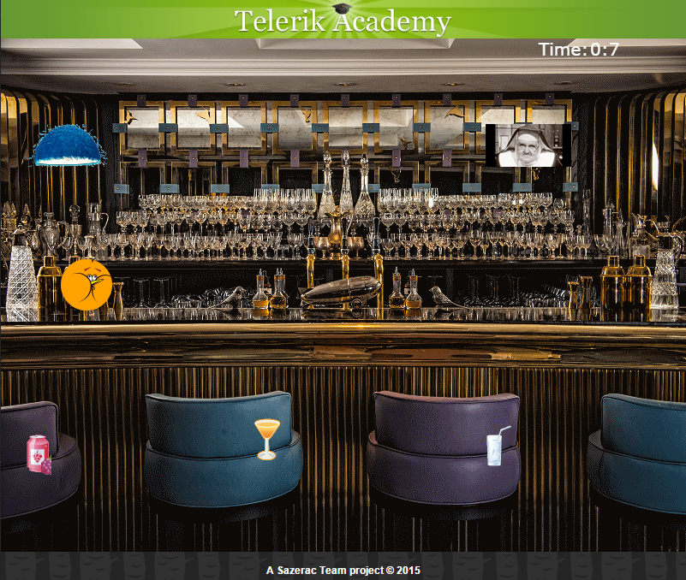
Final Product

Slide 4
How It Works ? – Part 1
Technology: Build with Kinetic.js and SVG
Following OOP Principles:
- drunkbird.js creates the model of the bird (named drunkBurd)
- drawableObject is inherited by cocktail, soft drink and game obstacle objects.
Separated Kinetic.js and SVG logic
- engine.js draws the objects in the browsers and defines how they interact(collision detection).
Implemented SVG
- via timer and end game screen

Slide 5
How It Works ? – Part 2
Secured better performance via the usage of different layers:
- background Layer
- drink Layer
- bird Layer
- obstacles Layer
Followed HQC Rules:
- Proper Naming
- Each function perform only one task

Slide 6
Cheers!

