Slide 1

Operators in Python
Python Comparison Operators

Slide 2
Operators in Python
Types of operators in Python
Arithmetic operators
Comparison operators
Assignment operators
Logical operators
Bitwise operators
Membership operators
Special operators
Identity operators
Membership operators

Slide 3
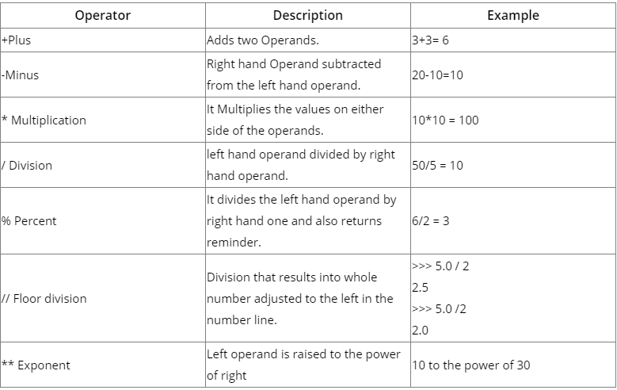
Arithmetic operators
Arithmetic operators are used for executing the mathematical functions in Python which includes, addition, subtraction, multiplication, division, etc.

Slide 4
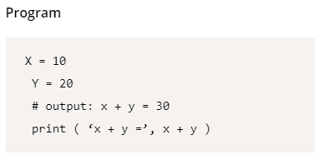
Python (+) Addition operator
Addition operator in python is being used to add two operands (values) in python programming. Look at the below program to know how it works.

Slide 5
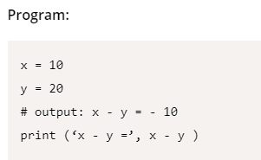
Python (-) Subtraction operator
In python programing, the operator, Subtraction is used to execute a mathematical function which subtracts the right hand operand from the left hand one.

Slide 6
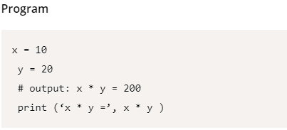
Python (*) Multiplication operator
It is used in python programming to multiply the values and thereby to get output. Let's consider the below program to understand the multiplication operator.

Slide 7
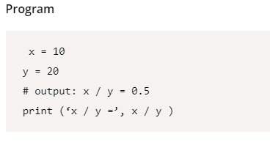
Python (/) Division operator
Division operator is used to divide the left hand operand by right hand one.
x = 10
y = 20
i.e x/y (10/20 = 0.5 )
Let’s consider it in python way

Slide 8
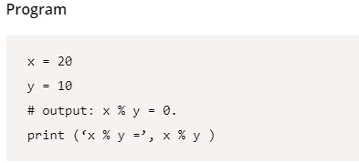
Python (%) Percentail operator
The Percentile (%) is the string formatting operator in python, and it is also called as a interpretation operator. It divides the left hand operand by right hand one and also returns reminder. Ex: x/y

Slide 9
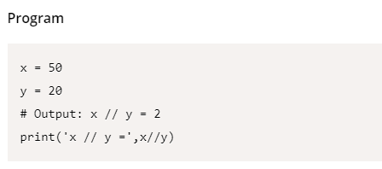
Python (//) Floor division operator
The Floor Operator is used to make a whole number adjusted to the left hand side in the number line.
Let's check the below program to know how a floor operator works in Python

Slide 10
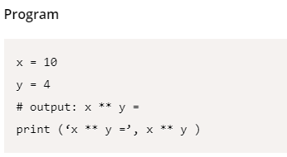
Python (**) Exponent operator
Exponent operator is used in Python to perform exponential (power) calculations by using operators. Let's look into this concept with the help of a program.

Slide 11

Python Comparison Operators
The name itself is explaining that this operator is used to compare different things or values with one another. In Python, the Comparison operator is used to analyze either side of the values and decides the relation between them. Comparison operator is also termed as a relational operator because it explains the connection between them.
We have different Comparison (Relational) operators. Let’s list them down and get to know each operator in detail.
== Equal
!= Not Equal
<> Two Operands are not equal
> Greater Than
< Less Than
>= Greater Than or Equal to
<= Less Than or Equal to

Slide 12
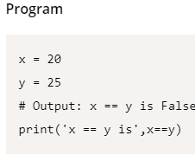
Python (==) Equal Comparison Operator
Equal operator is used to compare the two values and to give the result whether they are equal or not. If both the values are equal, then it gives the result as True, if not False.

Slide 13
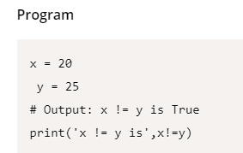
Python (!=) Not Equal Comparison Operator
This Not equal operator is used to compare two operands and returns True statement if they are Not equal, and False if they are Equal.

Slide 14
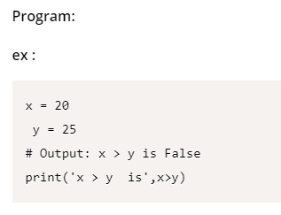
Python (>) Greater Than Operator
This operator is mainly used in Python to return true if the Left hand value is greater than right one. If left hand operand is greater than right hand operand, it returns True as the output.
Ex: 10 is > 8, then the answer becomes True
10 is > 12, then the answer becomes False

Slide 15
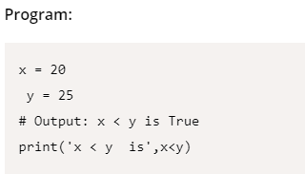
Python (<) Less Than Operator
This Operator compares the right hand operator with the left hand one and if the right hand one is greater than the left hand one, it returns True statement.
Ex: 10 is < 12, then the answer becomes True
10 is < 8, then the answer becomes False

Slide 16
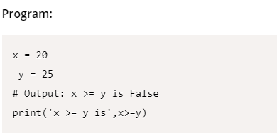
Python >= Greater Than or Equal to operator
Greater than operator is used in python to evaluate to True if the left hand operand is >= (greater than or equal) to right hand one

Slide 17
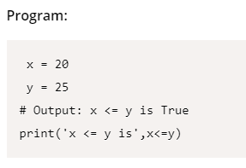
Python <= Less than or equal to operator
Less than or equal to operator returns true if the right hand operator is greater than or equal to left hand one.

Slide 18
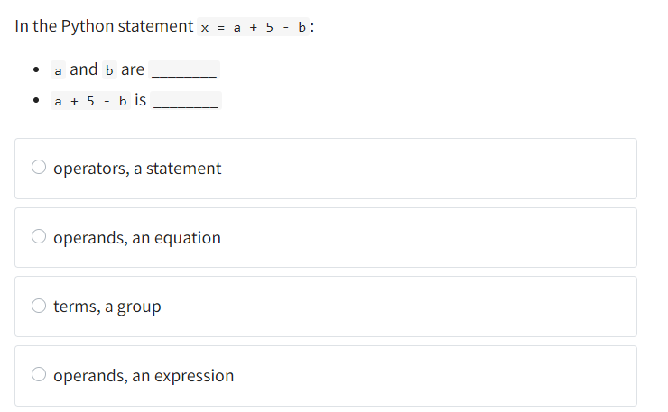
Question1

Slide 19
Answer
Operands, an expression
Explanation
The objects that operators act on are called operands. An expression involving operators and operands is called an expression.

Slide 20
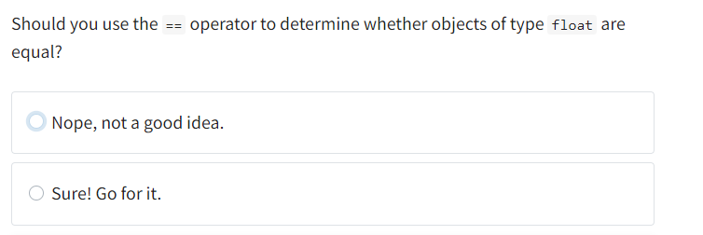
Question 2

Slide 21
Answer
Sure, yes

Slide 22
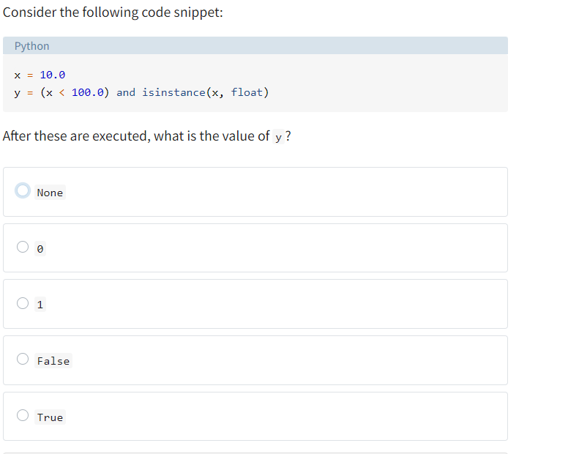
Question 3

Slide 23
Answer
True
Explanation
This is a case where the terms of the expression, (x < 100.0) and isinstance(x, float), are both not only truthy, but actually equal to the Python value True. The expression is therefore also True.

Slide 24
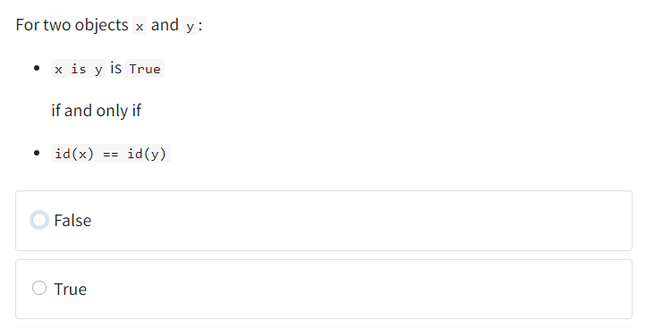
Question 4

Slide 25
Answer
False

Slide 26
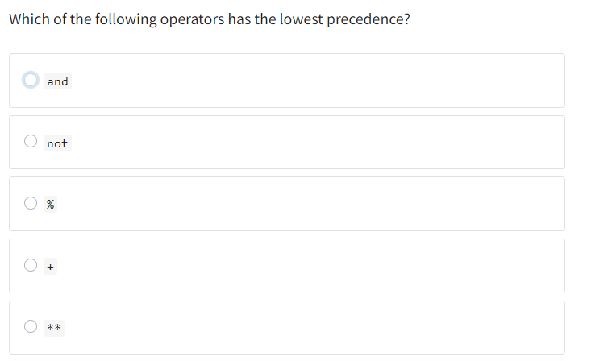
Question 5

Slide 27
Answer
And
Explanation
and has the lowest precedence of all the operators covered in this tutorial except or.
The question doesn’t state whether the + operator listed is binary addition or unary positive. But it doesn’t matter—
it wouldn’t have a lower precedence than and either way.

