Slide 1
EMPLOYEE SALARY PREDICTION with VARIOUS ML ALGORITHMS
CAPSTONE PROJECT
Presented By:
1. Chinnamgari Spurthi
Sreenidhi Institute of Science & Technology
AICTE ID : STU6835540f9d95f1748325391
AIML

Slide 2
OUTLINE
Problem Statement
System Development Approach
Algorithm & Deployment
Result
Conclusion
References

Slide 3

Problem Statement
To build a machine learning model that classifies employees into salary categories (>50K or ≤50K) based on features like age, education level, job role, working hours, experience, capital gain/loss, work class, & native country. The model an assist organizations in budgeting & salary planning. For instance, it helps HR teams estimate salary distributions & make informed hiring or compensation decisions.

Slide 4
System Approach
System requirements
Operating System: Windows / Ubuntu / macOS
Python Version: 3.8 or higher
RAM: Minimum 4 GB (8 GB recommended)
Processor: Intel i3 or higher
IDE: Jupyter Notebook / VS Code / Google Colab

Slide 5
System Approach
Library required to build the model
pandas – for data handling and manipulation
numpy – for numerical operations
matplotlib & seaborn – for data visualization
sklearn – for machine learning algorithms and preprocessing
joblib – for saving and loading models
streamlit – for deploying the model as a web app

Slide 6
Algorithm
1. Load the Dataset
Imported the dataset using pandas.read_csv() from a CSV file.
2. Data Exploration
Used functions like head(), tail(), and shape to understand the structure of the data.
3. Check for Missing Values
Used .isna().sum() to detect any missing values in the dataset.
4. Check for Duplicates
Identified duplicate records using .duplicated() and removed them to avoid data leakage.
5. Check for Special / Unknown Values
Inspected columns with value_counts() to detect irregular entries like '?'.

Slide 7
Algorithm
6. Replace Invalid Entries
Replaced special characters and rare categories with placeholders like 'NA' or 'others'.
7. Remove Irrelevant Records
Removed data of retired-age employees (e.g., age > 60) to ensure valid workforce data.
8. Drop Unwanted Columns
Removed columns like race, relationship, gender, fnlwgt, and education-num as they were either irrelevant or redundant.
9. Outlier Removal
Detected and removed extreme values to improve model accuracy and training stability.
10. Label Encoding
Converted the target variable (<=50K, >50K) to numerical format using label encoding.

Slide 8
Algorithm
11. Separate Features and Target
Split the data into independent features (X) and target variable (ye.
12. Identify Column Types
Detected which columns are categorical and which are numerical for preprocessing.
13. Data Preprocessing
Applied:
OneHotEncoding for categorical features
StandardScaler for numerical features
All combined using ColumnTransformer
14. Train-Test Split
Split the dataset into training and testing sets (e.g., 80% train, 20% test).

Slide 9
Algorithm
15. Model Selection
Defined various classification models including:
Logistic Regression
Random Forest
XGBoost
16. Model Training & Evaluation
Trained each model using the pipeline and evaluated using metrics:
Accuracy
Precision
Recall
F1-score
17. Visualization
Used bar charts and performance tables to compare models and understand results visually.
18. Save the Best Model
Exported the best-performing model pipeline using joblib.dump() for deployment.

Slide 10
Deployment
1. Import Libraries
Used Streamlit, Pandas, and Joblib to build the app.
2. Load Trained Model
Loaded the saved machine learning model using Joblib.
3. App Setup
Set the app title and layout using Streamlit.
4. User Inputs via Sidebar
Collected input like age, education, job role, etc., using sliders and dropdowns.
5. Map Full Forms
Displayed full-form options to the user and mapped them to short forms for prediction.

Slide 11
Deployment
6. Create Input DataFrame
Combined user inputs into a format suitable for prediction.
7. Display Inputs
Showed user-entered data before prediction.
8. Make Prediction
Predicted salary class (≤50K or >50K) on button click.
9. Run the App
Launched the app using Streamlit and accessed it through the browser.

Slide 12
Result
We used three models: Logistic Regression, Random Forest, and Gradient Boosting to predict employee salary categories. Among them, Gradient Boosting gave the best accuracy, compared to Logistic Regression & Random Forest. The models were compared using accuracy, precision, recall, and F1-score. A graph was created to visualize this comparison. The best model was saved and deployed using Streamlit.
MODEL | ACCURACY
Logestic Regression | 84.51 %
Random Forest | 83.43 %
Gradient Boosting | 86.11 %

Slide 13
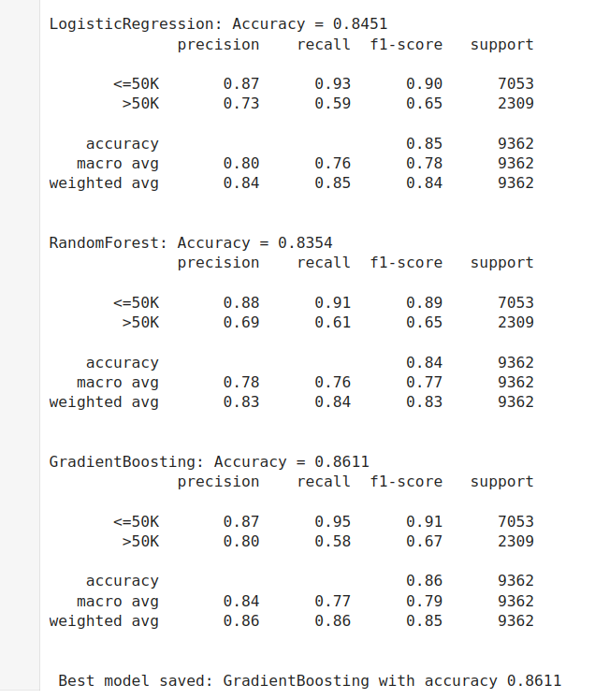
Result
Metrics summary of models

Slide 14
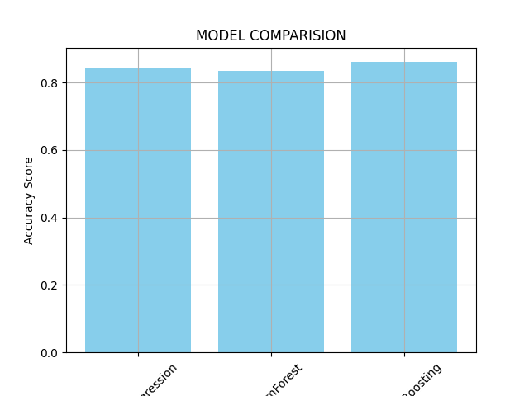
Result
Logistic regression
Random Forest
Gradient Boosting
Best Model : Gradient Boosting with accuracy 86.11 %

Slide 15
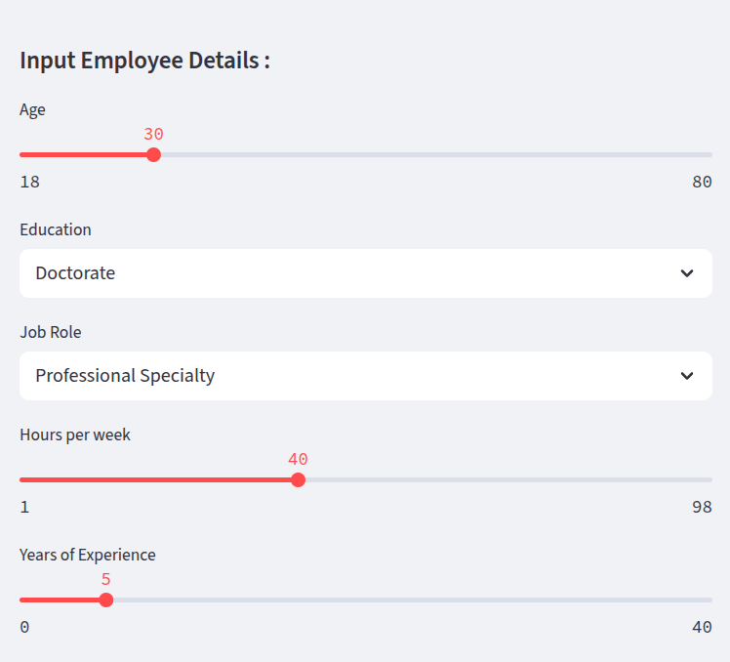
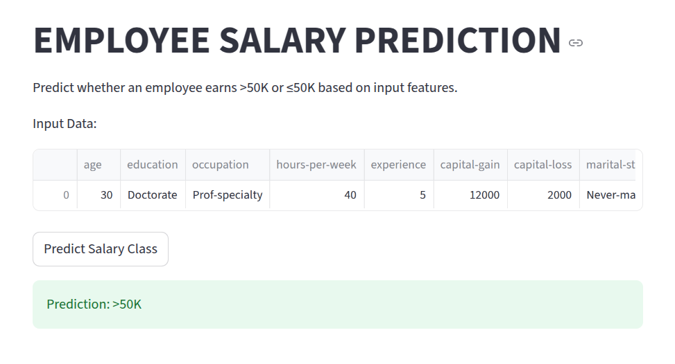
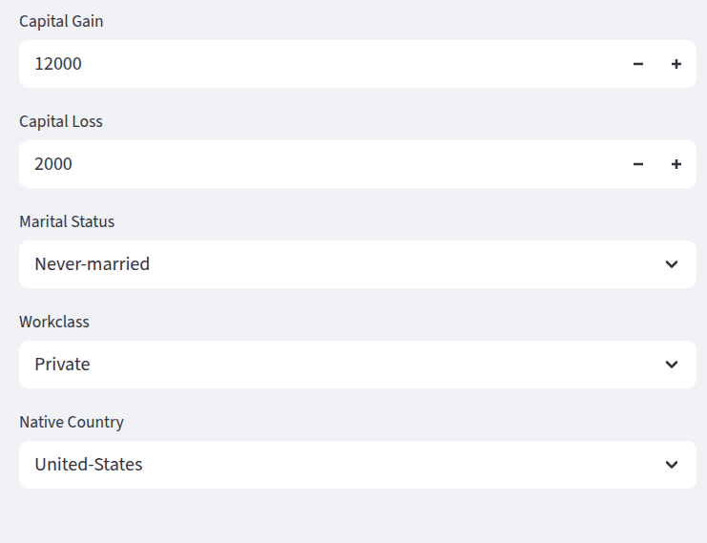
Result
WEB APP USING STREAMLIT

Slide 16
Result
Github repository link of project:
https://github.com/Spurthi-Chinnamgari/Empolyee-Salary-Prediction-Chinnamgari_Spurthi.git

Slide 17
Conclusion
Developed a salary classification system using input features like age, education, job role, etc.
Explored and cleaned the dataset, removing null values, special characters, and irrelevant data.
Faced challenges like:
Missing and inconsistent values in key columns (e.g., education, workclass).
Special characters like '?' and whitespace that needed proper replacement.
Outliers in age, capital gain/loss, and hours worked, affecting model performance.
Deciding which features were relevant (e.g., dropping gender, fnlwgt, etc.).
Compared three models: Logistic Regression, Random Forest, and Gradient Boosting.
Gradient Boosting performed best with an accuracy of 86.11% and was saved for deployment.
Created a simple Streamlit app for real-time salary prediction based on user input.

Slide 18
References
Jupyter Notebook – An interactive environment for coding and data analysis
Scikit-learn – Machine learning library used for model training and evaluation
Streamlit – Used for deploying the machine learning model as a web application
Pandas – Library used for data manipulation and analysis
Matplotlib – For visualizing model performance

Slide 19
THANK YOU

