Slide 1

Project Title -
Seasonal Agriculture Performance Analysis
Student Name-
College Name-
KONGARA SPURTHI
Siddhartha Academy of Higher Education
(VRSEC-Velagapudi Ramakrishna Siddhartha Engineering College)
AICTE STU ID :
STU68b902bf6b9191756955327

Slide 2

PROBLEM STATEMENT
Agricultural performance varies across different seasons due to changes in environmental conditions, farming practices, resource availability, and market conditions. These seasonal variations can affect crop production, resource usage, and the economic performance of farming activities.
This project analyzes the agricultural dataset to identify seasonal patterns, trends, relationships, and variations and to understand how agricultural performance differs across seasons.

Slide 3
Project Description
Seasonal Agriculture Performance Analysis is a data analytics project that studies how agricultural performance changes across different seasons. The project uses farm-level data containing information about crops, regions, environmental conditions, farming practices, resource usage, production, and economic performance.
.
The dataset is cleaned and analyzed using Python, Pandas, NumPy, Matplotlib, and Seaborn to identify meaningful seasonal patterns, trends, relationships, and variations. The analysis compares crop yield, production, rainfall, temperature, water usage, irrigation, profitability, and regional performance across Kharif, Rabi, and Zaid seasons.
The project also applies statistical analysis and visualizations to support the findings and identify significant seasonal differences. The final results provide evidence-based insights and recommendations for better seasonal agricultural planning and resource management.

Slide 4

WHO ARE THE END USERS?
Farmers – to understand seasonal crop performance and improve farming decisions.
Agricultural Planners & Officials – to support seasonal planning and resource management.
Researchers & Data Analysts – to study agricultural trends, patterns, and relationships.
Agricultural Organizations – to evaluate production, resource usage, and economic performance.

Slide 5

Technology Used
Programming Language: Python
Data Analysis: Pandas, NumPy
Data Visualization: Matplotlib, Seaborn
Statistical Analysis: SciPy
Development Environment: Google Collab
Dataset: CSV format
Dataset: Seasonal Agriculture Performance Dataset

Slide 6
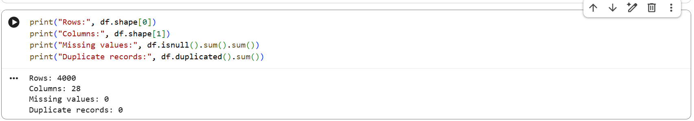
RESULTS
Dataset Validation and Cleaning

Slide 7
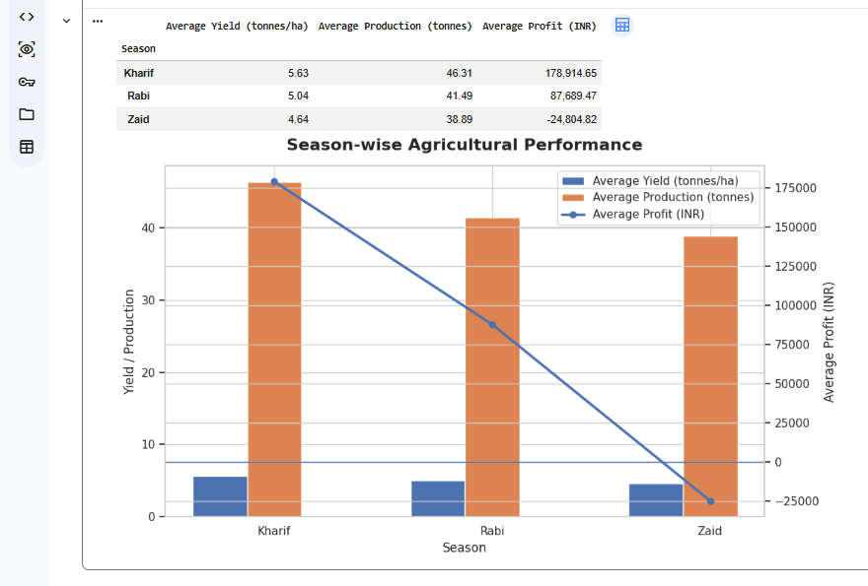
RESULTS
Season-wise Agricultural Performance

Slide 8
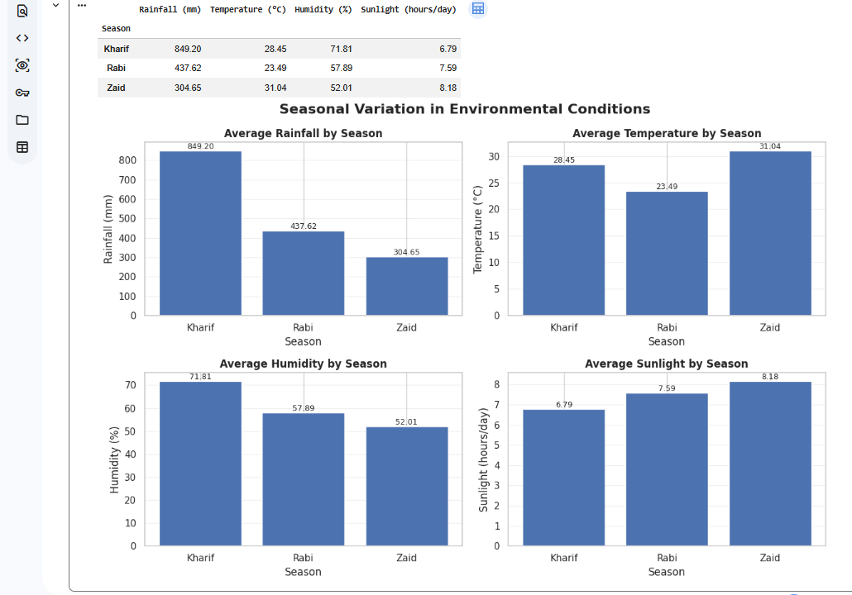
RESULTS
Seasonal Variation in Environmental Conditions

Slide 9
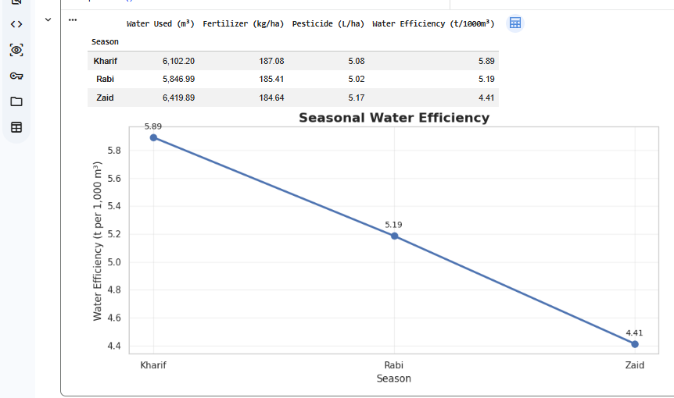
RESULTS
Seasonal Resource Usage and Water Efficiency

Slide 10
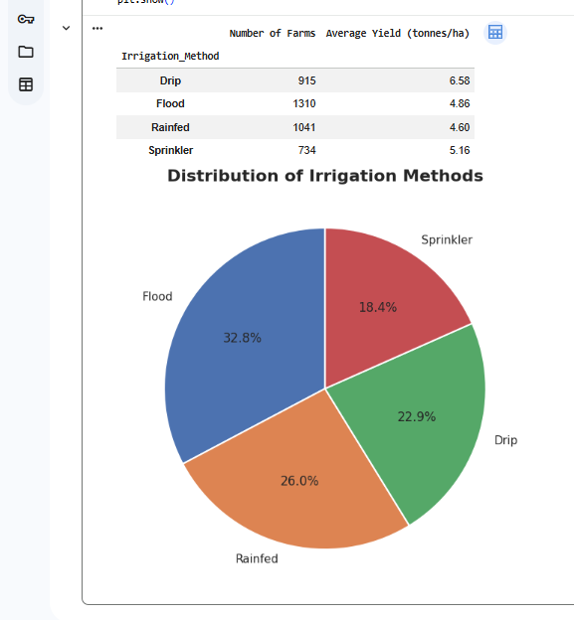
RESULTS
Irrigation Method Distribution

Slide 11
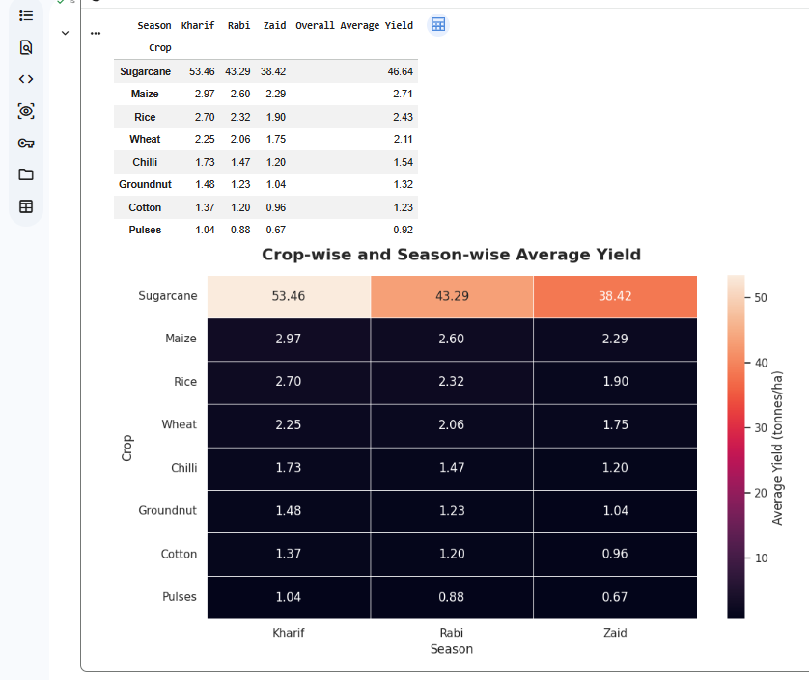
RESULT
Crop-wise and Season-wise Yield Analysis

Slide 12
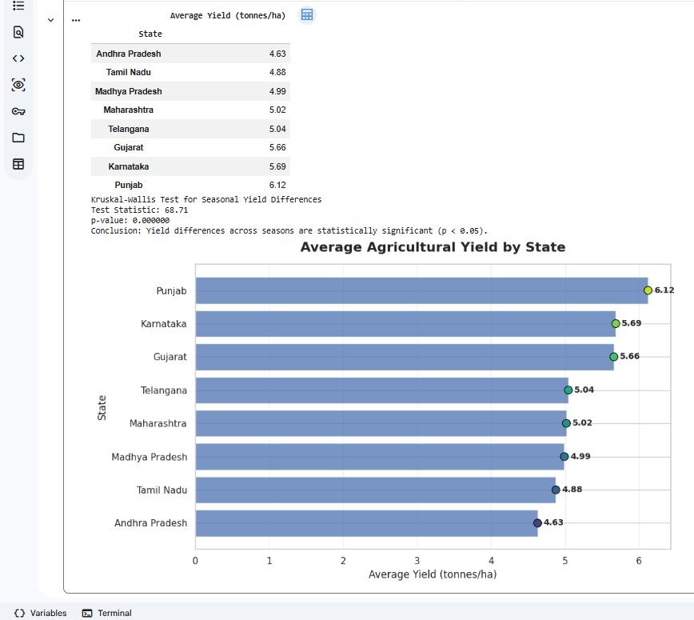
RESULT
Regional Agricultural Performance and Statistical Evidence

Slide 13
Future scope
Real-time agricultural data can be incorporated for more up-to-date analysis.
The analysis can be extended to include more regions, crops, and seasons.
Advanced predictive analytics can be introduced to forecast crop yield and profitability.
Weather and market data integration can provide deeper insights into seasonal agricultural performance.
An interactive dashboard or web application can be developed to make the insights easier to access and use.
The system can support personalized recommendations for crop selection, resource usage, and seasonal planning.

Slide 14
GitHub Link
https://github.com/SpurthiKongara/Seasonal-Agriculture-Performance-Analysis.git
https://github.com/SpurthiKongara/Seasonal-Agriculture-Performance-Analysis.git

Slide 15

VOIS Course completion certificate - Course name- Data Visualization

Slide 16
Thank you
.
.

