Slide 1
COMP2003 Tutorial 5
Analysis of algorithms

Slide 2
Outline
Motivation
Analysis of algorithms
Examples
Practice questions

Slide 3
Outline
Motivation
  Components of a program
  Brief introduction in algorithm analysis
  An illustrative example
  Motivation of algorithm analysis
  Limit rule and growth rate of common functions
Analysis of algorithms
Examples
Practice questions

Slide 4
Components of a program
Program = algorithms + data structures
  Algorithm is the way to handle the data and solve the problem
  Data structure is the way you store the data for manipulation
Usual way of writing a program
  First come up with the algorithms and data structures to be used,
  then use code to write the program

Slide 5
Brief introduction in algorithm analysis
The same problem
  May be solvable by more than one possible algorithm
    Suppose we have 2 or more algorithms solving the same problem
    For example, the problem is adding up a list of N consecutive integers
    (e.g. 1,2,3,4,5…..,100)
Which is better? How to define “better”?
  Runs faster?
    (Analysis the time complexity)
  Uses less memory spaces?
    (Analysis the space complexity)
The general rule
  As the input size grows, the time to run the algorithm and the amount of the memory spaces used grow
  Thus, it is a good idea to compare the performance based on the input size

Slide 6
An illustrative example: adding N consecutive integers
Algorithm 1:
  Using a for-loop
  Example:
    sum = 0
    for: i=0 to N-1
    sum = sum + A[i]
    return sum
  Requires N additions
    If the number of integer is 10,000, it requires 10,000 additions
Algorithm 2:
  Using a formula
  Example:
    sum = (A[0]+A[N-1])*(A[N-1]-A[N]+1)/2
    return sum
  Independent of the input size (N)
    If the number of integer is 10,000, it requires only a few arithmetic operations

Slide 7
Motivation of algorithm analysis
Suppose the input size is N
  We want to roughly determine the running time or the space complexity in term of N
  Too many terms is too clumsy
    N³+2N²+4 additions V.S. N⁵+2N^{2/3}+4N additions
    It is very hard to tell which one is better
Asymptotic notations
  Used to simplify the comparison among algorithms

Slide 8
Outline
Motivation
Analysis of algorithms
  Types of asymptotic notations
  Big-Oh: Asymptotic Upper Bound
  Big-Omega: Asymptotic Lower Bound
  Big-Theta: Asymptotic Tight Bound
Examples
Practice questions

Slide 9
Types of asymptotic notations
Three major types of asymptotic notations
  Big-Oh: Asymptotic Upper Bound
  Big-Omega: Asymptotic Lower Bound
  Big-Theta: Asymptotic Tight Bound
Measure the growth rate
  A faster growth rate does not mean the algorithm always performs slower than the counterpart
  It just means when the input size increases (e.g. N=10 becomes N=10,000), the running time grows much faster

Slide 10
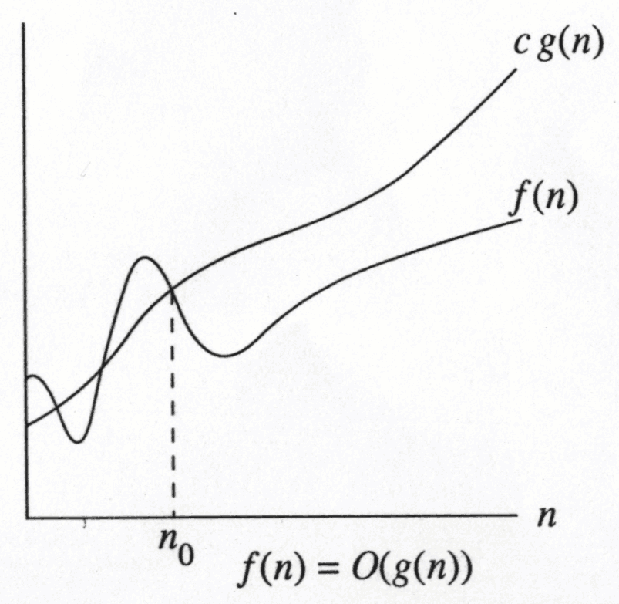
Big-Oh: Asymptotic Upper Bound
Definition:
  f(N) = O(g(N)),
  There are positive constants c and n₀ such that
    f(N) ≤ c g(N) when N ≥ n₀
Example problems
    How to prove that 2n² – 3n + 6 = O(n²) ?
    The problem is to find a pair of c and n₀ such that
      2n² – 3n + 6 ≤ cn² when n ≥ n₀

Slide 11
To prove that mathematically:
Try some values of c and find out the corresponding n₀ which satisfies the condition.
1. f(n) = O(n²)
(a) Suppose we choose c = 2:
2n² – 3n + 6 ≤ 2n²
– 3n + 6 ≤ 0
n ≥ 2
So we can see that if we choose c = 2 and n₀ = 2, the condition is satisfied.
(b) Suppose we choose c = 3:
2n² – 3n + 6 ≤ 3n²
n² + 3n - 6 ≥ 0
n ≤ -4.37(ignored) or n ≥ 1.37
So we can see that if we choose c = 3 and n₀ = 2, the condition is satisfied.
* There are other values of c and n₀ which satisfy the condition.
Notes:
>> Correct??
3. f(n) ≠ O(n) For any given positive constant c:
2n² – 3n + 6 ≤ cn
2n² – (c+3)n + 6 ≤ 0
If ∆ = (c+3)² – 48 < 0, these is no solution. Otherwise the solution is
So we can see that if n is bigger than the right constant, the inequality does not hold. Hence f(n) ≠ O(n).
4. f(n) ≠ O(1): Similar to f(n) ≠ O(n)

Slide 12
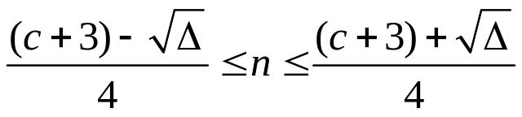
2. f(n) = O(n³) Suppose we choose c = 1:
2n² – 3n + 6 ≤ n³
-n³ + 2n² – 3n + 6 ≤ 0
n ≥ 2
So we can see that if we choose c = 1 and n₀ = 2, the condition is satisfied.
* There are other values of c and n₀ which satisfy the condition.
3. f(n) ≠ O(n) For any given positive constant c:
2n² – 3n + 6 ≤ cn
2n² – (c+3)n + 6 ≤ 0
If ∆ = (c+3)² – 48 < 0, these is no solution. Otherwise the solution is
So we can see that if n is bigger than the right constant, the inequality does not hold. Hence f(n) ≠ O(n).
4. f(n) ≠ O(1): Similar to f(n) ≠ O(n)

Slide 13
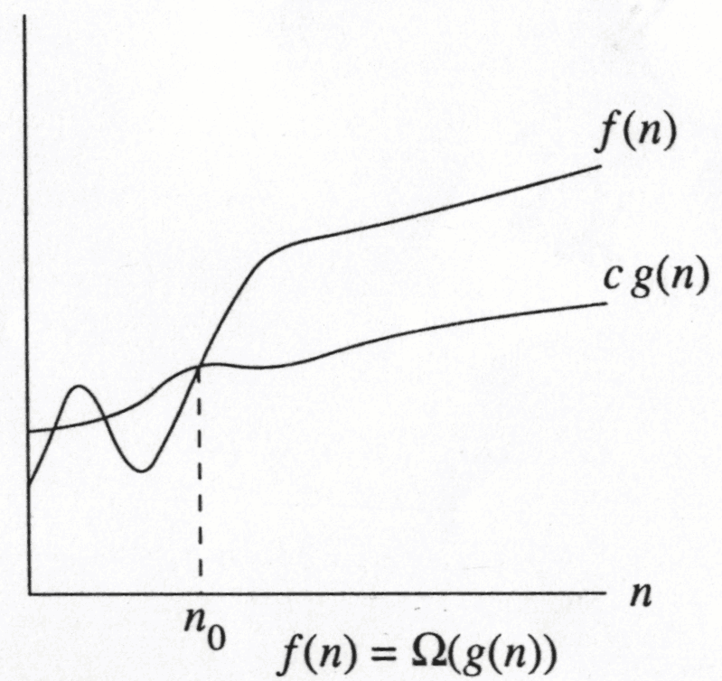
Big-Omega: Asymptotic Lower Bound
Definition
  f(N) = Ω(g(N))
  There are positive constants c and n₀ such that
    f(N) ≥ c g(N) when N ≥ n₀
Example problem
    How to prove that 2n² – 3n + 6 = Ω(n²) ?
    The problem is to find a pair of c and n₀ such that
      2n² – 3n + 6 ≥ cn² when n ≥ n₀

Slide 14
To prove that mathematically:
Try some values of c and find out the corresponding n₀ which satisfies the condition.
f(n) = Ω(n²)
Suppose we choose c = 1:
2n² – 3n + 6 ≥ n²
n² – 3n + 6 ≥ 0
n>0
So we can see that if we choose c = 1 and n₀ = 1, the condition is satisfied.
Notes:
>> Correct??
3. f(n) ≠ O(n) For any given positive constant c:
2n² – 3n + 6 ≤ cn
2n² – (c+3)n + 6 ≤ 0
If ∆ = (c+3)² – 48 < 0, these is no solution. Otherwise the solution is
So we can see that if n is bigger than the right constant, the inequality does not hold. Hence f(n) ≠ O(n).
4. f(n) ≠ O(1): Similar to f(n) ≠ O(n)

Slide 15
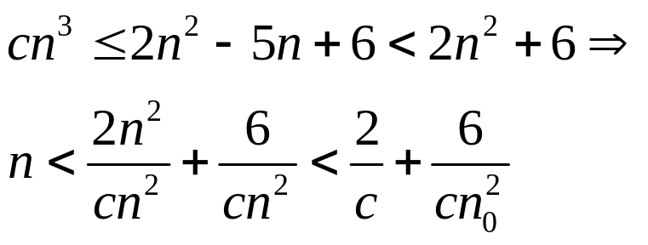
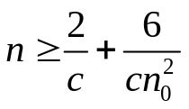
3. f(n) ≠ Ω(n³):
Assume there exists positive constants c and n₀ such that
for all n > n₀, 2n² − 5n + 6 ≥ cn³. We have
Which means for any the condition is not satisfied, contradicting our
assumption. This in turn shows that no positive constants c and n₀ exist for the
assumption, hence f(n) ≠ Ω(n³).

Slide 16
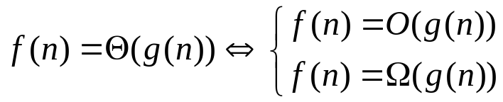
Big-Theta: Asymptotic Tight Bound
Definition:
Consider a function f(n) which is non-negative for all integers n ≥ 0.
f(n) = Ө(g(n)) (read as “f of n is big-theta of g of n”) iff:
There exists positive constants c₁ , c₂ and n₀ such that
c₁ * g(n) ≤ f(n) ≤ c₂ * g(n) for all integers n ≥ n₀.
And we say g(n) is an asymptotic tight bound of f(n).
Generally,
Example:
Consider f(n) = 2n² – 3n + 6. Then f(n) = Ө(n²)
To prove that mathematically: We only have to prove f(n) = O(g(n)) and
f(n) = Ω(g(n)) respectively, where g(n) = n² .

Slide 17
Estimating the growth rate of functions involving only polynomial terms
When estimating the asymptotic tight bound of f(n), there is a simple method as
described in following procedure:
1. Ignore the low order terms.
2. Ignore the constant coefficient of the most significant term.
3. The remaining term is the estimation.
Proof will be given later with the limit rules.
Example:
Consider f(n) = 2n² − 3n + 6. By applying the above, we
1. Ignore all the lower order terms. Therefore, we have 2n².
2. Ignore the constant coefficient of the most significant term. We have n².
3. The remaining term is the estimation result, i.e. f(n) = Ө(n²).

Slide 18





To prove f(n) = Ө(n²)
We need two things:
1. f(n) = 2n² − 3n + 6 = O(n²)
2. f(n) = 2n² − 3n + 6 = Ω(n²))
For condition 1:
f(n) = 2n² − 3n + 6
≤ 2n² + n² (assume )
= 3n²
Which means we have c=3 and satisfying the condition.
For condition 2:
f(n) = 2n² − 3n + 6
≥ 2n² - n² (since always holds)
= n²
Which means we have c=1 and n₀=1 satisfying the condition.
From above 2, we can choose c₁ = 1, c₂ = 3, and we have :
n² ≤ f(n) ≤ 3n² for all .

Slide 19
Proof of Slide 11:
With the limit rule, we now can prove:
For any f(n)=c₁g₁(n) + c₂g₂(n)+…+ c_{m}g_{m}(n) where c_{i} is constant and g_{i}(n) are
functions such that their order of magnitudes decrease with i, we have:
f(n)/g₁(n) = c₁ + c₂g₂(n)/g₁(n) +…+ c_{m}g_{m}(n)/g₁(n)
= c₁ (For n→∞)
Which means, f(n) = Ө(g₁(n)), which depends on only the term of the highest
order of magnitude. Note here that g_{i}(n) is arbitrary.

Slide 20

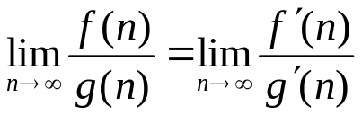
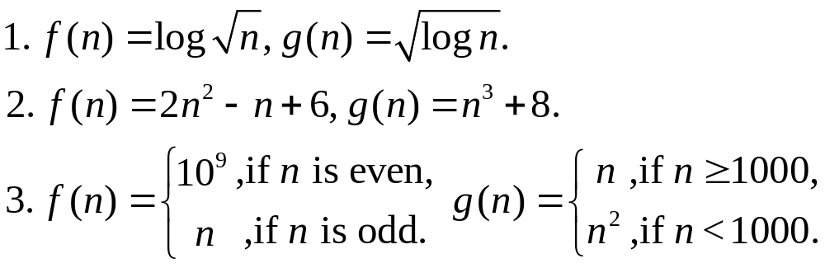
Problems:(This example requires knowledge of differentiation in calculus)
If the limit of both f(n) and g(n) approach 0 or both approach 1, we need to apply rule:
where f’(n) and g’(n) denote the derivatives of f(n) and g(n). Note that the rule can be applied multiple times.
In cases where the limit does not exist, we have to use the definition.
Exercise: find out the relationship between the pairs of functions. Determine whether f is O(g), Ω(g) or Ө(g).
f(n)= Ω(g(n))
f(n)= O(g(n))
f(n)= O(g(n))

Slide 21
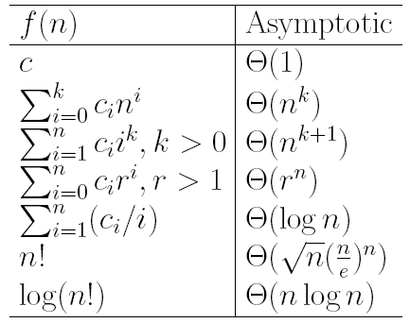
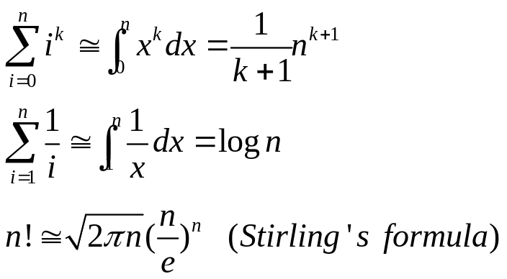

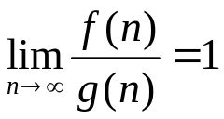
Some common asymptotic identities
Where denotes:

Slide 22
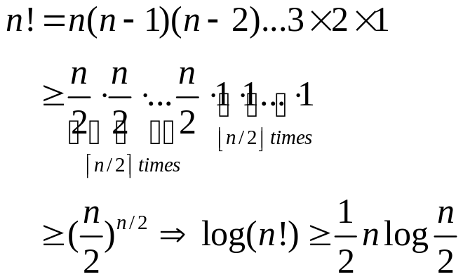
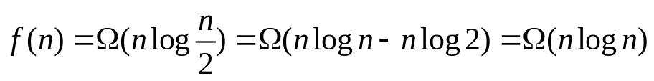
Example: Proof of log(n!) = Ө(nlogn).
We need to prove f(n) = log(n!) = O(nlogn) = Ω(nlogn)
1. Proof of log(n!) = O(nlogn) :
n! = n(n-1)(n-2)…3 × 2 × 1
≤ n^{n}
Therefore, log(n!) ≤ nlogn, and hence log(n!) = O(nlogn).
2. Proof of log(n!) = Ω(nlogn) :
From this we conclude that:
Thus log(n!) = Ω(nlogn).

Slide 23
Order of growth rate of some common functions
Growth rate: Slowest
Ө(c) where c>0 is a constant.
Ө(log^{k}n) where k>0 is a constant (the larger the k, the faster the growth rate)
Ө(n^{p}) where 0<p<1 is a constant (the larger the p, the faster the growth rate)
Ө(n)
Ө(nlogn)
Ө(n^{k}) where k>1 is a constant (the larger the k, the faster the growth rate)
Ө(k^{n}) where k>1 is a constant (the larger the k, the faster the growth rate)
Ө(n!)
Growth rate: Fastest
Exercise: Order the following functions by Big-Ө notation:
slowest
fastest

Slide 24
Outline
Motivation
Analysis of algorithms
Examples
  Assumptions in algorithm analysis
  Analyze loops
  Analyze recursive functions
  Maximum Consecutive Sum
Practice questions

Slide 25
Assumptions in algorithm analysis
Assumptions
  For this course, we assumed that instructions are executed one after another (sequential), without concurrent operations
  We use RAM (Random Access Model), in which each operation (e.g. +, -, x, /,=) and each memory access take one run-time unit O(1)
  Loops and functions can take multiple time units.

Slide 26
Example 1: Analyze the bubble sort
Analyze the bubble sort algorithm on an array of size N:
for: i=0 to N-1
for: j=N-1 to i+1
if A[j]<A[j-1] constant time O(1)
swap(A[j], A[j-1]) constant time O(1)
It takes at most
(N-1)+(N-2)+…+1 = N(N-1)/2 swaps
Assume each swap takes O(1) time, we have an O(N²) algorithm

Slide 27
Example 2: Analyze a loop
Loops (in C++ code format)
  int sum(int n)
  int partialSum;
  partialSum = 0; constant time O(1)
  for(int i=0;i<n;i++) O(1)+(n+1)*O(1)+n*O(1) = O(n)
  partialSum += i*i*i; O(1)+2*O(1)+O(1) = O(1)
  return partialSum constant time O(1)
  }
Time complexity
= 1st + 2nd*3rd + 4th
= O(1) + O(n)*O(1) + O(1)
= O(n)

Slide 28
Example 3: Analyze nested loops
Nested loops (in pseudo-code format)
  sum = 0; O(1)
  for i=0 to n O(n)
  for j=0 to n O(n)
  for k=0 to n O(n)
  sum++; O(1)
Time complexity
= 1st + 2nd*3rd*4th*5th
= O(1)+O(n)*O(n)*O(n)*O(1)
= O(n³)

Slide 29
Example 4: Analyze recursion (1/3)
Recursion consists of 2 main parts:
  Base case -- directly returns something
  Recursive case -- calls itself again with a smaller input
Example: factorial
  int factorial(int n) {
  if(n<=0)
  return 1; base case
  else
  return n*factorial(n-1); recursive case
  }

Slide 30
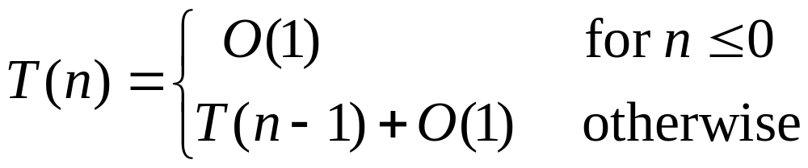
Example 4: Analyze recursion (2/3)
Recursion analysis
  Base case typically takes constant time O(1)
  Recursive case takes similar time with smaller input:
    Suppose for input size = n it takes T(n) time, then for input size = n-1 it takes T(n-1) time
We have this set of recurrence:

Slide 31
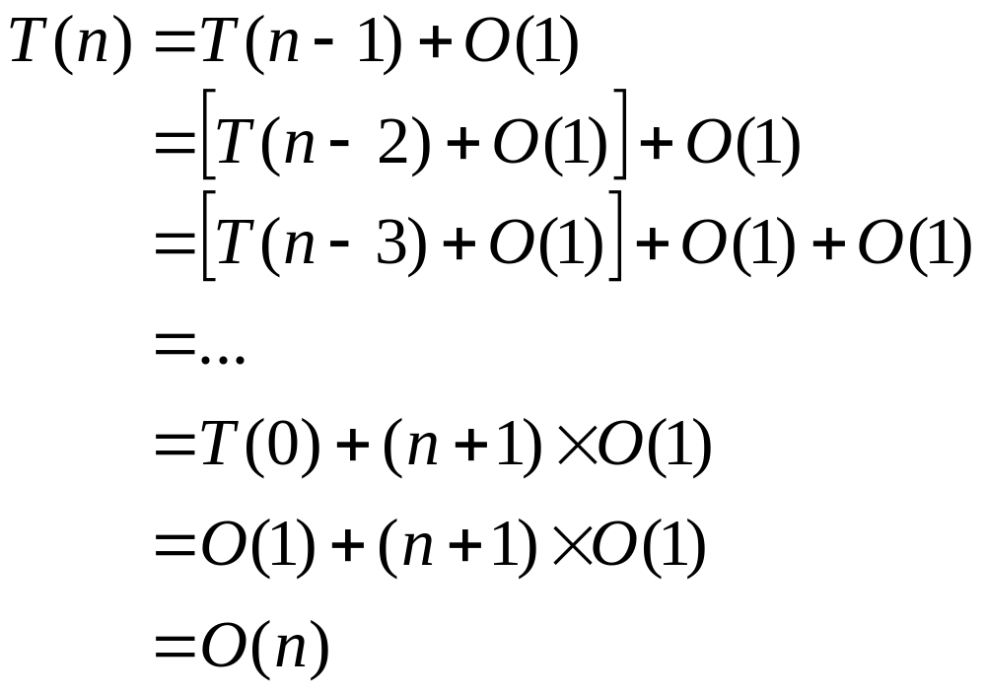
Example 4: Analyze recursion (3/3)
Recursion derivation

Slide 32
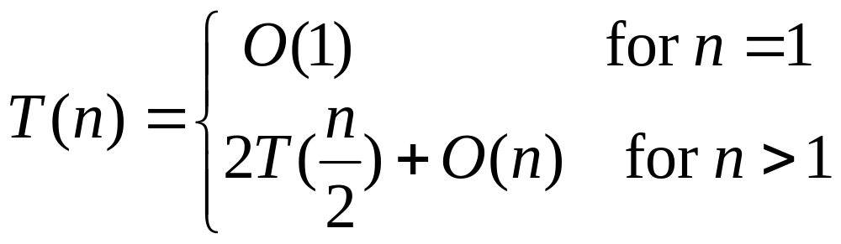
Example 5: Analyze recursion (1/4)
Recursion derivation
The mergesort algorithm (described in later tutorials) is a recursion and has the following recurrence:

Slide 33
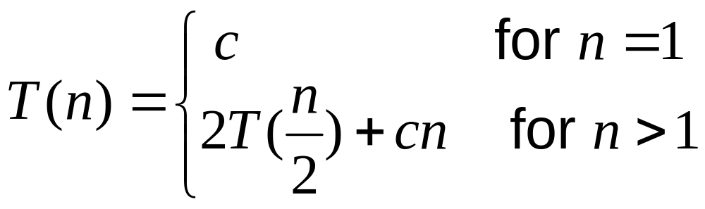
Example 5: Analyze recursion (2/4)
Usually we re-write the recurrence to the following for simplicity in derivation:

Slide 34
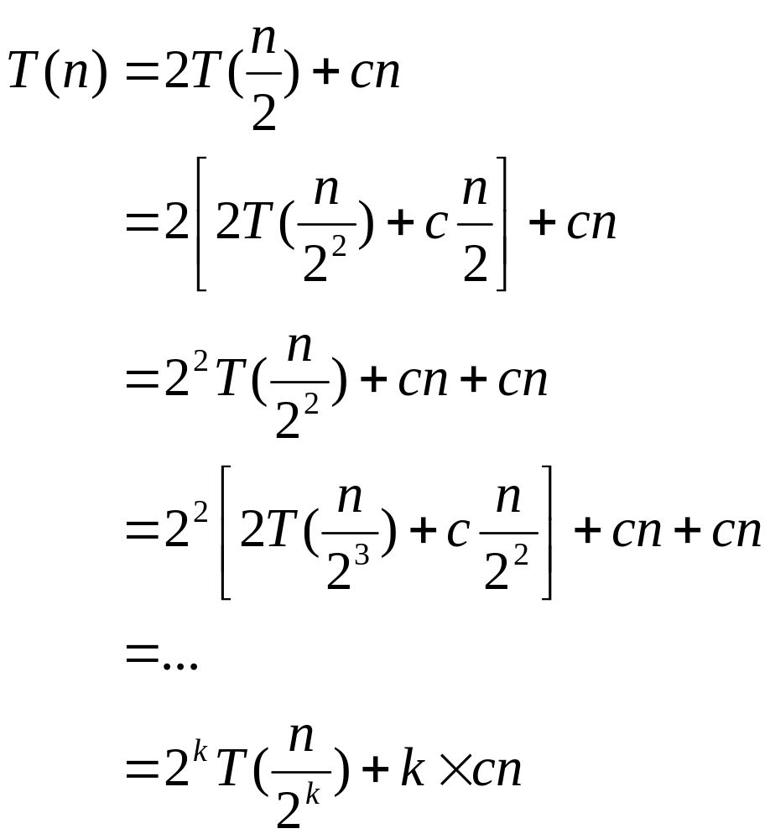
Example 5: Analyze recursion (3/4)
What’s next??

Slide 35
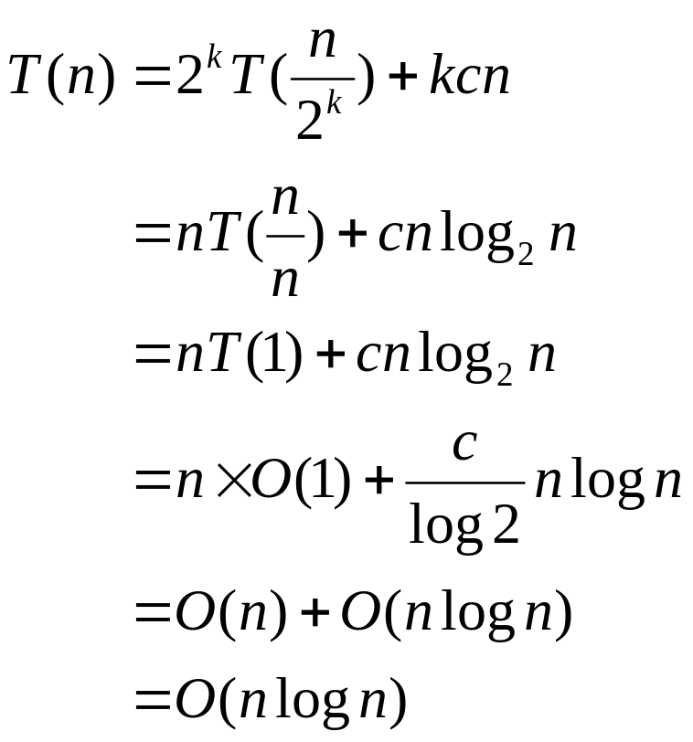
Example 5: Analyze recursion (4/4)
Let n = 2^{k}, then we can continue like this:
log₂n = klog₂2 => k = log₂n

Slide 36
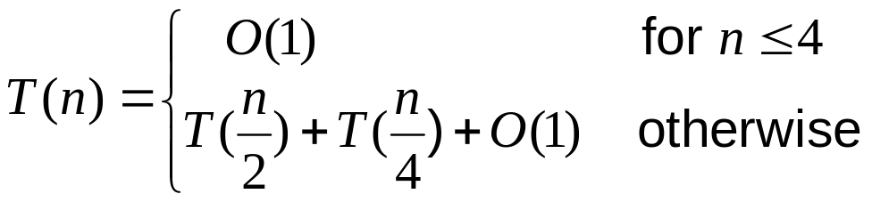
Example 6: Analyze recursion (1/4)
In the lecture…
  int fun(int n) {
  int a,b;
  if(n<=4)
  return 0;
  else {
  a = fun(n/2);
  b = fun(n/4);
  return a+b;
  }
  }
The recurrence is therefore:

Slide 37
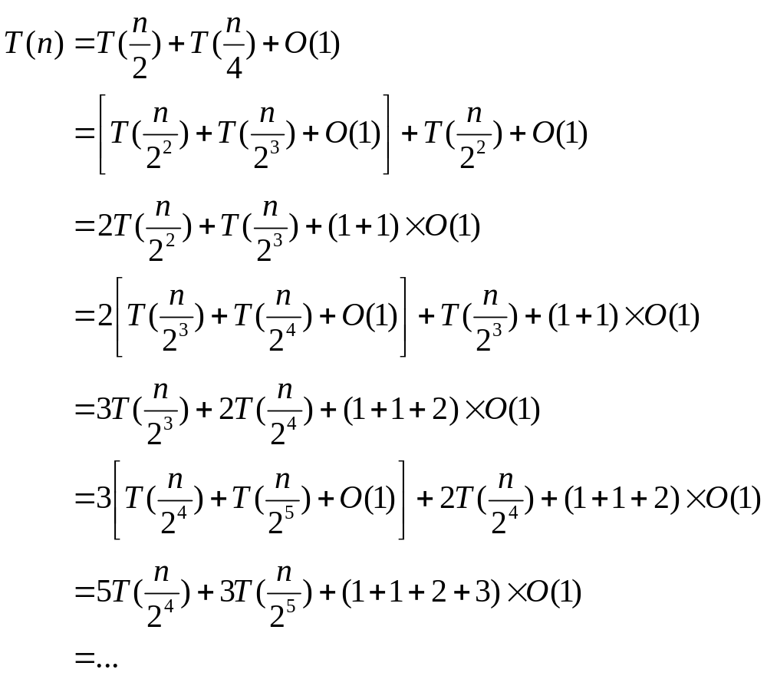
Example 6: Analyze recursion (2/4)
The coefficients of the first 2 terms are in the Fibonacci sequence, and the third term is the sum of such sequence… so…

Slide 38
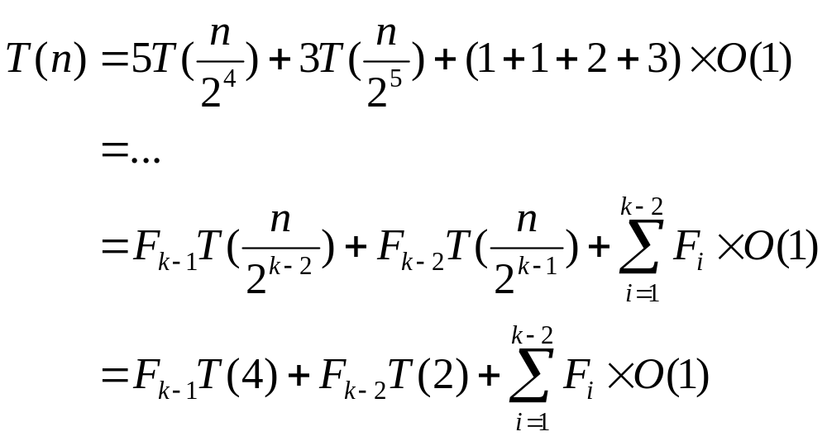
Example 6: Analyze recursion (3/4)
Let n = 2^{k}, and F_{i} be the i-th term of the Fibonacci sequence, we have:
What’s left is how to determine those F_{i}’s…

Slide 39
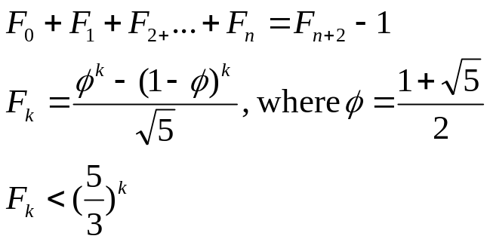
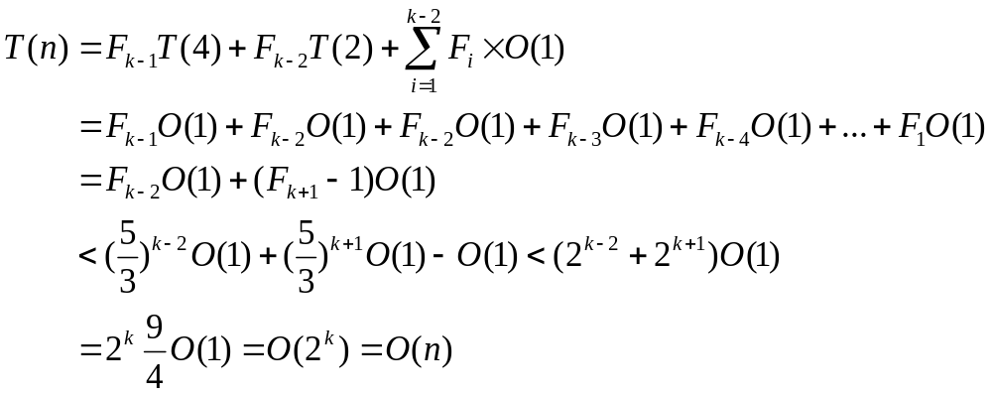
Example 6: Analyze recursion (4/4)
Properties of Fibonacci sequence (proof omitted):
We then have:

Slide 40
Maximum Consecutive Sum
Two algorithms presented:
  Brute forcing every possible consecutive sub-array and get the largest sum. O(n³) complexity
  Divide and Conquer. Solve the left and right half of the array and then solve the middle sub-array and compare them to get the max-sum. O(nlogn) time.
    You can apply the above techniques to analysis the time complexities of these two algorithms
  Refer to lecture notes for more details.
Actually, an O(n) algorithm exists for this problem

Slide 41
Outline
Motivation
Analysis of algorithms
Examples
Practice questions

Slide 42
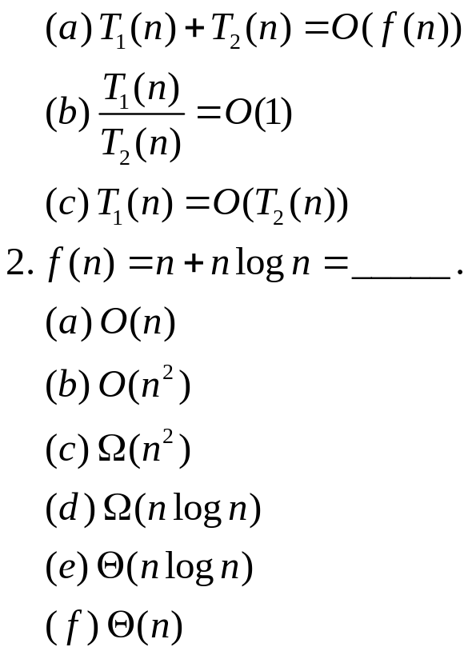
Practice Question 1
1. Suppose T₁(n) = O(f(n)), T₂(n) = O(f(n)). Which of the followings are TRUE:

Slide 43
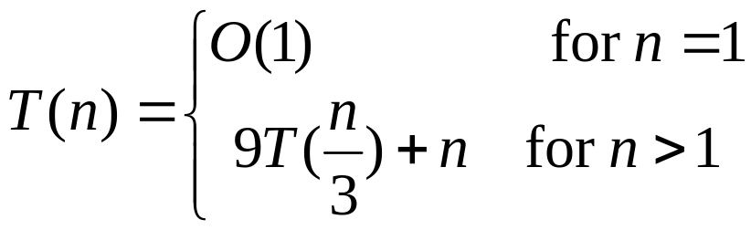
Practice Question 2
Given the recurrence:
Solve the recurrence and give the tightest possible bound for the Big-O complexity analysis of it.

Slide 44
Summary
Motivation
  Components of a program
  Brief introduction in algorithm analysis
  An illustrative example
  Motivation of algorithm analysis
  Limit rule and growth rate of common functions
Analysis of algorithms
  Types of asymptotic notations
  Big-Oh: Asymptotic Upper Bound
  Big-Omega: Asymptotic Lower Bound
  Big-Theta: Asymptotic Tight Bound
Examples
  Assumptions in algorithm analysis
  Analyze loops
  Analyze recursive functions
  Maximum Consecutive Sum
Practice questions
Thank you!

