Slide 1
Let’s Learn Logo
Animator and compiler

Slide 2
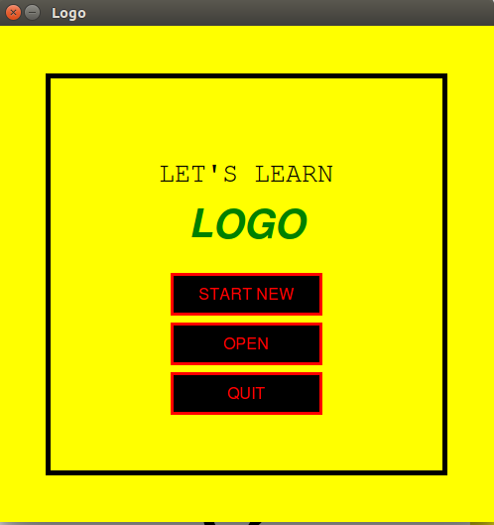
Aim
Make an animator and compiler for LOGO programming language.
First screen

Slide 3
What is LOGO ?
Logo is an educational programming language, designed in 1967 by Wally Feurzeig, Seymour Papert and Cynthia Solomon."Logo" is not an acronym. It was derived from the Greek logos meaning word or "thought" by Feurzeig, to distinguish itself from other programming languages that were primarily numbers, not graphics or logic, oriented.

Slide 4
Commands
fd {number} or forward {number} : to move {number} of steps forward
bk {number} or backward {number} : to move {number} of steps backward
rt {number} or right {number} : to turn the pointer by {number} degrees towards right
lt {number} or left {number} : to turn the pointer by {number} degrees towards left
repeat {number} [ {set of commands} ] : loop the {set of commands} {number} of times
to {-function name} {set of commands} end : create a function with function name {-function name} which can be called to execute the {set of commands}
{command1} + {command2} : to make a set of commands where {command2} is executed after {command1}
clear : clear and reset the window
penup or pu : to stop making line and just move pointer
pendown or pd : to start making the lines (default)

Slide 5
Grammar
statement -> expr
expr -> command | command + expr
command -> optionm number | repeat number [ expr ] | optionp
optionm -> right | rt | left | lt | forward | fd | backward | bk
optionp -> penup | pu | pendown | pd | clr | clear | func
func -> to func_name expr end | func_name
Added extra
Must start with ‘-’

Slide 6
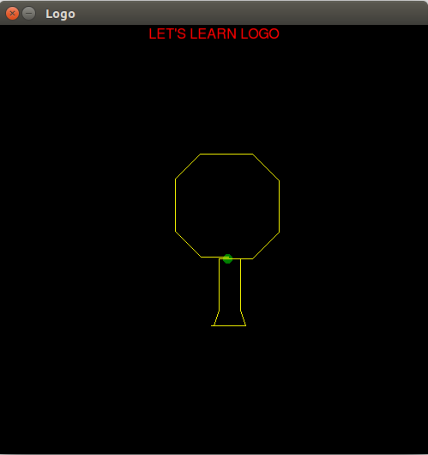
Example explained
to -ls rt 20 + fd 20 + lt 20 + fd 60 end
to -ts rt 90 + fd 25 + rt 90 end
to -rs fd 60 + lt 20 + fd 20 + rt 20 end
to -res rt 90 + fd 40 + rt 90 end
to -tr -ls + -ts + -rs + -res end
to -cp pu + fd 80 + rt 90 + fd 20 + lt 90 + pd end
to -cc repeat 360 [fd 2 + rt 1] end
to -te pu + bk 100 + pd + -tr + -cp + left 90 + -cc end
-te
Output

Slide 7
Thank you
Members :
Chaitanya Nagpal
IS201401011
Ayushi Anand
IS201401006

