Slide 1

Happy-Sad Image Recognition Model
Name | Roll No | Email
Amit Bhramanna | 324008 | amit.22110628@viit.ac.in
Gayatri Bhutada | 324009 | gayatri.22111190@viit.ac.in
Sanskar Dudhyal | 3240019 | sanskar.22110201@viit.ac.in
Vaibhav Gutte | 324020 | vaibhav.22110479@viit.ac.in
Bhairavnath Hake | 324022 | bhairavnath.22110927@viit.ac.in

Slide 2

Project Overview
Objective:
Build a deep learning model to classify images as either depicting happy or sad emotions.
Technologies Used:
TensorFlow/Keras for deep learning
OpenCV for image processing
Python programming language

Slide 3
Data Collection and Preprocessing
Data Source:
Collected images from various sources for training the model.
Data Preprocessing Steps:
- Removed non-image files and corrupted images
- Normalized image pixel values to [0,1] range
- Split dataset into training, validation, and test sets

Slide 4
Model Architecture
Deep Learning Model Architecture:
1. Convolutional Layers: Extract features from input images
2. MaxPooling Layers: Reduce spatial dimensions to capture important features
3. Fully Connected Layers: Perform classification based on extracted features
Input Shape: (256, 256, 3)
Output Layer: Sigmoid activation for binary classification (happy or sad)

Slide 5
Training and Evaluation
Training Process:
- Optimizer: Adam
- Loss Function: Binary Crossentropy
- Trained for 20 epochs
Model Evaluation Metrics:
- Accuracy
- Precision
- Recall

Slide 6
Code - Data Loading and Preprocessing
Python Code Snippets:
import tensorflow as tf
from tensorflow.keras.preprocessing.image import ImageDataGenerator
Load and preprocess data using ImageDataGenerator

Slide 7
Code - Model Building
Python Code Snippets:
'Build the deep learning model architecture using TensorFlow/Keras'

Slide 8
Code - Training and Evaluation
Python Code Snippets:
'Compile and train the model'
'Evaluate model performance using test dataset'

Slide 9
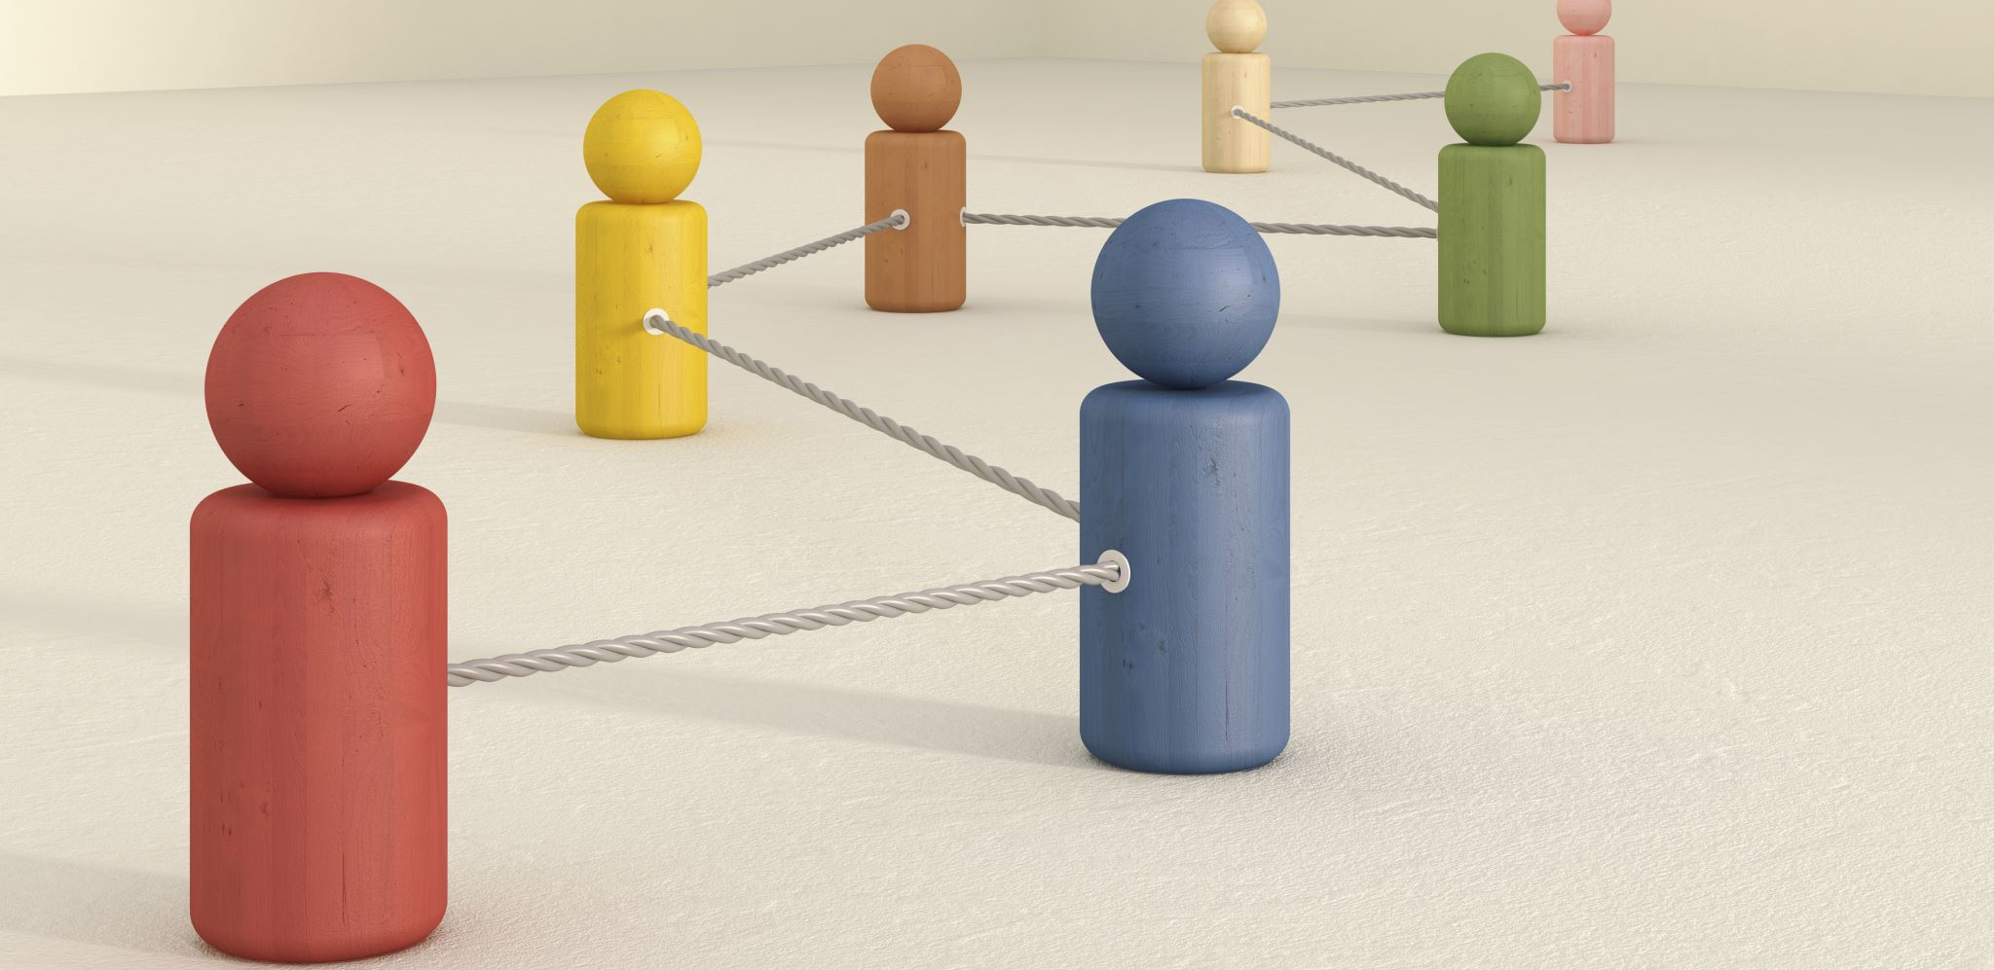
Conclusion and Future Work
Conclusion:
- Successfully developed a deep learning model for happy-sad image classification.
Future Work:
- Improve model accuracy with more data and advanced techniques.
- Deploy the model in real-world applications.

Slide 10

Thank You!

