Slide 1
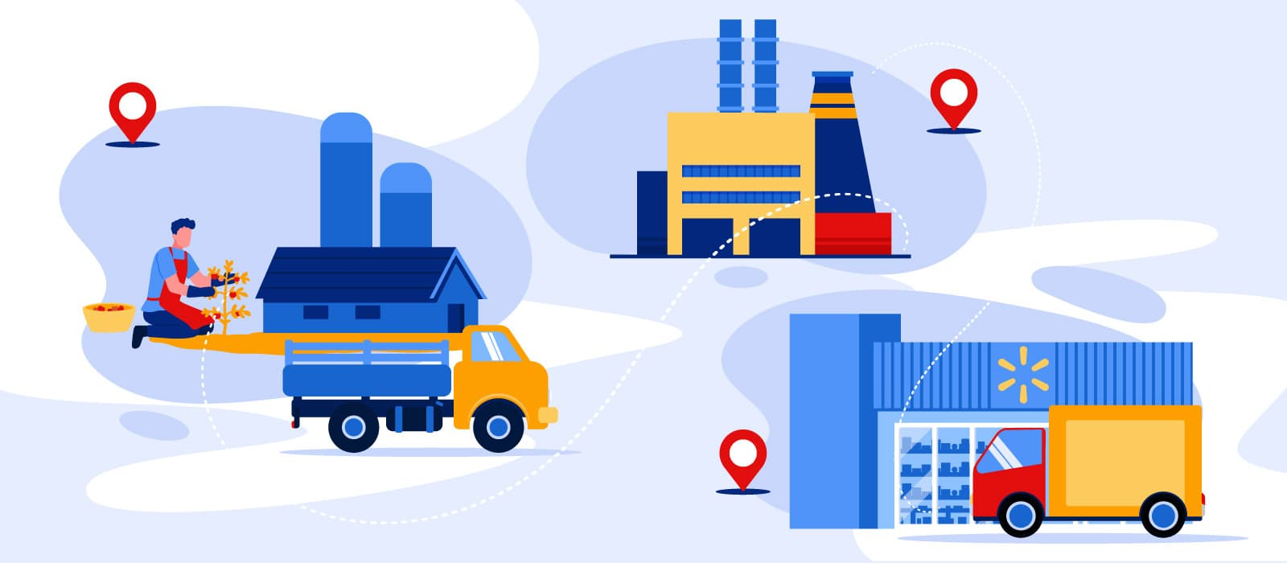
Blockchain technology for food supply chains
By Olwin Dsouza

Slide 2
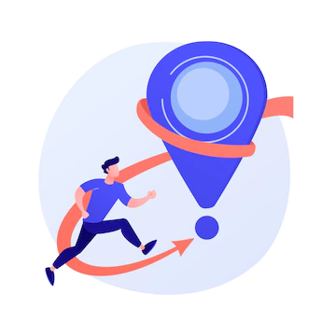
Roadmap of the session
How blockchain works?
How it is used in food supply industry?
How it is implemented?
Where the blockchain technology for food supply chain is used?
Demo of simple smart contract creation using Rimix.
Pg.1

Slide 3
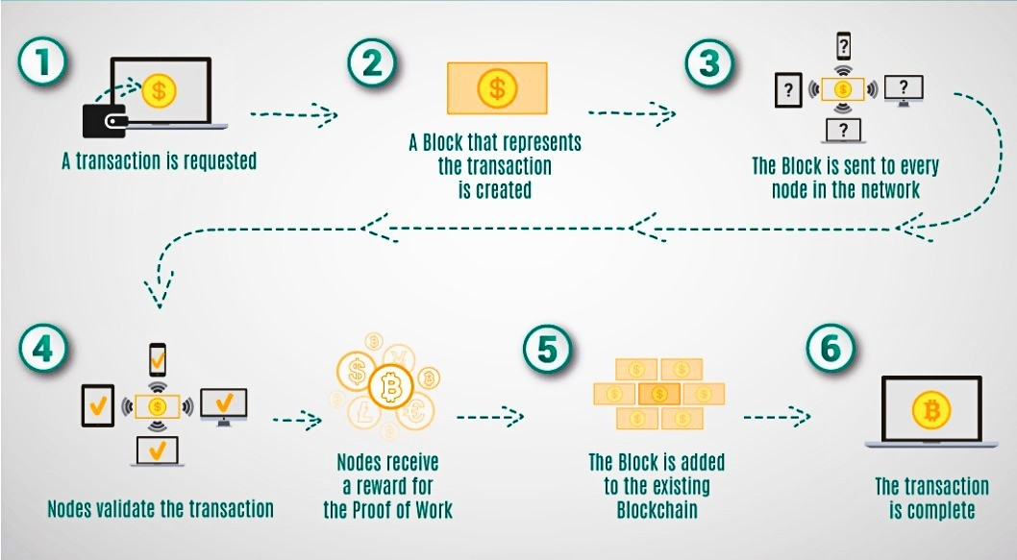
Working mechanism of blockchain
Pg.2

Slide 4
Domains which are using blockchain
Blockchain for payment processing and money
Blockchain for monitoring of supply chains
Blockchain for digital IDs
Blockchain for data sharing
Blockchain for copyright and royalties protection.
Blockchain for Internet of Things network management.
Blockchain for healthcare.
Pg.3

Slide 5
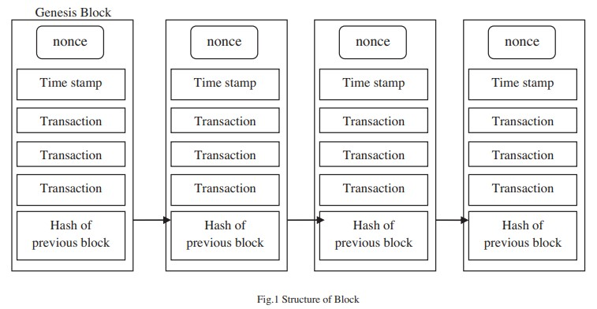
Implementation for food supply chains
Pg.4

Slide 6
The first block in blockchain is called as genesis block depicts the overall view of blocks in blockchain.
Digital Transactions in a blockchain are grouped together into blocks.
The block header contains nonce, hash of previous block and merkle root of the transaction.
Pg.5

Slide 7
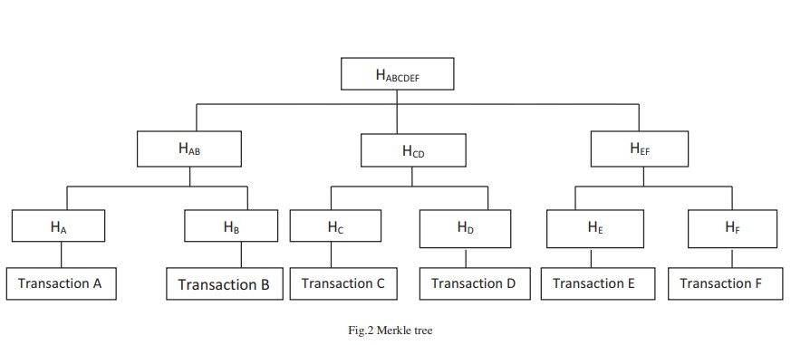
Merkle tree
Pg.6

Slide 8
merkle tree, which is the list of transaction stored in tree type of data structure.
leaf node HA is the hash of transaction A, HB is the hash of transaction B. The non leaf node HAB is the hash of transaction A and B. Similarly, all the hash values are combined together to form a root node HABCDEF.
If there is any change in any of the transaction will result in false hash value of root node.
Food supply chain management using merkle tree: The farmers, wholesalers, processors can feed their data in blockchain.
Pg.7

Slide 9
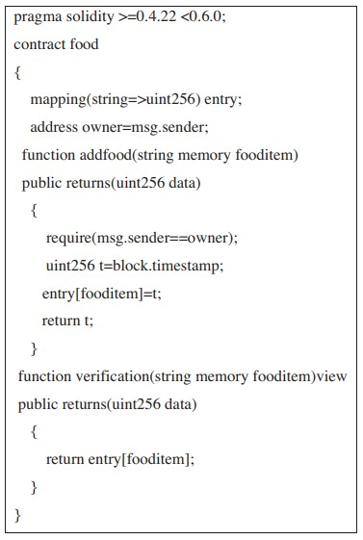
Smart contract
Pg.8

Slide 10
The ethereum is an open source platform used to execute smart contract for food supply chains. It stores the food data at different stages of food processing and can be verifiable by all the stakeholders in food supply chain. The below code is written in solidity language for adding the food items in the contract. There are two functions addfood and verification in the contract. The function addfood is used to map the food item with the timestamp. The function verification is used to return the timestamp for a food item. Similarly all the related food product details can be added in the contract. The stakeholders can verify the timestamp, origin, processing, sellers details etc using this contract. If anyone tries to change the values can also be easily monitored.
Pg.9

Slide 11
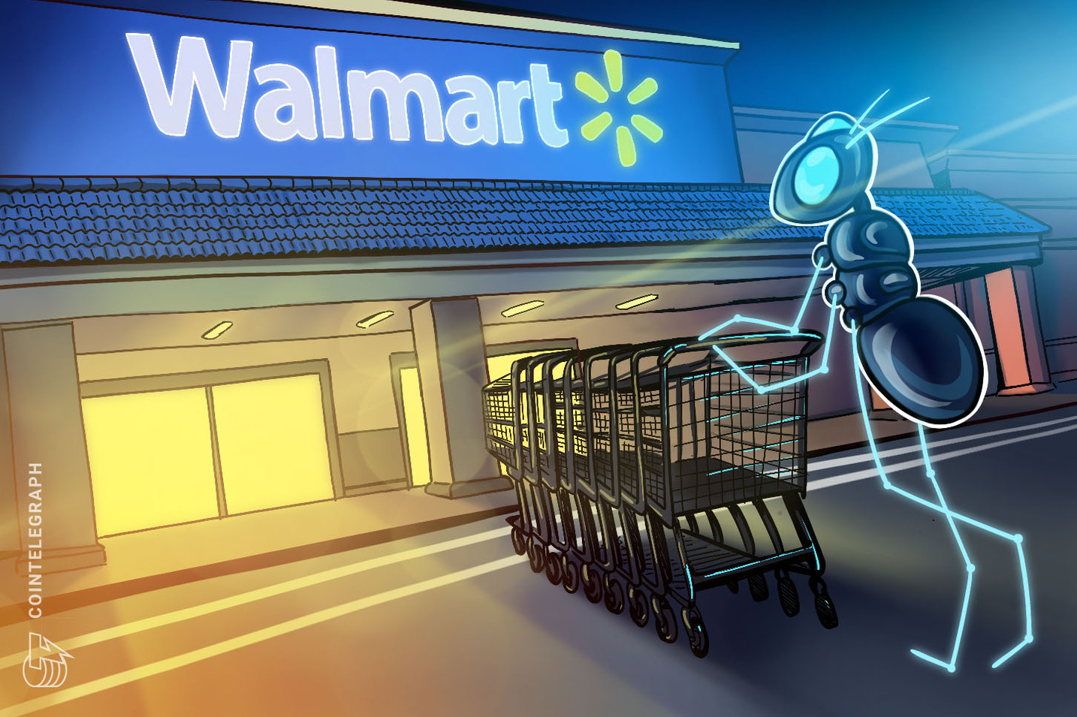
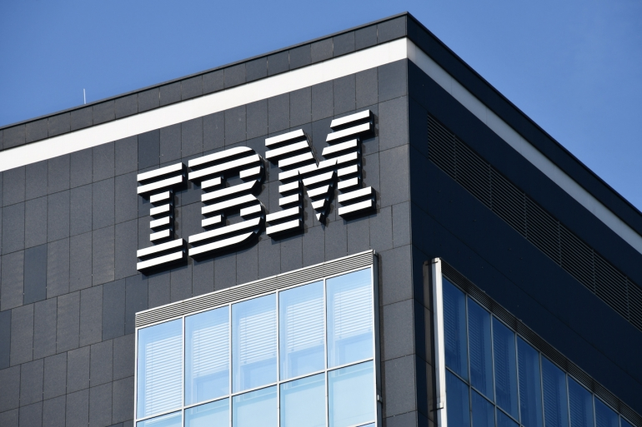
walmart
Pg.10

Slide 12
walmart
The largest retail company in the world, Walmart, has sent letters to its suppliers of farmed goods urging them to track their produce using blockchain technology.
The company announced its partnership with the US-based technology firm, IBM, to build the tracking system.
The IBM Food Trust will work to manage traceability in the food supply chain in two phases, allowing Walmart to tack food efficiently in a large system.
Pg.11

Slide 13
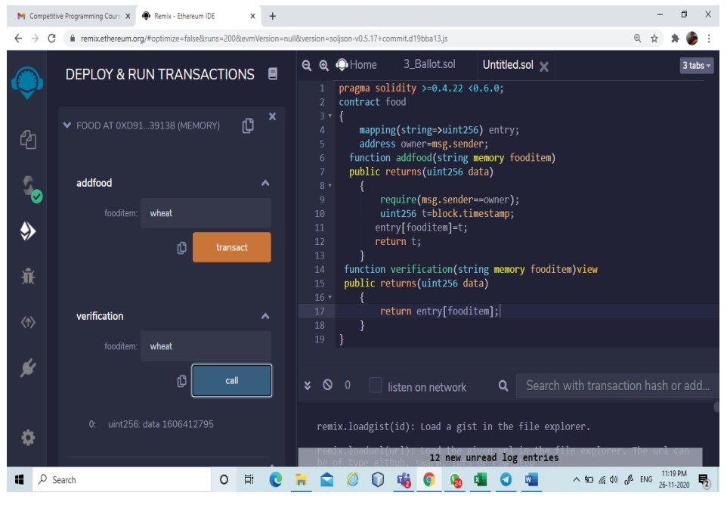
Screenshot of Rimix Environment
Pg.12

Slide 14
smart contract creation using Rimix.
Pg.13

Slide 15
Thank you

