Slide 1
Math In Programming
By Nguyen Duong, Miguel Garnica

Slide 2
Introduction
There are a lot of Math in programming.
Math is used in programming for almost everything, from 1 + 1 = 10, to Artificial intelligence! From drawing an image on screen to making two objects collide together with physical properties. Programming is math. Everything on your screen is a number.
(You’re in the matrix, WAKE UP!!)

Slide 3
Tween and Easing
“Tweening is simply a way to animate specific object, and define how it should move and change during the tweening process.
At its most basic level, an easing function takes the amount of time that has elapsed for an animation, and returns a new position for the animation based on a function of the time.” - Robert Penner
…
k , wut ? pls spek englis
Notes:
And one of the thing I will talk about are tweening and easing. WTF is tweening and easing. Here is the definition:
Blablablabla

Slide 4
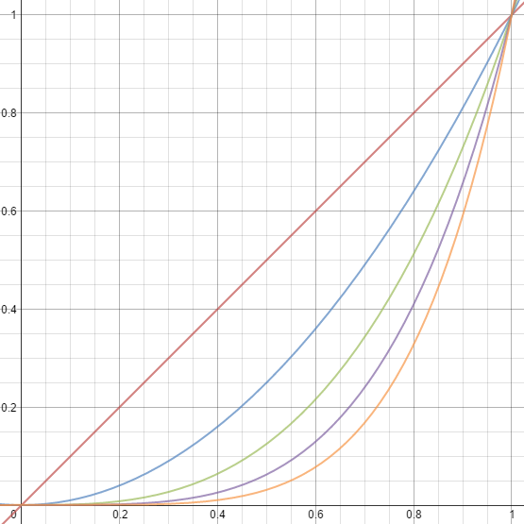
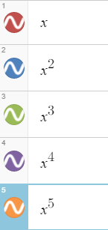
Graphs
Position (y)
Time (x)
Notes:
Dont have to be position, it can be any value

Slide 5
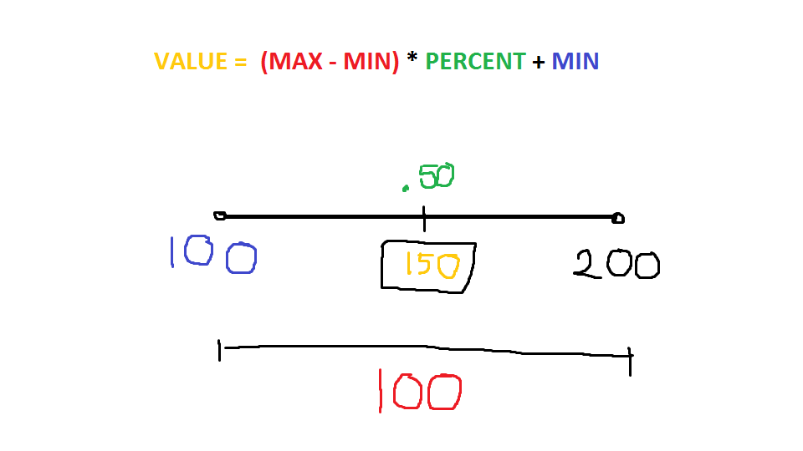
How does it work?
function EasingLinear (t, b, c, d) {
return c * (t / d) + b;
}
@t is the current time of the tween.
@b is the beginning value of the property.
@c is the change between the beginning and destination value
@d is the total time of the tween.

Slide 6
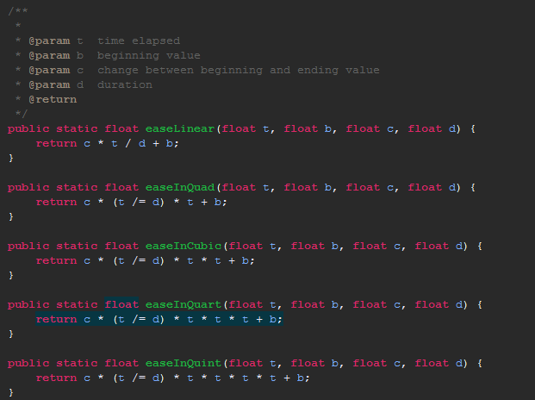
Variations of ease function

Slide 7
Easing
Linear vs Quadratic
Linear
Quadratic

Slide 8
Easing with different functions

Slide 9
Not just moving! But partying!

Slide 10
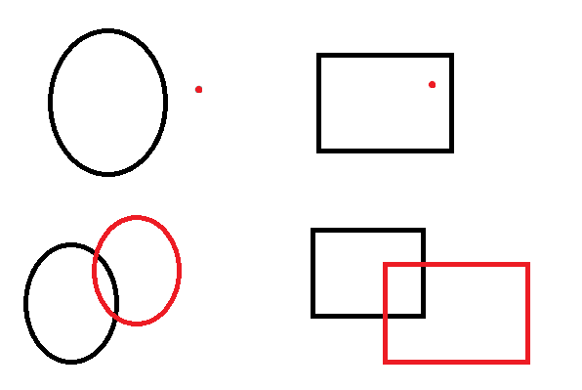
Collision Detection
Circle Point
Rectangle Point
Circle Circle
Rectangle Rectangle

Slide 11
Circles
Circle Point
Circle Circle

Slide 12
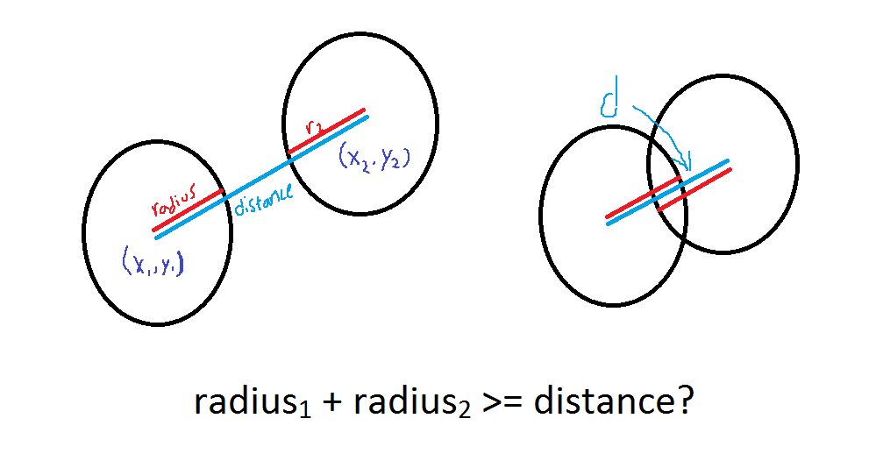
Circle Diagram

Slide 13

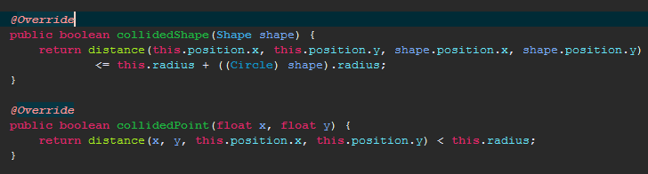
Circle Code

Slide 14
Rectangles
Rectangle Point
Rectangle Rectangle

Slide 15
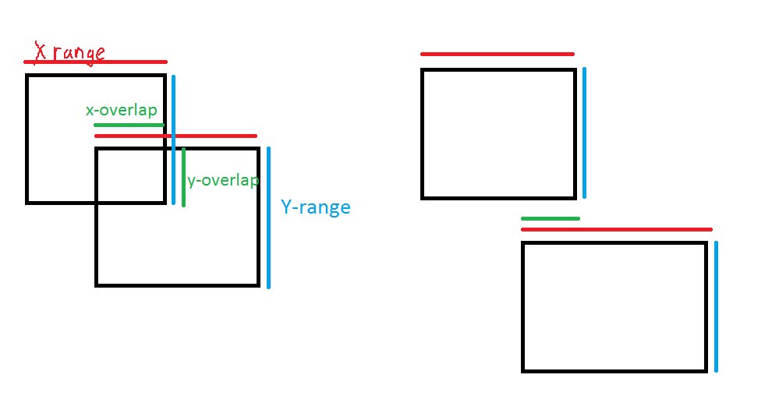
Rectangle Diagram

Slide 16
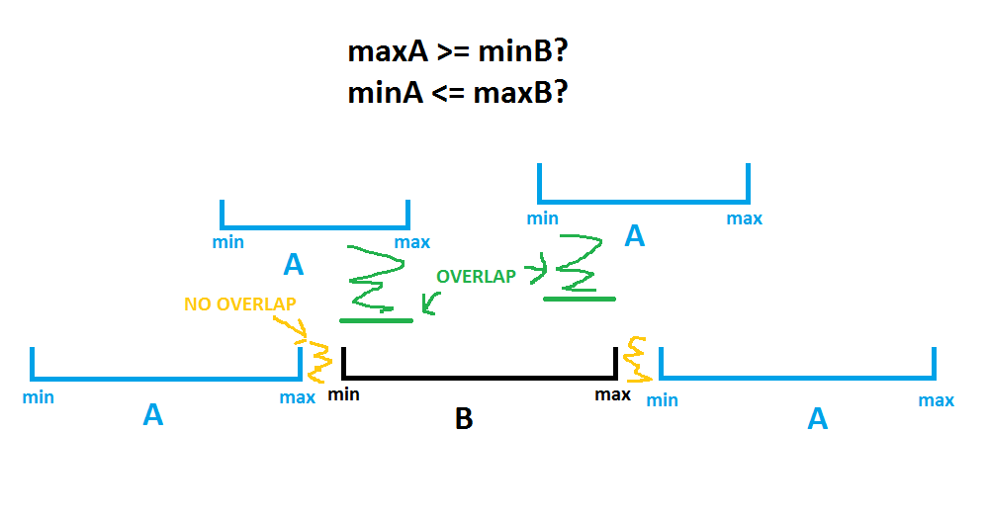
Rectangle Diagram cont.
Range Intersect.

Slide 17
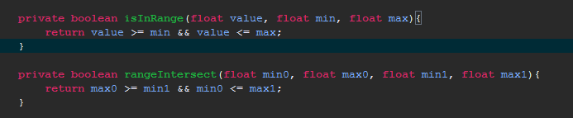
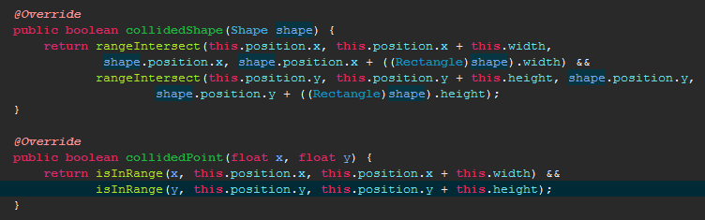
Rectangle Code
Notes:
If you’re not confused yet, check out this next thing.

Slide 18
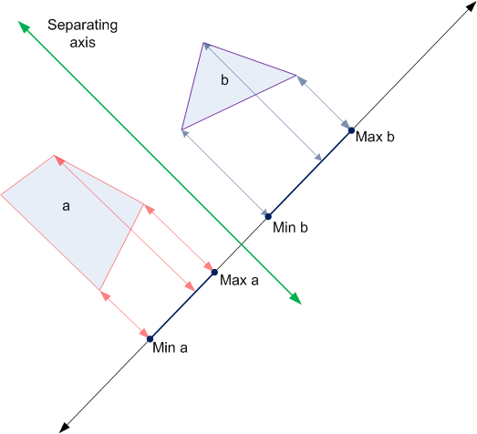
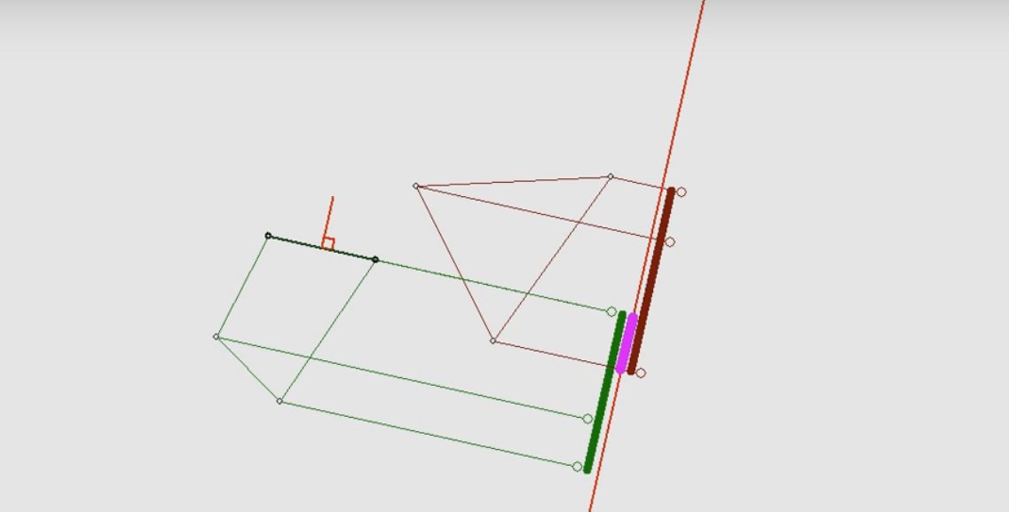
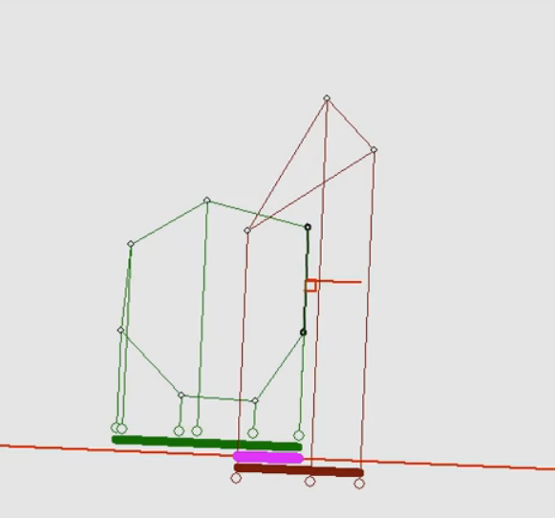
SAT (separating axis theorem)
Contact miguelgarnica@gmail.com for more info

Slide 19
Conclusion
Programming is hard.
Math is hard.
Try programming
And join our club
We meet wednesday and some thursday
Notes:
If you think that these stuff are interesting, then you should join our club

