Slide 1

Project Overview
Use national dietary data to identify factors in recovery rates, death rates, and confirmed case rates of Covid19.
Dataset is divided up into sources of protein, kg, kcal, and fat, and how each country acquires these per food type.
Ultimate goal is to be able to form public health recommendations for countries unable to acquire vaccines.

Slide 2
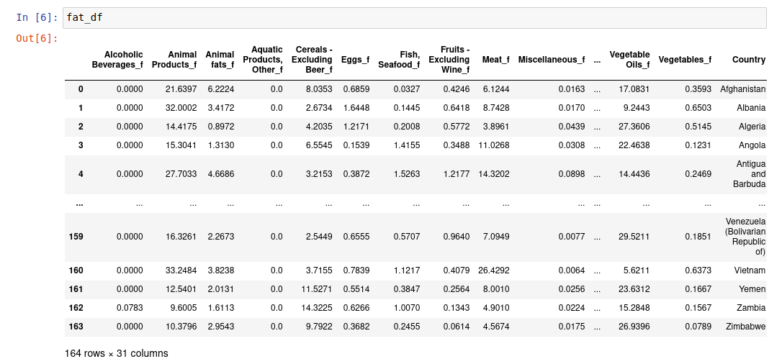
Example Dataframe

Slide 3
Check-in 2: LASSO
Using R2 to score overall fit
Using RMSE and MSE to determine if the model is overfitting
Compare with other feature importance methods that we’ve performed.

Slide 4
Check-in 2: XGBoost
Using VIF to identify multicollinearity
Using R2 to determine how good the model fit is
Using RMSE and MSE to determine if the model is overfitting
Compare with other feature importance methods that we’ve performed.

Slide 5
Questions
What metrics can we use to properly evaluate XGBoost model since the model can be represented as linear or tree? (ex. RMSE, R2, information gain, etc)
Details about deliverable for Project Check In 2? "Enhanced Performance" meaning?
Final Paper format: Methods paper?
Direction for the final part of project: We were thinking of implementing a recommendation system and wondering if our problem could be formulated as such?
Expectations for what was missed in Project Check-In 1?

