Slide 1
An Investigation into Incel Posting Habits on Reddit
William Frazee
Stage 1: Gathering
& Processing Data
ESI5937
Fall 2021

Slide 2
Research Problem & Goal
What are you goals for your research project? You can speak to what you might learn or how your project might benefit society.

Slide 3
Research Problem & Goal
Problem:
Incels are men who believe that they are unable to ever attract a female in a romantic manner. Their online communities tend to encourage misanthropic behaviors, which sometimes manifest violently in the real world. It would be beneficial for society if we could detect these users online and intervene before their radicalization is complete.
Goal:
To build a classifier that can detect if a Reddit user is likely to be an apart of the reddit incel community based on their comment activity.

Slide 4
Research Question
Can a framework of Natural Language Processing and Machine Learning explain the relationship between a Reddit user’s comment history, and them being an active user of r/Incels?

Slide 5
Variables and Metrics
Independent variables: A user’s comment history as a document composed of individual comments.
Dependent variable: Binary classification label of being an active user of r/Incels.

Slide 6
Identify and Gather Data
The data I need.
1. The text of comments of reddit users who are active users of r/Incels.
2. The text of comments of reddit users who are NOT active users of r/Incels.
My source data: Comment data from 60 popular subreddits and r/Incels over the 6 months of 2017 before r/Incels was banned.
https://sguru.org/best-subreddits-of-all-the-time/
1. Query for Reddit user comment histories over the r/Incels subreddit to determine who is an active incel user.
2. Query for comments those active incel users made in the list of 60 subreddits.
3. Query for comments non-incel users made in those same subreddits. Ensure that these users have a similar number of comments in these subreddits to incel users.

Slide 7
Process and Prepare Data
Step 1: Remove [deleted], [removed], and moderator posts.
Step 2: Turn every user’s comment history into an individual corpus. Concat comments, and append [START] and [END] to the start and end of every comment.
Step 3: Vectorize the textual data using TD-IDF, to prepare for feature creation/extraction.
Step 4: Do a 5-fold gridsearch for best hyperparameters.
Step 5: Save the result of the model.

Slide 8
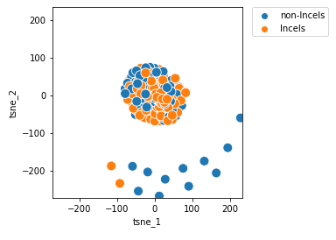
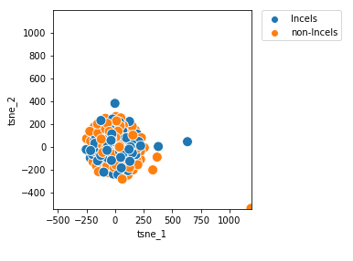
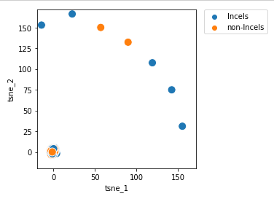
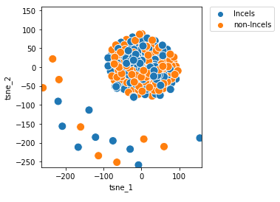
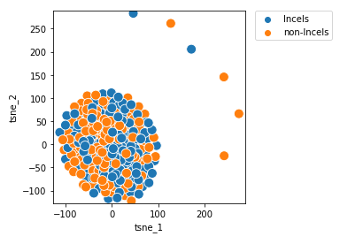
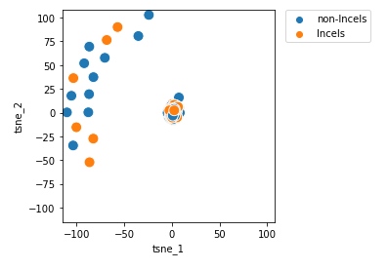
Dataset Properties: T-SNE Graph
2017-05
2017-06
2017-07
2017-08
2017-09
2017-10

Slide 9




Model Scores
2017-05
2017-06
2017-07
2017-08
2017-09
2017-10

Slide 10
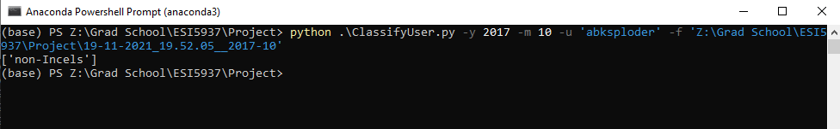
Predictive Script

Slide 11
Post Mortem
Compare my model with and without my domain knowledge subreddits that I’ve selected
More Months of Data. Maybe train on a year’s worth of data?

Slide 12
Github

Slide 13
Next Steps
Turn each user’s comment sample comment history into a single lined corpus, with tokens that indicate when the comments begin and end
Do not do text processing, raw text may contain complexities
Filter out moderator messages, deleted messages, and removed messages
Divide my data into 60% Training, 20% Validation, and 20% Test training sets.
Use TD-IDF to vectorize corpuses
Create a classifier

Slide 14
Next Steps Part 2
Ensure that we are comparing incel users and non incel users who have similar amounts of comments
Gather more months of data
Plot T-SNE / feature maps to see if there are features that overlap, if they do I might need to plot in higher dimensions with like a kernel classifier.
Compare my model with and without my domain knowledge subreddits that I’ve selected
Get some more interesting statistics to show off, like: highest number of comments by an incel user. Or, most popular words used by incels/non incels.

