Slide 1
An Investigation into Incel Posting Habits on Reddit
William Frazee
ESI5937 – Modeling Fanaticism
Fall 2021

Slide 2
Research Problem & Goal
Problem:
Incels are men who believe that they are unable (for reasons beyond their control) to attract a woman for a relationship. Their online communities tend to encourage misanthropic behaviors, which sometimes manifest violently in the offline world. It would be beneficial for society if we could detect these users online and intervene before their radicalization is complete.
Goal:
To build a classifier that can detect if a Reddit user is an active participant of the reddit incel community based on their comment history.

Slide 3
Research Question
Can a framework of Natural Language Processing and Machine Learning explain the relationship between a Reddit user’s comment history, and them being an active user of r/Incels?
More broadly, how well can we classify Reddit users as active participants of subreddits based on comment history?

Slide 4
Variables
Independent variable: A user’s comment history as a document composed of individual comments.
Dependent variable: Binary classification label of being an active user of r/Incels or not.

Slide 5
Identify and Gather Data
The data I needed:
1. The text of comments of reddit users who are active users of r/Incels.
2. The text of comments of reddit users who are NOT active users of r/Incels and have a comment history size equal to active r/Incel users.
My source data: Comment data from 50 popular subreddits and r/Incels over the 6 months of 2017 before r/Incels was banned. Plus comment data from 10 hand picked subreddits.
https://sguru.org/best-subreddits-of-all-the-time/
1. Query for Reddit user comment histories over the r/Incels subreddit to determine who is an active incel user.
2. Query for comments those active incel users made in the list of 60 subreddits.
3. Query for comments non-incel users made in those same subreddits. Ensure that these users have a similar number of comments in these subreddits to incel users.

Slide 6
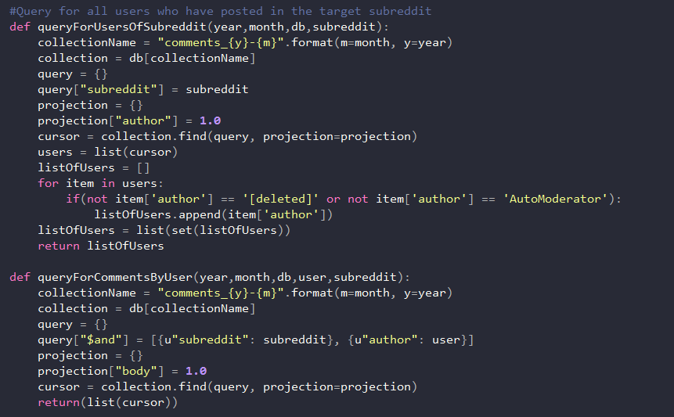
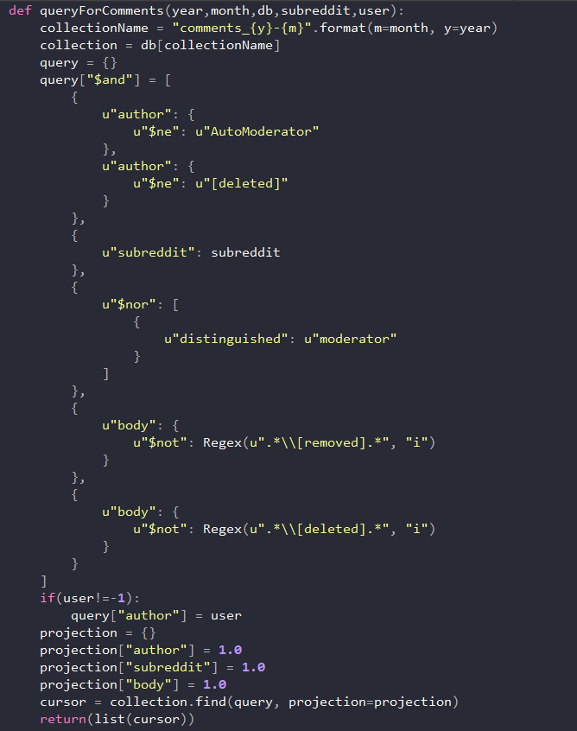
Data Queries

Slide 7
Process and Data Prep
Step 1: Remove [deleted], [removed], and moderator posts.
Step 2: Turn every user’s comment history into an individual corpus. Concat comments, and append [START] and [END] to the start and end of every comment.
Step 3: Vectorize the textual data using TD-IDF, to prepare for feature creation/extraction.
Step 4: Train a svm classifier.
Step 5: Do a 5-fold gridsearch for best hyperparameters.
Step 6: Save the result of the model.

Slide 8
Dataset Properties: Number of Users
2017-05 |  | 2017-06 |  | 2017-07
Incel Users | Non Incel Users | Incel Users | Non Incel Users | Incel Users | Non Incel Users
224 | 224 | 194 | 194 | 197 | 198
2017-08 |  | 2017-09 |  | 2017-10
Incel Users | Non Incel Users | Incel Users | Non Incel Users | Incel Users | Non Incel Users
268 | 267 | 224 | 223 | 434 | 434

Slide 9
Dataset Properties: Number of Comments
2017-05 |  | 2017-06 |  | 2017-07
Incel Users | Non Incel Users | Incel Users | Non Incel Users | Incel Users | Non Incel Users
10661 | 8735 | 8137 | 5432 | 5967 | 5967
2017-08 |  | 2017-09 |  | 2017-10
Incel Users | Non Incel Users | Incel Users | Non Incel Users | Incel Users | Non Incel Users
11131 | 8461 | 8678 | 6059 | 17592 | 15369

Slide 10
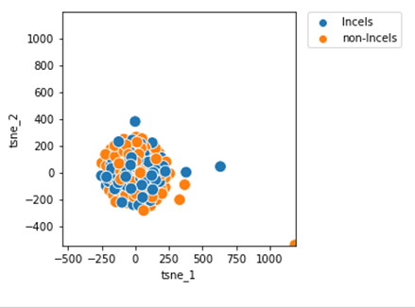
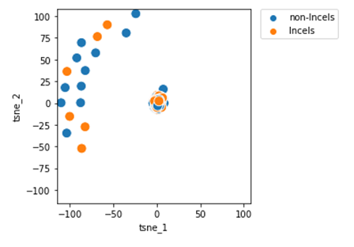
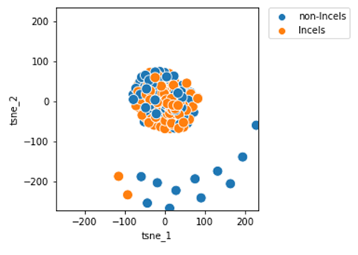
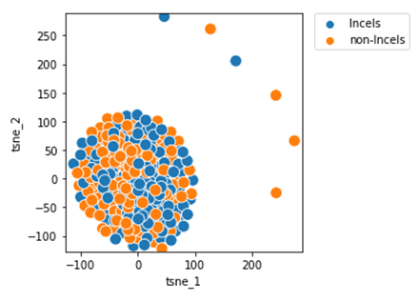
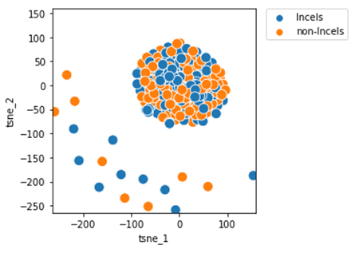
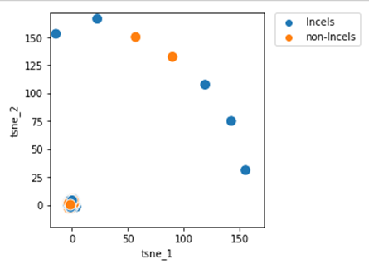
Dataset Properties: T-SNE Graph
2017-05 | 2017-06 | 2017-07
2017-08 | 2017-09 | 2017-10

Slide 11
Dataset Properties: High TD-IDF Scores
2017-05 | 2017-06 | 2017-07
2017-08 | 2017-09 | 2017-10

Slide 12
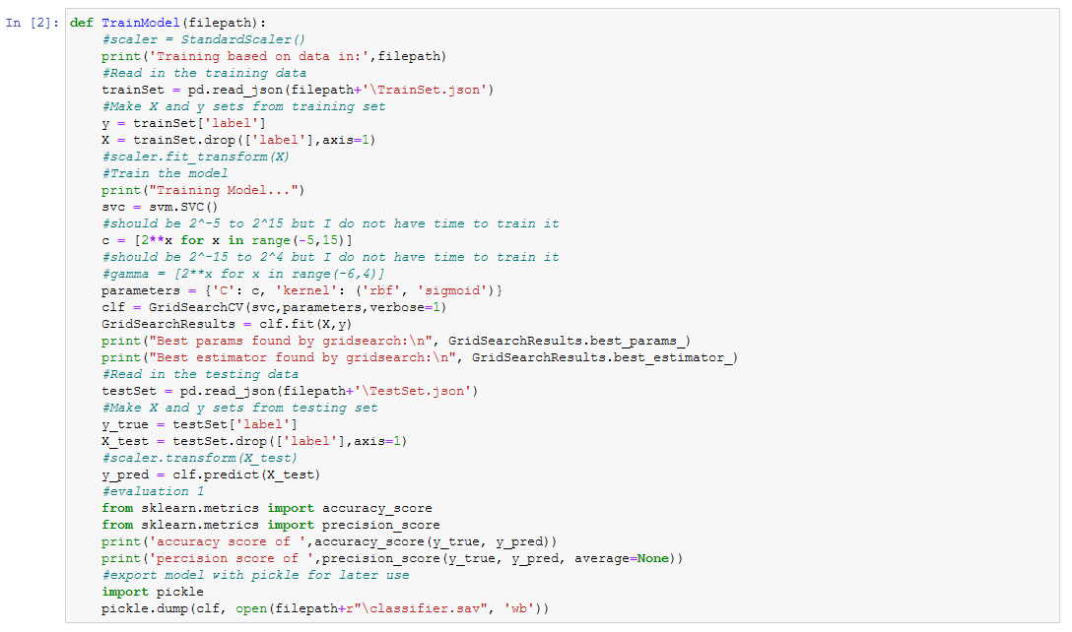
Model Training/Tuning/Testing

Slide 13
Model Scores
Month of Data | Accuracy Score | Precision Score [Incel, non-Incel]
2017-05 | 0.66 | [0.69, 0.64]
2017-06 | 0.60 | [0.71, 0.56]
2017-07 | 0.66 | [0.71, 0.62]
2017-08 | 0.73 | [0.78, 0.68]
2017-09 | 0.60 | [0.53, 0.65]
2017-10 | 0.66 | [0.72, 0.61]

Slide 14
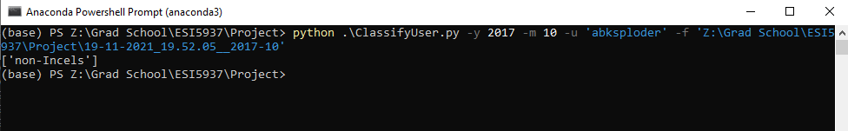
Application: Predictive Script

Slide 15
Post Mortem
Vary the subreddits that comments were pulled from.
More Months of Data. Modify my script to train on a variable amount of data.
Additional Research Question: How well does this pipeline perform on other subreddits, not just r/Incels?

Slide 16
Github
https://github.com/Spyrix/RedditUserClassification

