Slide 1
CS 240
Programming Assignment
Phase 1
Winter Semester 2025-2026
Presenter: Myron Tsatsarakis – myrontsa@csd.uoc.gr
7 October 2025

Slide 2
Concept
Main Idea: Library Management System
Supports
  Loaning, returning, reviewing books by members
  Showcasing popular book titles at the building window
Library: contains Genres list and Members list
Sorted Genres list
  Each Genre contains a sorted doubly-linked Books list
Sorted Members list
  Each Member contains an unsorted, sentinel-based, Loans list

Slide 3
Design &
Data Structures

Slide 4
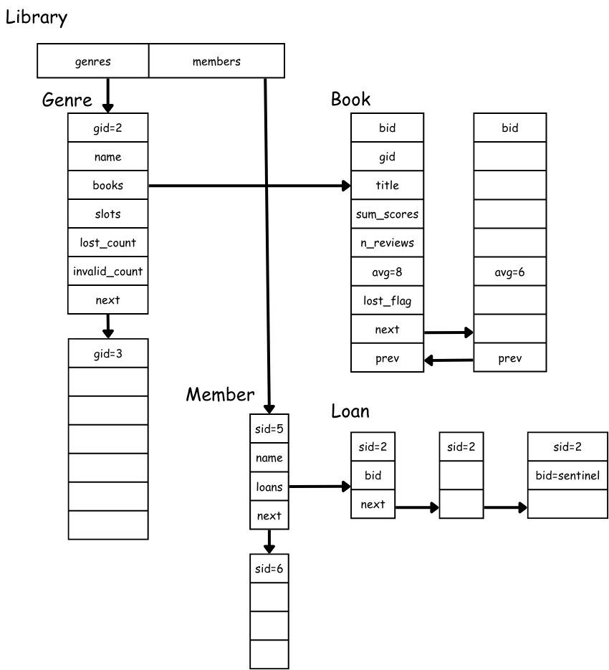

Slide 5
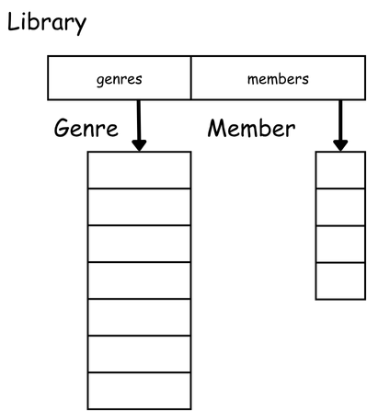
Library
Type Library
  struct of 2 pointers to lists
  genres pointer to Genre List
  members pointer to Member List
  Both lists
    Singly-Linked
    Sorted by id (gid or sid)
1 global Library instance

Slide 6
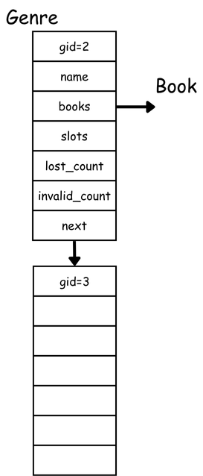
Genre List
Genre List
  Singly-Linked
  Sorted by gid
Type Genre
  gid unique id
  name string (chars array)
  books pointer to Book List
  slots count of display slots
  lost_count count of lost books
  invalid_count count of invalid reviews
  next pointer to Genre

Slide 7
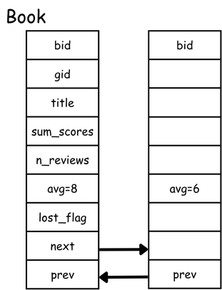
Book List
Book List
  Doubly-Linked
  Sorted descending by avg
Type Book
  bid unique id
  gid genre id
  title string (chars array)
  sum_scores sum of received user scores
  n_reviews sum of received user reviews
  avg floor(sum_scores / sum_reviews)
  lost_flag boolean. true if book is reported as lost
  next pointer to Book
  prev pointer to Book

Slide 8
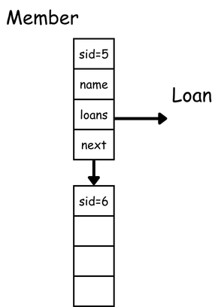
Member List
Member List
  Singly-Linked
  Sorted by sid
Type Member
  sid unique id
  name string (chars array)
  next pointer to Member

Slide 9
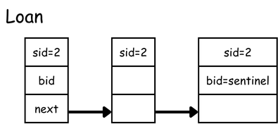
Loan List
Loan List
  Singly-Linked
  Sentinel
Type Loan
  sid member id
  bid book id
  next pointer to Loan

Slide 10
Events

Slide 11
G <gid> <name>
Insert Genre
Inserts genre gid
  Find genre gid in library genres list
  If it exists, return
  Insert genre gid
  Sorted Insert

Slide 12
BK <bid> <gid> <title>
Insert Book
Inserts book bid to genre gid
  Find genre gid in library genres list
  Search for book bid
  If it exists, return
  Initialize book bid data to zero
  Insert book bid
  Sorted Insert

Slide 13
M <sid> <name>
Insert Member
Inserts member sid
  Find member sid in library members list
  If it exists, return
  Insert member sid
  Sorted Insert

Slide 14
L <sid> <bid>
Loan Book
Inserts loan record sid of book bid
  Find member sid in library members list
  If not exists, return
  Find book bid, across genres
  If not exists, return
  Find loan record of book bid, among loan records of member sid
  If it exists, return
  Insert loan record of book bid, to loan records of member sid

Slide 15
R <sid> <bid> <score> <status>
Return Book
Update book and genre stats, and delete loan record
  Find member sid in library members list. If not exists, return.
  Find loan record of book bid, among sid loans. If not exists, return.
  Find book bid, across genres. If not exists, return.
  Store the genre gid containing the book
  If status is lost
    Set book lost_flag to true. Update gid lost_count. Delete loan record.
  If status is ok and score is NA. Delete loan record.
  If status is ok and score is outside [0, 10]. Update gid invalid_count . Delete loan record.
  If status is ok and score is [0, 10]
    Update n_reviews = n_reviews + 1
    Update sum_scores = sum_scores + score
    Update avg = floor(sum_scores / n_reviews)
    Reposition book in the gid book list. Book list must be sorted descending by avg.
    Delete loan record

Slide 16
D
Display Books
  Using the S event, set the total number of display slots as SLOTS
  For each genre g:
    points = sum(book.sum_scores) for each book where n_reviews > 0 and lost_flag=false
    quota = floor(points / SLOTS)
    seats = floor(points / quota).
    seats are decremented from SLOTS
    rem = points – (seats * quota)
  Distribute remaining SLOTS to genres with the highest rem values:
    From highest to lowest rem genres:
      rem are decremented from SLOTS
      seats = seats + rem
  The final number of seats for each genre, is stored in the slots field: slots = seats
  For each genre g:
    Store the top n books with the highest avg score. Where n = g.slots
    These books can then be printed using the PD event

Slide 17
Coding Tips
Understand your algorithm before coding it
Test your algorithm with simple examples before coding
  Use pen & paper, draw shapes
After coding your algorithm test it with various inputs
  Do this before moving the next algorithm
  Make sure you are confident your code works before continuing
  Use gdb to debug errors
If an algorithm is too complex, split it to simpler parts
  Apply the above for each part recursively
Provided tests are not enough
  Implement your own, more complex, tests to verify correctness
  Try to cover all possible input cases
Utilize mailing list and office hours

Slide 18
Examination Tips
Practice
  Explaining your algorithms using high-level non-technical language
  Try it on friends and non-technical people
    Rubber duck method
  Make sure your descriptions are understandable and convincing
Thoroughly review your project the day before the examination
  Make sure your remember your design decisions and implementation details.
  Try to answer why you made a design decision

