Slide 1
Overview
Program VePro
Assembling the matrices A,B,C,D
Assembling the Final matrix
Gauss-Jordan Elimination
Deferential equation
Plot

Slide 2
Program VePro

Slide 3
The program VePro, using a linearized fully parabolic version
of the depth-averaged flow equations, calculates an analytical
solution for the transverse distribution of longitudinal velosity
in rectangular channels and as well as in channels of compound
cross-section.
The program also calculates the discharge with the Analytical
method and with the Mannings formula.
Here we give an example for a channel with two cross-sections.

Slide 4
%_____________________________# INPUT #________________________________
% Insert the sum of the cross sections
cs=2;
% Insert the hights hi=[h1,h2,h3....hv]
hi=[0.025,0.05];
% Insert the width of each cross section Dy=[Dy1,Dy2,Dy3....Dyv]
Dy=[0.19,0.37];
% Insert the manning number ni=[n1,n2,n3....nv]
ni=[0.0116,0.0116];
% Insert the discretization accuracy
Sum=1000;
% Insert the slope
s=0.00047;
% Insert the Gravity (m/s^2)
g=9.81;
% Insert the cv=[cv1,cv2,cv3....cvv]
Cv=[0.20,0.20];
%______________________________________________________________________
%__________________________________## BEGIN ##_____________________________
%Setting the matrices where we will save the parameters
h=[hi,0];
n=[ni,0];
a=zeros(1,cs);
b=zeros(1,cs);
Cf=zeros(1,cs);
gt=zeros(1,cs);
H=zeros(1,cs+1);
Ai=zeros(1,cs);
Bi=zeros(1,cs);
Ci=zeros(1,cs);
Di=zeros(1,cs);
Gt1=zeros(1,cs);
Gt2=zeros(1,cs);
Ca=zeros(1,cs);
Cb=zeros(1,cs);
% Calculate the α, b, γ parameters for each cross-section
for k=1:cs
Cf(k)=n(k)^2*g/(h(k)^(1/3));
a(k)=sqrt(2*sqrt(Cf(k))/(Cv(k)*h(k)^2));
b(k)=-a(k)^2*g*(h(k))*s/Cf(k);
gt(k)=-b(k)/a(k)^2;
H(k+1)=(n(k+1)/n(k))*(h(k+1)/h(k))^(5/6);
end
% Print on screen the matrices [Cf],[a],[b],[γ]
sp=[Cf',a',b',gt'];
format short e;
disp(' [Cf] [a] [b] [γ]');
disp(sp);

Slide 5
[Cf] [a] [b] [γ]
4.5145e-003 3.2788e+001 -2.7449e+001 2.5533e-002
3.5831e-003 1.5474e+001 -1.5405e+001 6.4339e-002

Slide 6
Assembling the matrices A,B,C,D

Slide 8
for i=1:cs
for j=1:cs
Ai(i,i)=-1;
Bi(i,i)=-1;
Ci(i,i)=exp(a(i)*Dy(i));
Di(i,i)=-exp(-a(i)*Dy(i));
if i==j+1
Ai(i,j)=exp(a(j)*Dy(j));
Bi(i,j)=exp(-a(j)*Dy(j));
end;
if i==j-1
Ci(i,j)=-H(i+1)*a(i+1)/a(i);
Di(i,j)=H(i+1)*a(i+1)/a(i);
end;
end
end
% Corrections added to the matrices
Ai(1,1)=1;
Bi(1,1)=1;
Di(cs,cs)=-Di(cs,cs);

Slide 9
Assembling the Final matrix

Slide 10
% Assembling the [γ] matrix
for i=2:cs
Gt1(i)=gt(i)-gt(i-1);
end
Gt1(1)=-gt(1);
Gt2(cs)=-gt(cs);
FM=[Ai,Bi,Gt1';Ci,Di,Gt2'];
disp(' ');
disp(' ');
disp(' Final Matrix assembled');
disp(' ');
disp(FM);

Slide 11
Final Matrix assembled
1.0000e+000 0 1.0000e+000 0 -2.5533e-002
5.0759e+002 -1.0000e+000 1.9701e-003 -1.0000e+000 3.8806e-002
5.0759e+002 -8.4090e-001 -1.9701e-003 8.4090e-001 0
0 3.0652e+002 0 3.2624e-003 -6.4339e-002

Slide 12
Gauss-Jordan Elimination

Slide 13
GJ=rref(FM);
rGJ=cs*2;
cGJ=cs*2+1;
GJn=GJ(1:rGJ,cGJ);
format short e;
Ca=GJn(1:cs);
Cb=GJn(cs+1:rGJ);
CC=[Ca,Cb];
disp(' ')
disp(' Ca Cb');
disp(CC);
Ca Cb
3.4536e-005 -2.5568e-002
-2.0968e-004 -2.1117e-002

Slide 14
Deferential equation

Slide 16
Ui=zeros(cs,Sum);
Qan=0;
q=0;
ss=1;
for z=1:cs
W=zeros(1,Sum);
yi=linspace(0,Dy(z),Sum);
if z==1
y(ss:z*Sum)=yi;
else
y(ss:z*Sum)=yi+y((z-1)*Sum);
end;
W=Ca(z)*exp(a(z)*yi)+ Cb(z)*exp(-a(z)*yi)+gt(z);
Ui(z,1:Sum)=sqrt(W);
U(ss:z*Sum)=Ui(z,1:Sum);
ss=ss+Sum;
% Calculate the Discharge Analyticaly
dy=Dy(z)/Sum;
for l=1:Sum
q=Ui(z,l)*h(z)*dy;
Qan=Qan+q;
q=0;
end
dy=0;
end
% $Example
% Discharge for compound channel with two rectangular cross-sections
% Manning equation
A1=h(1)*Dy(1);
A2=h(2)*Dy(2);
P1=h(1)+Dy(1);
P2=h(2)+Dy(2)+(h(2)-h(1));
R1=A1/P1;
R2=A2/P2;
q1=1/n(1)*A1*R1^(2/3)*s^0.5;
q2=1/n(2)*A2*R2^(2/3)*s^0.5;
Qm=q2+q1;
Q=[Qan,Qm];
% Print on screen the results
disp(' Discharge (m^3/s)');
disp(' ');
disp(' Qan Qman ');
disp(Q);
% $End of Exmaple

Slide 17
Discharge (m^3/s)
Qan Qman
4.7705e-003 4.8482e-003

Slide 18
Plot

Slide 19
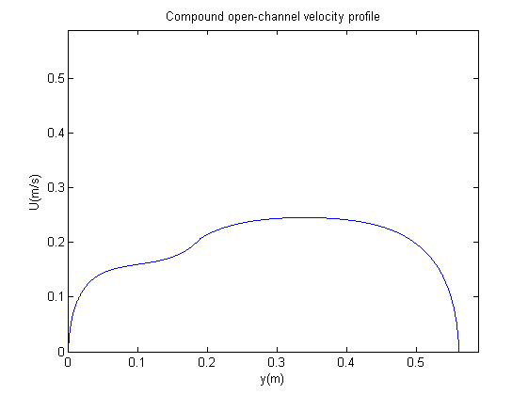

Slide 20
B=sum(Dy);
plot(y,U);
%Setting the graph borders
axis ([0 B+B/20 0 B+B/20]) ;
xlabel('y(m)');
ylabel('U(m/s)');
title('Compound open-channel velocity profile');
%________________________________## END ##_________________________________

