Slide 1
Hello Crystal
Heuristic Learning over CrystalRL
a transparent agent that evolves itself — and adapts to every investor
Ivan Pavliuk · July 2026 · a pitch for Joseph Lynch

Slide 2
The dream — and the two walls it always hits
An investment agent that reads its own diagnostics, rewrites its own machinery, and adapts itself to each person — “I can lose 10%, I have 5 years, I need a third more” — without a human re-engineering it per user.
Why self-evolving agents usually cannot be trusted:
Wall 1 — you cannot read the agent. A black box that changes itself is evolution without eyes: you learn what it became only after it costs money.
Wall 2 — you cannot trust the judge. In markets the evaluator is a backtest: noisy, leaky, and gameable by the very optimization it judges.
Analogy: studying a brain you can neither image nor stimulate, with behavioral scores the subject can fake. Neuroscience answered with imaging, interventions, and controls — so do we.
2/17

Slide 3
Our thesis, in one sentence
An agent may evolve itself exactly as far as it can be read.
CrystalRL
Heuristic Learning
The safety rail
the transparent agent: its policy is a table, its memory is named probabilities you can write to, its objective is the user's own contract. Interpretability is the load-bearing wall, not documentation.
the LLM coding agent on top: proposes machinery changes and tailors the system to each investor. Unlimited imagination, zero authority — experimental controls decide.
calibration gates, honest refusal, pre-registration: it exists so the first two can run at full speed without fooling us.
Transparency makes self-evolution safe; the coding agent makes it cheap.
3/17

Slide 4
What are you getting from that?
Tell it back in your own words — the fastest way to sync two brains.
the check-understanding habit, borrowed from J. Eisner, How to work with a professor
https://www.cs.jhu.edu/~jason/advice/how-to-work-with-a-professor.html
4/17

Slide 5
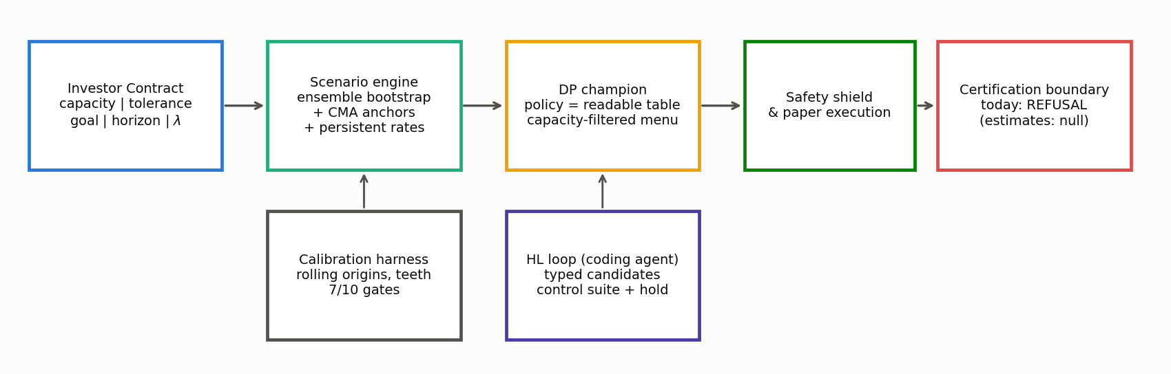
The system in one picture
CrystalRL core: contract → readable policy → execution a subject you can image AND stimulate
HL loop: the coding agent proposes; controls decide sham / dose / replication
Safety rail: self-calibration + a certification boundary that refuses until evidence matures publishing the nulls
5/17

Slide 6
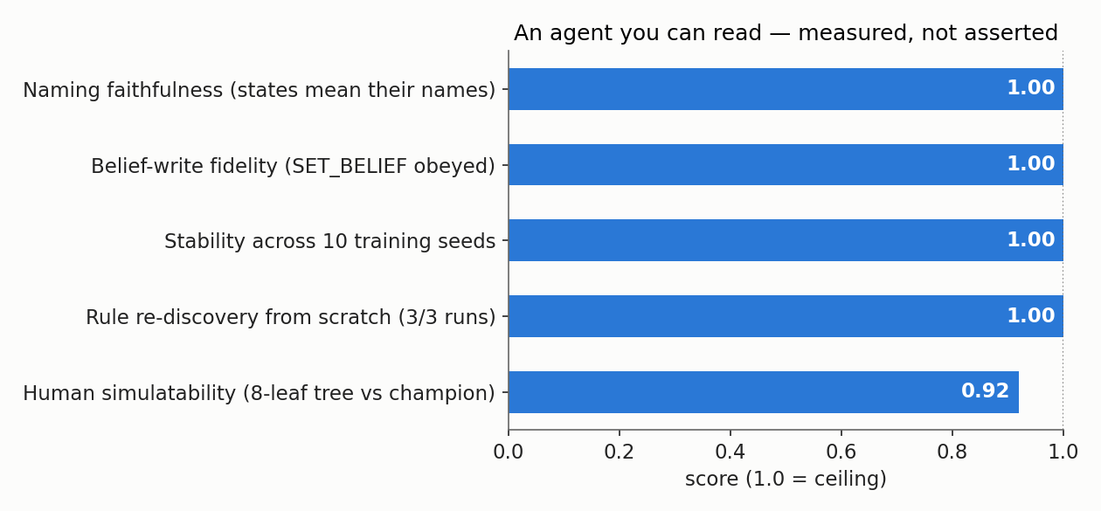
CrystalRL — an agent you can read and write
The champion policy is a table: “behind the goal → full allowed equity; at the goal → lock it in” — an 8-leaf tree reproduces it at 0.92. a receptive-field atlas, not electrode guesswork
Its memory is named: SET_BELIEF(bear)=0.8 is a command the policy must obey — write fidelity 100%; a ±2-nat nudge slides behavior between named codes. optogenetics for a policy
Transparency is measured: the audit puts today's substrate at ceiling (right).
Forcing a short story loses 0.0 accuracy (MDL deficit).
The honest frontier: on harder substrates legibility is not free — a certified return↔legibility tension. Exactly the open research seat.
6/17

Slide 7
Heuristic Learning — the coding agent on top
The LLM agent reads the logbook and diagnostics, then proposes typed changes to the machinery: new action menus, new scenario members, new solver knobs — unlimited imagination, zero authority.
Why the paranoia? FunSearch-style loops trust an exact evaluator. Markets are the opposite regime: the judge is a backtest — noisy, leaky, gameable.
• matched-random
sham stimulation
When the judge cannot be trusted, controls decide, not scores.
• wrong-direction
inverted stimulus
• half-dose
dose–response
And because the agent is readable, every accepted change is inspectable — a diff on a table, a shift in a named belief: evolution with eyes.
• out-of-time
another lab
• one hold-out read
read once
7/17

Slide 8
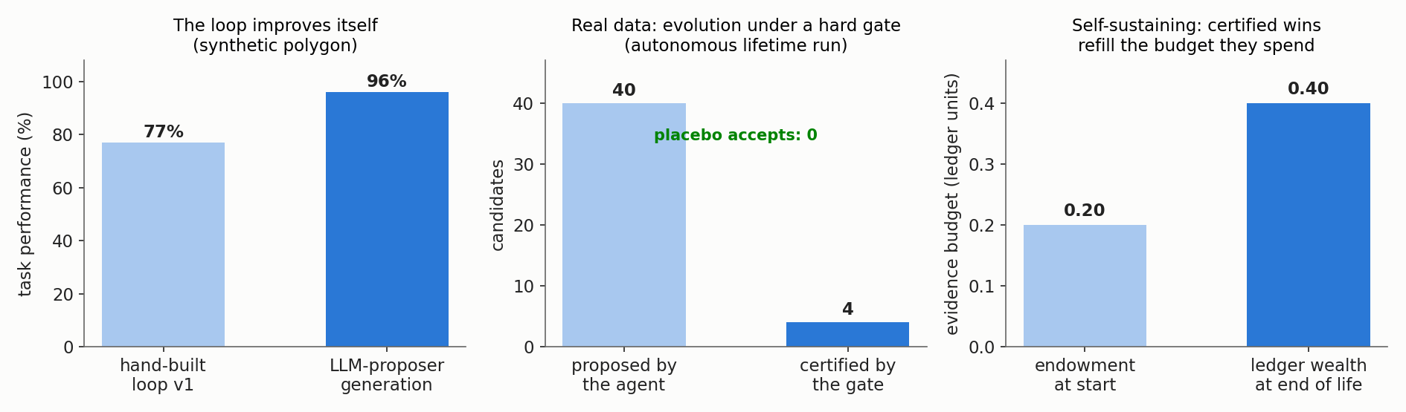
The loop's track record: it already evolves itself
Synthetic polygon: the LLM-proposer generation lifted the loop's own skill 77% → 96%.
First certified real-data policy: 7 accepts, 0 placebo — and the result is a readable sentence: “P(bear) > 0.66 → exposure 0.74.”
Fully autonomous lifetime run: 40 proposals → 4 certified refinements; the evidence budget grew 0.20 → 0.40 — certified wins refill what experiments spend.
Red-teamed and broken twice → fixed; the fix verified by the attacker's own script.
8/17

Slide 9
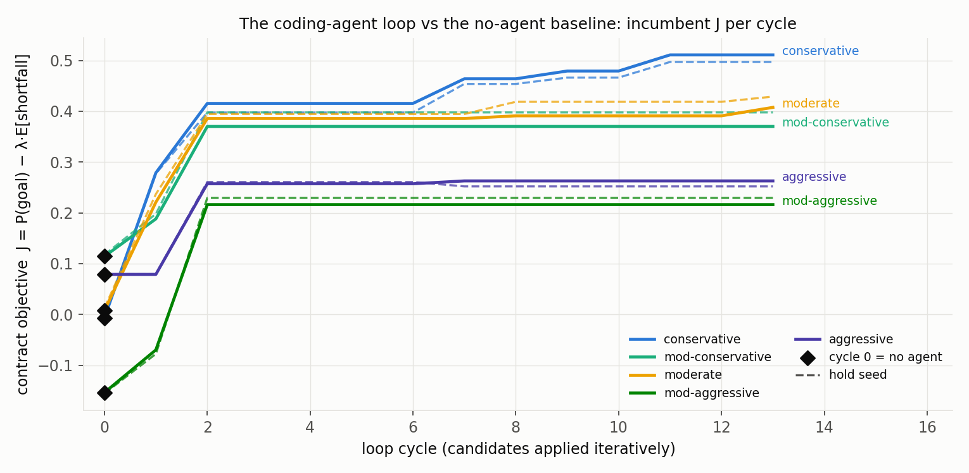
Adaptation: the loop tailors the system to each investor
Every user is a contract: capacity ≠ tolerance ≠ goal (pain threshold vs pain tolerance) — capacity is a hard filter the evolution itself may never relax.
Infeasible goal? The system refuses and offers honest levers: time, contributions, a smaller goal — never more risk.
Then the loop runs per profile: five investors, one machinery, five differently-evolved menus.
Per-profile learning curves vs. the no-agent cycle-0 baseline; solid = development, dashed = held-out.
65 cycles, 15 accepted, all 15 hold-confirmed — conservative profile: goal probability 1% → 52% at an unchanged risk budget.
9/17

Slide 10
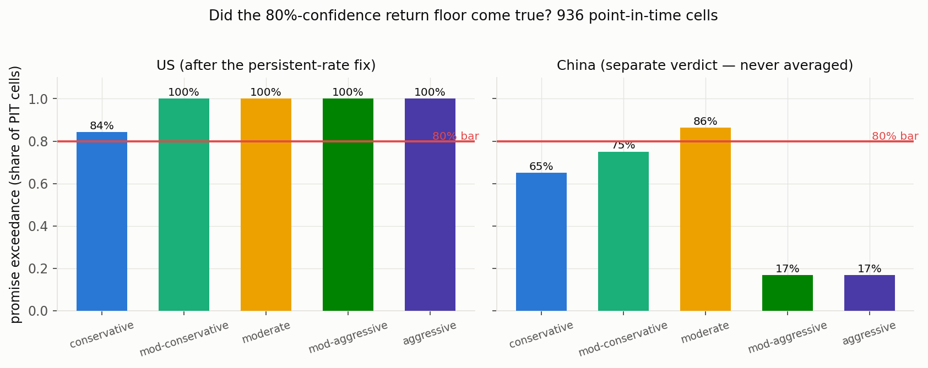
The safety rail holds (so evolution can run)
936 point-in-time cells, two markets: US 5/5 profiles ≥ 80% exceedance; risk (drawdown) promises 100% of all cells, both markets.
China: 1/5 — separate verdict, never averaged; all three failures diagnosed, fixes queued.
Self-calibration: 7/10 gates green → every number still wears the UNCALIBRATED label; certification refuses by design, dated unlocks (2027 / 2029).
The promise backtest: quote at every past date, replay the same policy on what actually happened.
The replication-crisis lessons — pre-registration, publishing nulls, no averaging across species — implemented as code.
10/17

Slide 11
What did not work — the graveyard that makes survivors believable
CAPE (famous valuation indicator): made forecasts worse → falsified, reverted.
The PPO challenger: loses to the readable table → reported, not hidden.
A Nasdaq-tracking sleeve dominated every Chinese profile → red-flagged by the agent itself: its edge is one untestable sample era.
The conservative promise failed its first backtest (48.5% vs 80%) → the diagnosis became a structural fix: 48.5% → 84.2%, repairing exactly the diagnosed cells.
On hard substrates legibility is not free: a certified return↔legibility tension — the open frontier of the interpretability track.
A system that demonstrably kills its own ideas is the one whose surviving claims — and whose self-modifications — you can trust.
11/17

Slide 12
Why this becomes a product (the investor view)
Personalization at software cost: a tailored strategy normally needs a human quant per segment — here the coding agent does the tailoring, every change certified.
A transparent agent is an auditable agent: tables and named beliefs — an audit standard competitors do not have, where regulators demand explainability.
Self-evolution compounds: the autonomous run already funds its own experiments — the machine improves while we sleep, under gates.
Credibility you can date: 80 forecasts locked before realization; scoring reads 2027 / 2029. Auditable, not marketing.
1.46 vs 1.39
−12.9% vs −15.5%
0.20 → 0.40
Sharpe — the certified live rule
vs buy-and-hold (629 untouched days)
max drawdown — same rule,
meaningfully less pain
the autonomous loop's evidence
budget: self-funding under gates
12/17

Slide 13
Your part: a six-month research program, not a task list
You are the neuroscientist of an artificial subject: read–write access to every “synapse,” behavior reproducible by seed, interventions free and ethical — and the subject changes itself, so interpretability must keep up with evolution.
1
Month 1 — the measuring instruments: simulatability psychophysics (can a human predict the policy in unseen cells?); harden the ceiling metrics across seeds, substrates, profiles.
2
Months 2–3 — the atlas: an ethogram of behavioral motifs across profiles; belief faithfulness (does P(bear) encode what its name claims?); SET_BELIEF as a mapped optogenetics write-protocol.
3
Months 3–5 — your own loops: run HL loops with your own coding agent to push the certified return↔legibility frontier — where legibility is not free.
4
Months 5–6+ — the explanation gate: every “why” the product tells a user passes faithfulness tests you own; standing red-team seat (dead salmon); co-author Hello Crystal + lead the methods paper (“an ethogram of an artificial investor”).
13/17

Slide 14
What I am handing you today
1 · The CrystalRL paper (Overleaf)
2 · The repository
“CrystalRL — Crystal Clear Reinforcement Learning”: the interpretable-model paper you will drive. Your hypotheses and tasks are inside as todo notes.
→ Overleaf link: [ I will paste it here ]
github.com/Sqaard/self-evolving-trading-bot
Clone it; then README → ONBOARDING.md — the first result takes an afternoon.
3 · agent_skill.md — for your Claude
4 · My experiment logbook
Drop it into your personal Claude: the lab's honesty contract, your track, the guardrails, and the mandatory logging protocol your agent must follow.
EXPERIMENT_LOGBOOK.md — already filled: use my entries as the worked example. The rule: update it after EVERY experiment — an unlogged result does not exist.
Everything is in the repo — if my laptop dies tomorrow, the project does not.
14/17

Slide 15
How we will work together
Weekly sync (Sunday): online meeting or a recorded video.
Agenda sent 1–2 days in advance, four points:
Working principles:
Write the paper first — both drafts exist; \joseph{} todos are waiting for you.
Shared repo + honest logbook — every run logged, nulls first; hand-off-ready at any time.
Lead with the null — a negative result is a result.
Ask early — asking beats a week of guessing.
what you have worked on since we last met,
what you are struggling with,
what you need help with,
what your goals are for next time.
format per J. Eisner, How to work with a professor (“working with others”) + M. Dredze, How to be a successful PhD student
https://www.cs.jhu.edu/~jason/advice/how-to-work-with-a-professor.html
15/17

Slide 16
The ask
Own the interpretability track — the load-bearing wall of a self-evolving agent — as co-author of Hello Crystal and driver of CrystalRL.
By next Sunday:
run the sandbox and read the top-5 logbook entries (an afternoon);
tell me which phase of the six-month program you would reshape — it is a proposal, not a syllabus;
bring three objections — breaking our explanations is the job.
Hello, Crystal.
The subject is waiting to be studied — and it will not sit still.
16/17

Slide 17
“The first principle is that you must not fool yourself —
and you are the easiest person to fool.”
— Richard Feynman, Cargo Cult Science (1974)
This lab is built to obey that sentence.
17/17

