Slide 1

BIG-DATA FINPORTFOLIO IR
Big Data Infrastructure course project
Ivan Pavliuk

Slide 2
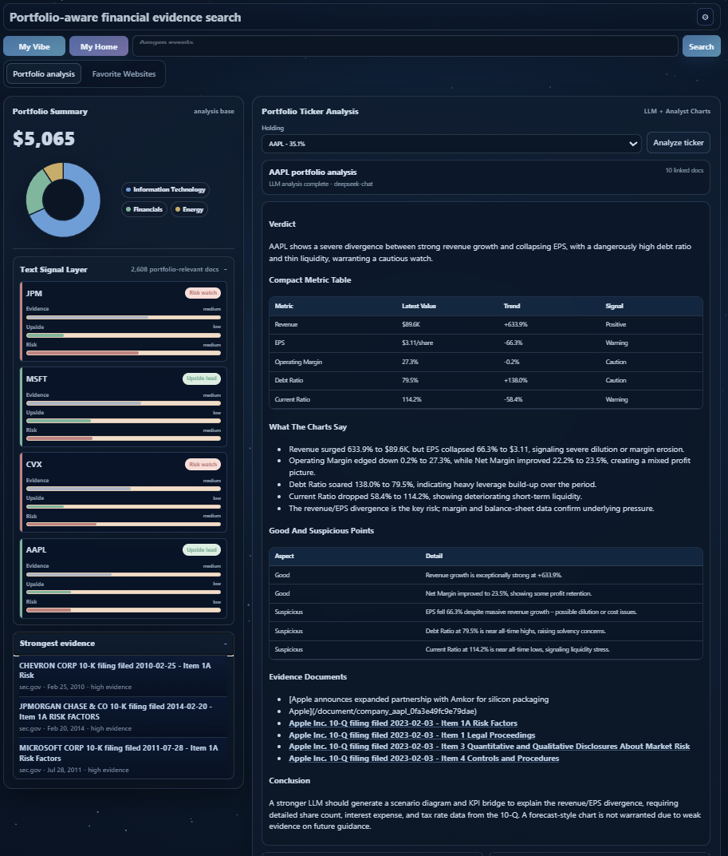
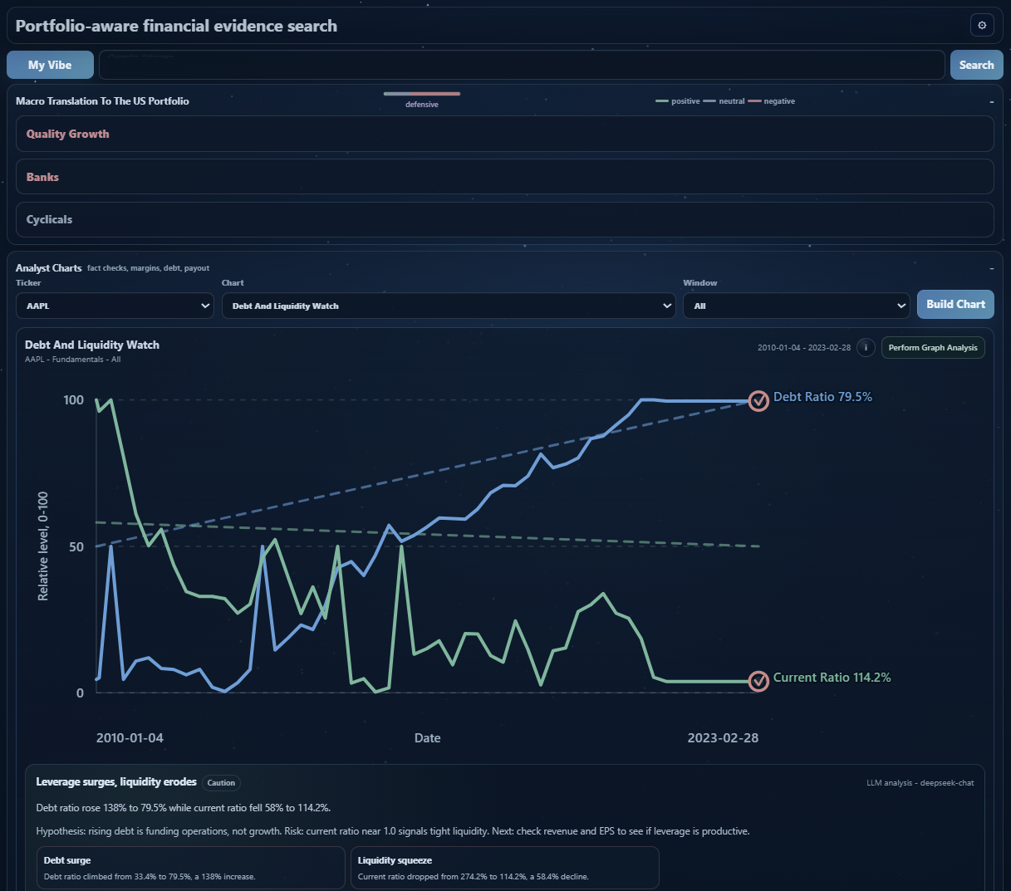
What is the project?
FinPortfolio IR finds high-quality, point-in-time financial evidence (SEC filings, macro releases, company IR) — for a given portfolio and decision date.
Big Data layer processes the whole collected corpus with Apache Spark.
① Collect
web crawler + automatic updates
② Big Data
Spark MapReduce: index + analytics
③ Analyze
practical value + short report

Slide 3
Part 1 — Data gathering: sources
Three evidence worlds, collected from the open web with reproducible provenance — every document carries its source, URL, timestamps and a stable hash (≈ 26,368 documents).
Source priority matters: a risk query should prefer an SEC 10-K risk section over a product press release.
Macro
18,240 official FRED / regulators
SEC EDGAR
7,011 sections 10-K · 10-Q · 8-K
Company IR
1,117 documents official newsrooms

Slide 4
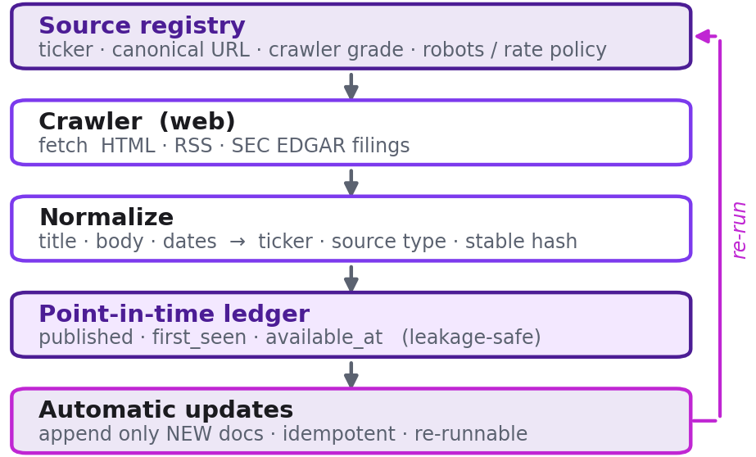
Part 1 — Crawler & automatic updates
139 human-verified source URLs across 29 Dow-30 companies, plus 12 official source families.
Fetcher: HTML · RSS · SEC EDGAR filings.
Normalizer: any source → one schema (ticker · source type · stable hash).
Point-in-time ledger: published / first_seen / available_at — retrieval filters on available_at.
Automatic updates: a re-run appends only NEW documents — idempotent.

Slide 5
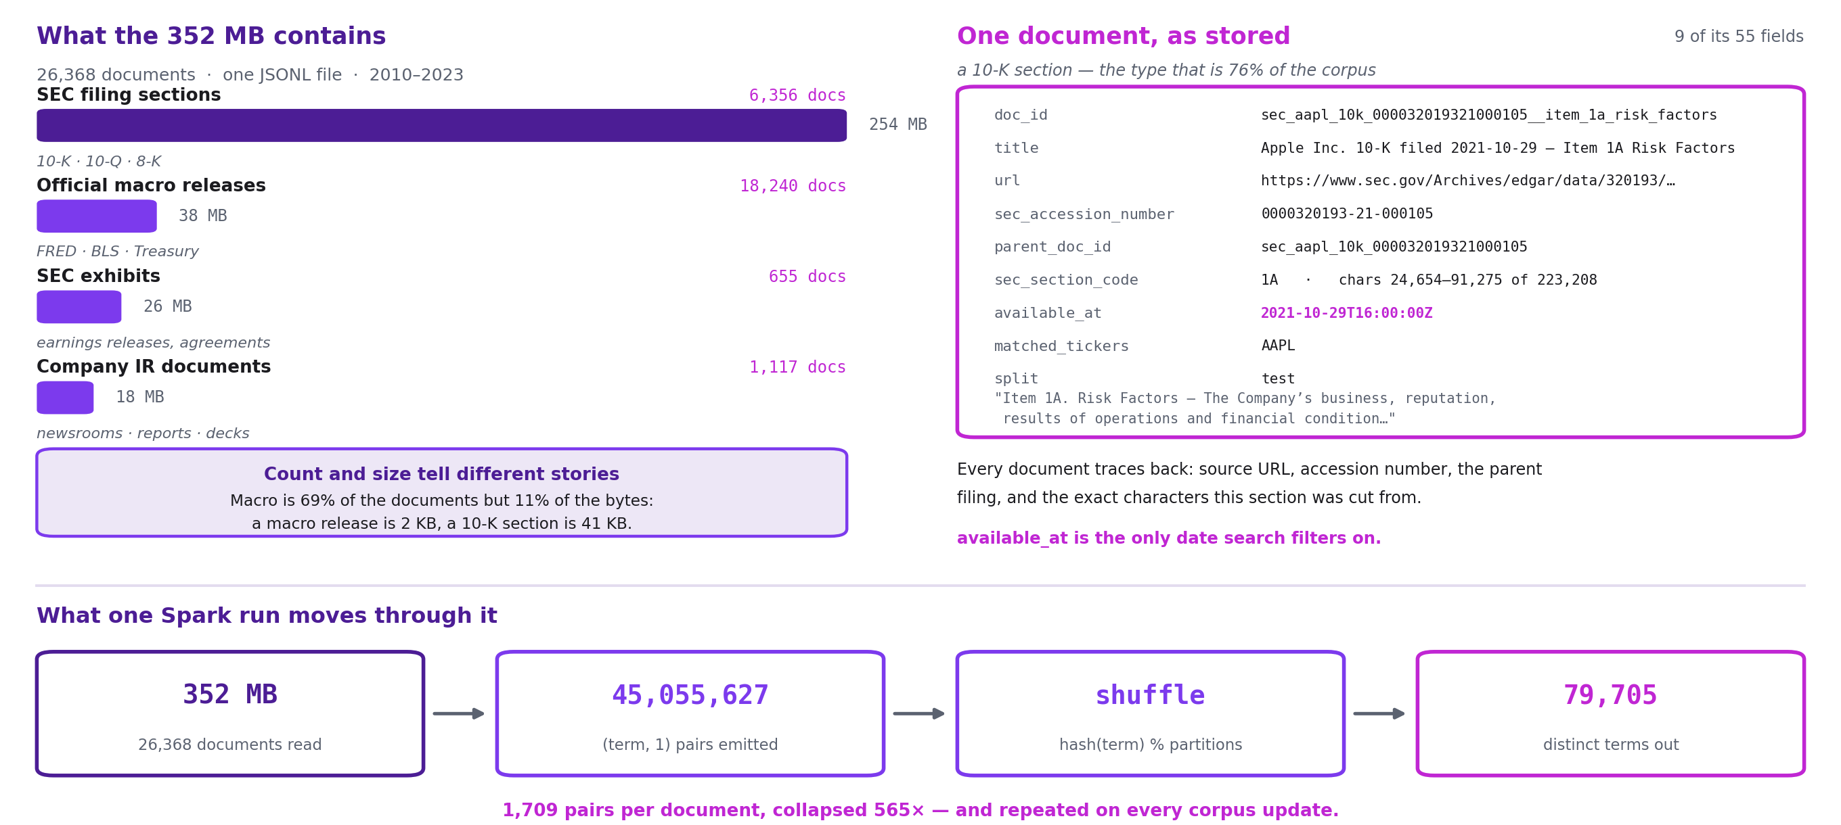
Part 2 — What the data really is

Slide 6
Part 2 — Selection: Apache Spark
Apache Spark is selected — it expresses MapReduce directly, adds SQL and streaming, and scales from a local to a cluster unchanged.
The same job runs unchanged on a laptop (local[*]) and on a Docker Spark cluster — only the master URL differs.
Hadoop MR
the model, but Java + disk
Storm
streaming only, hard on Windows
Spark ✓
Python · MapReduce SQL · streaming

Slide 7
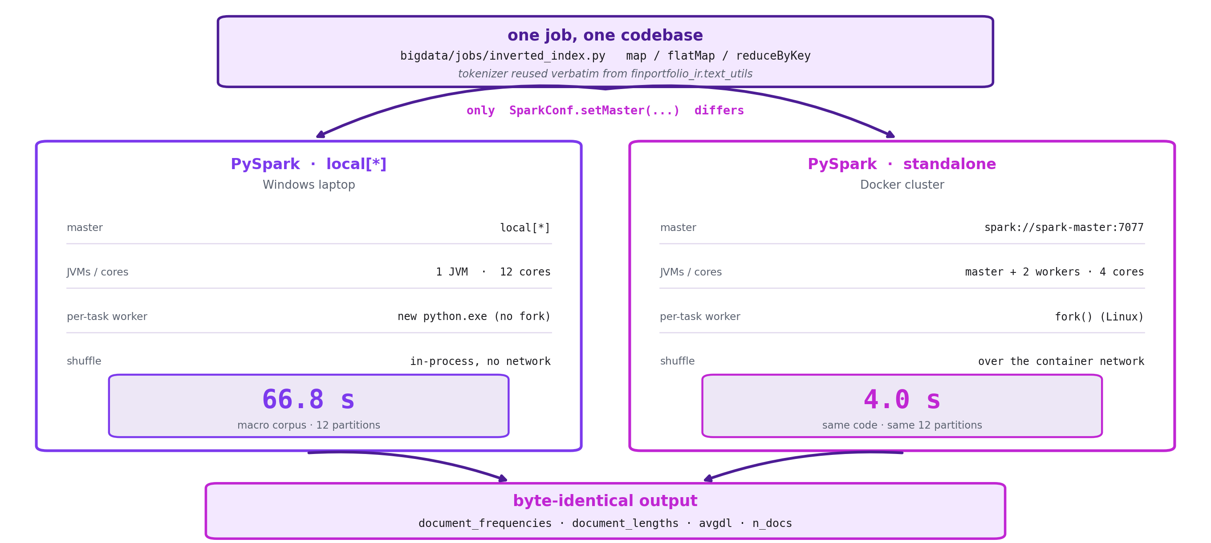
Part 2 — One job, two deployments

Slide 8
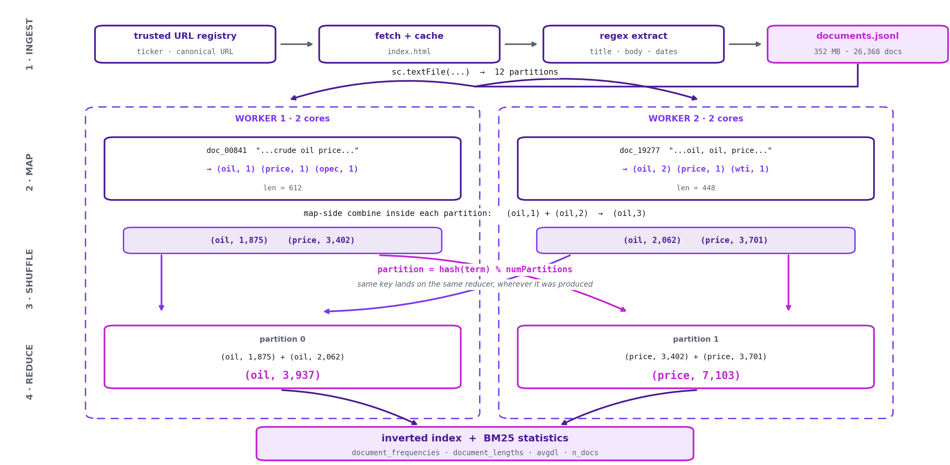
Part 2 — From URL to inverted index

Slide 9
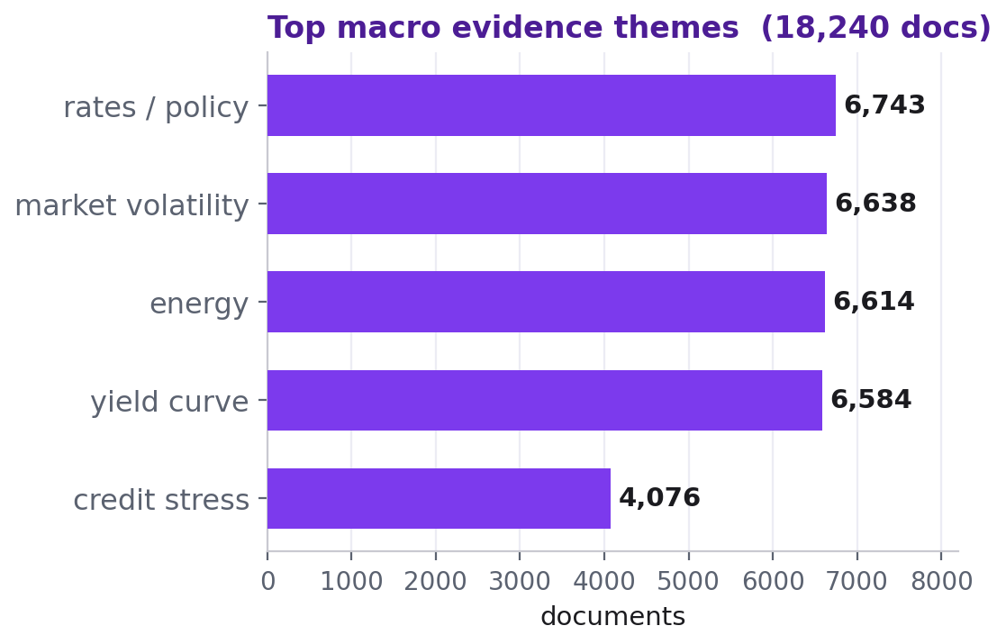
Part 3 — Analytics: the practical value
Rates
6,743 docs on policy
Inflation
3,466 docs
Fed policy
3,451 docs
Coverage
2010 → 2026 · ~1.3k/yr

Slide 10
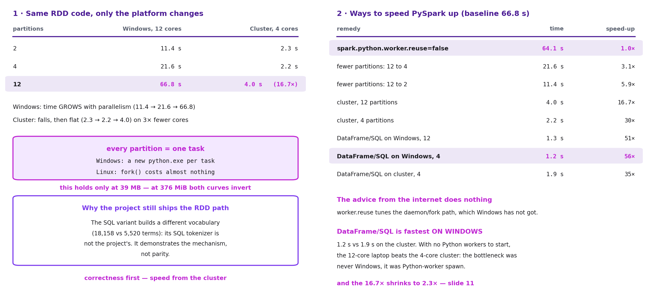
Part 4 — PySpark: Windows vs Cluster
Same job on Windows: 2 → 11.4 s · 4 → 21.6 s · 12 → 66.8 s. More splitting, slower.
Why the cluster is faster
4.0 s · 16.7×
12 pieces × 4 steps = 48 tasks, on 4 cluster cores
Each task needs its own Python process. Linux copies a running one; Windows builds a fresh one — ~1.25 s each, and Spark starts them one at a time.
48 × 1.25 s ≈ 60 of the 66.8 s.
Controls: 12.8 s on 1, 4 or 12 cores; worker.reuse=false changes nothing (64.1 s).
Why SQL is faster
1.3 s · 51×
same job in SQL, same 12 pieces, same laptop
No Python of ours inside: split / explode / group by run in Spark's own engine. There is nothing to start.
Pieces stop mattering: 1.2 s at 4, 1.3 s at 12.
And Windows beats the cluster, 1.2 s against 1.9 s.
One cost, seen twice: starting a Python process. Linux makes it cheap; SQL makes it unnecessary.
The hand-written path is what ships — only it is byte-identical. SQL's tokenizer is not ours.
39 MB corpus: almost all of this time is start-up. Next slide.

Slide 11
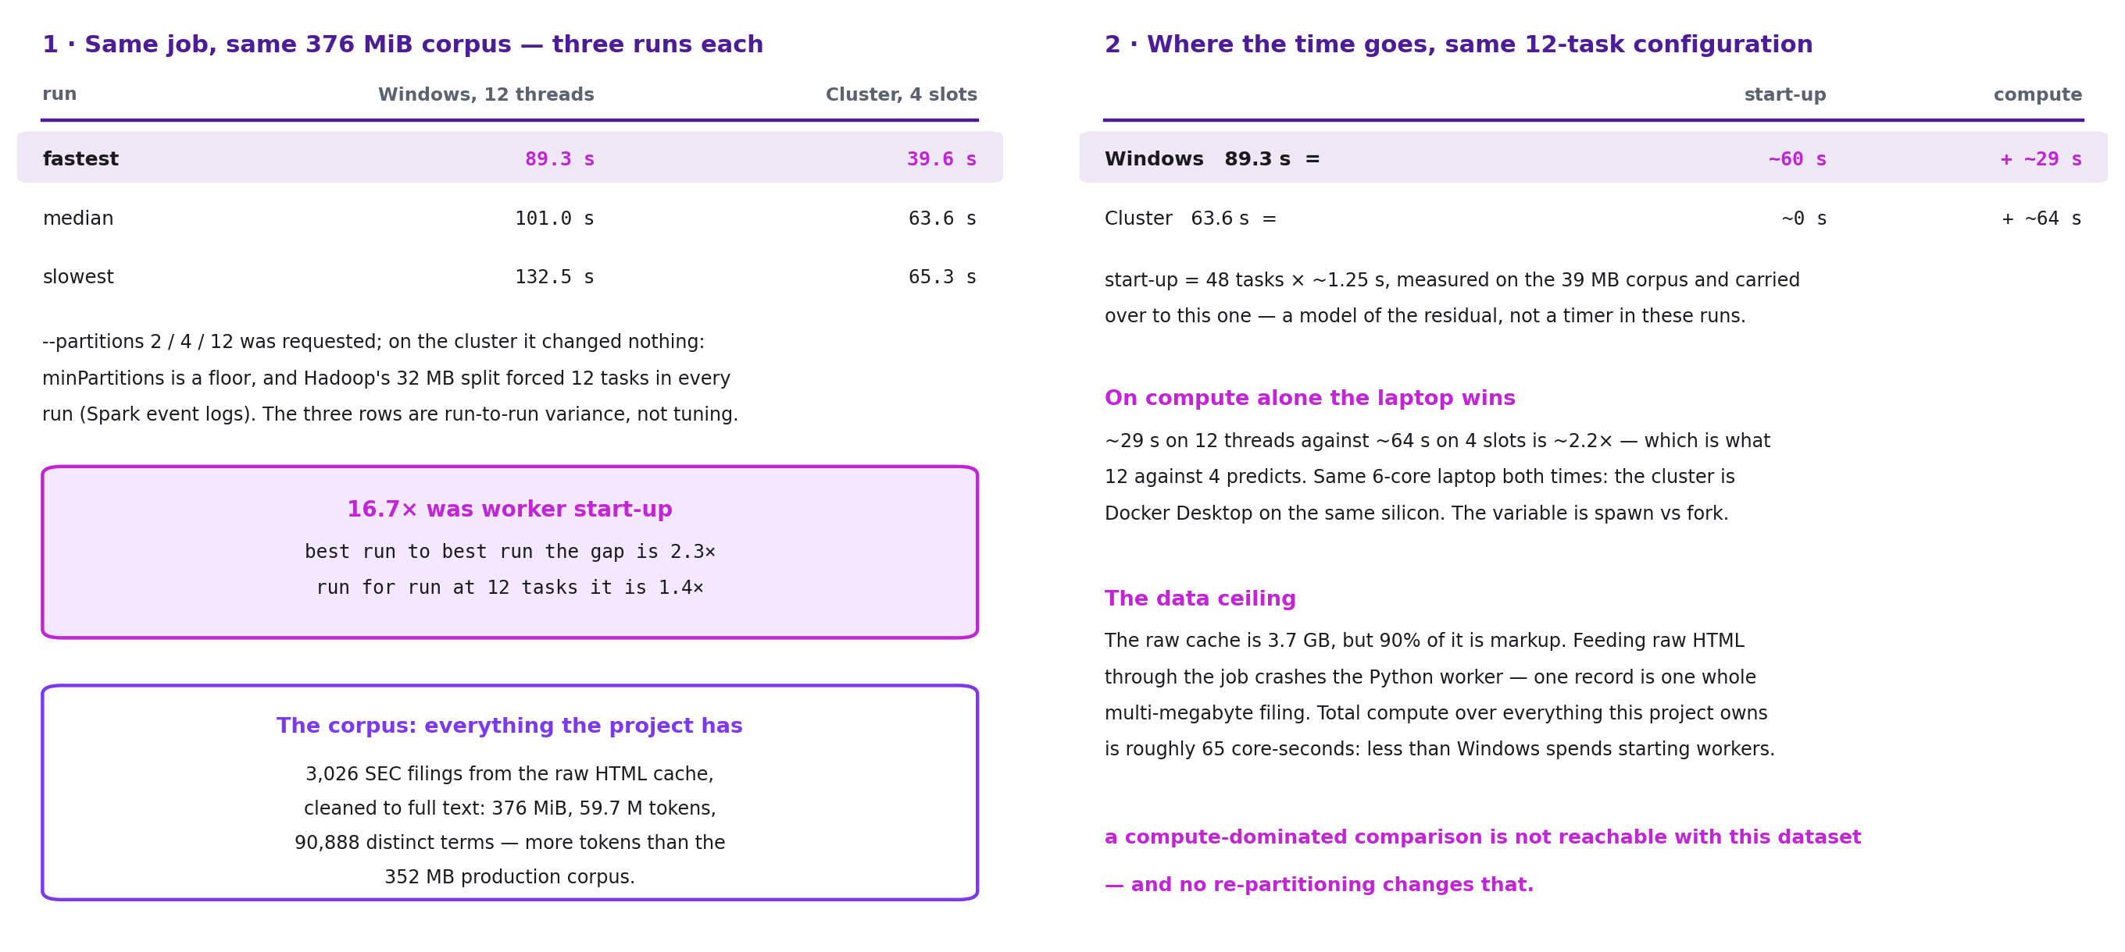
Part 5 — It was measuring start-up
Real data: 3,026 SEC filings, 376 MiB, 59.7 M tokens — everything this project has.
The gap collapses
2.3× best run to best run
1.4× run for run, same setting
The 16.7× was Python start-up, not computing power.
The law on the last slide flips too: here 12 pieces is the fastest Windows run, not the slowest.
--partitions never took effect on the cluster, so that spread is variance, not tuning.
Where the time goes
 | wall clock | start-up * | residual
Windows, 12 threads | 89.3 s | ~60 s | ~29 s
Cluster, 4 cores | 63.6 s | ~0 s | ~64 s
On compute alone the laptop is ~2.2× faster: ~29 s against ~64 s.
* modelled, not timed here: measured with zero data, so corpus-independent.
Same laptop — the cluster is Docker Desktop on it, 2 × 2 cores.
All the compute this project owns is ~65 core-seconds — less than Windows spends starting processes.
A comparison decided by computing is not reachable with this data.

Slide 12
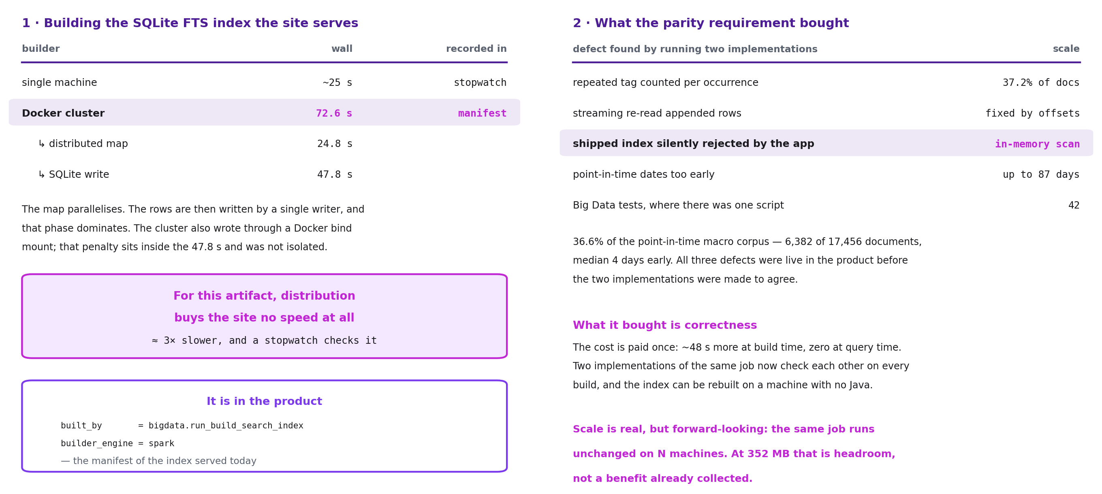
Part 6 — The overall effect on the site
The artifact the site serves: one SQLite search index over 26,368 documents, 352 MB.
What distribution cost
What the parity requirement bought
72.6 s · 2.9× slower
what the parity work turned up | scale
a repeated tag counted twice | 37.2% of macro docs
the updater double-counted rows | now fixed
the app silently ignored the index | fell back to a scan
release dates set too early | 36.6%, up to 87 d
tests, where there was one script | 42
 | wall clock | recorded in
One machine | ~25 s | stopwatch
Docker cluster | 72.6 s | manifest
– spread over cores | 24.8 s
– one writer, in turn | 47.8 s
The spread-out phase parallelises. The write cannot: SQLite takes one writer.
The first three were live in the product. Two builds forced to agree byte for byte is what found them.
Distribution bought the site no speed at all. What it bought is correctness.
Paid once at build time, zero at query time. The cluster also wrote through a Docker mount — that cost is inside the 47.8 s.
Scale is real but forward-looking: at 352 MB that is headroom, not a benefit already collected.

Slide 13
Conclusion
42
Big Data tests
2.3×
on real work
① crawler + auto-updates
② Spark MapReduce on a Docker cluster
③ analytics + report
One codebase: the same job on a laptop or a cluster — output identical.

Slide 14
Screenshots

Slide 15
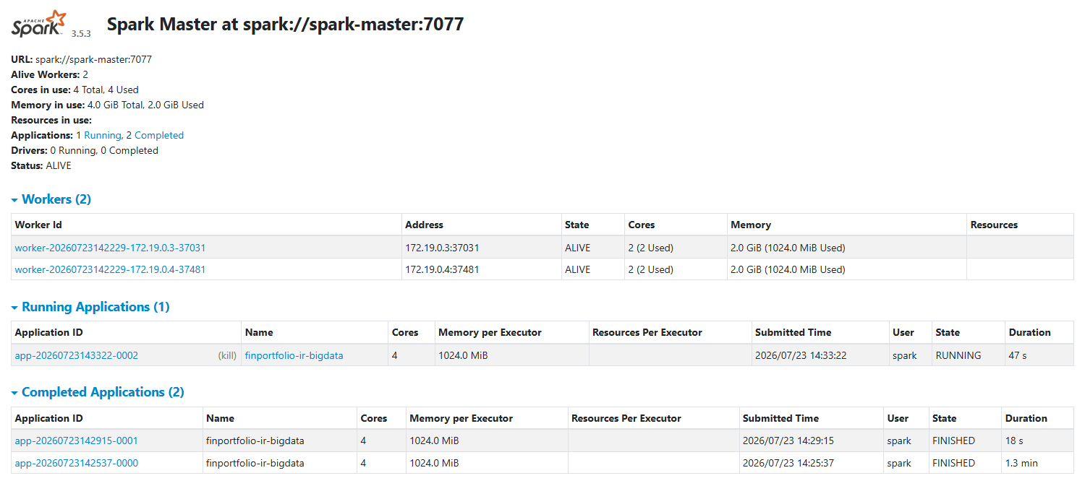

Slide 16
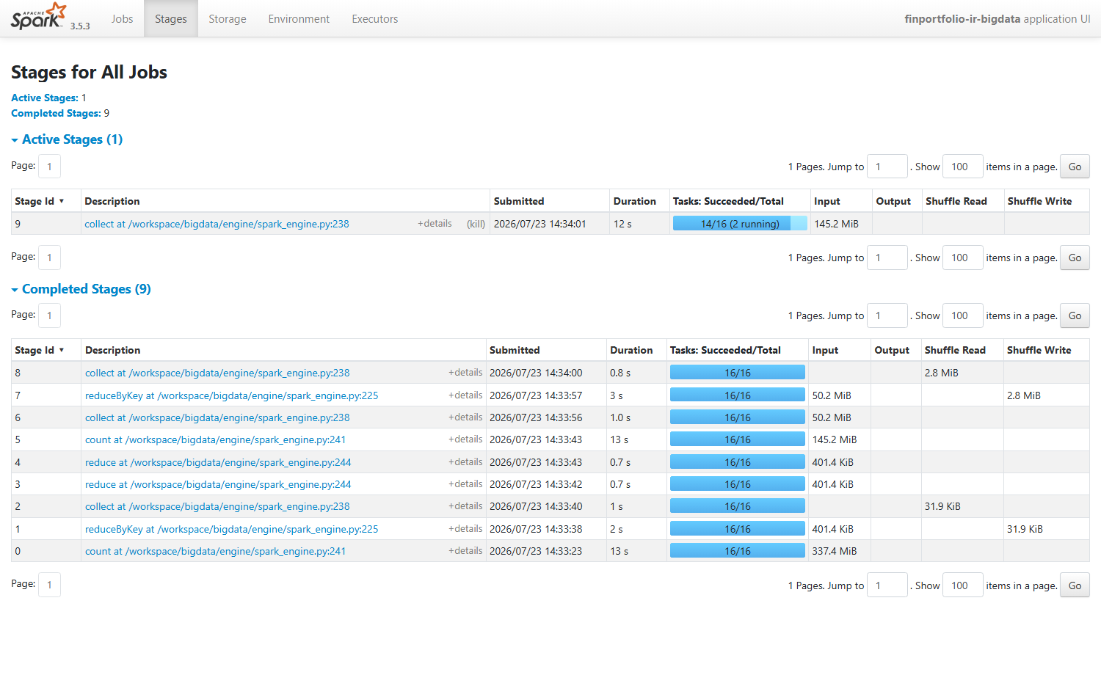

Slide 19
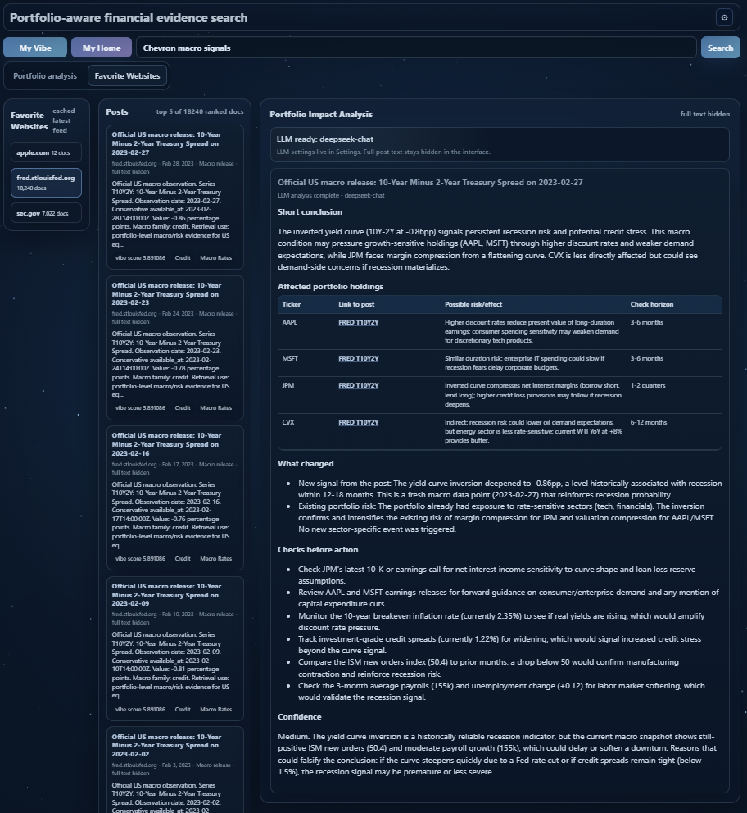

Slide 20
