Slide 1
Cloud-Based Estimation tool for Lithium Battery Characterization, Health, and State of Charge

Slide 2
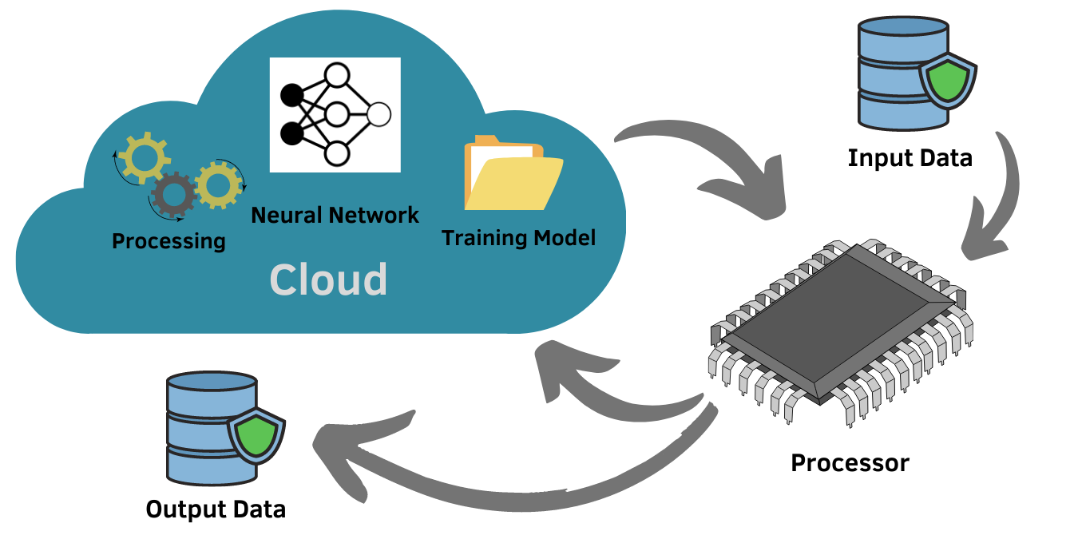
Deliverable
Battery
Hardware:
Data Acquisition System (V,I,T)
Display
(SOC, SOH, battery parameters)

