Slide 1
Module 4
Circuit Analysis in the S Domain
Dr. Elizabeth Rufus
Professor, School of Electronics Engineering

Slide 2


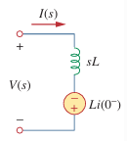
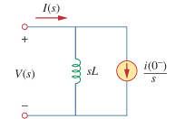



Circuit analysis using Laplace Transform
For a resistor, the voltage-current relationship in the time domain and in frequency domain is as follows:
For an inductor,
Taking the Laplace transform of both sides and applying time differentiation property,

Slide 3


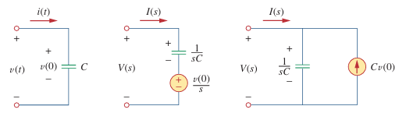


Circuit analysis using Laplace Transform
For an capacitor,
If we assume zero initial conditions for the inductor and the capacitor, the above equations reduce to:

Slide 4
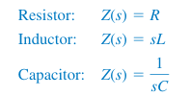

Circuit analysis using Laplace Transform
Impedance in the s-domain:
The dependent source can have only two controlling values, a constant times either a voltage or a current.

Slide 5
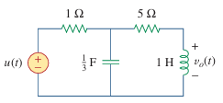
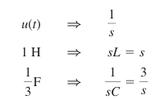
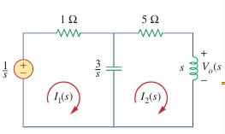



Circuit analysis using Laplace Transform
1. Find v₀(t) in the circuit, assuming zero initial conditions.
For mesh 1,
----1
For mesh 2,
----2

Slide 6

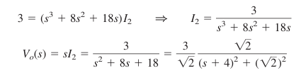

Circuit analysis using Laplace Transform
Substitute eqn.2 in 1
Multiplying through by 3s gives,
Taking the inverse transform yields,

Slide 7
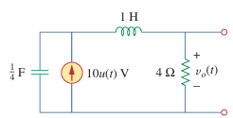



Circuit analysis using Laplace Transform
2. Determine v₀(t) in the circuit, assuming zero initial conditions
Answer:
3. Find v_{o}(t) in the circuit. Note that, since the voltage input is multiplied by u(t), the voltage source is a short for all t < 0 and i_{L} (0) = 0.

Slide 8
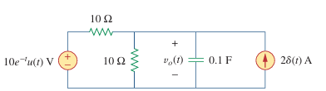
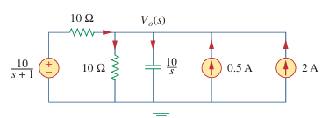


Circuit analysis using Laplace Transform
4. Find v₀(t) in the circuit. Assume v_{o}(0) = 5 V.
Circuit in the frequency domain
The initial condition is included in the form of the current source.
Node equation

Slide 9


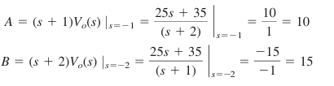


Circuit analysis using Laplace Transform

Slide 10
Circuit analysis using Laplace Transform

Slide 11
Next class: Circuit analysis using with initial conditions

Slide 12
Next class: Circuit analysis using with initial conditions

