Slide 1
Module - 4
Transfer Functions
Dr. Sathya P
Associate Professor
SENSE

Slide 2

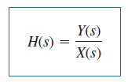
Transfer Functions
The transfer function indicates how a signal is processed as it passes through a network.
It is a fitting tool for finding the network response, determining network stability and network synthesis.
It describes how the output behaves with respect to the input.

Slide 3
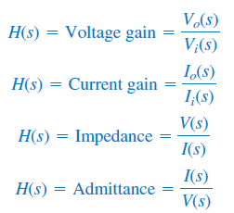
Types of Transfer functions:

Slide 4


If we know the input X(s) and the transfer function H(s), we find the output Y(s) as
Take the inverse transform to get y(t).
A special case is when the input is the unit impulse function, x(t) = δ(t), so that X(s) = 1. For this case,
The term h(t) is the unit impulse response.

Slide 5
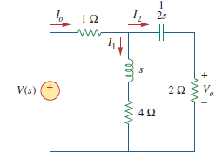
Numerical - 1

Slide 6
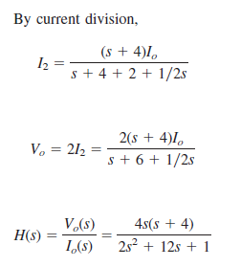

Slide 7

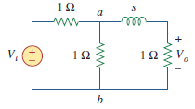
Numerical - 2

Slide 8
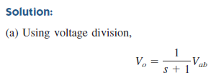




Slide 9

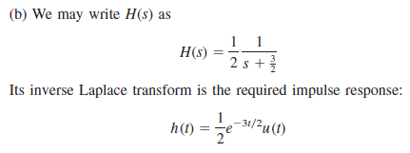

Slide 10
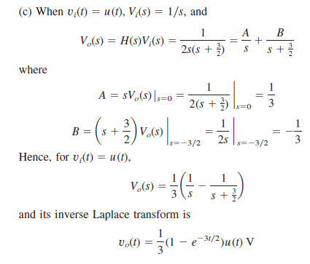

Slide 11
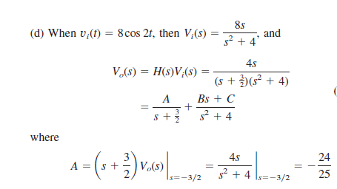


Slide 12
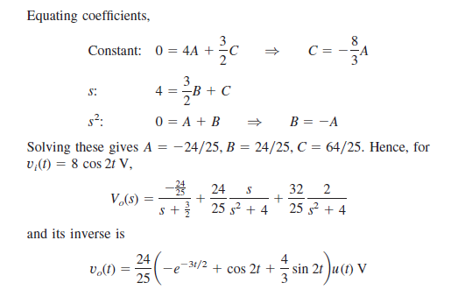

Slide 13
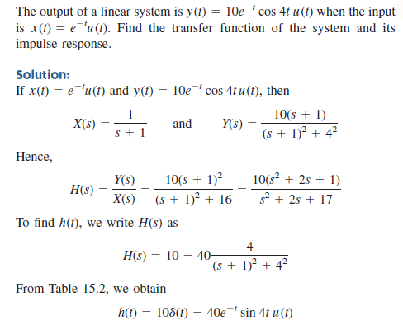
Numerical - 3

Slide 14
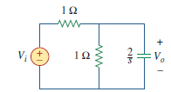

Practice Problem

