Slide 1
Web APIs
API = Application Programmer Interface
CS 240 – Advanced Programming Concepts

Slide 2
Internet Basics: TCP
TCP (Transmission Control Protocol): The protocol on which the Internet is based
Allows programs running on different computers to connect and communicate directly with each other
Requires that each computer have a unique identifier called an “IP Address”
128.187.80.20
72.30.38.140

Slide 3
Internet Basics: Ports
TCP uses Port Numbers to identify individual programs running on a computer
TCP Port Numbers are in the range 0 – 65535
Ports 0 – 1023 are reserved for system services (email, web, etc.)
Ports 1024 – 49151 are registered to particular applications
Ports 49152 – 65535 can be used for custom or temporary purposes
Email servers typically run on Port 25
Web servers typically run on Port 80
The combination of IP Address and TCP Port Number uniquely identifies a particular program on a particular computer
(128.187.80.20, 25) => Email server on machine 128.187.80.20
(72.30.38.140, 80) => Web server on machine 72.30.38.140

Slide 4
Internet Basics
Through TCP, a program on one computer can connect to a program running on another computer by specifying its (IP Address, TCP Port Number)
Connect to (128.187.80.20, 25) => Connect to email server on machine 128.187.80.20
Connect to (72.30.38.140, 80) => Connect to web server on machine 72.30.38.140
Such a TCP connection is called a “Socket”
Once a connection has been established, the two programs can pass data back and forth to each other (i.e., communicate)

Slide 5
Internet Basics: DNS
IP Addresses are hard to remember
Users prefer to reference machines by Name rather than by IP Address
pinky.cs.byu.edu instead of 128.187.80.20
www.yahoo.com instead of 72.30.38.140
DNS (Domain Name System) is a protocol for looking up a machine’s IP Address based on its (Domain) Name
Connect to (www.yahoo.com, 80)
DNS, what is the IP Address for “www.yahoo.com”?
72.30.38.140
OK, Connect to (72.30.38.140, 80)

Slide 6
URLs (uniform resource locators)
scheme://domain:port/path?query_string#fragment_id
scheme (case-insensitive) – http or https
domain (case-insensitive) – The server’s domain name or IP address. The domain name google.com, or its IP address 72.14.207.99, is the address of Google's website.
port (optional) – The port, if present, specifies the server’s TCP port number. For http URLs, the default port is 80. For https URLs, the default port is 443.
path (case-sensitive) – The path is used to specify and perhaps locate the requested resource.
query_string (optional, case-sensitive) – The query string, if present, contains data to be passed to software running on the server. It may contain name/value pairs separated by ampersands, for example ?first_name=John&last_name=Doe.
fragment_id (optional, case-sensitive) – The fragment identifier, if present, specifies a part or a position within the overall resource or document.

Slide 7
URLs
http://www.espn.com:80/basketball/nba/index.html?team=dallas&order=name#Roster
scheme – http
domain – www.espn.com
port – 80
path – /basketball/nba/index.html
query_string – ?team=dallas&order=name
fragment_id – #Roster

Slide 8
The URL Class
import java.net.URL;
…
URL url = new URL( ”http://www.espn.com:80/basketball/nba/index.html?team=dallas&order=name#Roster”);
String host = url.getHost();
int port = url.getPort();
String path = url.getPath();
String query = url.getQuery();
String fragment = url.getRef();
// Many more URL operations

Slide 9
HTTP (hypertext transfer protocol)
Network protocol that drives the Web
Built on top of TCP
By default, Web servers run on TCP Port 80
HTTP has a Request/Response structure
Client (e.g., web browser) sends a “request” message to the server
Server sends back a “response” message to the client

Slide 10
HTTP Request message format
<method> <request-URL> <version>\n
<headers>\n
\n
<entity-body>
<method> is the operation to perform on URL
<request-URL> can be full URL or just the path part
<version> is of the form HTTP/<major>.<minor>
<entity-body> is a stream of bytes (could be empty)
GET /test/hi-there.txt HTTP/1.1
Accept: text/*
Host: www.joes-hardware.com

Slide 11
HTTP Response message format
<version> <status> <reason-phrase>\n
<headers>\n
\n
<entity-body>
<version> is of the form HTTP/<major>.<minor>
<status> is a 3-digit number indicating status of request
<reason-phrase> human-readable description of status code
<entity-body> is a stream of bytes (could be empty)
HTTP/1.0 200 OK
Content-type: text/plain
Content-length: 18
Hi! I’m a message!

Slide 12
HTTP Request Methods
GET – Retrieve document from server
POST – Send data to server for processing
PUT – Store document on server
DELETE – Remove document from server
HEAD – Retrieve document headers from server
OPTIONS – Determine what methods the server supports
TRACE – Trace the path taken by a request through proxy servers on the way to the destination server

Slide 13
HTTP Response status codes
100-199 Informational
200-299 Successful
300-399 Redirection
400-499 Client error
500-599 Server error
200 OK
401 Unauthorized to access resource
404 Requested resource does not exist

Slide 14
HTTP Headers
List of name/value pairs
Name: Value\n
Empty line separates headers and entity body
General headers (request or response)
Date: Tue, 3 Oct 1974 02:16:00 GMT
Time at which message was generated
Connection: close
Client or server can specify options about the underlying connection

Slide 15
HTTP Request Headers
Host: www.joes-hardware.com
Host from the request URL
User-Agent: Mozilla/4.0
Client application making the request
Accept: text/html, text/xml
MIME types the client can handle
Authorization: dfWQka8dkfjKaie39ck
Authorization credentials to identify the user
Referer: http://www.joes-hardware.com/index.html
Page that contained the link currently being requested
If-Modified-Since: Tue, 3 Oct 1974 02:16:00 GMT
Conditional request; only send the document if it changed since I last retrieved it

Slide 16
HTTP Response Headers
Content-length: 15023
Length of response entity body measured in bytes
Content-type: text/html
MIME type of response entity body
Server: Apache/1.2b6
Server software that handled the request
Cache-Control: no-cache
Clients must not cache the response document

Slide 17
HTTP
Java’s HttpServer class can be used to implement an HTTP server
Java’s HttpURLConnection class can be used by clients to make HTTP requests of a server and receive HTTP responses from the server

Slide 18
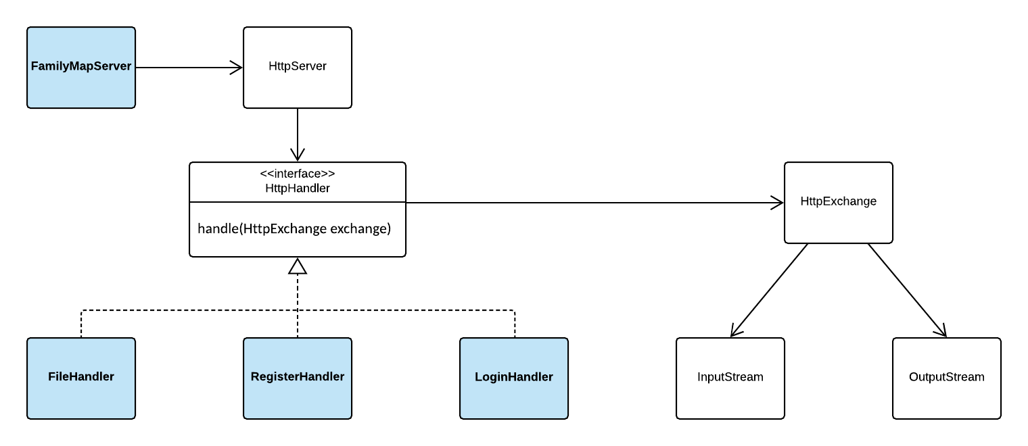
Creating a Server with the HttpServer Class

Slide 19
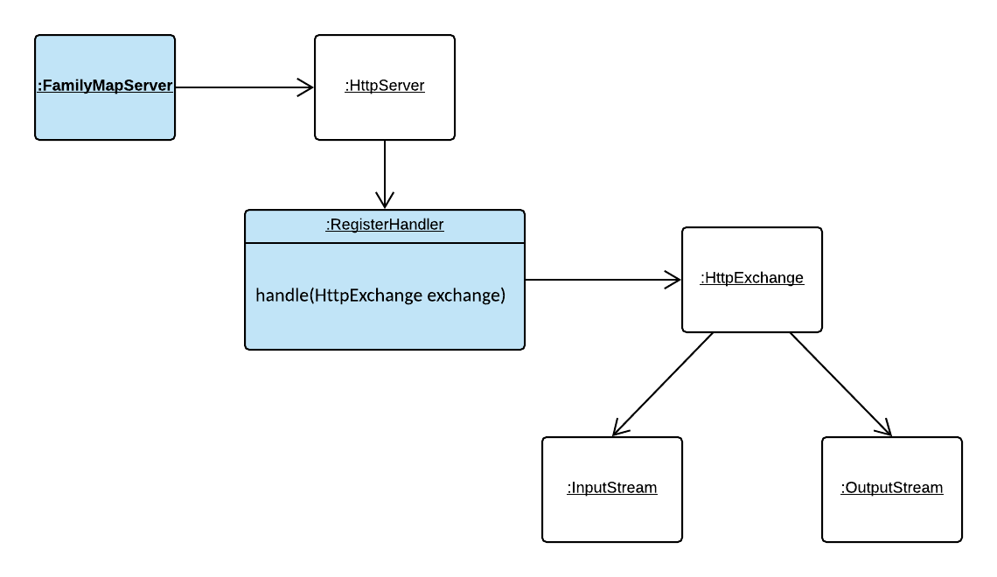
HttpServer Runtime View (handling a register request)

Slide 20
HttpServer Creation and Startup
private void startServer(int port) throws IOException { InetSocketAddress serverAddress = new InetSocketAddress(port); HttpServer server = HttpServer.create(serverAddress, 10); registerHandlers(server); server.start(); System.out.println(”FamilyMapServer listening on port " + port); }
private void registerHandlers(HttpServer server) { server.createContext("/", new FileRequestHandler()); server.createContext("/user/register", new RegisterRequestHandler());
… }

Slide 21
The HttpExchange class
The typical life-cycle of a HttpExchange is shown in the sequence below
getRequestMethod() - to determine the request method (i.e. GET, POST, etc).
getRequestHeaders() - to examine the request headers (if needed)
getRequestBody() - returns an InputStream for reading the request body.
getResponseHeaders() - to set any response headers, except content-length (returns a mutable map into which you can add headers).
sendResponseHeaders(int, long) - to send the response headers and response code. Must be called before next step.
getResponseBody() - to get an OutputStream to send the response body. When the response body has been written, the stream (or the exchange) must be closed to terminate the exchange.

Slide 22
Connecting to a Server with the HttpURLConnection Class
HTTP GET Example
GetExample.java
HTTP POST Example
PostExample.java

Slide 23
HTTP GET Request/Response Steps
Client: Create URL instance
Client: Open connection (url.openConnection()), set read timeout, set request method to GET, connect
Server: Handler's handle method is called and passed an HttpExchange instance
Server: Process request (use HttpExchange to get request method, URI, headers, etc if needed to process request)
Server: Send response code (exchange.sendResponseHeaders( responseCode, responseLength))
Server: Get output stream (exchange.getResponseBody())
Server: Write response to stream
Server: Close the exchange (exchange.close())
Client: Get Response code, get input stream
Client: Read and process response

Slide 24
HTTP POST Request/Response Steps
Client: Create URL instance
Client: Open connection, set read timeout, set request method to POST, setDoOutput(true), connect
Client: Get output stream (connection.getOutputStream())
Client: Write request body to output stream
Server: Handler's handle method is called and passed an HttpExchange instance
Server: Process request (use HttpExchange to get request method, URI, headers (e.g. authorization), etc if needed to process request)
Server: Get input stream (exchange.getRequestBody())
Server: Process request (convert json to object, do business logic)
Server: Send response code (exchange.sendResponseHeaders( responseCode, responseLength))
Server: Get output stream (exchange.getResponseBody())
Server: Write response to stream
Server: Close the exchange (exchange.close())
Client: Get Response code, get input stream
Client: Read and process response

Slide 25
HttpHandler Example: Ticket to Ride Web API
Get list of games
Description: Returns list of currently-running games
URL Path: /games/list
HTTP Method: GET
Request Body: None
Response Body: JSON of the following form:
{ "game-list": [
{ "name": "fhe game", "player-count": 3 },
{ "name": "work game", "player-count": 4 },
{ "name": "church game", "player-count": 2 }
]
}
ListGamesHandler.java

Slide 26
HttpHandler Example: Ticket to Ride Web API
Claim route
Description: Allows player to claim route between two cities
URL Path: /routes/claim
HTTP Method: POST
Request Body: JSON of the following form:
{ "route": "atlanta-miami" }
Response Body: None
ClaimRouteHandler.java

Slide 27
Writing a File Handler
Register “/” with your file handler
server.createContext("/", new FileHandler());
Will cause all requests but those that are registered with a more specific path to route to your file handler
Ignore everything but GET requests
Could send a 405 (Method Not Allowed)
Get the request URI from the exchange
String urlPath = httpExchange.getRequestURI().toString());
If urlPath is null or “/”, set urlPath to “/index.html”

Slide 28
Writing a File Handler (cont.)
Append urlPath to a relative path (no leading slash) to the directory containing the files
String filePath = ”web” + urlPath;
Assumes there is a directory named “web” in the root of the project containing your server and the files are in the “web” directory
Create a file object and check if the file exists (file.exists())
Return a 404 (not found) error if the file does not exist
For Family Map Server, also send the provided custom 404.html page
If the file exists, read the file and write it to the HttpExchange’s output stream
OutputStream respBody = exchange.getResponseBody(); Files.copy(file.toPath(), respBody);

