Slide 1
Forecasting Climate Conditions in Delhi, India
Ben van Oostendorp
MAT 346 F2021
Prof. Vermesi & Prof. Bede

Slide 2
Data Exploration
https://www.kaggle.com/sumanthvrao/daily-climate-time-series-data

Slide 3
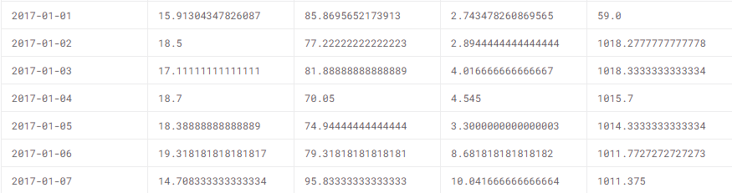
Date | Mean Temp | Humidity | Wind Speed | Mean Pressure

Slide 4
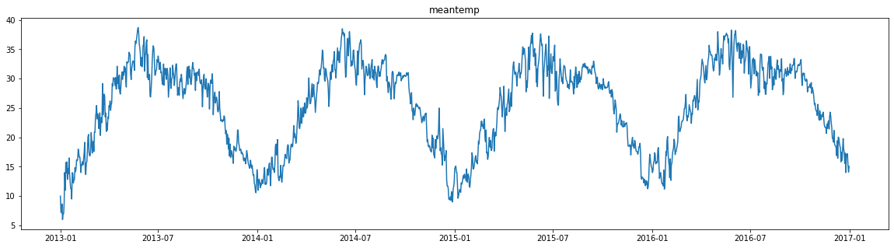
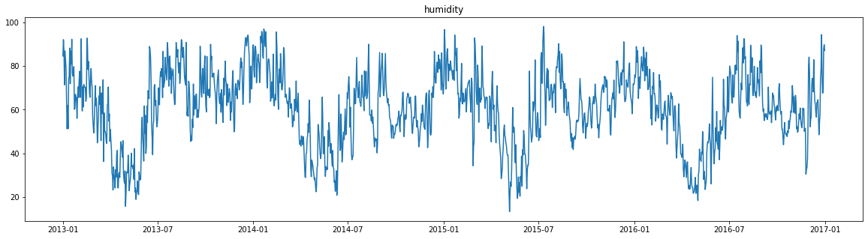
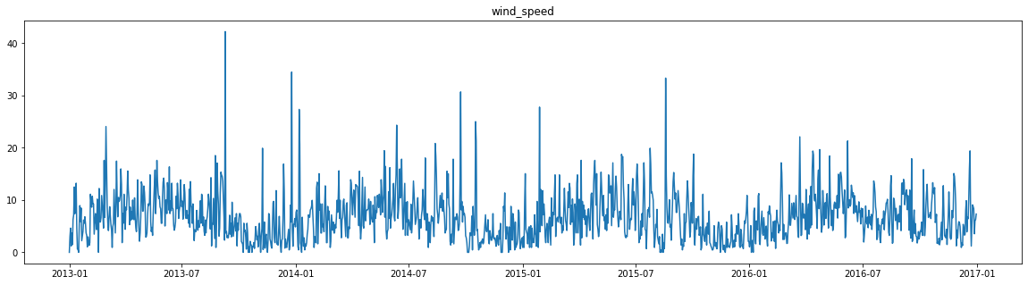
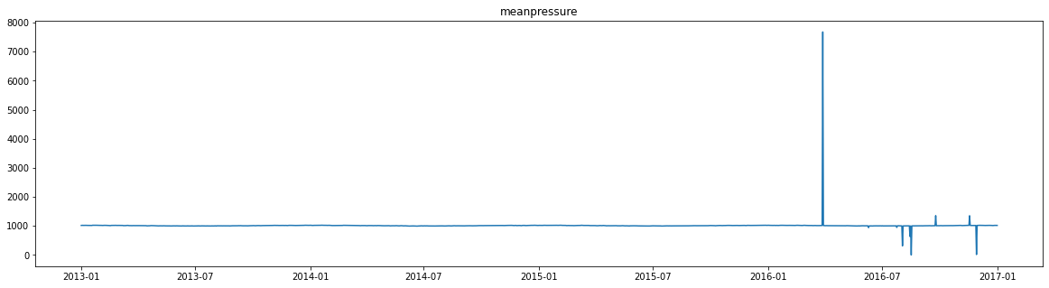

Slide 6
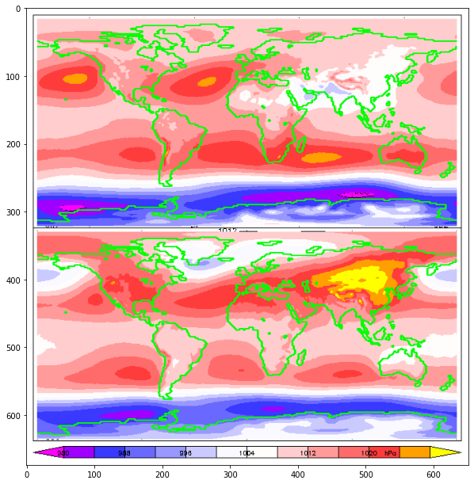
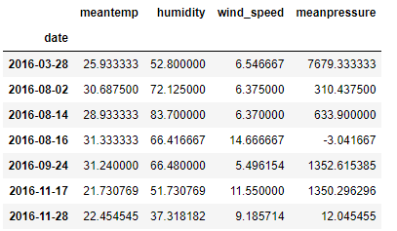
Standard air pressure at sea level is 1013.25 mb. The highest air pressure recorded was 1089 mb in Mongolia. The lowest air pressure, 870 mb, was recorded in a typhoon in the Pacific Ocean
https://www.wunderground.com/blog/weatherhistorian/world-and-us-lowest-barometric-pressure-records.html#:~:text=The%20most%20commonly%20accepted%20figure,near%20the%20island%20of%20Guam.
https://wmo.asu.edu/content/highest-sea-lvl-air-pressure-above-700m

Slide 7
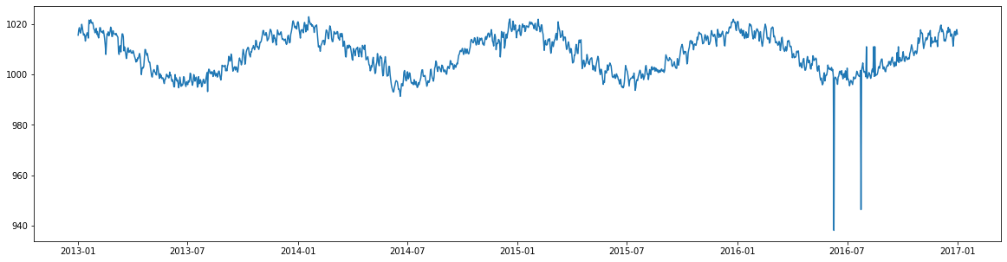

Slide 8
Let’s start building an ARIMA model

Slide 9
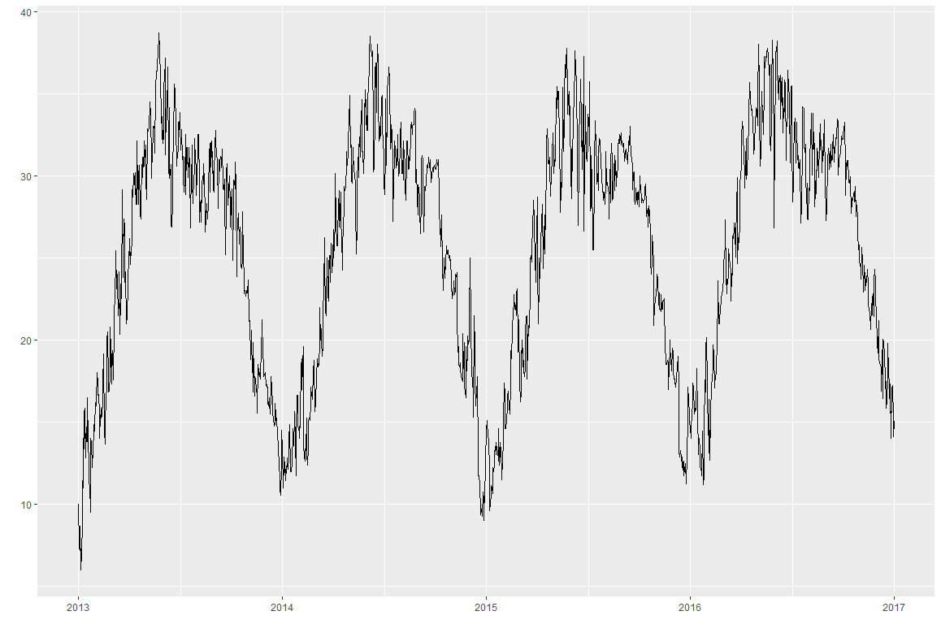
Used meantemp

Slide 10
Preliminary Testing
KPSS (level and trend)
PP
ADF
CH
OCSB
HEGY
ACF & PACF
STL Decomposition

Slide 11

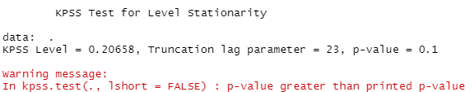
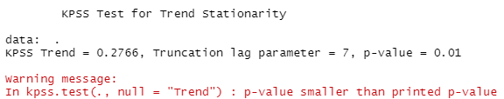
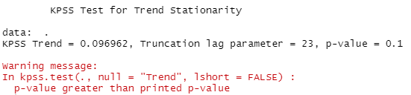
KPSS

Slide 12


PP

Slide 13



ADF

Slide 14
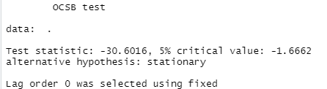
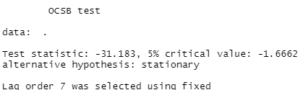
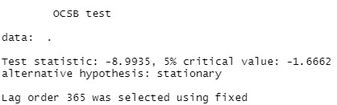
OCSB

Slide 15
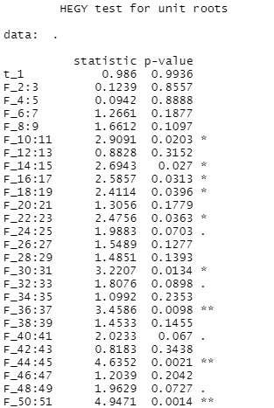
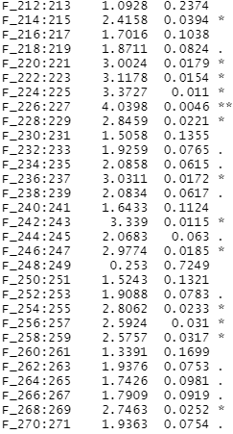
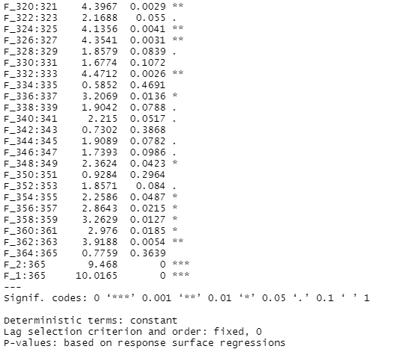
HEGY

Slide 16
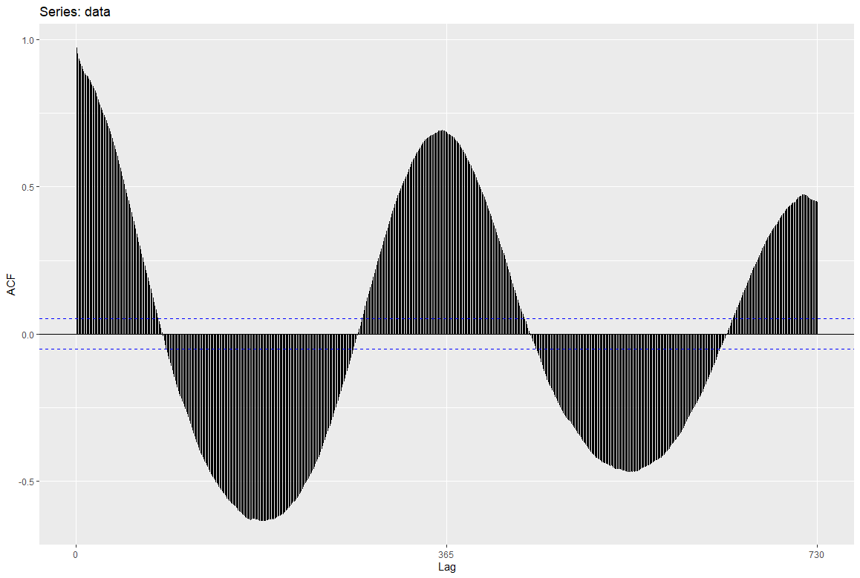
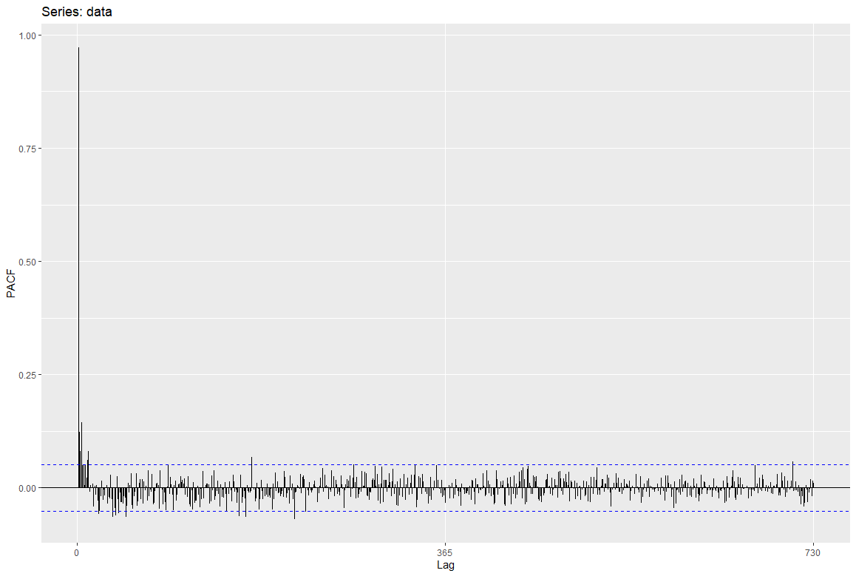
ACF & PACF

Slide 17
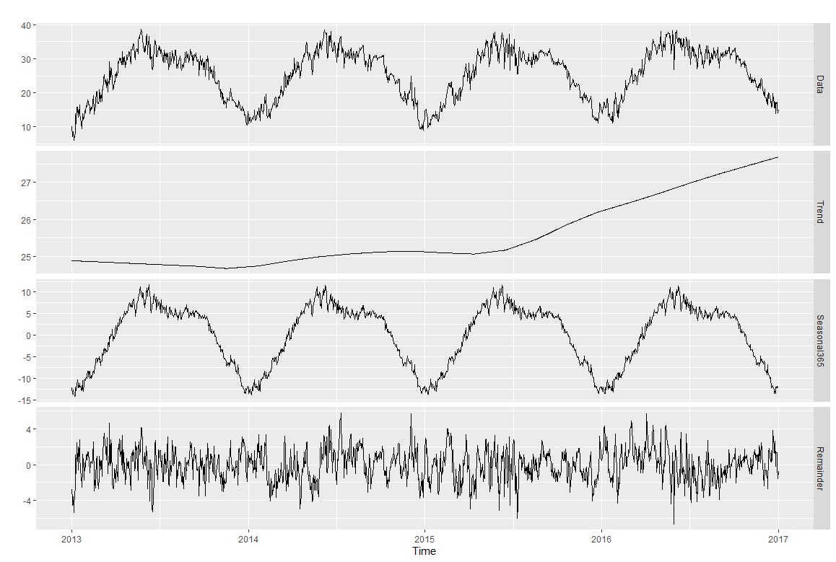
STL Decomposition

Slide 18
Reflect unit root in Trend/Level:
KPSS (for Trend) with short and long lag
KPSS (for Level) with short and long lag
ADF with short and long lag
PP for long lag
Reflect no unit root in Trend/Level:
PP with short lag
Reflect no unit root in Season:
OCSB with short and long lag
Unable to run:
CH (the lag values are too large*)
*we can get around this in a second

Slide 19
What does this all tell us about the data?
And how do we use it to build the ARIMA?

Slide 20
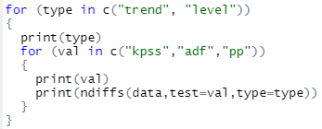

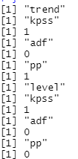

We need to difference the data! But what order of differencing do we need?
ndiffs
nsdiffs

Slide 21
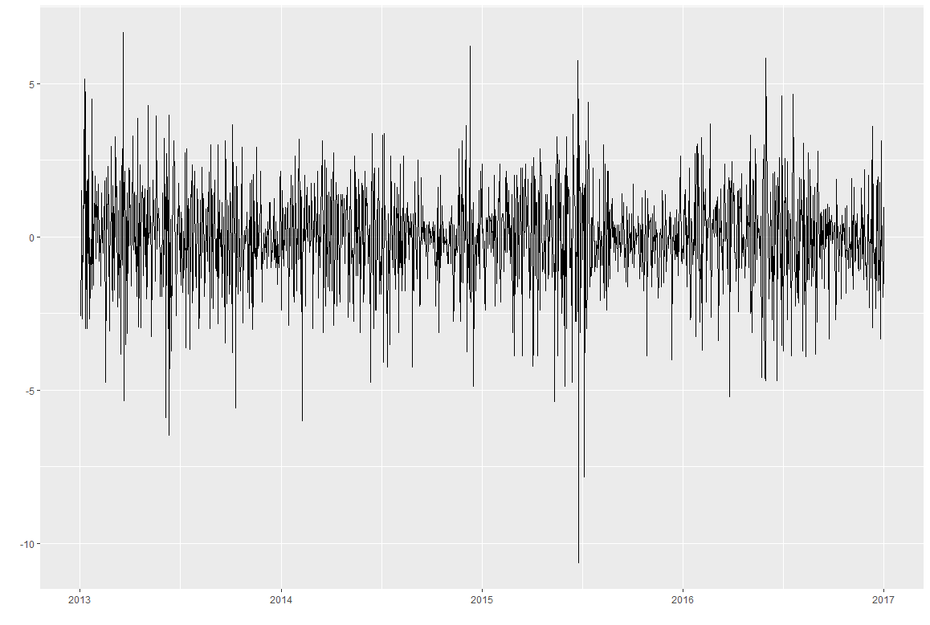
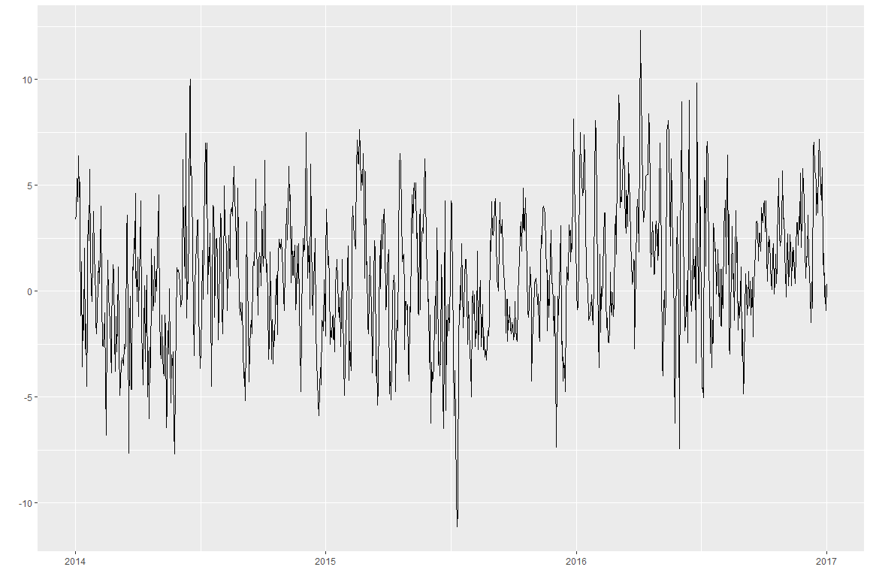
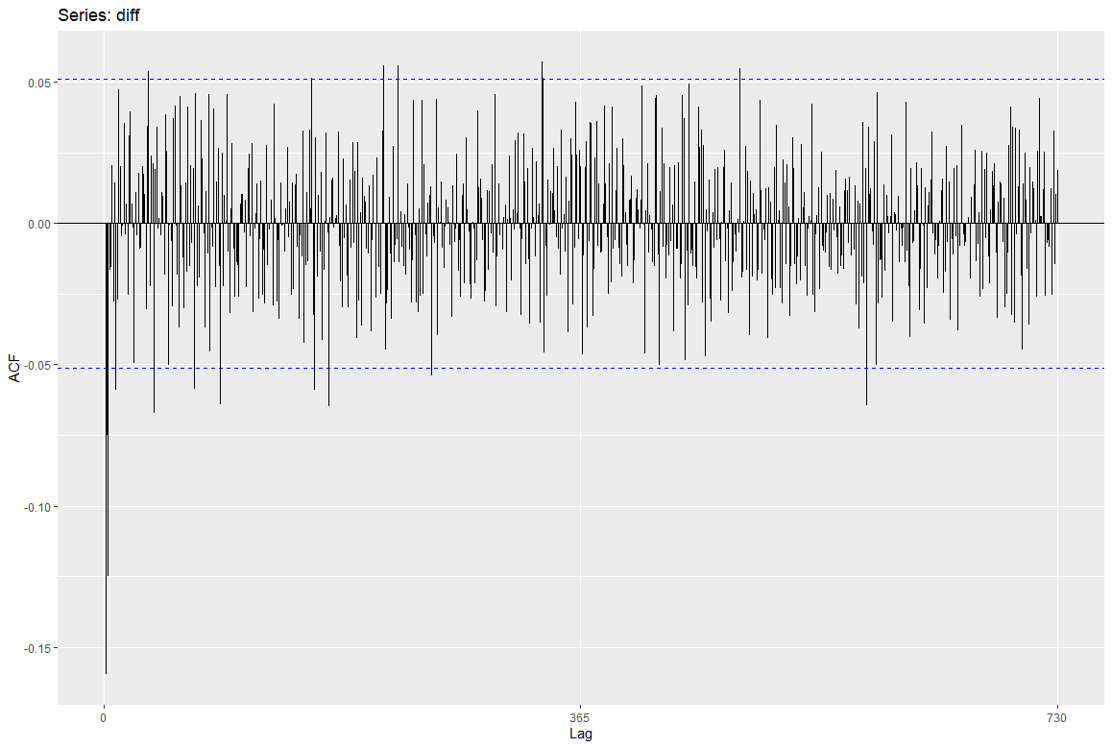
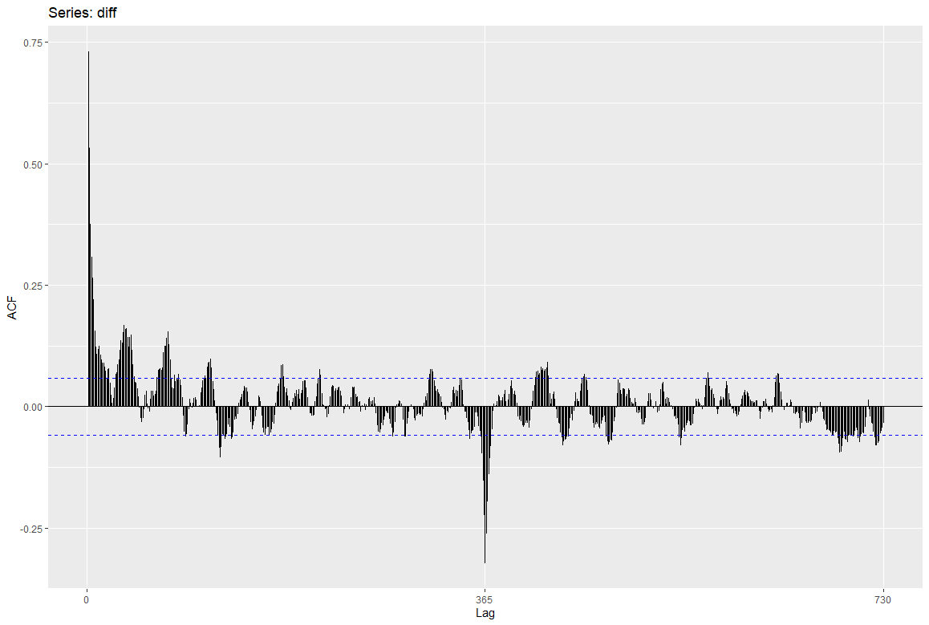
Differencing!

Slide 22
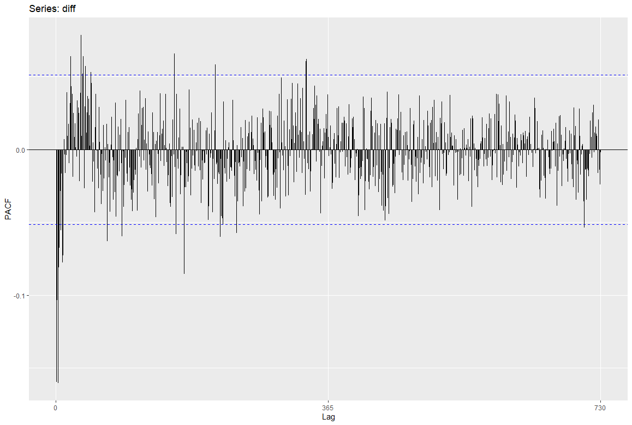
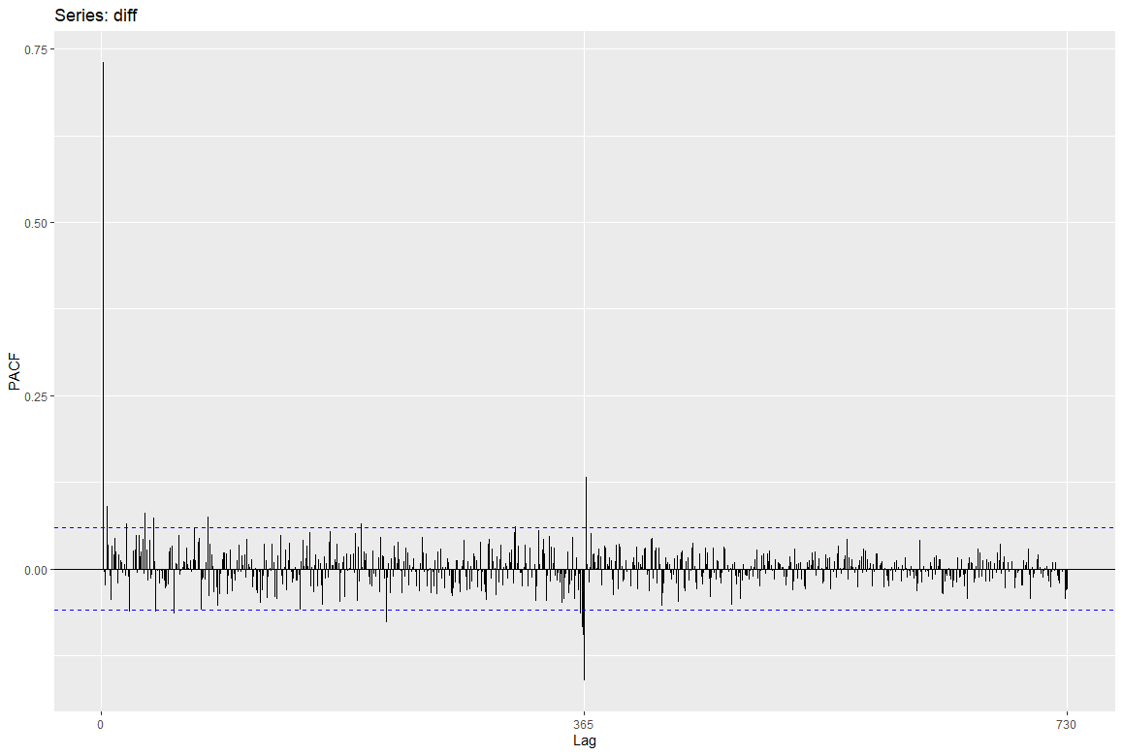


Differencing!
ndiffs
nsdiffs

Slide 23
Building ARIMA

Slide 24
What parameters to use?
ARIMA(p,d,q)(P,D,Q)[M]
Let’s look at the ACF and PACF

Slide 26
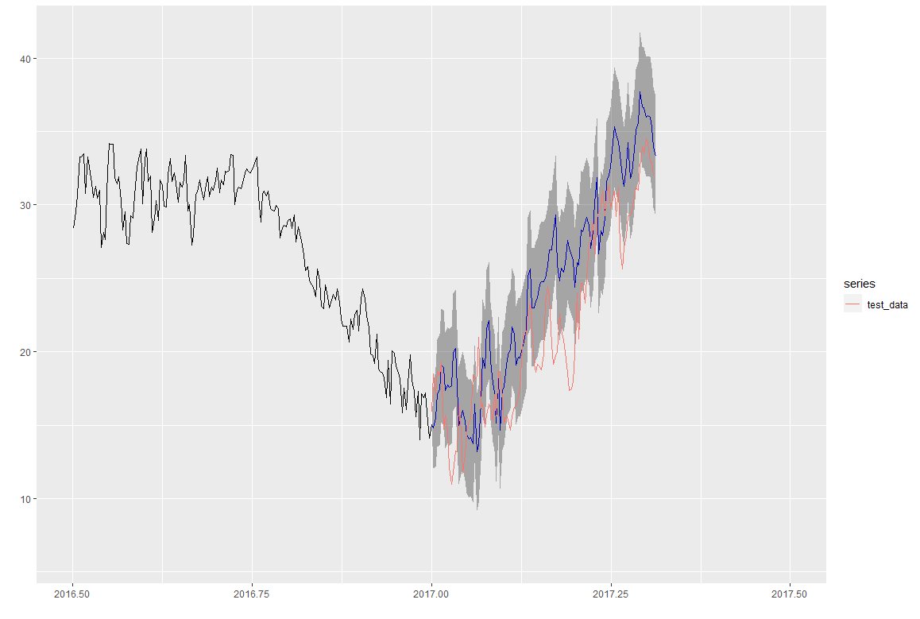
ARIMA(1,1,1)(0,1,0)[365]
Show the forecast from the model

Slide 27
Evaluation
and the metrics to do so

Slide 28
Model Evaluation
ACF (ACF1)
AIC
AICc
BIC
Ljung-Box Test
Box-Pierce Test
RMSE
ME
MAE
MPE
MAPE
MASE

Slide 29
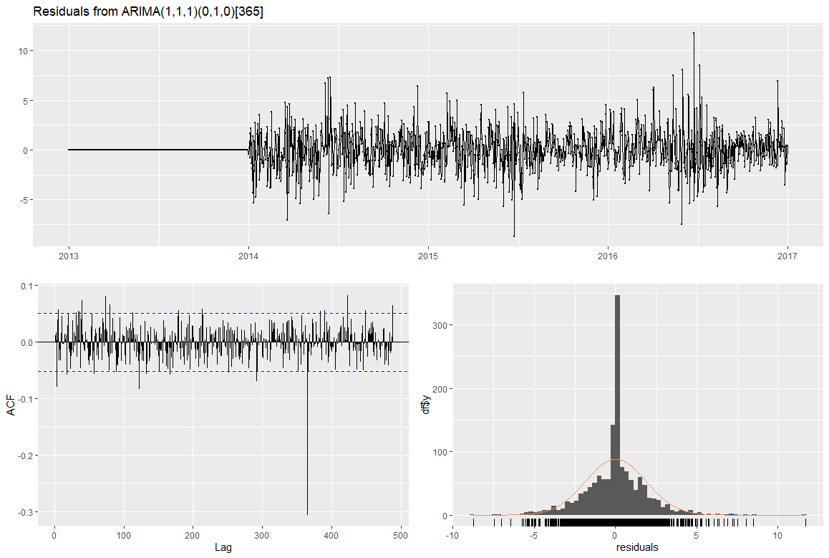
Output graph from checkresiduals

Slide 30
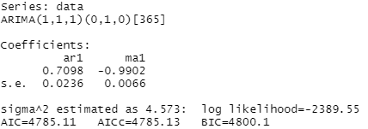



Slide 31
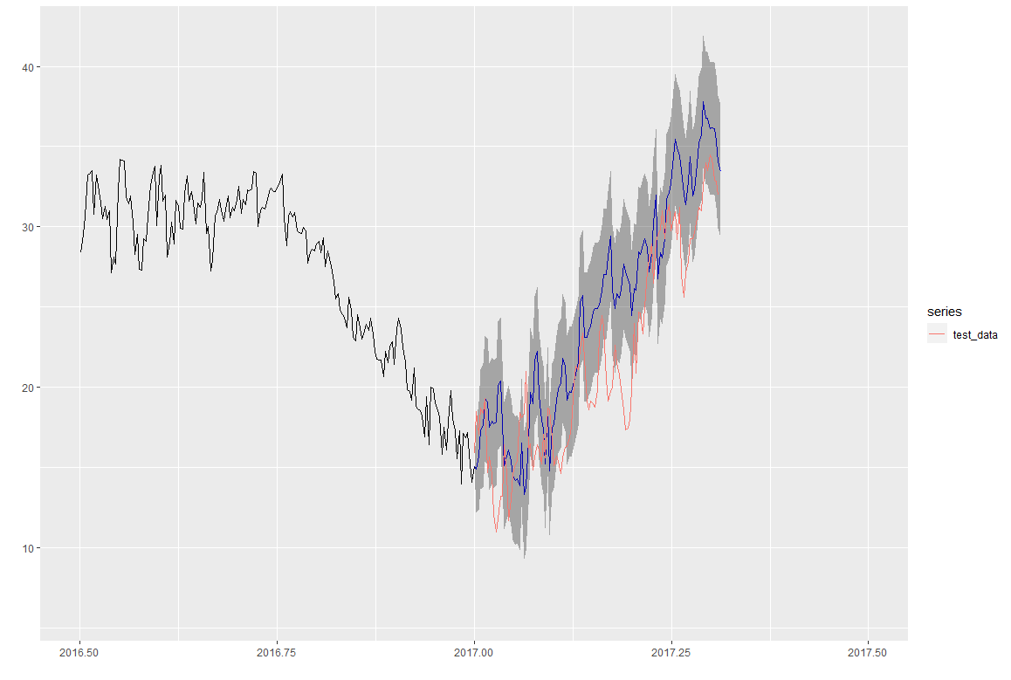
Auto.arima
There’s a version of Arima models in R that does the parameter checking by using the metrics to try and figure out the best model for us

Slide 32
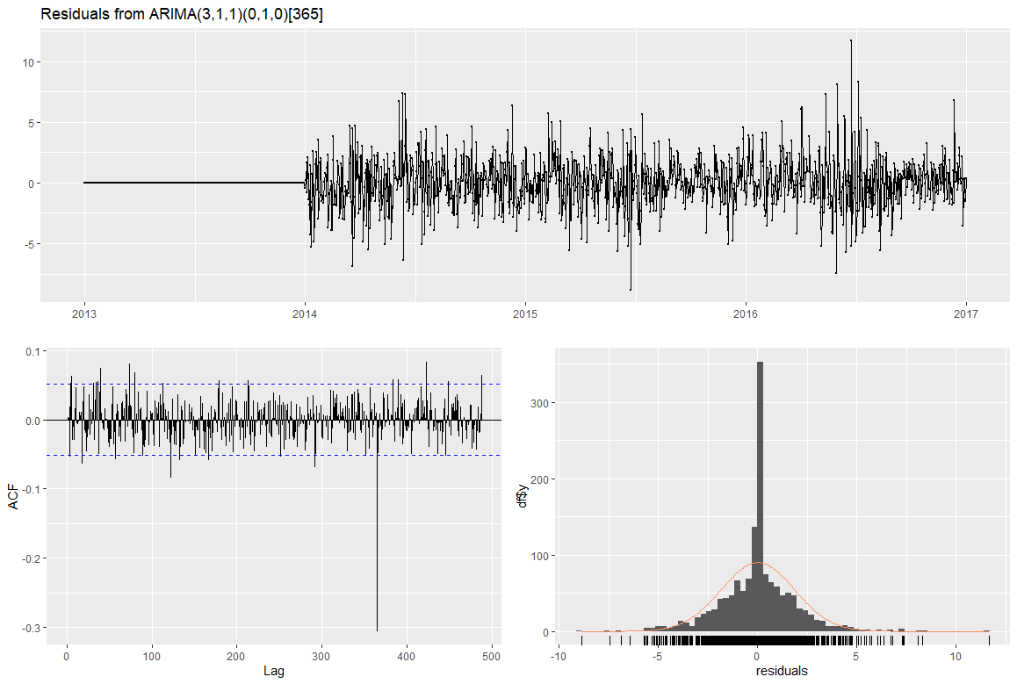

Slide 33
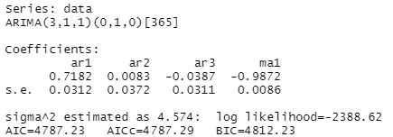



Slide 34
Thanks

