Slide 1
Lists, Tuples and Dictionaries
Quick Comprehension Check

Slide 2
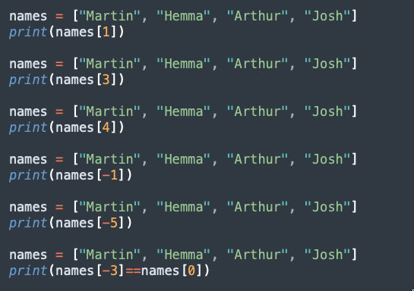
Accessing

Slide 3
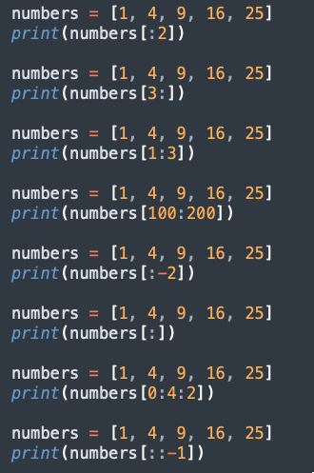
Slicing

Slide 4
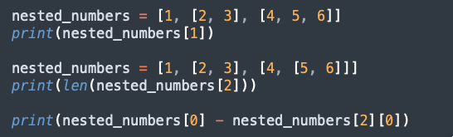
Nesting

Slide 5
Nesting

Slide 6
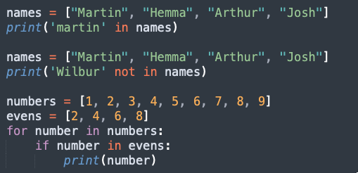
Membership operator

Slide 7
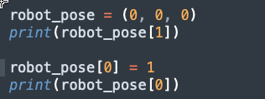
Tuples

Slide 8
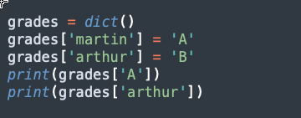
Dictionaries

