Slide 1
COMP3752 Computer Game Development Patterns/Principles/Team vs Team Combat
Peter Mitchell

Slide 2
Topics Today
Overview of the 3D Character Controller from last week.
Coroutines
ScriptableObjects
Game Design Patterns
SOLID Principles and Unity
Team vs Team Combat (based on Star Wars: Galaxy of Heroes)
Designing a Level Editor

Slide 3
Coroutines
A way to synchronously run methods that do not need to finish right away.

Slide 4
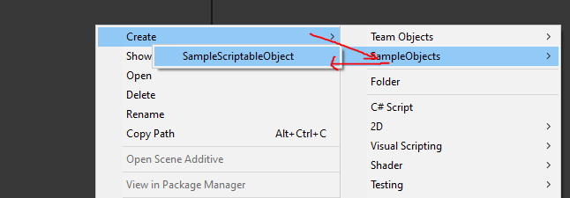
ScriptableObjects
Provide a way to define data independent of objects that can be hot swapped into objects with defining objects in the inspector.
[CreateAssetMenu(fileName = "SampleScriptableObject", menuName = "SampleObjects/SampleScriptableObject", order = 1)]
public class SampleScriptableObject : ScriptableObject
{
public string someStringData;
public int someIntValue;
public Vector3[] someListOfPoints;
}

Slide 5
Game Design Patterns
Singleton Pattern
Observer Pattern
Command Pattern
Component Pattern
Flyweight Pattern
State Pattern

Slide 6
SOLID Principles in Unity
[S]ingle Responsibility Principle
[O]pen Closed Principle
[L]iskov Substitution Principle
[I]nterface Segregation Principle
[D]ependency Inversion Principle

Slide 7
Team vs Team

Slide 8
Designing a Level Editor

Slide 9
Any Questions?
Further reading with references to a lot of content I talked about can be found in the PDF version to go with this talk.
Welcome to send me a message or ask during the Wednesday session if you have any questions about the content. Time permitting, I may give suggestions or suggest sources to look at.

