Slide 1
COMP3752 Computer Game Development Patterns/Principles/Team vs Team Combat
Peter Mitchell

Slide 2
Topics Today
Overview of the 3D Character Controller from last week.
Coroutines
ScriptableObjects
Game Design Patterns
SOLID Principles and Unity
Team vs Team Combat (based on Star Wars: Galaxy of Heroes)
Designing a Level Editor

Slide 3
Coroutines
A way to synchronously run methods that do not need to finish right away.
private IEnumerator movePlaces()
{
for(int i = 0; i < 10; i++)
{
Vector3 modifiedPosition = new Vector3(
Random.Range(origin.x - 4, origin.x + 4),
Random.Range(origin.y - 4, origin.y + 4), Random.Range(origin.z - 4, origin.z + 4));
transform.position = modifiedPosition;
yield return new WaitForSeconds(1f);
}
transform.position = origin;
}

Slide 4
Coroutines
void Update()
{
if(Input.GetKeyDown(KeyCode.Space))
{
StartCoroutine(movePlaces());
}
}

Slide 5
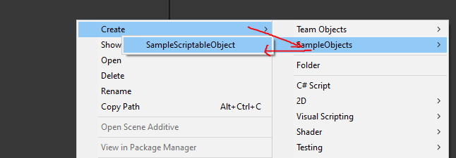
ScriptableObjects
Provide a way to define data independent of objects that can be hot swapped into objects with defining objects in the inspector.
[CreateAssetMenu(fileName = "SampleScriptableObject", menuName = "SampleObjects/SampleScriptableObject", order = 1)]
public class SampleScriptableObject : ScriptableObject
{
public string someStringData;
public int someIntValue;
public Vector3[] someListOfPoints;
}

Slide 6
Game Design Patterns
Singleton Pattern
Observer Pattern
Command Pattern
Component Pattern
Flyweight Pattern
State Pattern

Slide 7
SOLID Principles in Unity
[S]ingle Responsibility Principle
“Every class should have one responsibility.”
[O]pen Closed Principle
“Open for extension, but closed for modification.”
[L]iskov Substitution Principle
“Functions that use pointers or references to base classes must be able to use objects of derived classes without knowing it.”
[I]nterface Segregation Principle
“Many client-specific interfaces are better than one general-purpose interface.”
[D]ependency Inversion Principle
“Depend upon abstractions, not concretions.”

Slide 8
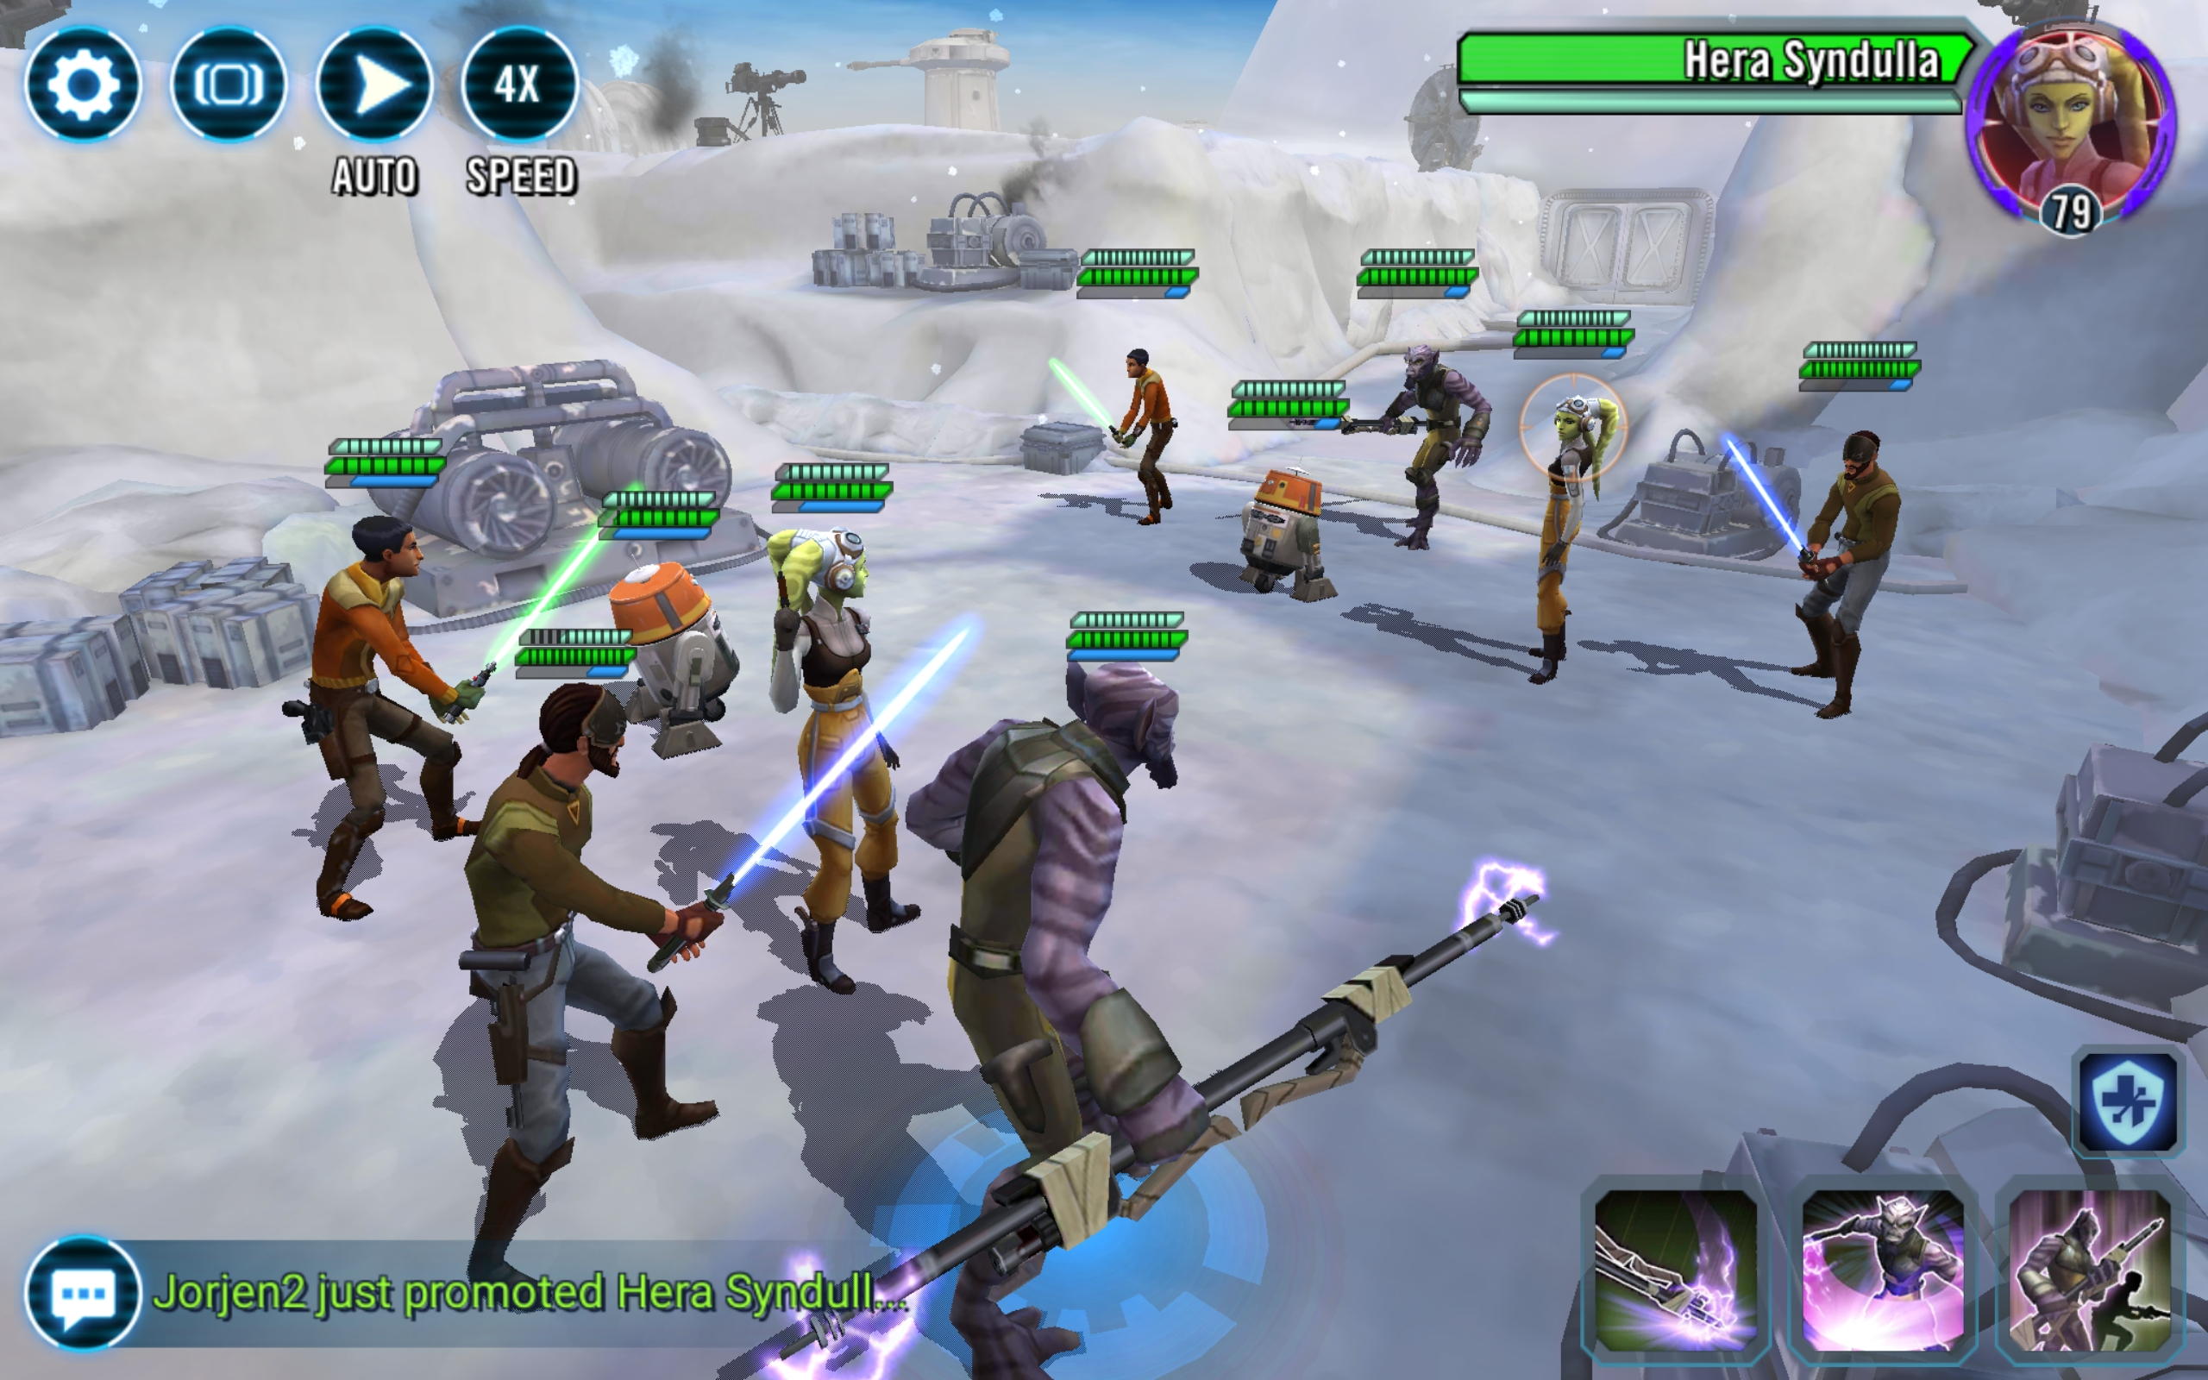
Team vs Team

Slide 9
Designing a Level Editor
If there is time I will discuss how the level editor integrates into Chad’s Challenge.

Slide 10
Any Questions?
Further reading with references to a lot of content I talked about can be found in the PDF version to go with this talk.
Welcome to send me a message or ask during the Wednesday session if you have any questions about the content. Time permitting, I may give suggestions or suggest sources to look at.

