Slide 1
COMP3752 Computer Game Development 3D Tower Defence
Peter Mitchell

Slide 2
Topics Today
Tower Defence Game
Structure of a Tower Defence, Camera Movement, State Machines, AI Behaviours, Object Management Suggestions.
3D Character Controller
Events
GameObject Composition (Single Responsibility Principle)
Chad’s Challenge (My 2011 XNA based Group Project)
Procedural 3D Grid Generation

Slide 3
Structure of a Tower Defence
Towers (Projectiles, Tower Placement)
Single target, rapid fire, area of effect, slowing
Enemies (Wave Spawning, Following Path, Unit Death or Player Failure)
Normal enemy, fast enemy, dangerous enemy, mini boss, boss
Game Flow
Initial Construction -> Spawn Wave -> Intermission -> Repeat Spawn Wave/s and Intermission -> Game End

Slide 4
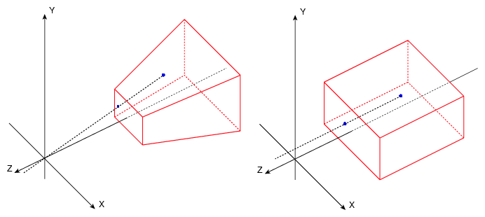
Camera Movement
transform.position (x,y,z movement)
transform.localEulerAngles (x,y,z rotation)
Restricting bounds can be applied with Mathf.Clamp(v, min, max)
Perspective Camera (left) vs Orthographic (right)

Slide 5
State Machines
There are more waves (after timer)
Initial Construction
Timer
Spawn Wave
Wave Defeated
Pause
Game Over
Victory
Complete

Slide 6
AI Behaviours
Enemies: Follow Path
Follow nodes until teleporter or death
Towers: Find targets in range and shoot

Slide 7
Object Management Suggestions
Object Pooling (reuse of objects)
Sensible Hierarchy Object Spawning (attach to a parent)
Object Reference Caching

Slide 8
3D Character Controller
CharacterController instead of Rigidbody Component

Slide 9
Events
C# and Unity variations
Use Unity Events for Unity UI and for situations where you want to set events up in the inspector. Otherwise use the C# version.
Events work by registering actions to an event. Then when something happens you tell the event to invoke causing any registered actions to be all executed.

Slide 10
GameObject Composition
Single Responsibility Principle: Each component should have a distinct job that is focused on one job.
Can use Events to decouple the requirements for components to pass important messages.

Slide 11
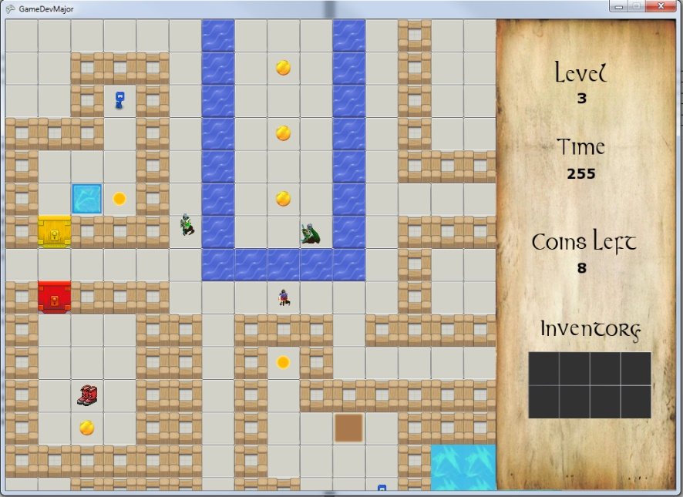
Chad’s Challenge
Game Dev project that I lead development on in 2011 version of the topic using XNA.
A game mimicking the game Chip’s Challenge.
Features a level editor that was used to make all 10 levels.

Slide 12
Procedural 3D Grid Generation
Demo generates rooms that do not overlap and joins to other rooms by creating corridors.
A Poisson Disk Sampling is then used to place objects over the grid evenly and each object’s position is validated to only spawn inside the rooms.

Slide 13

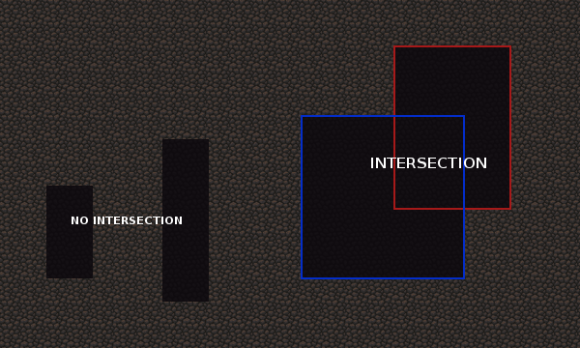
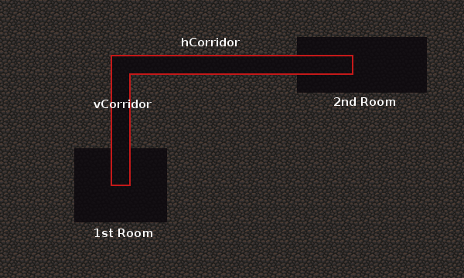
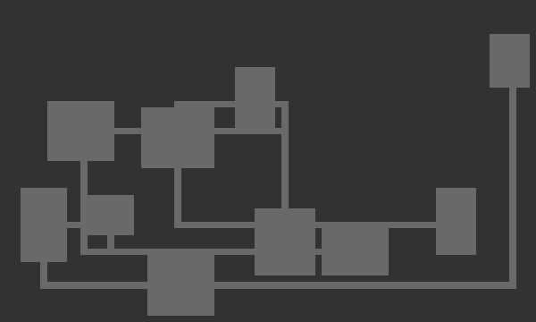
Map Generation with Rooms linked via Corridors
A
B
C
D

Slide 14
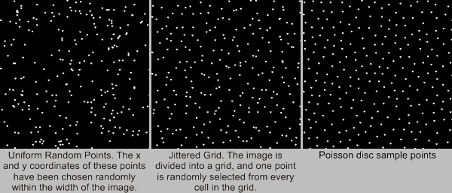
Random Distributions

Slide 15
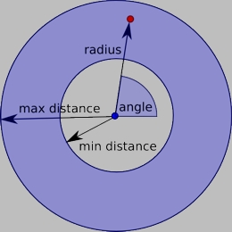
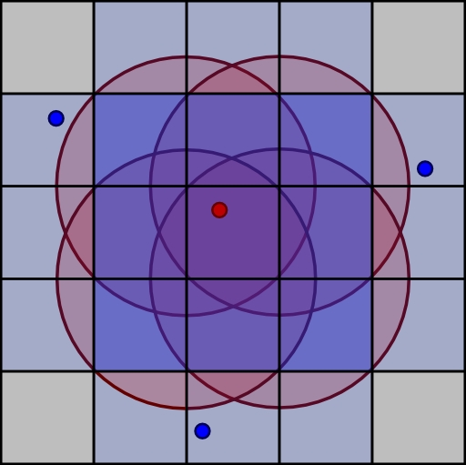
Poisson Disk Sampling
Generate Sample Point:
Check neighbours for conflicts:

Slide 16
Workshop Next Week
Next week will be the last week I’m running the Unity workshops.
If there are particular topics you would like some insight into let me know ASAP and I will try to cover them.

