Slide 1
COMP3752 Computer Game Development 2D Platformer
Peter Mitchell

Slide 2
Topics Today
Adding GameObjects in 2D
Using free Sprites from the “Free Platform Game Assets” pack
Super Meat Boy Style Character Controller
Based on code by Nyero
Using 2D Colliders, Tags, Sorting Layers, and Sprite Animation
Extras: Procedural Platformer, GitHub with Unity, Debugging with Unity.

Slide 3
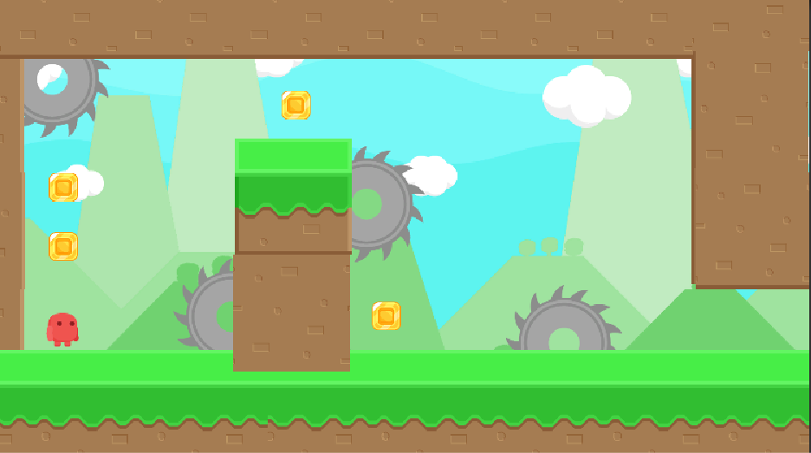
2D Platformer

Slide 4
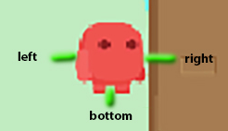
Super Meat Boy Style Character Controller
Raycasts to check for wall/ground.
Apply forces for horizontal acceleration.
Directly change velocity to jump.
Directly change velocity to “glue” to walls.

Slide 5
Platformer Procedural Generation
Populate Rooms
Create Base Map (Room/Level Boundaries)
Create Solution Path
Create Extra Platforms (not implemented)
Spawn Platforms
Spawn Objects
Determine Player Start Location

Slide 6
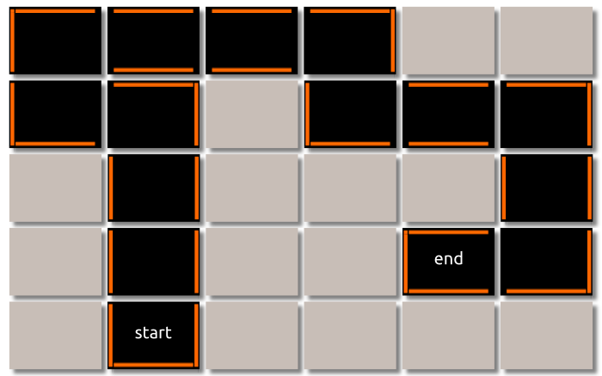
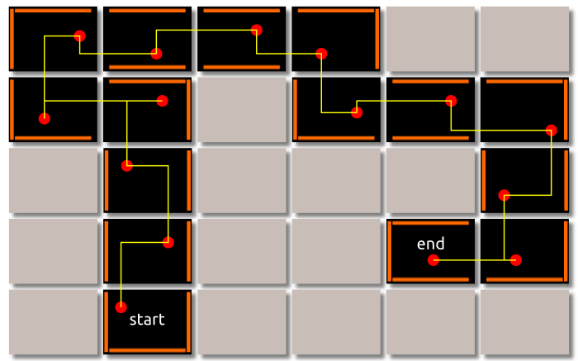
Platformer Level Layout

Slide 7
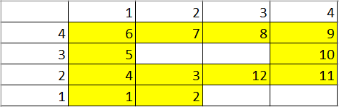
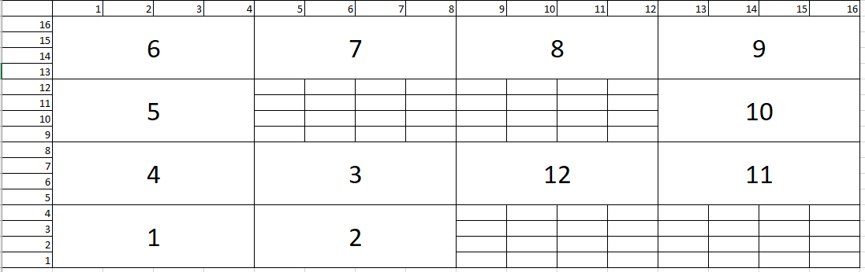
Goal to End Path Sequence Grid Generation
(1,1) to (3,2) over 12 rooms total.
Initial Path (right).
Expanded grid with 4x4 for each cell. (below)

Slide 8
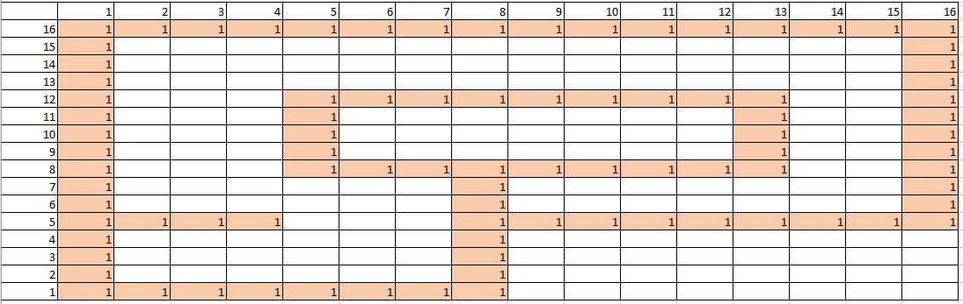
Border walls on Rooms

Slide 9
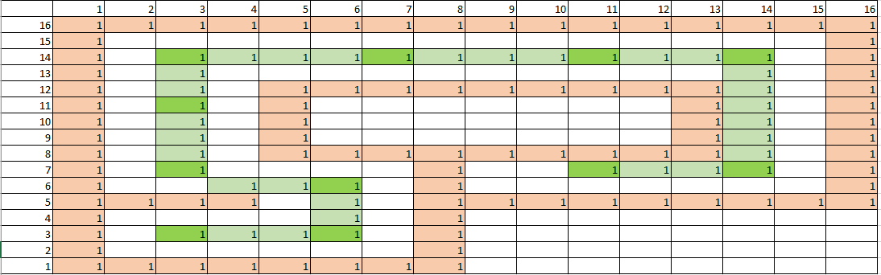
Insertion of Platforms to Link Rooms
Platform links formed from the centre of each room to the centre of the next.
Not actually coloured yet. Everything is still a dirt block as a “1” at this point.

Slide 10
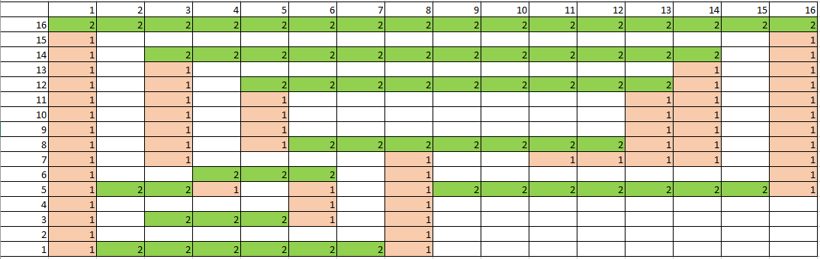
Final Pass Conversion from all 1s to 2s/1s
A search over all 1s is performed to change any to a 2 where they are the top layer.

