Slide 1
COMP3752 Computer Game Development 2D Platformer
Peter Mitchell

Slide 2
Topics Today
Adding GameObjects in 2D
Using free Sprites from the “Free Platform Game Assets” pack
Super Meat Boy Style Character Controller
Based on code by Nyero
Using 2D Colliders, Tags, Sorting Layers, and Sprite Animation

Slide 3
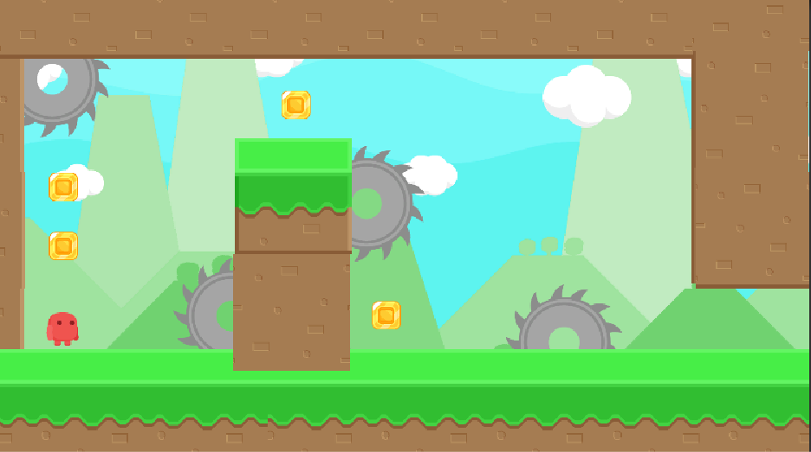
2D Platformer

Slide 4
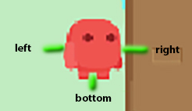
Super Meat Boy Style Character Controller
Raycasts to check for wall/ground.
Apply forces for horizontal acceleration.
Directly change velocity to jump.
Directly change velocity to “glue” to walls.

