Slide 1
ContrastCheckerPlus
Visual user’s manual as for 11.03.25

Slide 2
Starting the app
As for now, the app can be started at any time while working near the Olympus optical microscope at CeNT. Can be turned on with a shortcut on Desktop (right screen).
As the first switch-on of the contrast imaging modes can cause the program to crash (no error returned, probably some internal error in used libraries), it is advised to manually open the app, take a screenshot and switch on the contrast imaging mode, hoping for it to work. In case of a crash, repeat the process patiently.

Slide 3
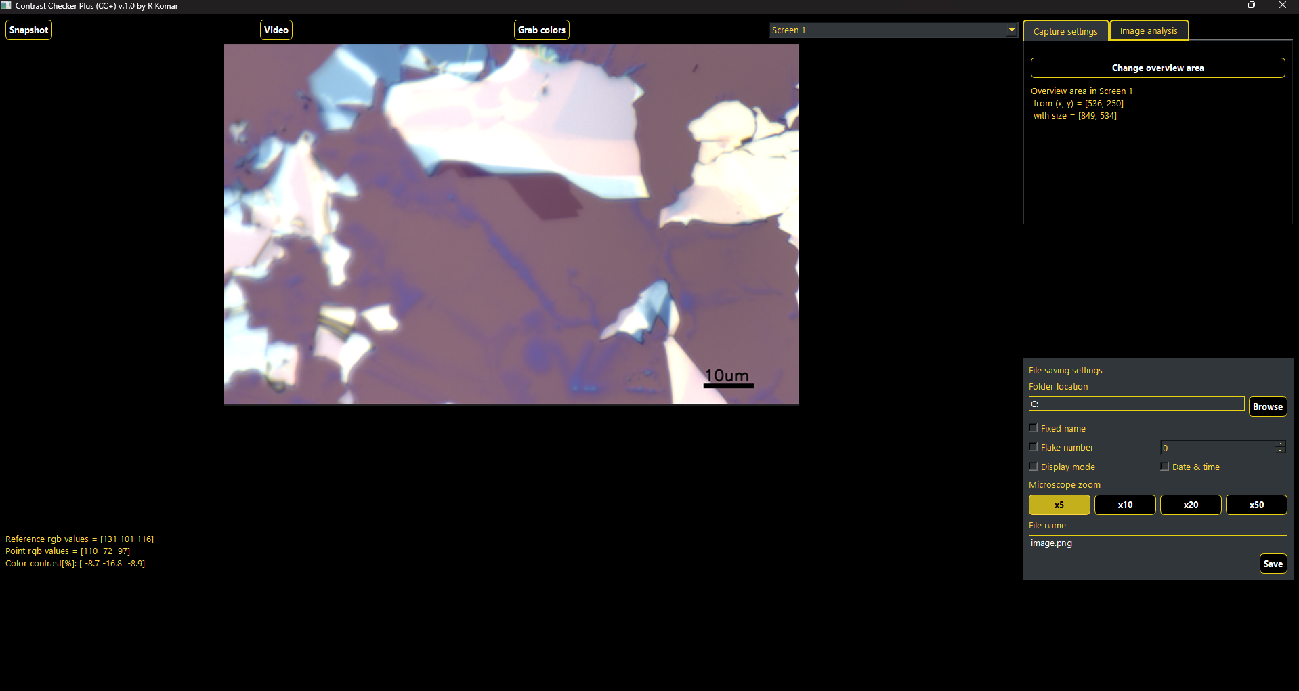
General look at the app

Slide 4
Defining overview area
# In „Capture settings” tab you can press the button to change the overview area where you take the screenshot.
# With the drop down menu (left from the tabs) you can change which monitor you want to screenshot.
When window will hides itself, you have to press-release mark the region of interest (just as the snipping tool in windows)
Text under the button will update and program will take a screenshot

Slide 5
Update the image in the app
There are two modes of taking a screenshot:
# „Snapshot” – updates the screenshot in the program
# „Video” – starts a continuous collection of screenshot (update every 50ms). It is limited by capabilities of the computer (especially with contrast mode) and is advised to use it with image in StreamMotion decreased to be around 1600px in width.

Slide 6
Grabbing colors from the image
# „Grab colors” – starts the process of the color grabbing. Then you click chosen points on the image: reference and „point”; to select colors.
# On successful choice, the RGB values of both points will be displayed below and the color contrast between the points is calculated and displayed (in %) in the last line

Slide 7
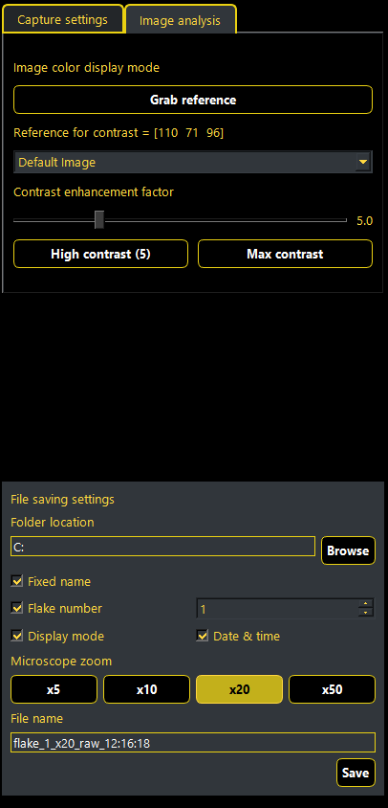
Image analysis tab
Activated when clicking the „Image analysis” header just next to the „Capture settings”.
Allows you to switch between default image and different color contrast modes (as of 11.03: one working mode (CC) and one experimental (CG) ).

Slide 8
Image analysis tab
# On „Grab reference” button pressed, starts a process similiar to „Grab colors”, but only one color is taken. On app start the reference is not defined and set as RGB = [0, 0, 0]. On successful color grab the label updates to show RGB values of selected point.

Slide 9
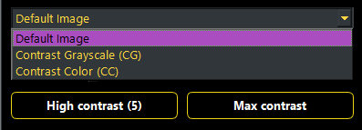
Image analysis tab
# In this drop down menu you can select contrast-imagining mode:
Default Image – grabbed screenshot with no color corrections;
Contrast Grayscale (CG) – each point on the image gets assigned values from 0 to 255 depending on how far in color it is from the reference (255 – the color is the same);
Contrast Color (CC) – each point’s color is multiplied by factor: (1 + C(P, R) * CEF), where: C(P, R) is color contrast between the point and reference; CEF – enhancement factor.

Slide 10
Image analysis tab
# Contrast enhancement factor enhancing the color differences in CC and CG modes. On app start it is set to 1 (it is multiplicative). Avaliable range is 0 to 20 with buttons for convinient change to 5 and Max (20).

Slide 11
Image analysis tab
Activated when clicking the „Image analysis” header just next to the „Capture settings”.
Allows you to switch between default image and different color contrast modes (as of 11.03: one working mode (CC) and one experimental (CG) ).
# On „Grab reference” button pressed, starts a process similiar to „Grab colors”, but only one color is taken. On app start the reference is not defined and set as RGB = [0, 0, 0]. On successful color grab the label updates to show RGB values of selected point.
# In this drop down menu you can select contrast-imagining mode:
Default Image – grabbed screenshot with no color corrections;
Contrast Grayscale (CG) – each point on the image gets assigned values from 0 to 255 depending on how far in color it is from the reference (255 – the color is the same);
Contrast Color (CC) – each point’s color is multiplied by factor: (1 + C(P, R) * CEF), where: C(P, R) is color contrast between the point and reference; CEF – enhancement factor.
# Contrast enhancement factor enhancing the color differences in CC and CG modes

Slide 12
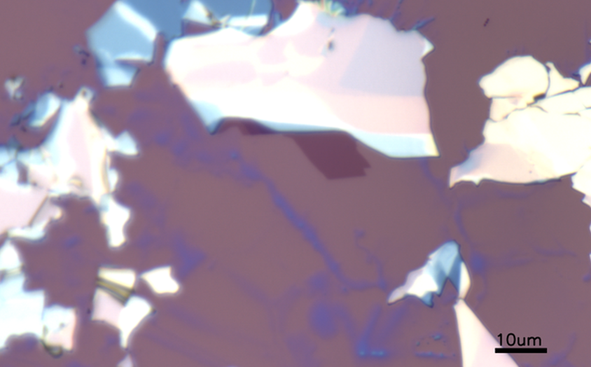
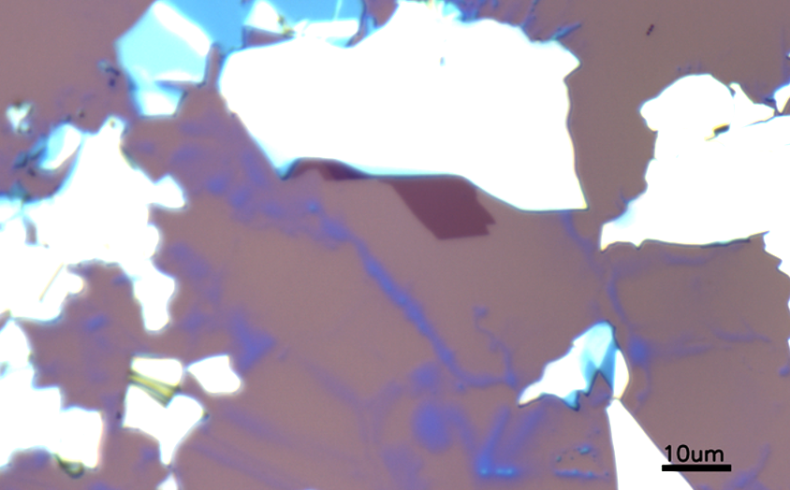
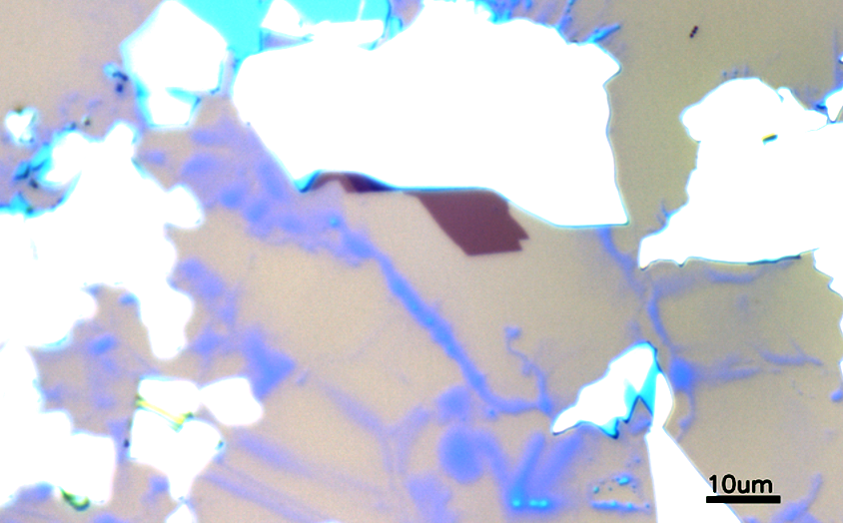
Color contrast mode (CC)
Default image
CC image with CEF = 1
CC image with CEF = 5

Slide 13
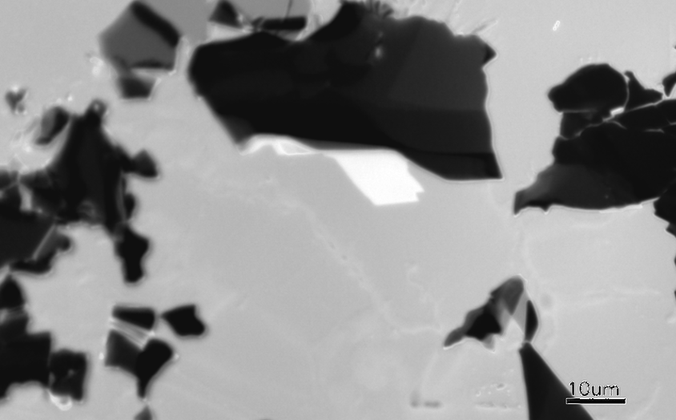
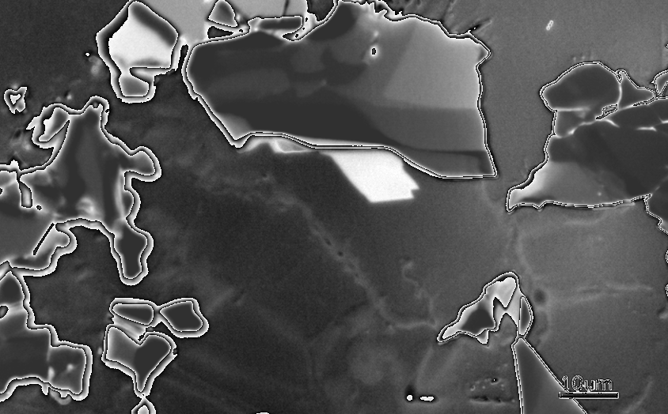
Grayscale contrast mode (CG)
buggy – work in progress
Default image
CC image with CEF = 1
CC image with CEF = 5

Slide 14
File save settings
Available all the time just below the settings tabs.
Generally used to save images from the app.

Slide 15
File save settings
# Folder location lets you specify at which location you want to save your files. In the label you can read and write the location.
On „Browse” button press, a system window will open, which lets you choose the location.

Slide 16
File save settings
# There you can specify the name of your file. The label at the bottom, just above the „Save” button, is „read” and „write” for filename.
On „Fixed name” unchecked, you can edit the filename manually (writtable in the label). On checked you can enable other options of file naming:
Flake number – number specified in the spin box in the right;
Display mode – appends a flag describing the display mode used (raw for Default, grayscale for CG, contrast for CC);
Date & time – appends time in format HH_MM_SS;
Buttons for microscope zoom to choose the magnification used (not possible to disable).
On „Save” button press the image is saved.

Slide 17
Possible future additions in the app
Flake thickness estimation based on color contrast with the substrate – needs a calibrations with many flakes for every material.
Sync with pylums and automatic sample scanning (movement around a sample through the app).
Deep Lerning-powered recognition of thin flakes for TMS and CrSBr (together with point 2. can give a fully automated flake search).
Debugging or updating code for screenshot taking to increase the speed of video.

