Slide 1
Introduction to Python Programming
Introduction to String Methods
So far we have discussed mainly how to process numerals using different functions. However, in Python we have several string functions which can be used to manipulate strings. We will now discuss few important string related functions and then we will apply those functions.
String Method | Description of the Method
len(s) | Returns the length of ‘s’
s.count(sub[, start [, end]]) | Returns the number of non-overlapping occurrences of substring sub in s. optional arguments start and end are interpreted as in slice notation.
s.endswith(sub [,start [, end]]) | Returns True if s ends with sub or False otherwise
s.find(sub [,start [, end]]) | Returns the lowest index ‘s’ where substring sub is found. Optional arguments start and end are interpreted as in slice notation.
s.isalpha() | Returns True if s contains only letters or false otherwise.

Slide 2
Introduction to Python Programming
Introduction to String Methods(contd..)
String Method | Description of the Method
s.isdigit() | Returns True if s contains only digits or False otherwise
s.join(sequence) | Returns a string that is the concatenation of the strings in the sequence. The separator between elements is s.
s.lower() | Returns a copy of s converted to lowercase.
s.upper() | Returns a copy of s converted to upprcase.
s.replace(old,new [,count]) | Returns a copy of s with all occurrences of substring old replaced by new. If the optional argument count is given , only the first count occurrences are replaced.
s.startwith(sub) | Returns True if s starts with sub or False otherwise.
In our next slide we will show examples on String handling.

Slide 3
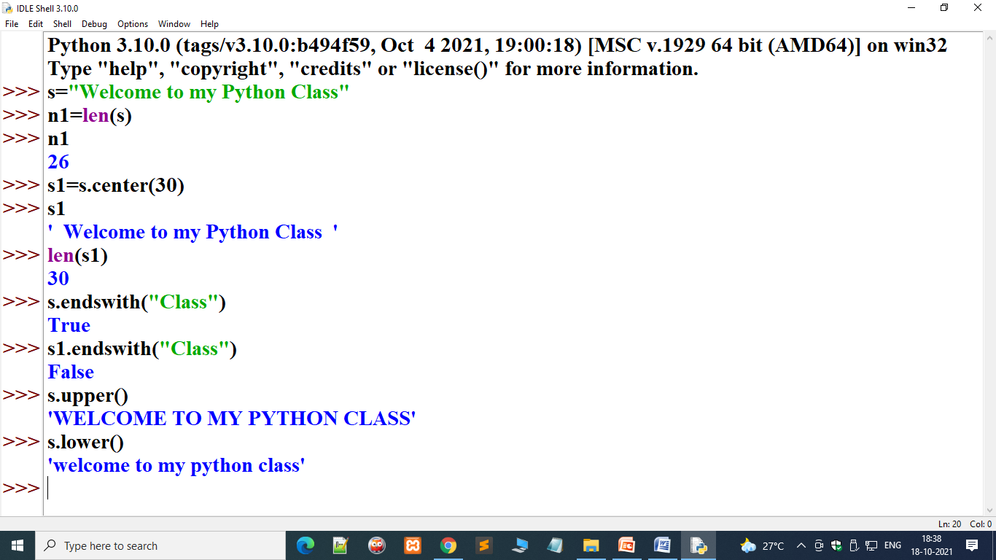
Introduction to Python Programming
Introduction to Strings
Example of Lists(contd..):

Slide 4
Introduction to Python Programming
Introduction to Strings
Exercises on String Manipulation: Assignment-3
1. q1as3.py: Input any sentence. Reverse it. Display modified sentence.
2. q2as3.py: Input any sentence/string. Print whether it is Palindrome/Not a Palindrome.
q3as3.py: Input any sentence and remove all spaces from LHS of that sentence.
q4as3.py: input any sentence and remove all extra spaces from RHS of that sentence.
q5as3.py: Input any name such as “Felix Raymond Anthony Desouza”. Modify the name as follows “Desouza, Felix Raymond Anthony” and print the modified name.
6. q6as3.py : Write a program to calculate number of vowels in a sentence.
7. q7as3.py: Write a program to calculate number of consonants in a sentence ‘s’
8. q8as3.py: Input any sentence and extract all words from that sentence and display
on screen.
9. q9as3.py : Write a program to input a string ‘s’ and pattern to be searched ‘p’. The program will display how many times ‘p’ found in ‘s’.
q10as3.py: Write a program to input any +ve integer (1-9999999) and convert it
into corresponding words. [ Example: 3232335 : Thirty Two Lakh Thirty Two Thousand Three Hundred Thirty Five.]

Slide 5
Introduction to Python Programming
Introduction to Strings
Exercises on String Manipulation: Assignment-3
Q.No.8: Suppose our sentence is
S=“This is a test,.. Sentence<>()this is (my) End.”
Output:
This
Is
A
test
Sentence
This
Is
My
End
Number of words=9

Slide 6
Introduction to Python Programming
Introduction to Strings
Exercises on String Manipulation: Assignment-3
N=3232335
One,two,three,…..,nineteen ➔ 19 words ➔a()
Twenty,thirty,forty,…,ninety → 8 words ➔ b()
Hundred,Thousand,Lakh ➔ 3 words
N=3232395
Nlkh=n//100000 ➔32
N=n%10000=32395
Nth=n/1000➔32
N=n%1000=395
Nh=n//100➔3
N=n%100➔95

Slide 7
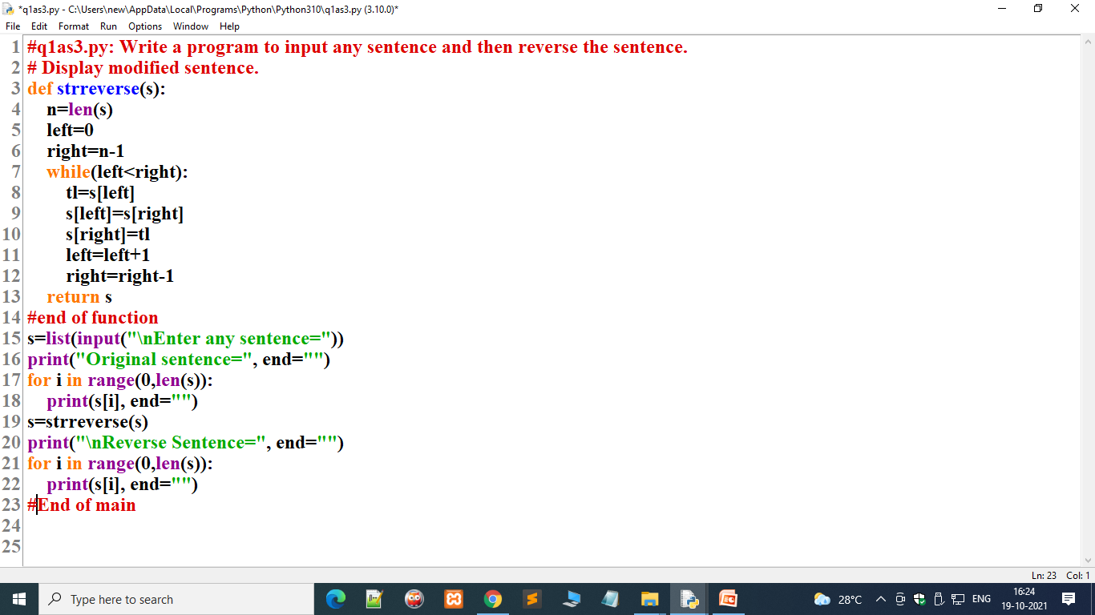
Introduction to Python Programming
Introduction to Strings
1. Solution of q1as3.py: Input any sentence. Reverse it. Display modified sentence.

Slide 8
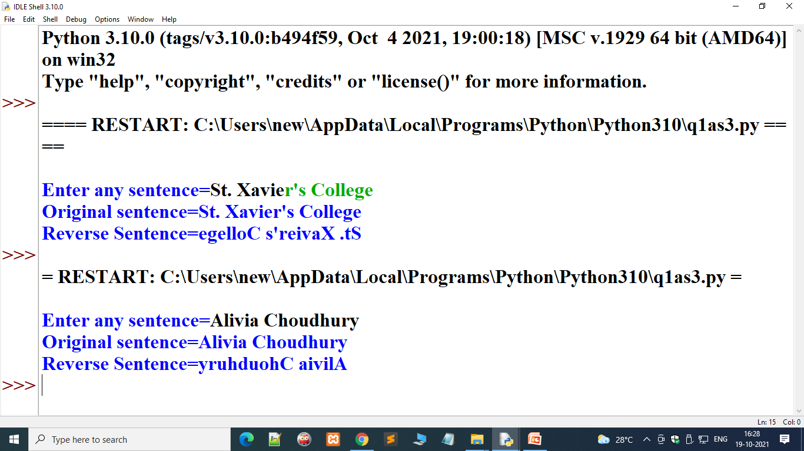
Introduction to Python Programming
Introduction to strings
1. Solution of q1as3.py(contd..): Input any sentence. Reverse it. Display modified sentence.

Slide 9
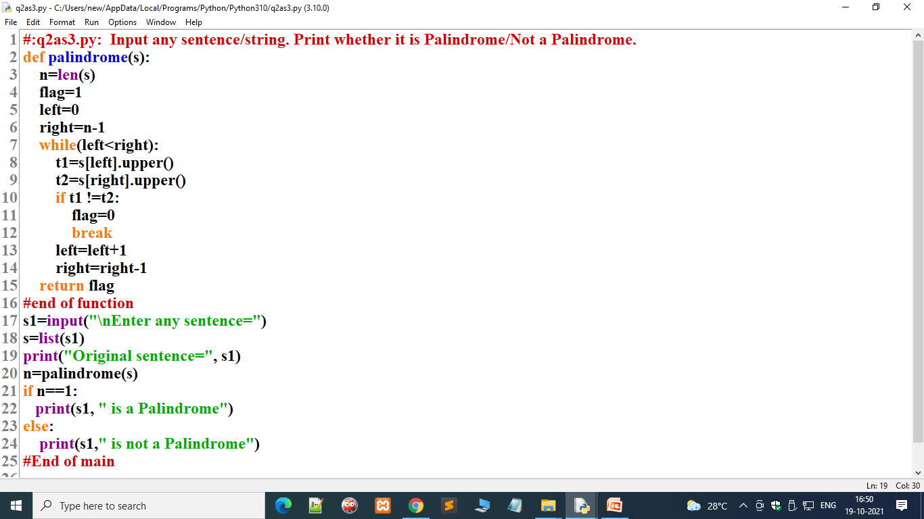
Introduction to Python Programming
Introduction to Strings
Solution of :Q-2: q2as3.py: Input any sentence/string. Print whether it is Palindrome/Not a Palindrome.

Slide 10
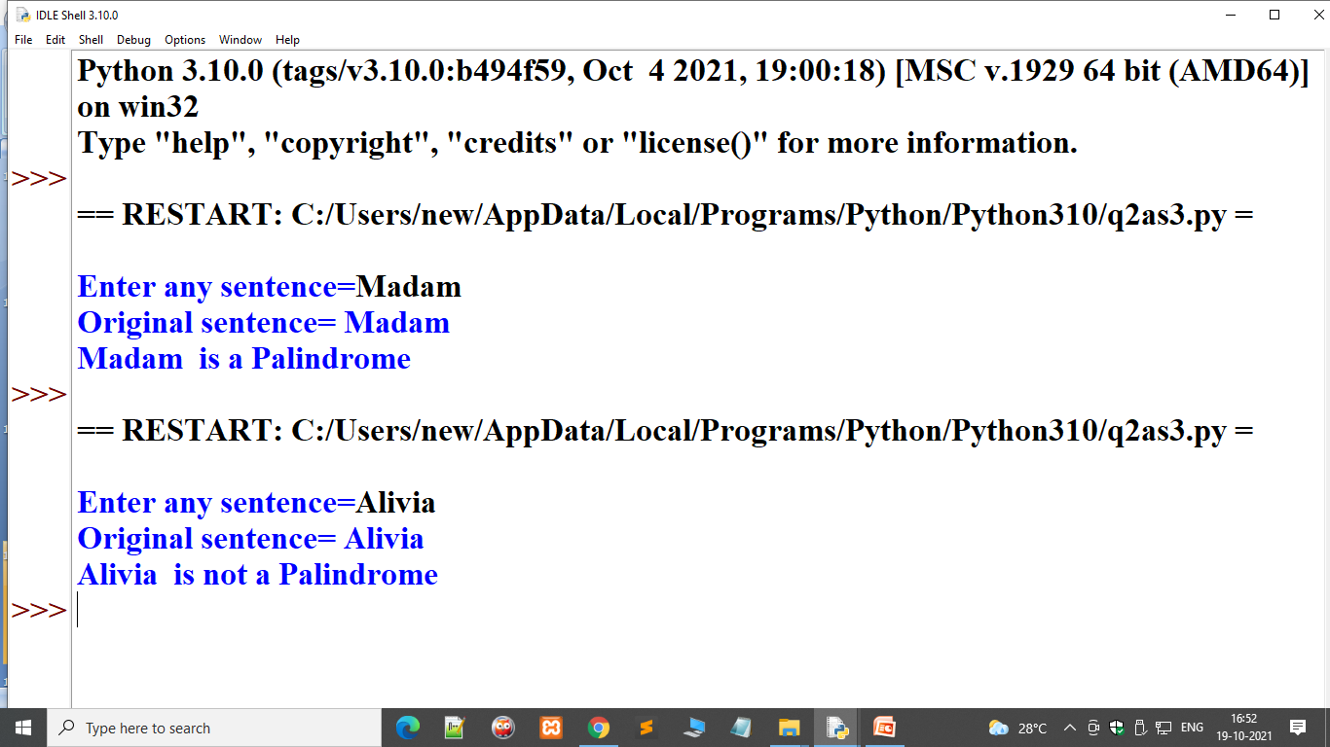
Introduction to Python Programming
Introduction to Strings
Solution of :Q-2: q2as3.py(contd..): Input any sentence/string. Print whether it is Palindrome/Not a Palindrome.

Slide 11
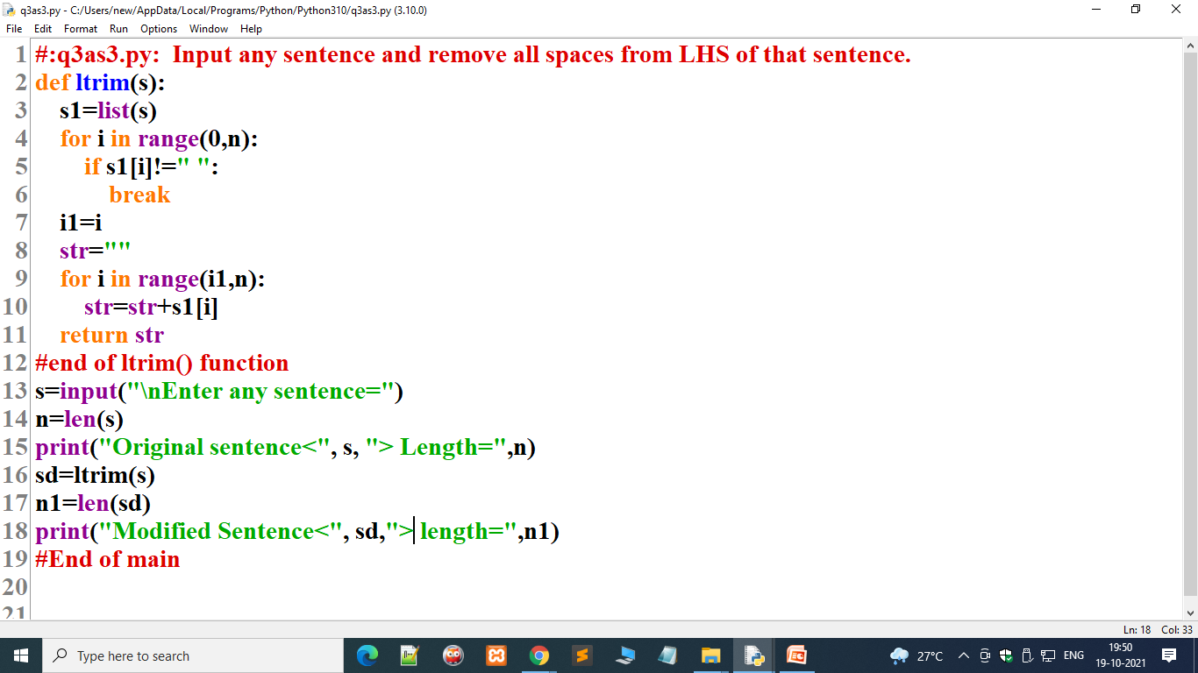
Introduction to Python Programming
Introduction to Strings
3. Solution of q3as3.py: Input any sentence and remove all spaces from LHS of that sentence.

Slide 12
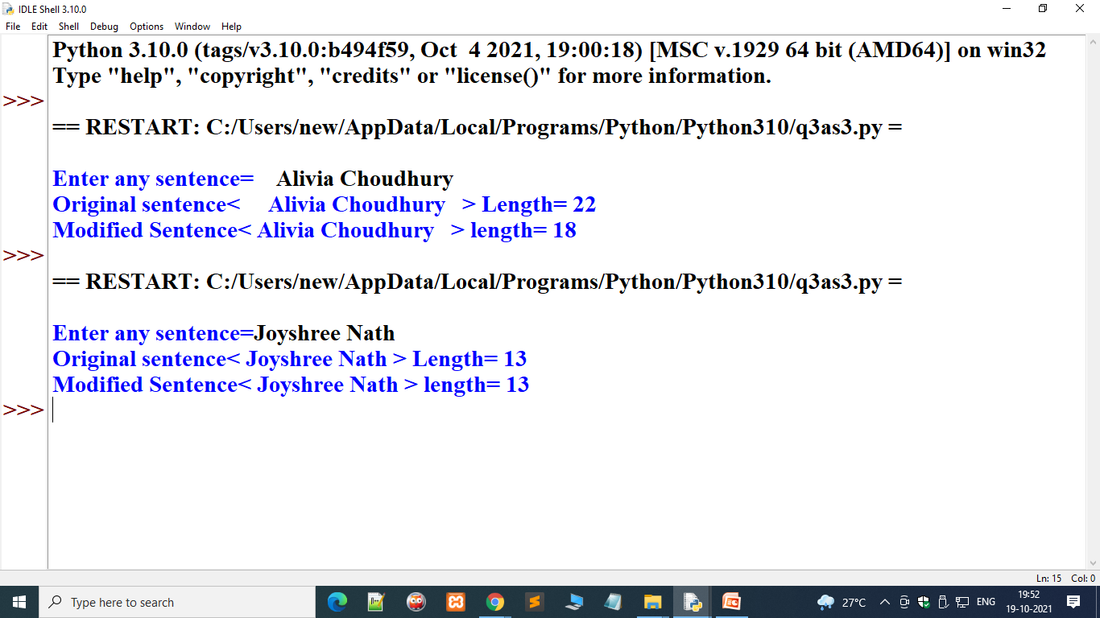
Introduction to Python Programming
Introduction to Strings
3. Solution of q3as3.py(contd..): Input any sentence and remove all spaces from LHS of that sentence.

Slide 13

Introduction to Python Programming
Introduction to Strings
4. Solution of q4as3.py: Input any sentence and remove all spaces from RHS of that sentence.

Slide 14
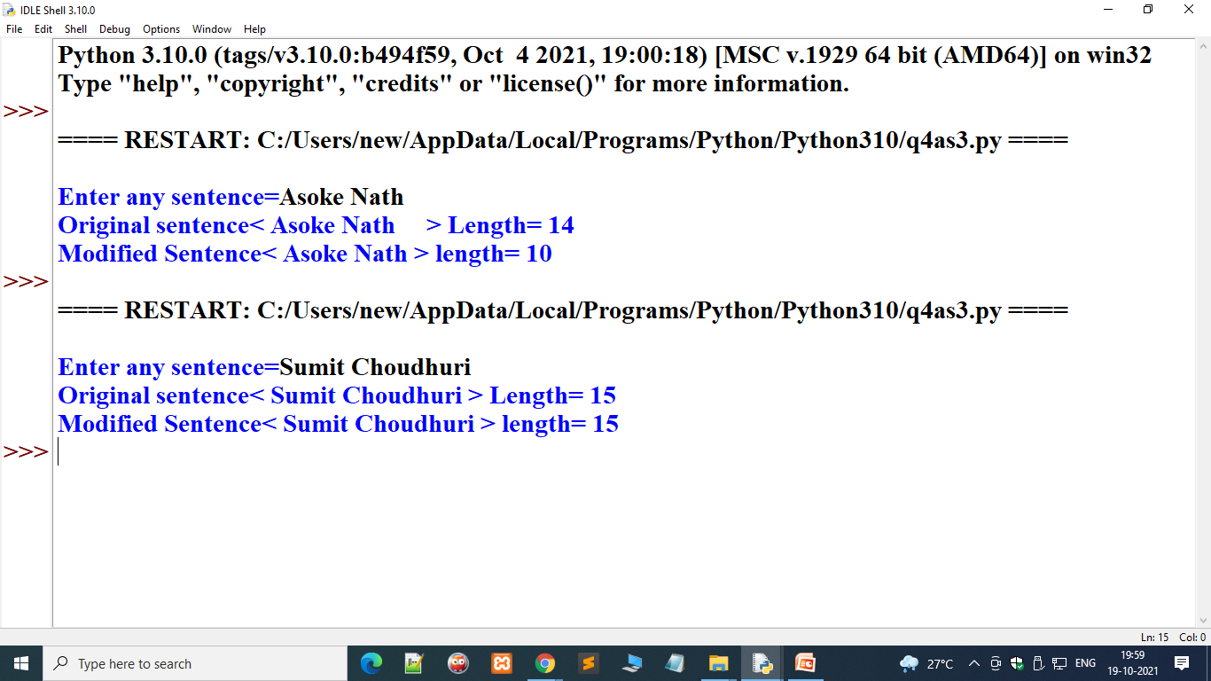
Introduction to Python Programming
Introduction to Strings
4. Solution of q4as3.py(contd..): Input any sentence and remove all spaces from RHS of that sentence.

Slide 15
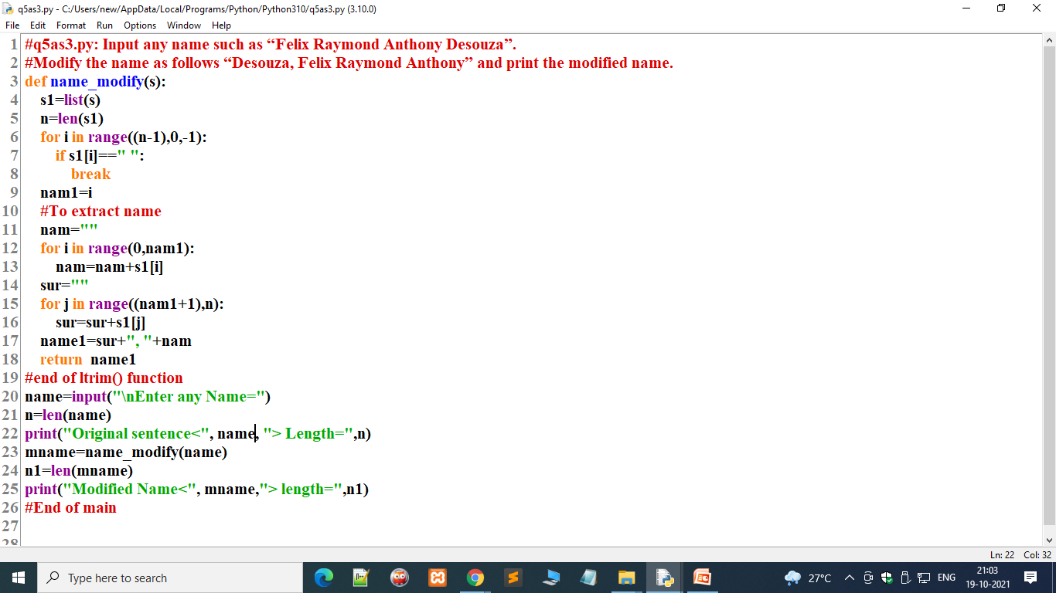
Introduction to Python Programming
Introduction to Strings
5. Solution of q5as3.py: Input any name such as “Felix Raymond Anthony Desouza”. Modify the name as follows “Desouza, Felix Raymond Anthony” and print the modified name.

Slide 16
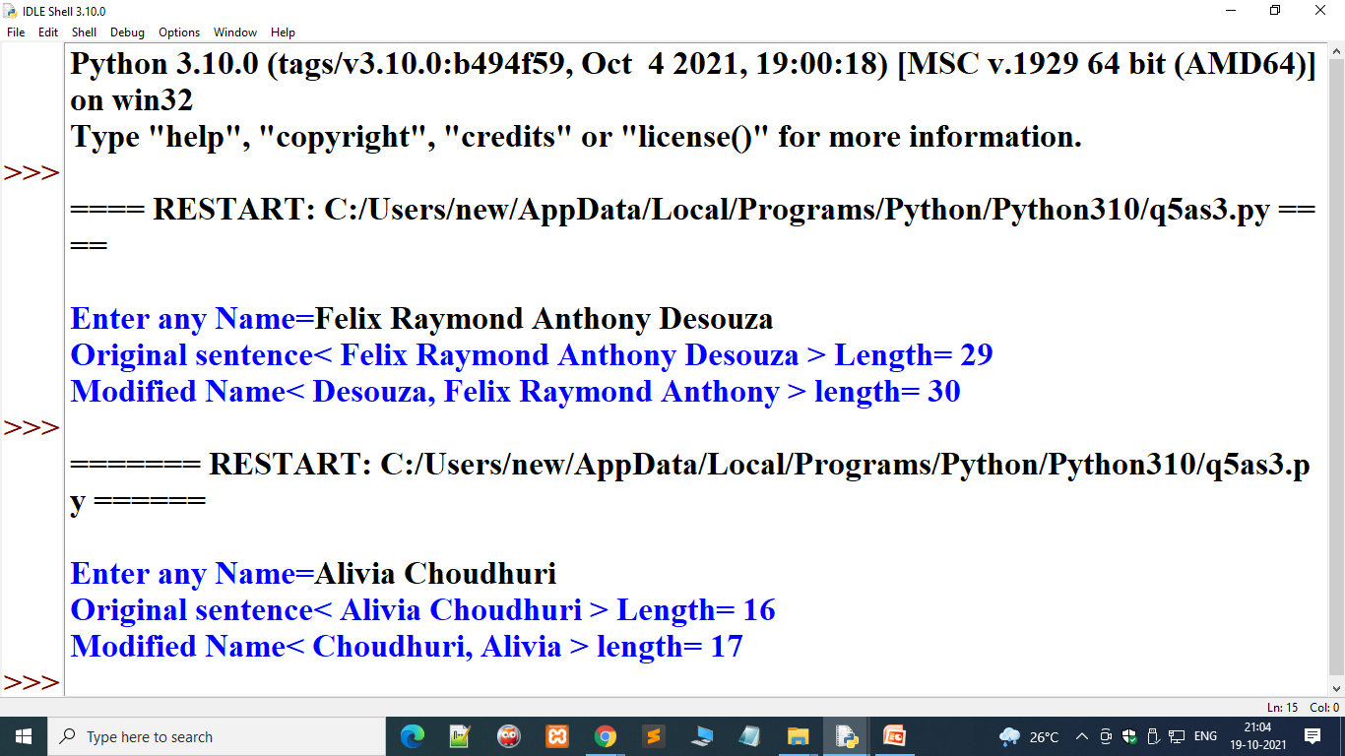
Introduction to Python Programming
Introduction to Strings
5. Solution of q5as3.py(contd..): Input any name such as “Felix Raymond Anthony Desouza”. Modify the name as follows “Desouza, Felix Raymond Anthony” and print the modified name.

Slide 17
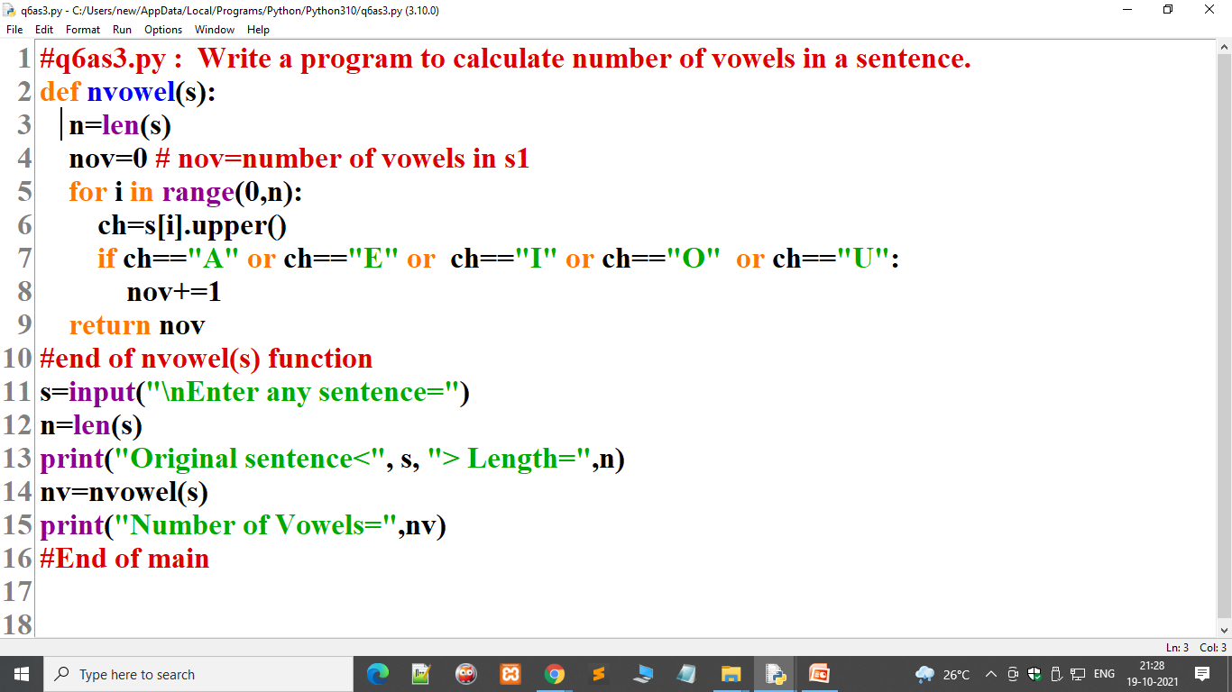
Introduction to Python Programming
Introduction to Strings
6. Solution of q6as3.py : Write a program to calculate number of vowels in a sentence.

Slide 18
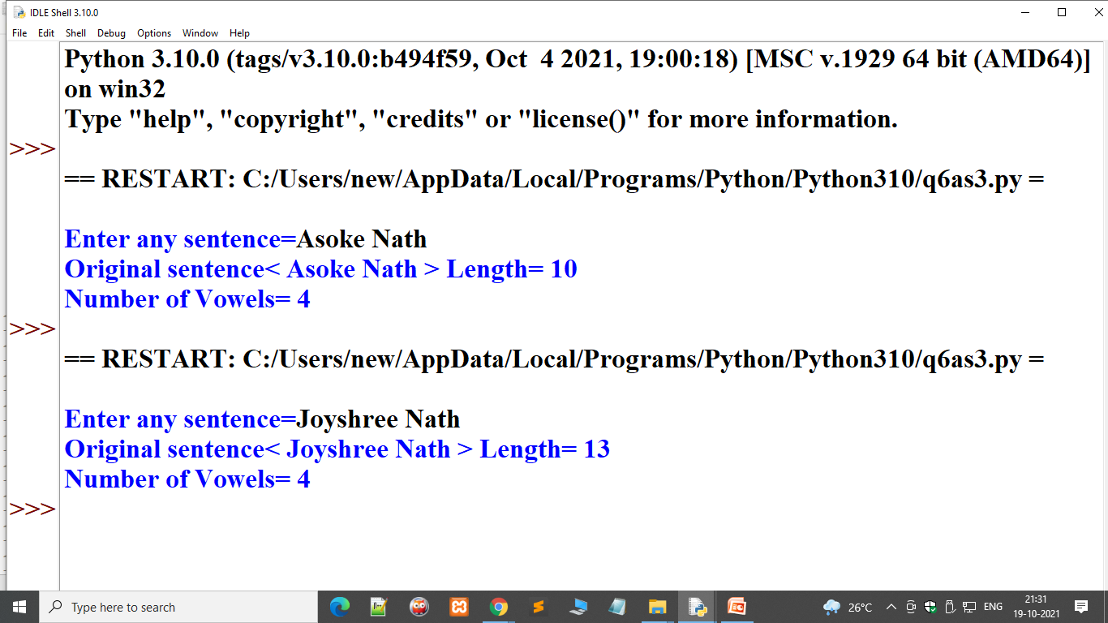
Introduction to Python Programming
Introduction to Strings
6. Solution of q6as3.py(contd..) : Write a program to calculate number of vowels in a sentence.

Slide 19
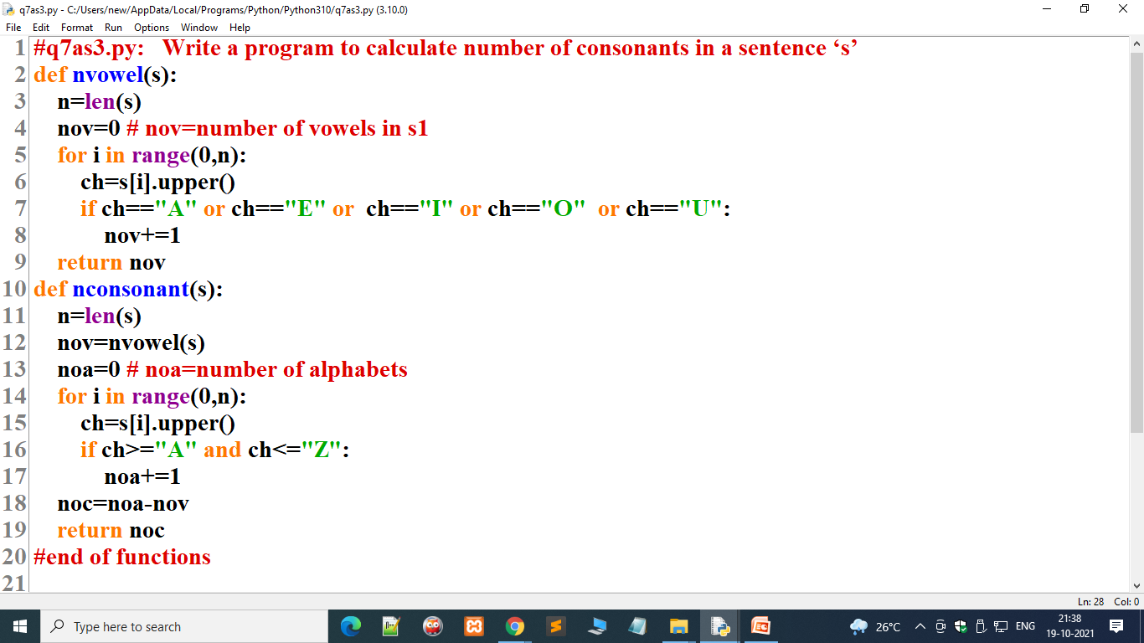
Introduction to Python Programming
Introduction to Strings
Solution of q7as3.py: Write a program to calculate number of consonants in a sentence ‘s’

Slide 20
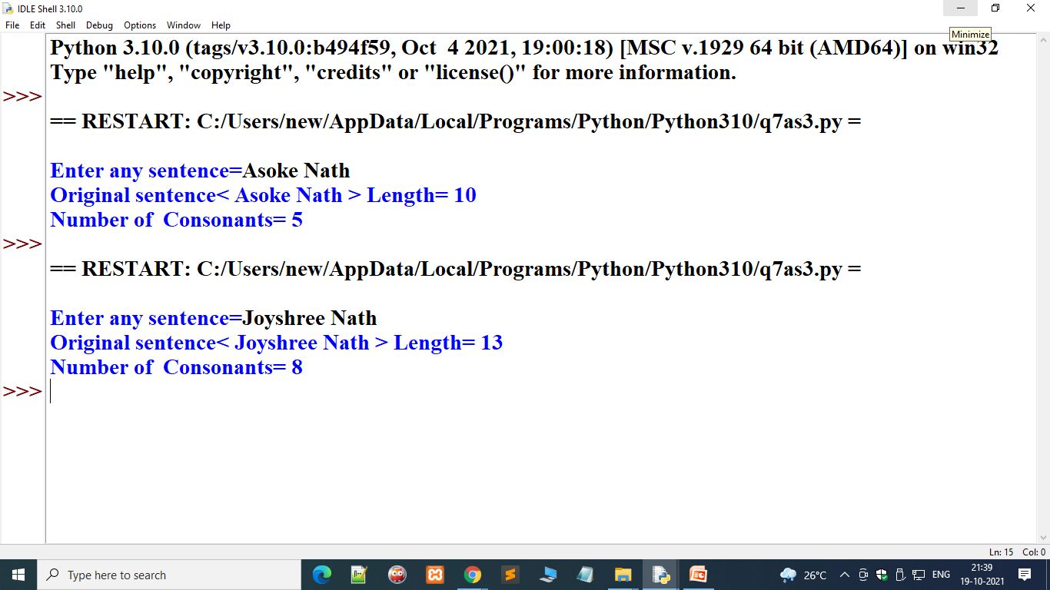
Introduction to Python Programming
Introduction to Strings
Solution of q7as3.py(contd..): Write a program to calculate number of consonants in a sentence ‘s’

Slide 21
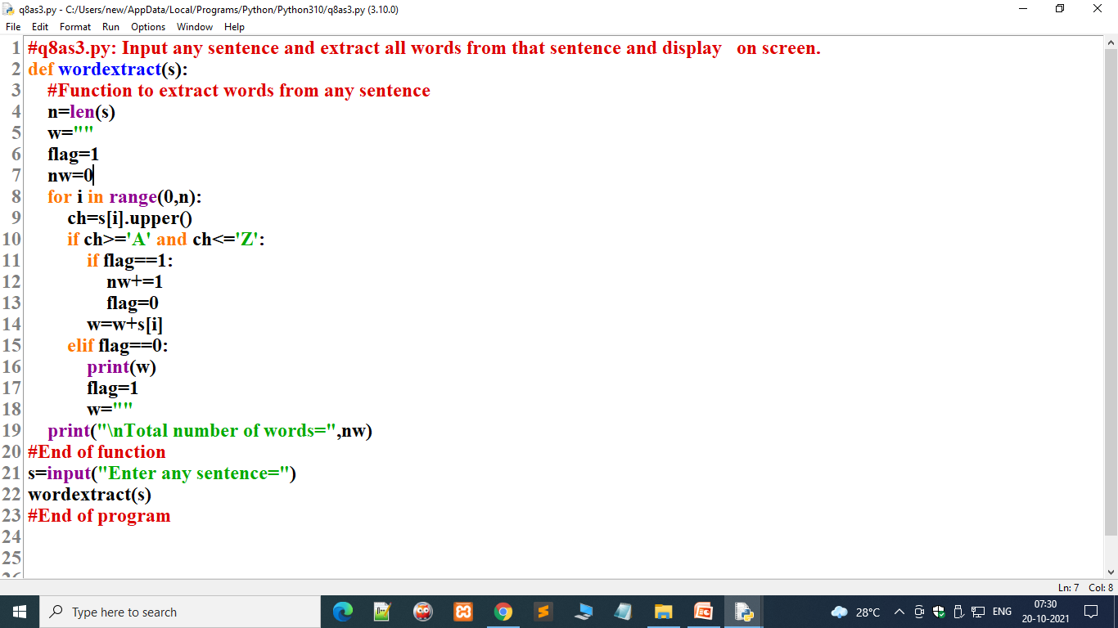
Introduction to Python Programming
Introduction to Strings
8.Solution of q8as3.py: Input any sentence and extract all words from that sentence and display on screen.

Slide 22
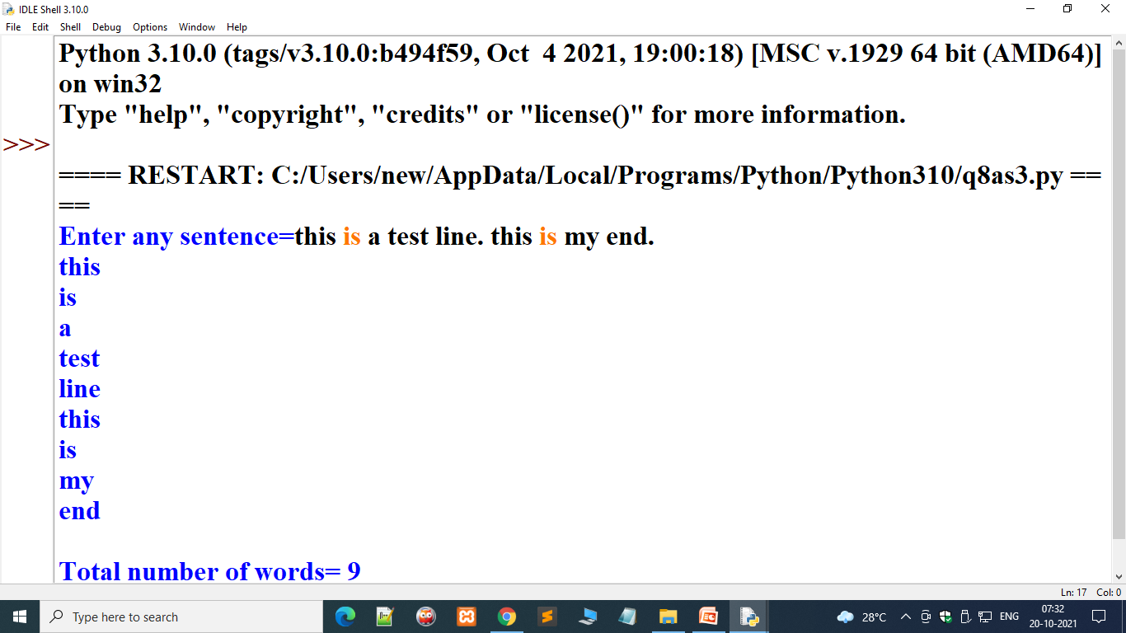
Introduction to Python Programming
Introduction to Strings
8.Solution of q8as3.py(contd..): Input any sentence and extract all words from that sentence and display on screen.

Slide 23
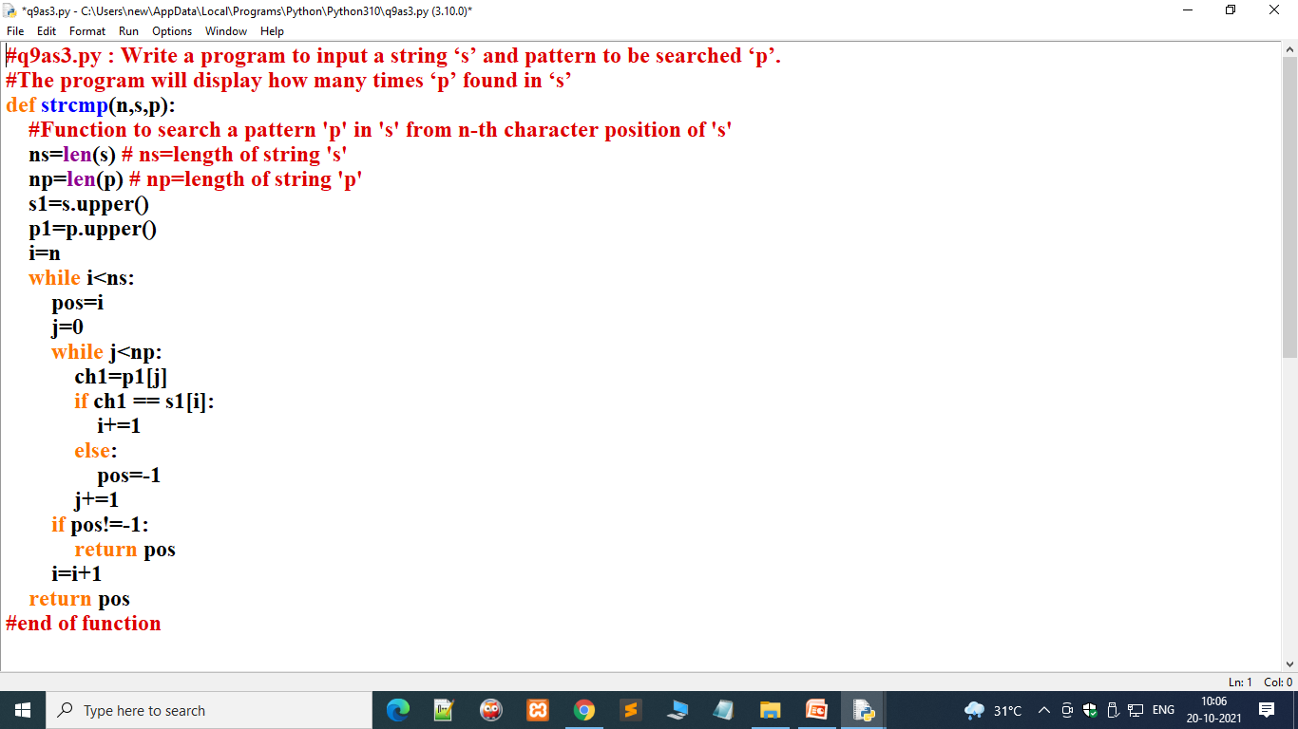
Introduction to Python Programming
Introduction to Strings
9. Solution of q9as3.py : Write a program to input a string ‘s’ and pattern to be searched ‘p’. The program will display how many times ‘p’ found in ‘s’.

Slide 24
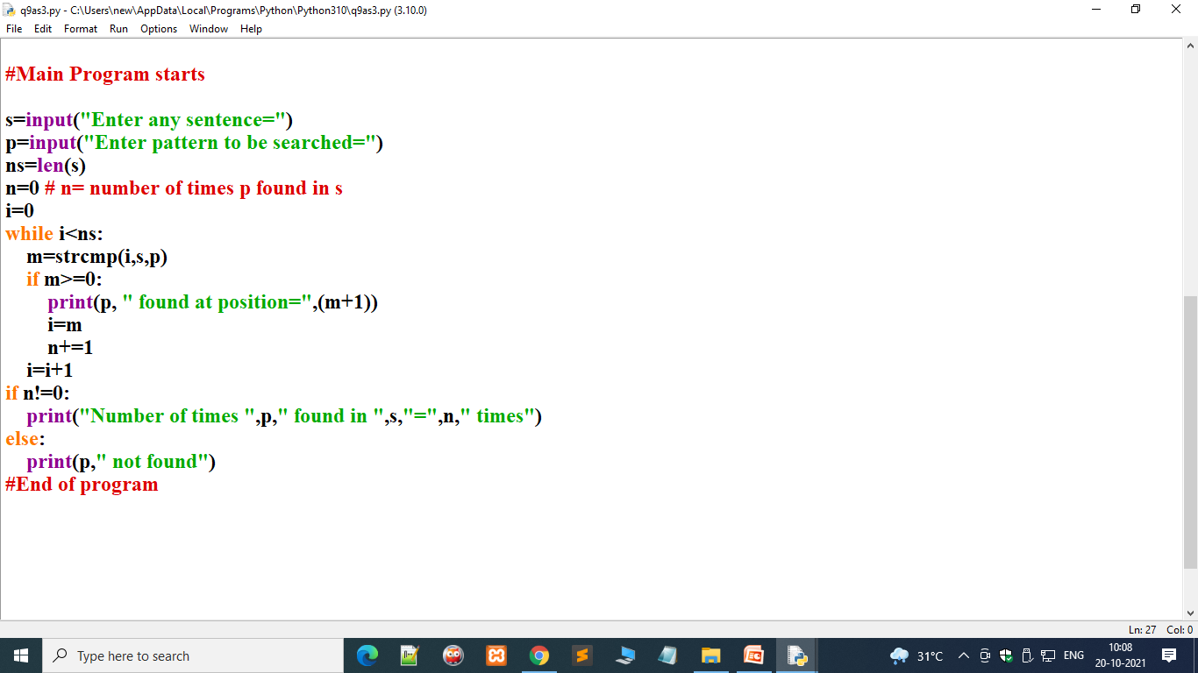
Introduction to Python Programming
Introduction to Strings
9. Solution of q9as3.py(contd..) : Write a program to input a string ‘s’ and pattern to be searched ‘p’. The program will display how many times ‘p’ found in ‘s’.

Slide 25
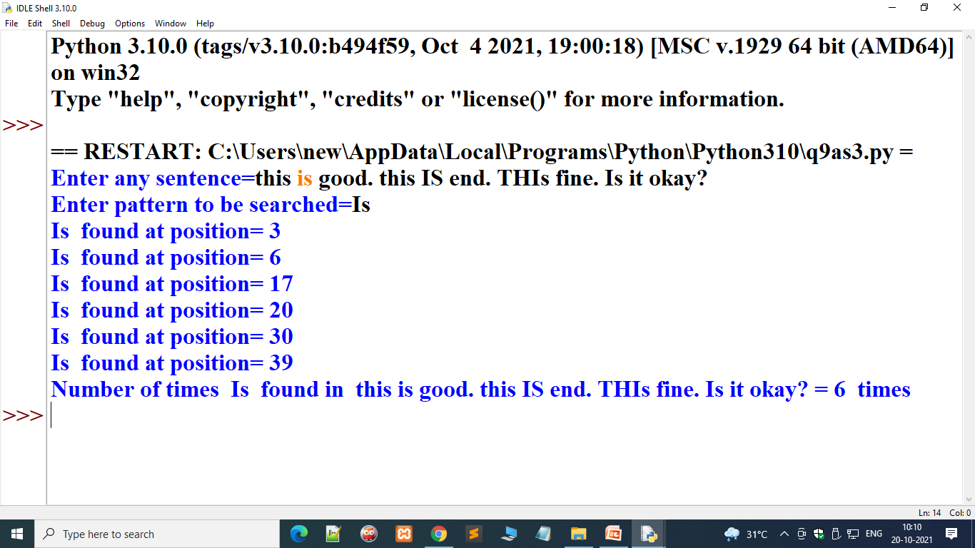
Introduction to Python Programming
Introduction to Strings
9. Solution of q9as3.py(contd..) : Write a program to input a string ‘s’ and pattern to be searched ‘p’. The program will display how many times ‘p’ found in ‘s’.

Slide 26
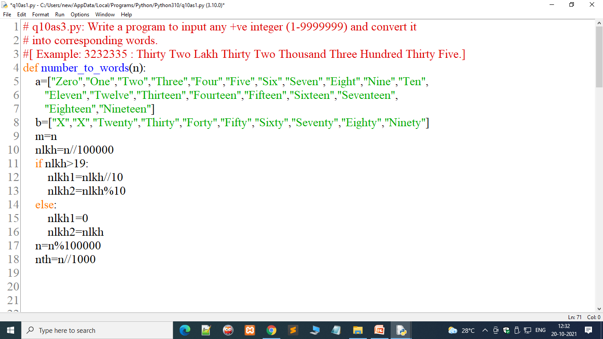
Introduction to Python Programming
Introduction to Strings
q10as3.py: Write a program to input any +ve integer (1-9999999) and convert it
into corresponding words. [ Example: 3232335 : Thirty Two Lakh Thirty Two Thousand Three Hundred Thirty Five.]

Slide 27
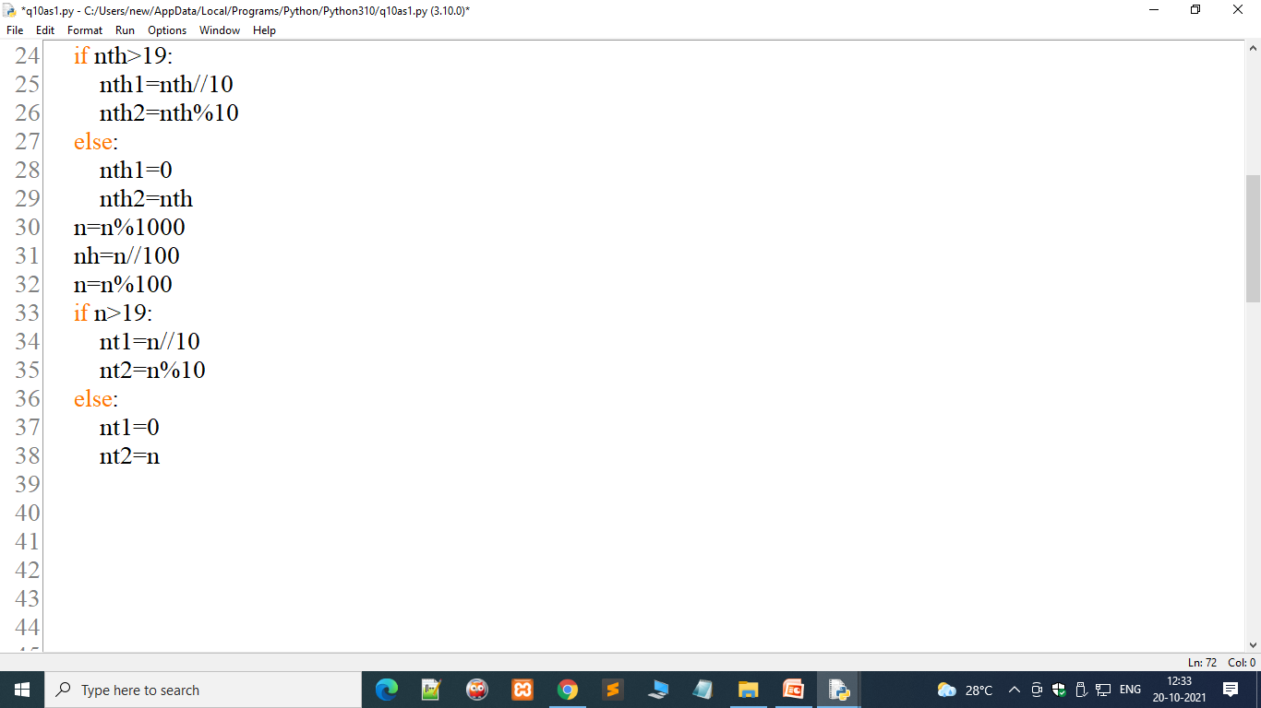
Introduction to Python Programming
Introduction to Strings
q10as3.py: Write a program to input any +ve integer (1-9999999) and convert it
into corresponding words. [ Example: 3232335 : Thirty Two Lakh Thirty Two Thousand Three Hundred Thirty Five.]

Slide 28
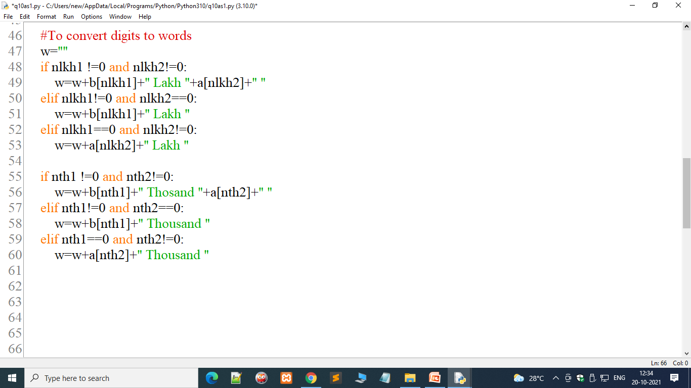
Introduction to Python Programming
Introduction to Strings
q10as3.py: Write a program to input any +ve integer (1-9999999) and convert it
into corresponding words. [ Example: 3232335 : Thirty Two Lakh Thirty Two Thousand Three Hundred Thirty Five.]

Slide 29
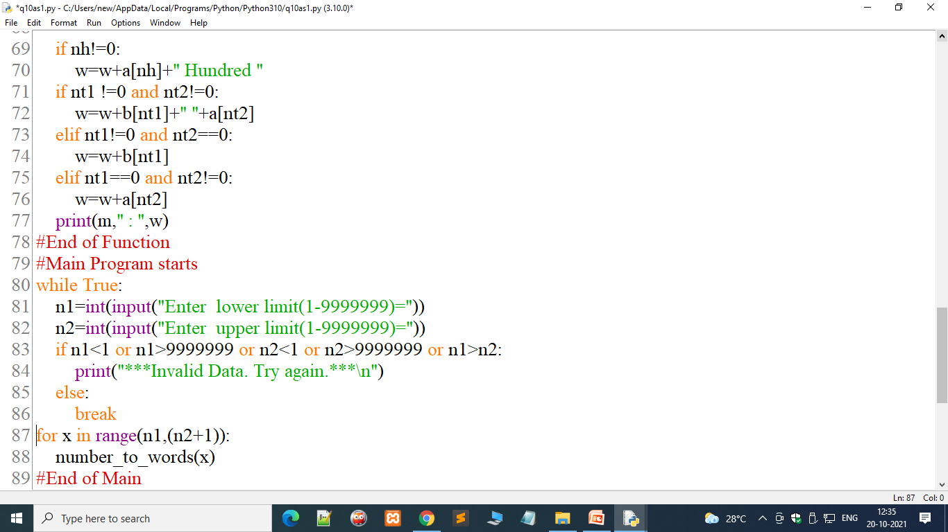
Introduction to Python Programming
Introduction to Strings
q10as3.py: Write a program to input any +ve integer (1-9999999) and convert it
into corresponding words. [ Example: 3232335 : Thirty Two Lakh Thirty Two Thousand Three Hundred Thirty Five.]

Slide 30
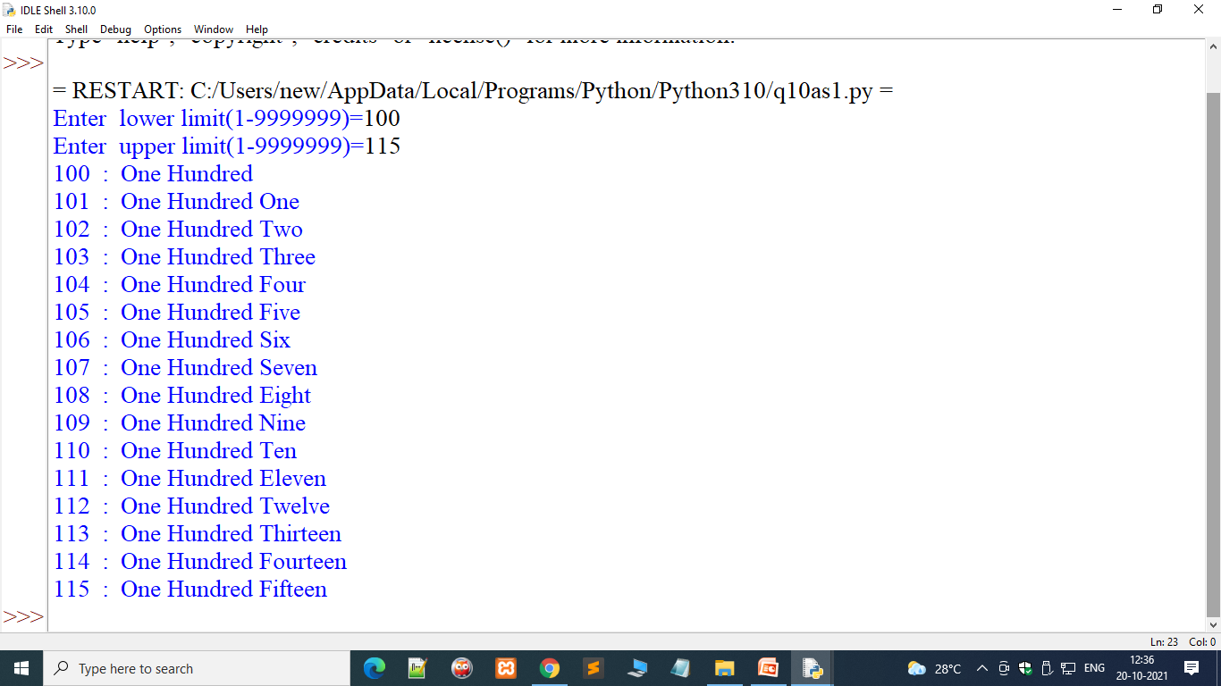
Introduction to Python Programming
Introduction to Strings
q10as3.py: Write a program to input any +ve integer (1-9999999) and convert it
into corresponding words. [ Example: 3232335 : Thirty Two Lakh Thirty Two Thousand Three Hundred Thirty Five.]

