Slide 1
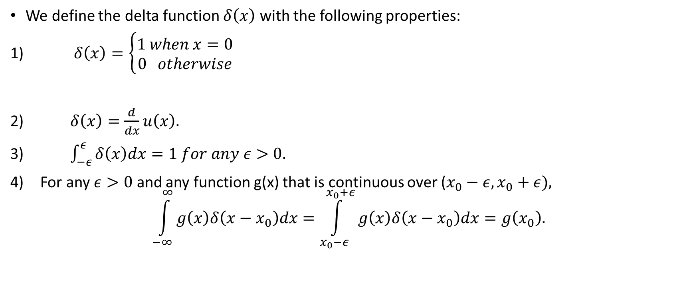
Definition
We define the delta function $δ\left(x\right)$ with the following properties:
1) $δ\left(x\right)=\left\{\begin{matrix}1 when x=0 \\ 0 otherwise\end{matrix}\right.$
2) $δ\left(x\right)=\frac{d}{dx}u\left(x\right).$
3) $\int_{−ε}^{ε}{δ\left(x\right)dx=1 for any ε>0.}$
For any $ε>0$ and any function g(x) that is continuous over ($x_{0}−ε, x_{0}+ε),$
$$\int_{−∞}^{∞}{g\left(x\right)δ\left(x−x_{0}\right)dx=\int_{x_{0}−ε}^{x_{0}+ε}{g\left(x\right)δ\left(x−x_{0}\right)dx=g\left(x_{0}\right).}}$$

Slide 2
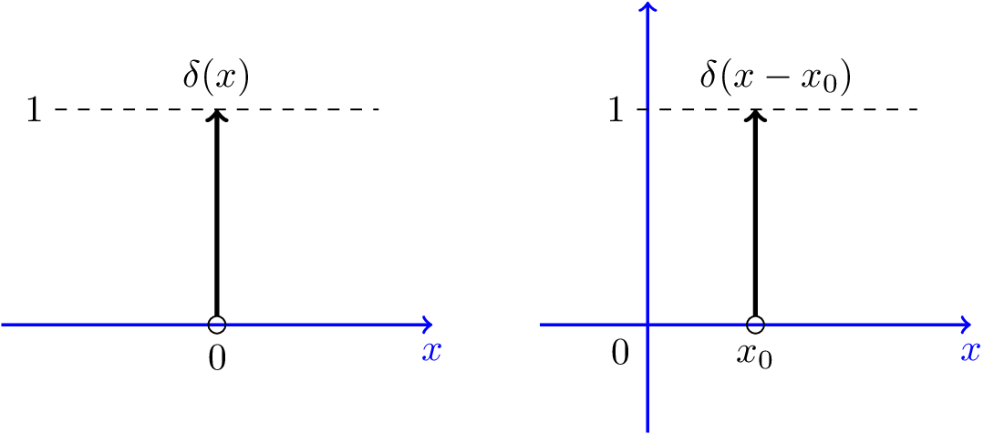
Graphical Representations

Slide 3
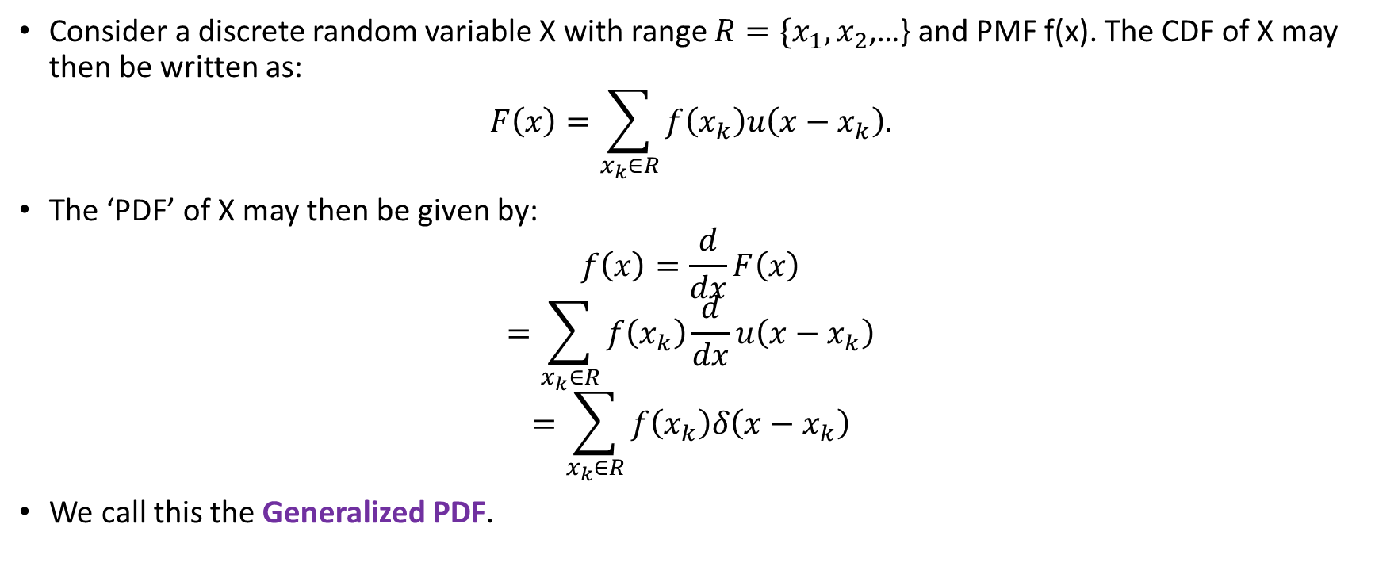
CDF and ‘PDF’ of a Discrete Random Variable
Consider a discrete random variable X with range $R=\{x_{1},x_{2}$,…} and PMF f(x). The CDF of X may then be written as:
$$F\left(x\right)=\sum_{x_{k}∈R}{f\left(x_{k}\right)u\left(x−x_{k}\right).}$$
The ‘PDF’ of X may then be given by:
$$f\left(x\right)=\frac{d}{dx}F\left(x\right)$$
$$=\sum_{x_{k}∈R}{f\left(x_{k}\right)\frac{d}{dx}u\left(x−x_{k}\right)}$$
$$=\sum_{x_{k}∈R}{f\left(x_{k}\right)δ\left(x−x_{k}\right)}$$
We call this the Generalized PDF.

Slide 4
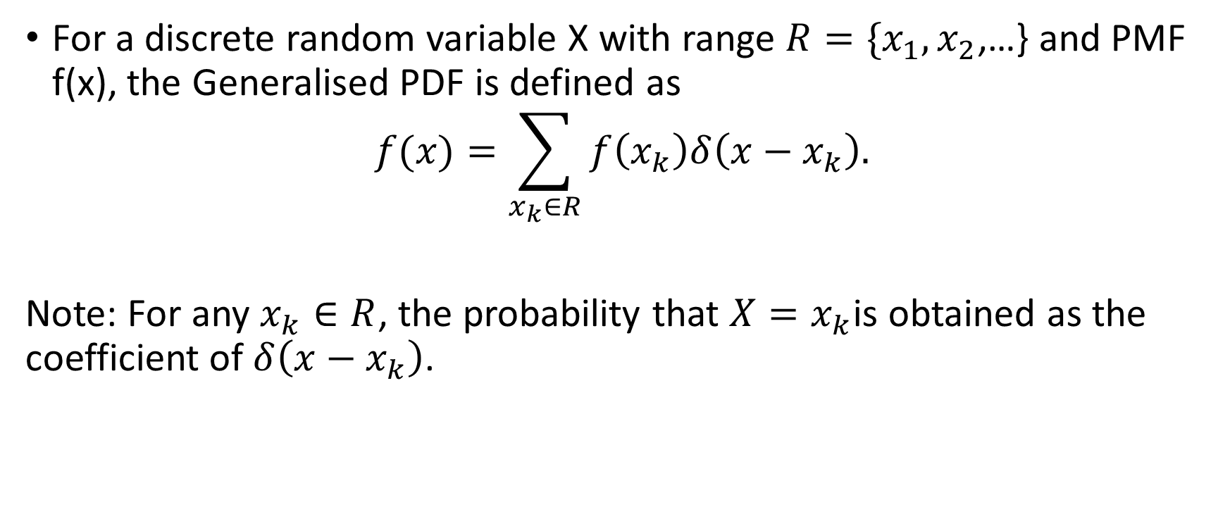
Definition
For a discrete random variable X with range $R=\{x_{1},x_{2}$,…} and PMF f(x), the Generalised PDF is defined as
$$f(x)=\sum_{x_{k}∈R}{f\left(x_{k}\right)δ\left(x−x_{k}\right).}$$
Note: For any $x_{k}∈R$, the probability that $X=x_{k}$is obtained as the coefficient of $δ\left(x−x_{k}\right)$.

Slide 5
Why Generalized PDF?
It is useful to use the generalized PDF because all random variables have a generalized PDF.
So, we can use the same formulae for discrete, continuous, and mixed random variables.
If the (generalized) PDF of a random variable can be written as the sum of delta functions, then X is a discrete random variable.
If the PDF does not include any delta functions, then X is a continuous random variable.
Finally, if the PDF has both delta functions and non-delta functions, then X is a mixed random variable.
Nevertheless, the formulas for probabilities, expectation and variance are the same for all kinds of random variables.

Slide 6
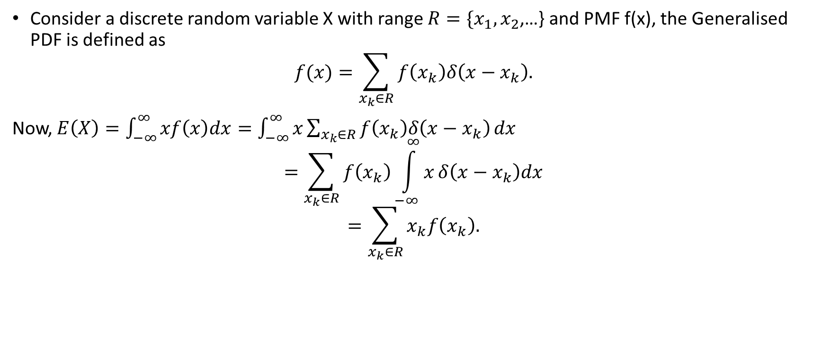
Expectation
Consider a discrete random variable X with range $R=\{x_{1},x_{2}$,…} and PMF f(x), the Generalised PDF is defined as
$$f(x)=\sum_{x_{k}∈R}{f\left(x_{k}\right)δ\left(x−x_{k}\right).}$$
Now, $E\left(X\right)=\int_{−∞}^{∞}{xf\left(x\right)dx}=\int_{−∞}^{∞}{x\sum_{x_{k}∈R}{f\left(x_{k}\right)δ\left(x−x_{k}\right)}dx}$
$$=\sum_{x_{k}∈R}{f\left(x_{k}\right)\int_{−∞}^{∞}{x}δ\left(x−x_{k}\right)dx}$$
$$=\sum_{x_{k}∈R}{x_{k}f\left(x_{k}\right).}$$

Slide 7
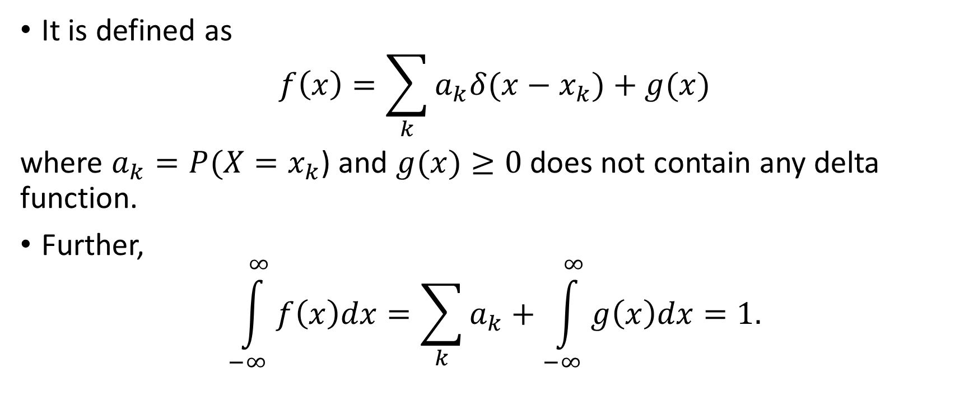
Generalized PDF of a Mixed Random Variable
It is defined as
$$f\left(x\right)=\sum_{k}{a_{k}δ(x−x_{k})}+g(x)$$
where $a_{k}=P(X=x_{k}$) and $g(x)≥0$ does not contain any delta function.
Further,
$$\int_{−∞}^{∞}{f\left(x\right)dx}=\sum_{k}{a_{k}}+\int_{−∞}^{∞}{g\left(x\right)dx}=1.$$

Slide 8
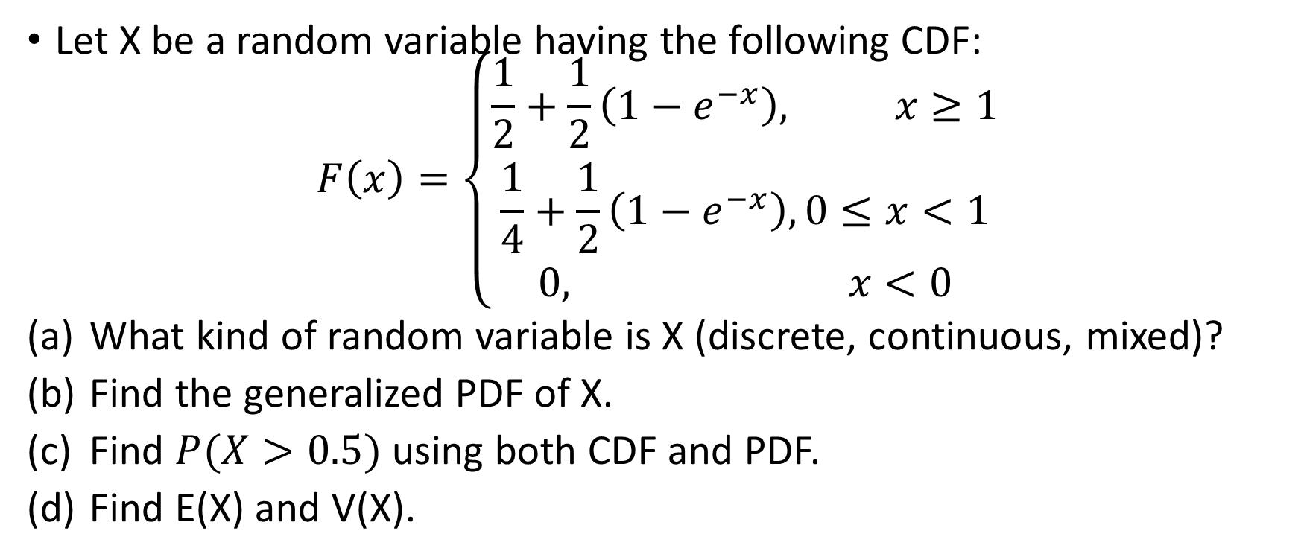
Example
Let X be a random variable having the following CDF:
$$F\left(x\right)=\left\{\begin{aligned}\frac{1}{2}+\frac{1}{2}\left(1−e^{−x}\right), x≥1 \\ \frac{1}{4}+\frac{1}{2}\left(1−e^{−x}\right), 0≤x<1 \\ 0, x<0\end{aligned}\right.$$
What kind of random variable is X (discrete, continuous, mixed)?
Find the generalized PDF of X.
Find $P(X>0.5)$ using both CDF and PDF.
Find E(X) and V(X).

Slide 9
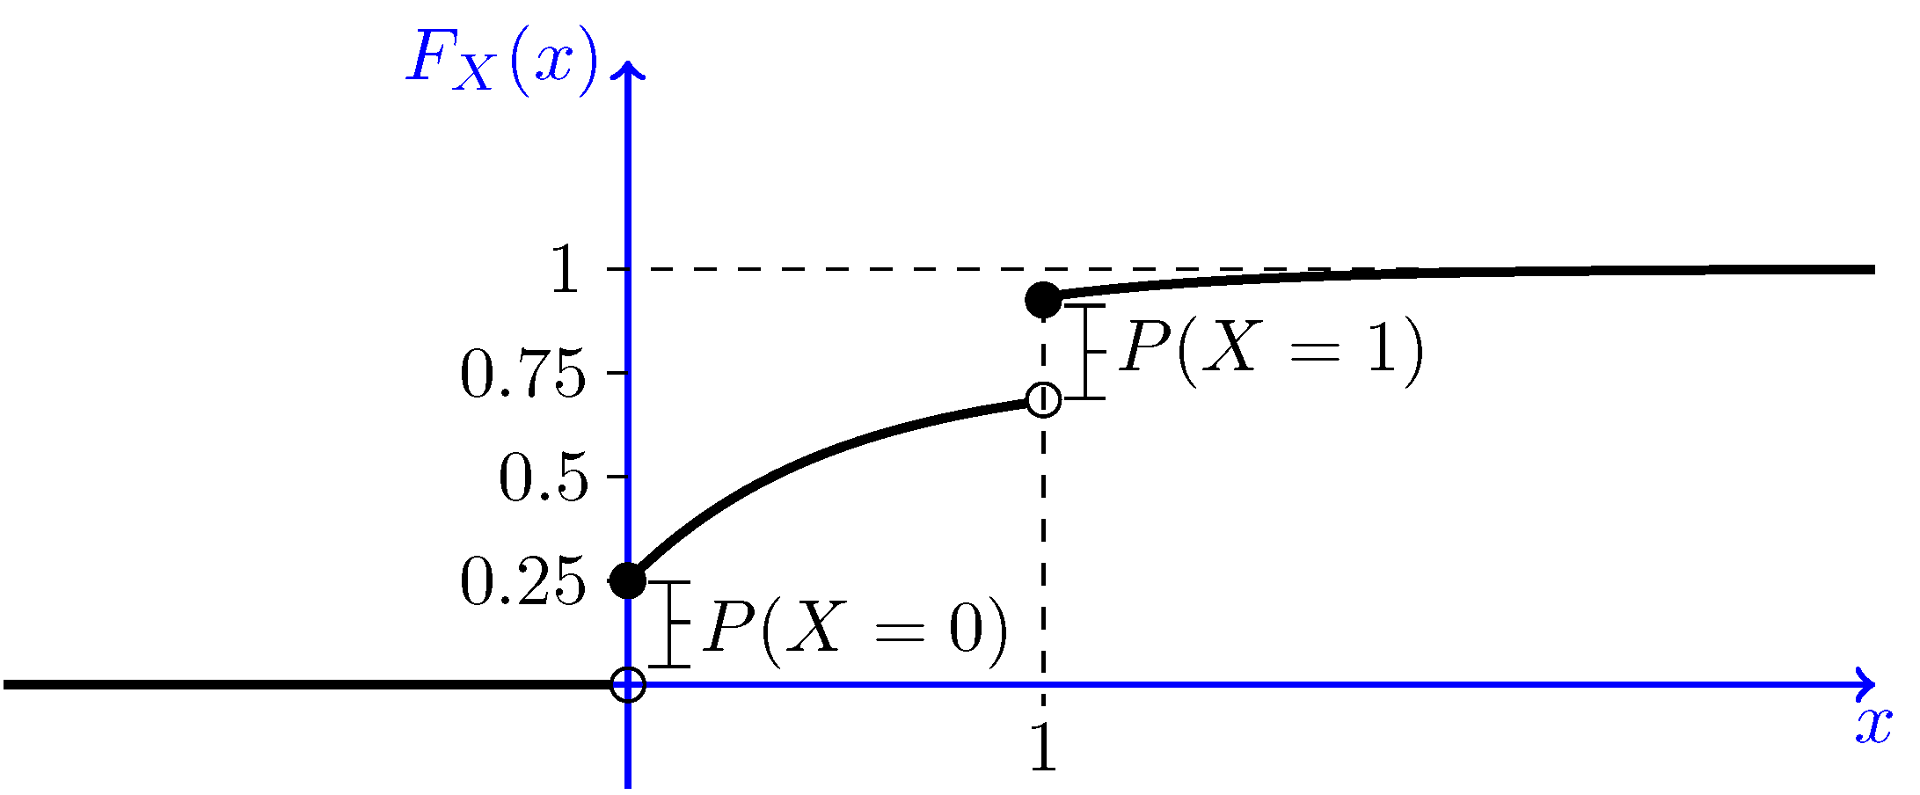
Solution – Part (a)
Let us plot F(x) to better understand the problem.
We see that the CDF has two jumps, at x=0 and x=1.
The CDF increases continuously from x=0 to x=1 and also after x=1.
Since the CDF is neither in the form of a staircase function, nor is it continuous, we conclude that X is a mixed random variable.

Slide 10
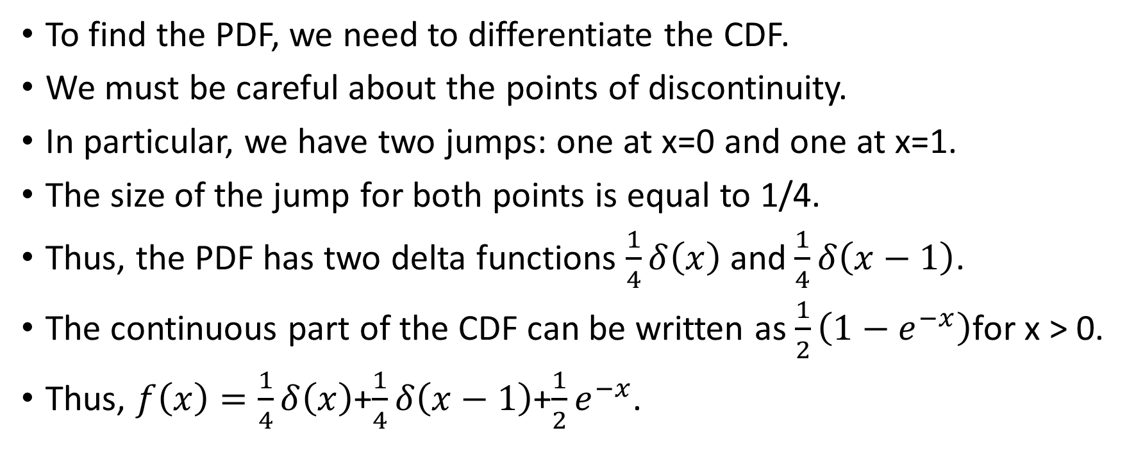
Solution – Part (b)
To find the PDF, we need to differentiate the CDF.
We must be careful about the points of discontinuity.
In particular, we have two jumps: one at x=0 and one at x=1.
The size of the jump for both points is equal to 1/4.
Thus, the PDF has two delta functions $\frac{1}{4}δ\left(x\right)$ and$\frac{1}{4}δ\left(x−1\right)$.
The continuous part of the CDF can be written as $\frac{1}{2}\left(1−e^{−x}\right)$for x > 0.
Thus, $f\left(x\right)=\frac{1}{4}δ\left(x\right)$+$\frac{1}{4}δ\left(x−1\right)$+$\frac{1}{2}e^{−x}$.

Slide 11

Solution – Part (c) – Using the CDF
$$P\left(X>0.5\right)=1−F\left(0.5\right)$$
$$=1−[\frac{1}{4}+\frac{1}{2}\left(1−e^{−0.5}\right)]$$
$$=0.5533$$

Slide 12

Solution – Part (c) – Using the PDF
$$P\left(X>0.5\right)=\int_{0.5}^{∞}{f\left(x\right)dx}$$
$$=\int_{0.5}^{∞}{\left\{\frac{1}{4}δ\left(x\right)\text{+}\frac{1}{4}δ\left(x−1\right)\text{+}\frac{1}{2}e^{−x}\right\}dx}$$
$$=\left(\frac{1}{4}×0\right)+\left(\frac{1}{4}×1\right)+\frac{1}{2}e^{−0.5}$$
$$=0.5533$$

Slide 13
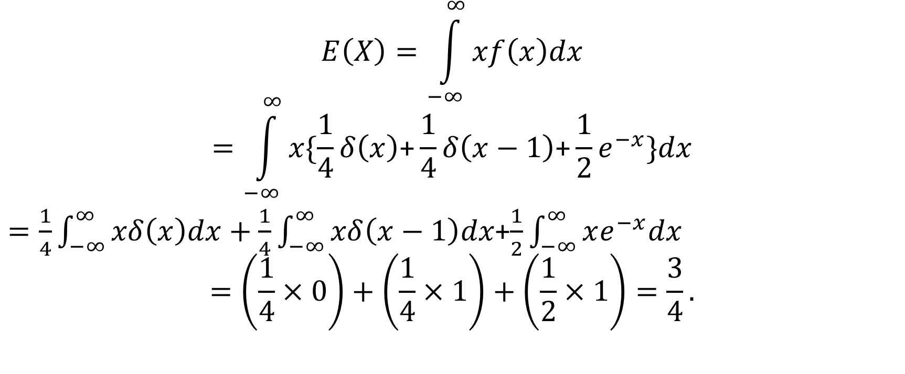
Solution – Part (d) – E(X)
$$E\left(X\right)=\int_{−∞}^{∞}{xf\left(x\right)dx}$$
$$=\int_{−∞}^{∞}{x\{\frac{1}{4}δ\left(x\right)\text{+}\frac{1}{4}δ\left(x−1\right)\text{+}\frac{1}{2}e^{−x}\}dx}$$
$=\frac{1}{4}\int_{−∞}^{∞}{xδ\left(x\right)dx}+\frac{1}{4}\int_{−∞}^{∞}{xδ\left(x−1\right)dx}$+$\frac{1}{2}\int_{−∞}^{∞}{xe^{−x}dx}$
$$=\left(\frac{1}{4}×0\right)+\left(\frac{1}{4}×1\right)+\left(\frac{1}{2}×1\right)=\frac{3}{4}.$$

Slide 14

Solution – Part (d) – V(X)
$$E\left(X^{2}\right)=\int_{−∞}^{∞}{x^{2}f\left(x\right)dx}$$
$$=\int_{−∞}^{∞}{x^{2}\{\frac{1}{4}δ\left(x\right)\text{+}\frac{1}{4}δ\left(x−1\right)\text{+}\frac{1}{2}e^{−x}\}dx}$$
$$=\left(\frac{1}{4}×0\right)+\left(\frac{1}{4}×1\right)+\frac{1}{2}\int_{−∞}^{∞}{x^{2}}e^{−x}dx$$
$$=\frac{1}{4}+\frac{1}{2}Γ\left(3\right)=\frac{5}{4}.$$
Thus, $V\left(X\right)=\frac{5}{4}−{\left(\frac{3}{4}\right)}^{2}=\frac{11}{16}.$

