Slide 1
Mixed Random Variables
These are random variables that are neither discrete nor continuous, but are a mixture of both.
In particular, a mixed random variable has a continuous part and a discrete part.
Thus, we can use our normal tools to analyse them.

Slide 2
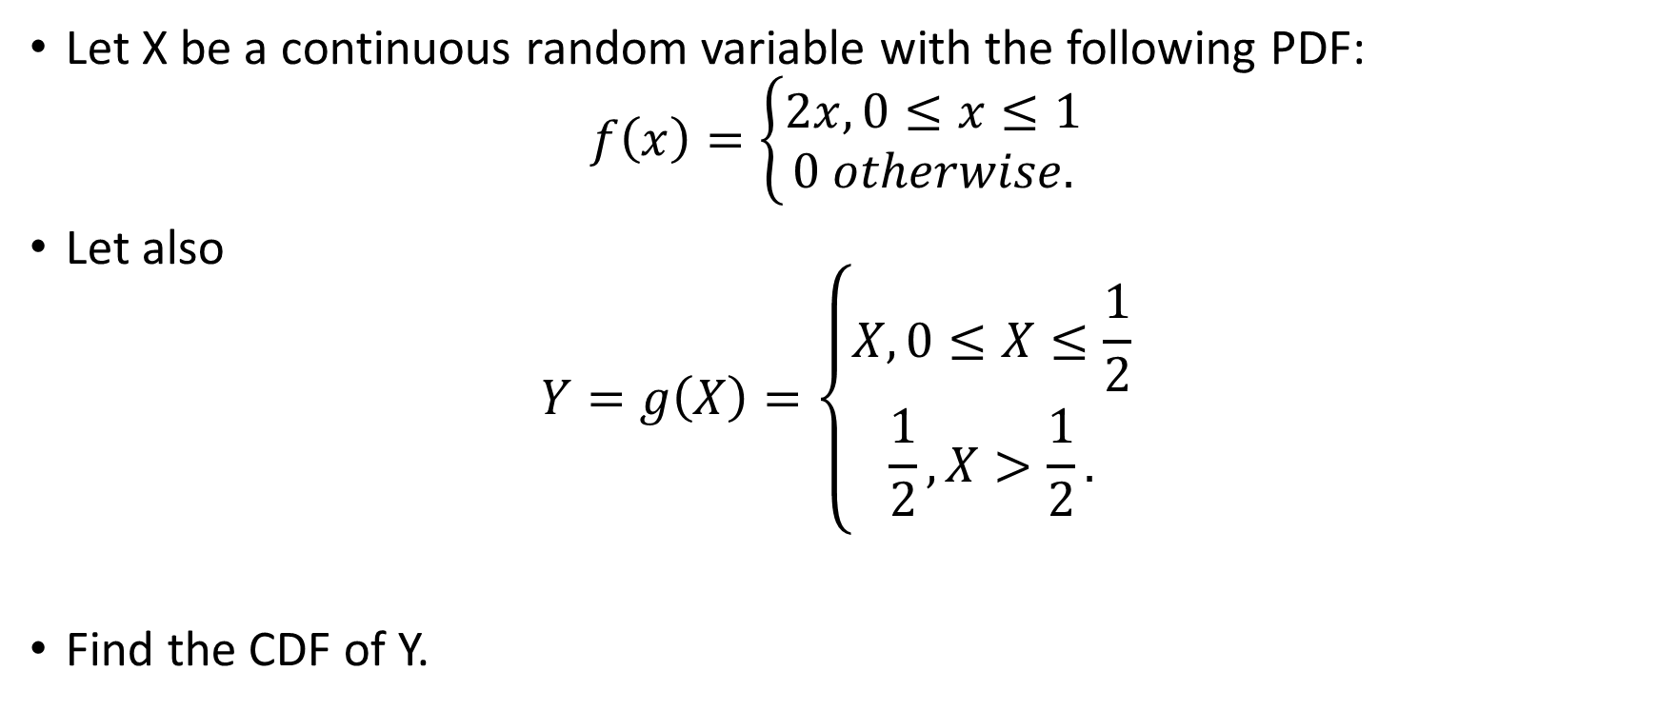
Example
Let X be a continuous random variable with the following PDF:
$$f\left(x\right)=\left\{\begin{matrix}2x, 0≤x≤1 \\ 0 otherwise.\end{matrix}\right.$$
Let also
$$Y=g\left(X\right)=\left\{\begin{matrix}X, 0≤X≤\frac{1}{2} \\ \frac{1}{2},X>\frac{1}{2}.\end{matrix}\right.$$
Find the CDF of Y.

Slide 3
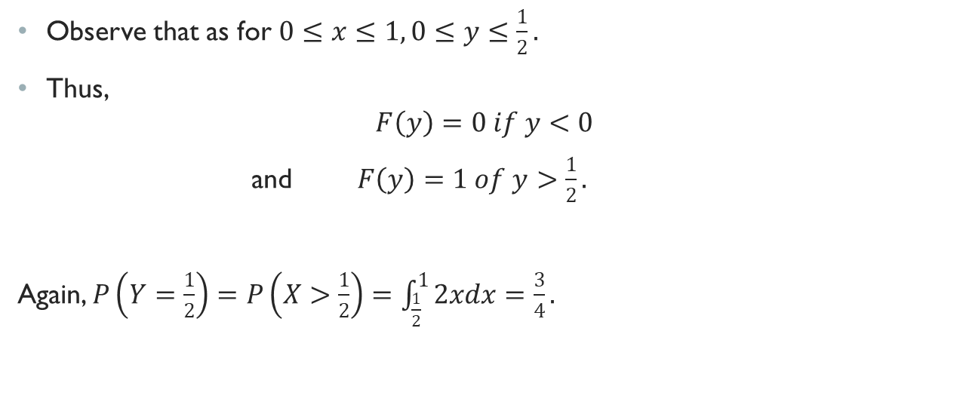
Solution
Observe that as for $0≤x≤1, 0≤y≤\frac{1}{2}.$
Thus,
$$F\left(y\right)=0 if y<0$$
and $F\left(y\right)=1 of y>\frac{1}{2}.$
Again, $P\left(Y=\frac{1}{2}\right)=P\left(X>\frac{1}{2}\right)=\int_{\frac{1}{2}}^{1}{2xdx}=\frac{3}{4}.$

Slide 4
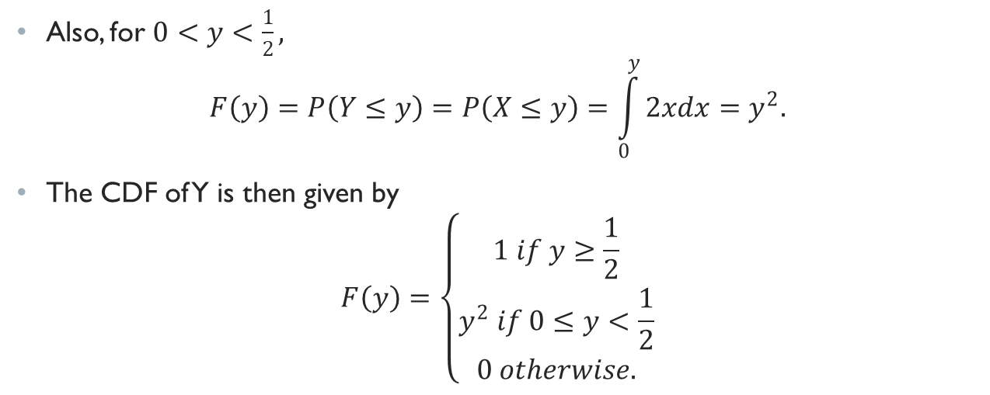
Solution Contd.
Also, for $0<y<\frac{1}{2},$
$$F\left(y\right)=P\left(Y≤y\right)=P\left(X≤y\right)=\int_{0}^{y}{2xdx}=y^{2}.$$
The CDF of Y is then given by
$$F\left(y\right)=\left\{\begin{matrix}1 if y≥\frac{1}{2} \\ y^{2} if 0≤y<\frac{1}{2} \\ 0 otherwise.\end{matrix}\right.$$

Slide 5
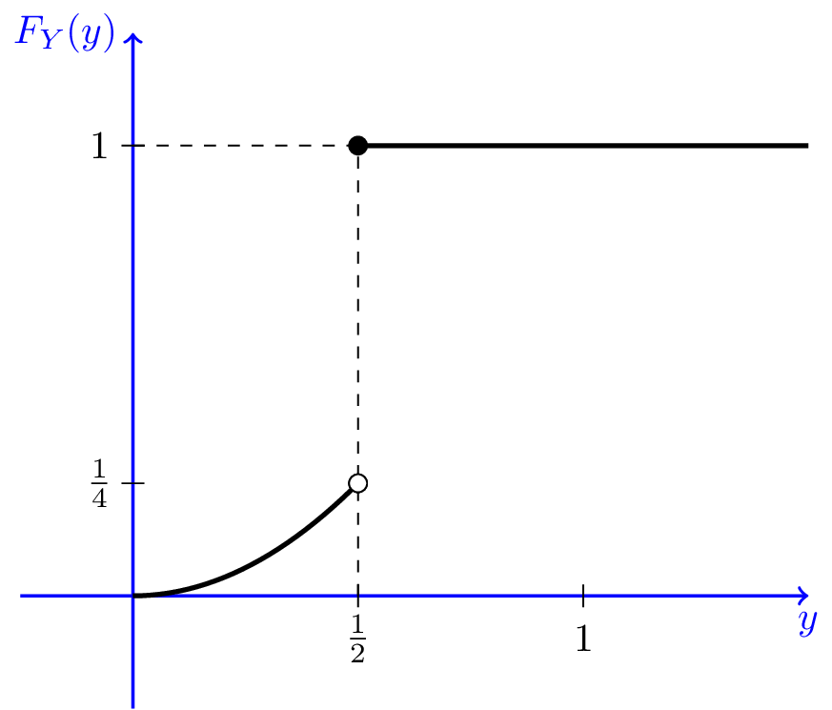
Graphical representation
The figure shows the CDF of Y.
We note that the CDF is not continuous, so Y is not a continuous random variable.
On the other hand, the CDF is not in the staircase form, so it is not a discrete random variable either.
It is indeed a mixed random variable.
There is a jump at y =1/2, and the amount of jump is 1−1/4 = 3/4, which is the probability that Y = 1/2. The CDF is continuous at other points.

Slide 6
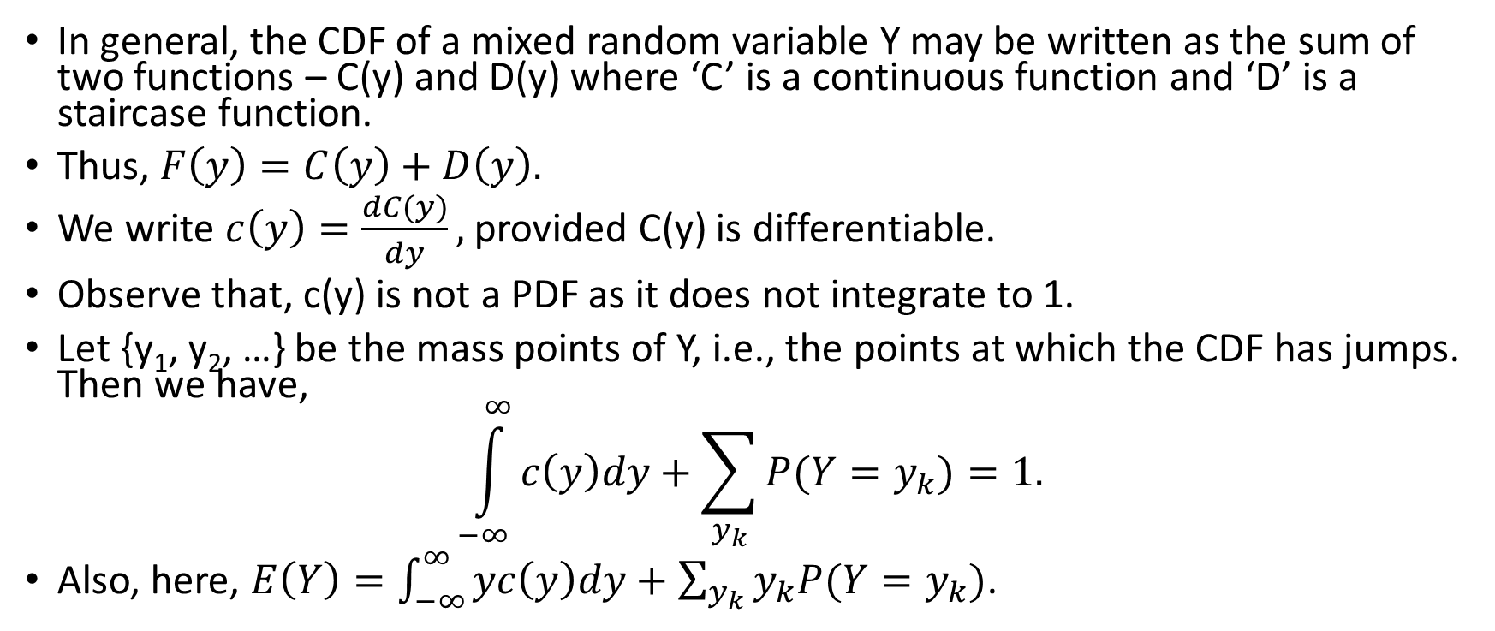
An Important Note
In general, the CDF of a mixed random variable Y may be written as the sum of two functions – C(y) and D(y) where ‘C’ is a continuous function and ‘D’ is a staircase function.
Thus, $F\left(y\right)=C\left(y\right)+D\left(y\right).$
We write $c\left(y\right)=\frac{dC(y)}{dy},$provided C(y) is differentiable.
Observe that, c(y) is not a PDF as it does not integrate to 1.
Let {y₁, y₂, …} be the mass points of Y, i.e., the points at which the CDF has jumps. Then we have,
$$\int_{−∞}^{∞}{c\left(y\right)dy}+\sum_{y_{k}}{P(Y=y_{k})}=1.$$
Also, here, $E\left(Y\right)=\int_{−∞}^{∞}{yc\left(y\right)dy}+\sum_{y_{k}}{y_{k}P(Y=y_{k})}$.

Slide 7
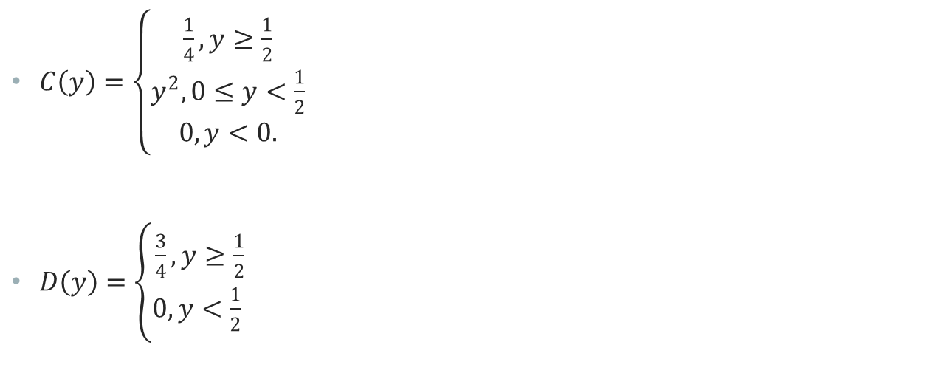
Present Example
$C\left(y\right)=\left\{\begin{matrix}\frac{1}{4},y≥\frac{1}{2} \\ y^{2}, 0≤y<\frac{1}{2} \\ 0, y<0.\end{matrix}\right.$
$D\left(y\right)=\left\{\begin{matrix}\frac{3}{4}, y≥\frac{1}{2} \\ 0, y<\frac{1}{2} \end{matrix}\right.$

Slide 8

Example
Let X be a continuous random variable with the following PDF:
$$f\left(x\right)=\left\{\begin{matrix}2x, 0≤x≤1 \\ 0 otherwise.\end{matrix}\right.$$
Let also
$$Y=g\left(X\right)=\left\{\begin{matrix}X, 0≤X≤\frac{1}{2} \\ \frac{1}{2},X>\frac{1}{2}.\end{matrix}\right.$$
Find
$P\left(\frac{1}{4}≤Y≤\frac{3}{8}\right)$
$P(Y≥\frac{1}{4}$)
E(Y).

Slide 9
Solution
Since we have the CDF of Y, we can find the probability that Y is in any given interval.
We should pay special attention if the interval includes any jump points.

Slide 10

Solution – Part (a)
We have,
$$P(1/4≤Y≤3/8)=F(3/8)−F(1/4)$$
$$={\left(\frac{3}{8}\right)}^{2}−{\left(\frac{1}{4}\right)}^{2}=\frac{9}{64}−\frac{1}{16}=\frac{5}{64}.$$

Slide 11

Solution – Part (b)
$P(Y≥\frac{1}{4}$)=$1−F(\frac{1}{4}$)+$P(Y=\frac{1}{4}$)
$={1−\left(\frac{1}{4}\right)}^{2}+0=\frac{15}{16}$.

Slide 12

Solution – Part (c)
We have, $F\left(y\right)=C\left(y\right)+D\left(y\right)$,
where $C\left(y\right)=\left\{\begin{matrix}\frac{1}{4},y≥\frac{1}{2} \\ y^{2}, 0≤y<\frac{1}{2} \\ 0, y<0.\end{matrix}\right.$
and $D\left(y\right)=\left\{\begin{matrix}\frac{3}{4}, y≥\frac{1}{2} \\ 0, y<\frac{1}{2} \end{matrix}\right.$

Slide 13
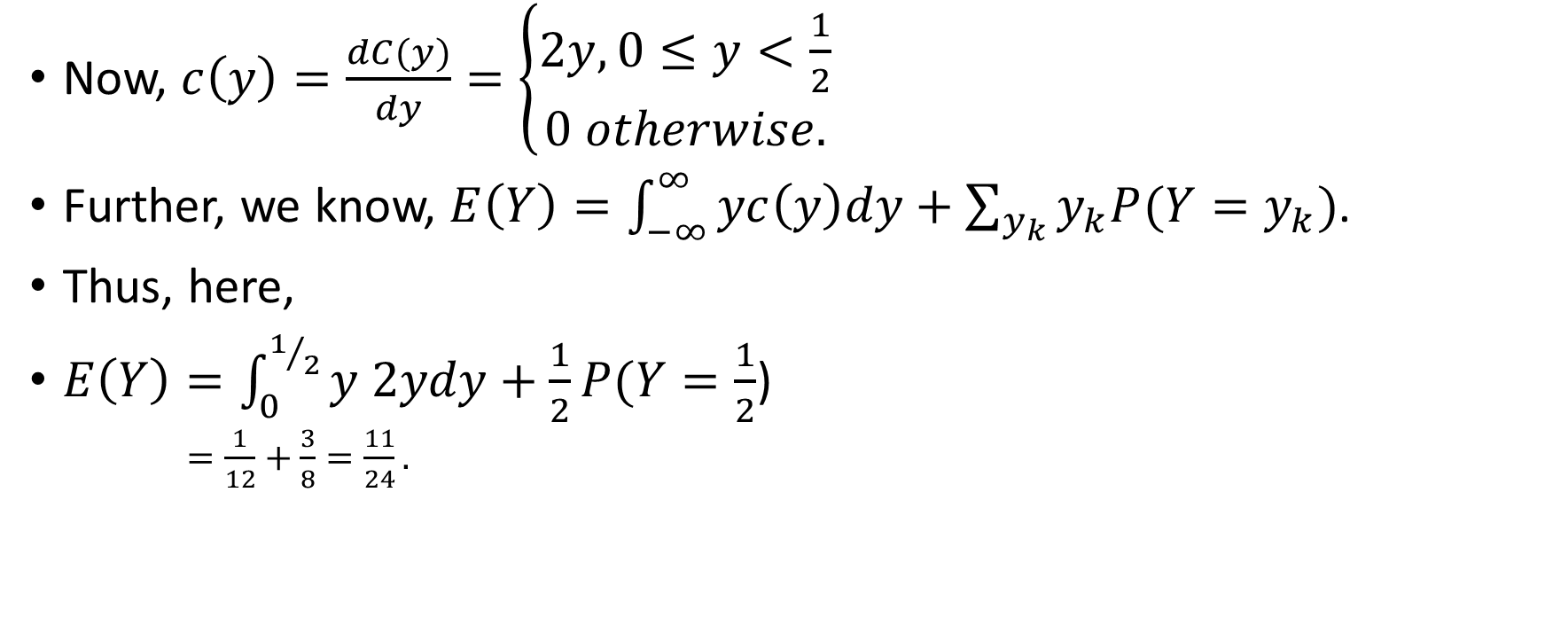
Solution – Part (c) Contd.
Now, $c\left(y\right)=\frac{dC(y)}{dy}=\left\{\begin{matrix}2y,0≤y<\frac{1}{2} \\ 0 otherwise.\end{matrix}\right.$
Further, we know, $E\left(Y\right)=\int_{−∞}^{∞}{yc\left(y\right)dy}+\sum_{y_{k}}{y_{k}P(Y=y_{k})}$.
Thus, here,
$E\left(Y\right)=\int_{0}^{1/2}{y 2ydy}+\frac{1}{2}P(Y=\frac{1}{2}$)
$=\frac{1}{12}+\frac{3}{8}=\frac{11}{24}.$

Slide 14
Using the Delta Function
In this section, we will use the Dirac delta function to analyze mixed random variables.
Technically speaking, the Dirac delta function is not actually a function. It is what we may call a generalized function. Nevertheless, its definition is intuitive and it simplifies dealing with probability distributions.
Remember that any random variable has a CDF. Thus, we can use the CDF to answer questions regarding discrete, continuous, and mixed random variables.
On the other hand, the PDF is defined only for continuous random variables, while the PMF is defined only for discrete random variables.
Using delta functions will allow us to define the PDF for discrete and mixed random variables. Thus, it allows us to unify the theory of discrete, continuous, and mixed random variables.

Slide 15
Dirac Delta Function
Remember, we cannot define the PDF for a discrete random variable because its CDF has jumps.
If we could somehow differentiate the CDF at jump points, we would be able to define the PDF for discrete random variables as well.
Here, we will introduce the Dirac delta function and discuss its application to probability distributions.

Slide 16
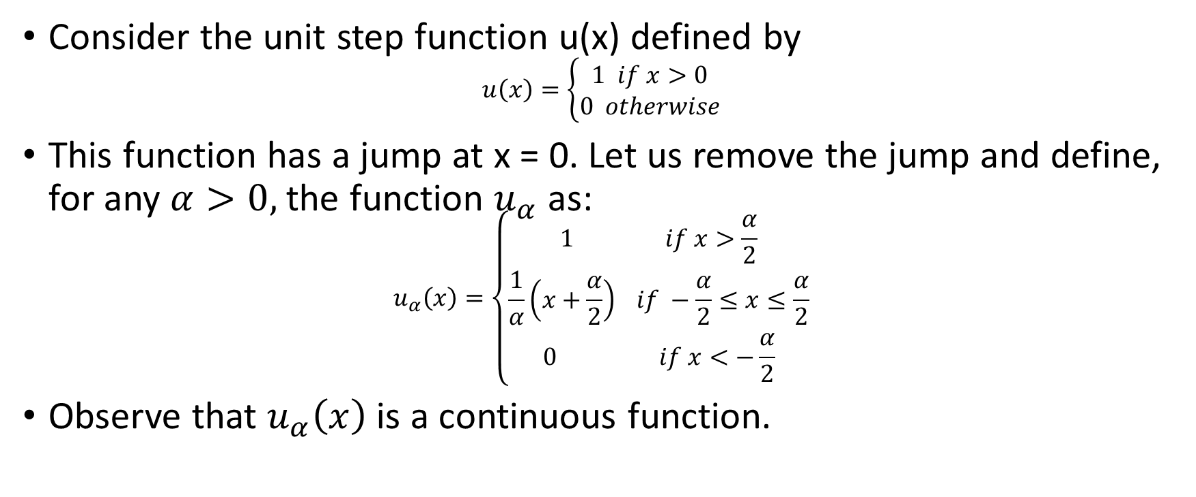
Dirac Delta Function Contd.
Consider the unit step function u(x) defined by
$$u\left(x\right)=\left\{\begin{matrix}1 if x>0 \\ 0 otherwise\end{matrix}\right.$$
This function has a jump at x = 0. Let us remove the jump and define, for any $α>0,$ the function $u_{α}$ as:
$$u_{α}\left(x\right)=\left\{\begin{matrix}1 if x>\frac{α}{2} \\ \frac{1}{α}\left(x+\frac{α}{2}\right) if −\frac{α}{2}≤x≤\frac{α}{2} \\ 0 if x<−\frac{α}{2}\end{matrix}\right.$$
Observe that $u_{α}\left(x\right)$ is a continuous function.

Slide 17

Dirac Delta Function Contd.
We define:
$$δ_{α}\left(x\right)=\frac{du_{α}\left(x\right)}{dx}=\left\{\begin{matrix}\frac{1}{α} if \left|x\right|<\frac{α}{2} \\ 0 if\left|x\right|>\frac{α}{2}\end{matrix}\right.$$

Slide 18
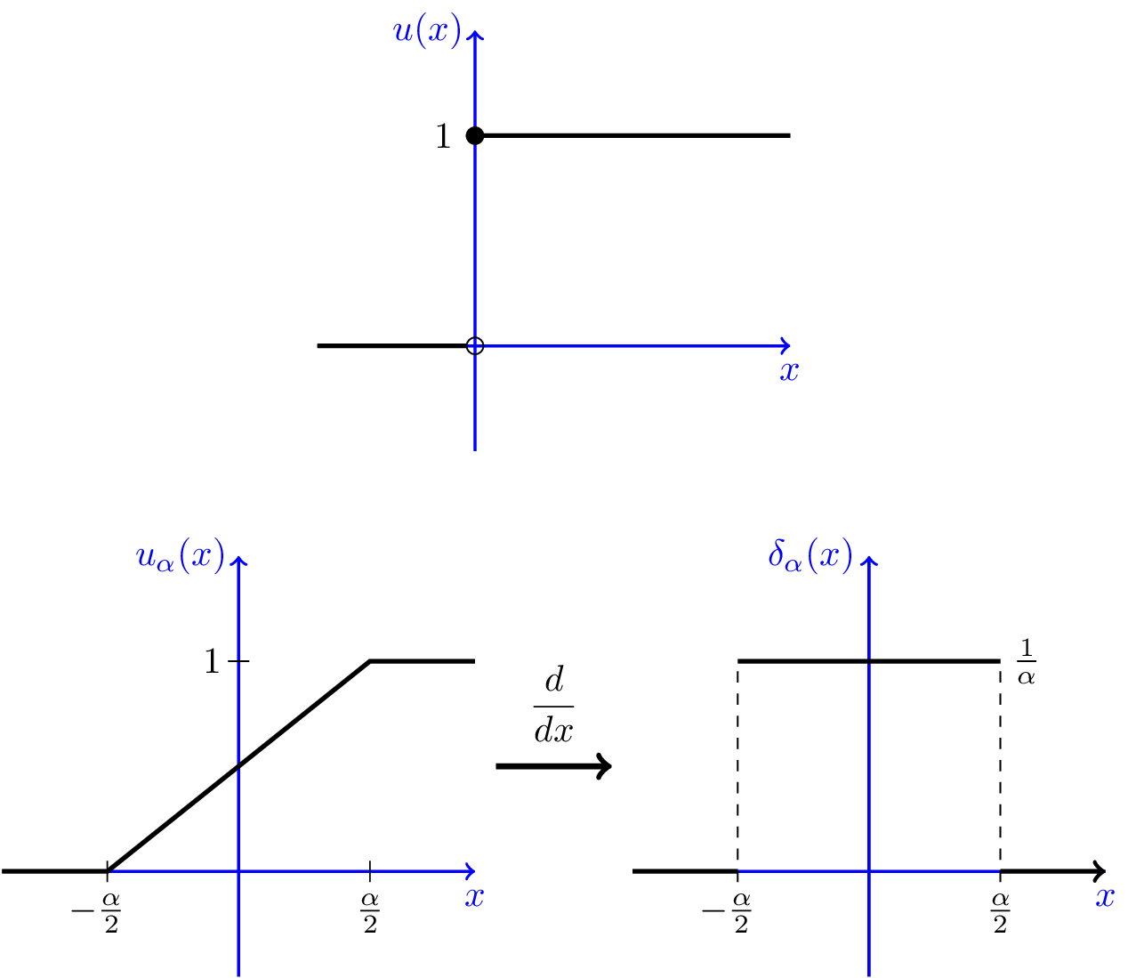
Graphical Representations

Slide 19
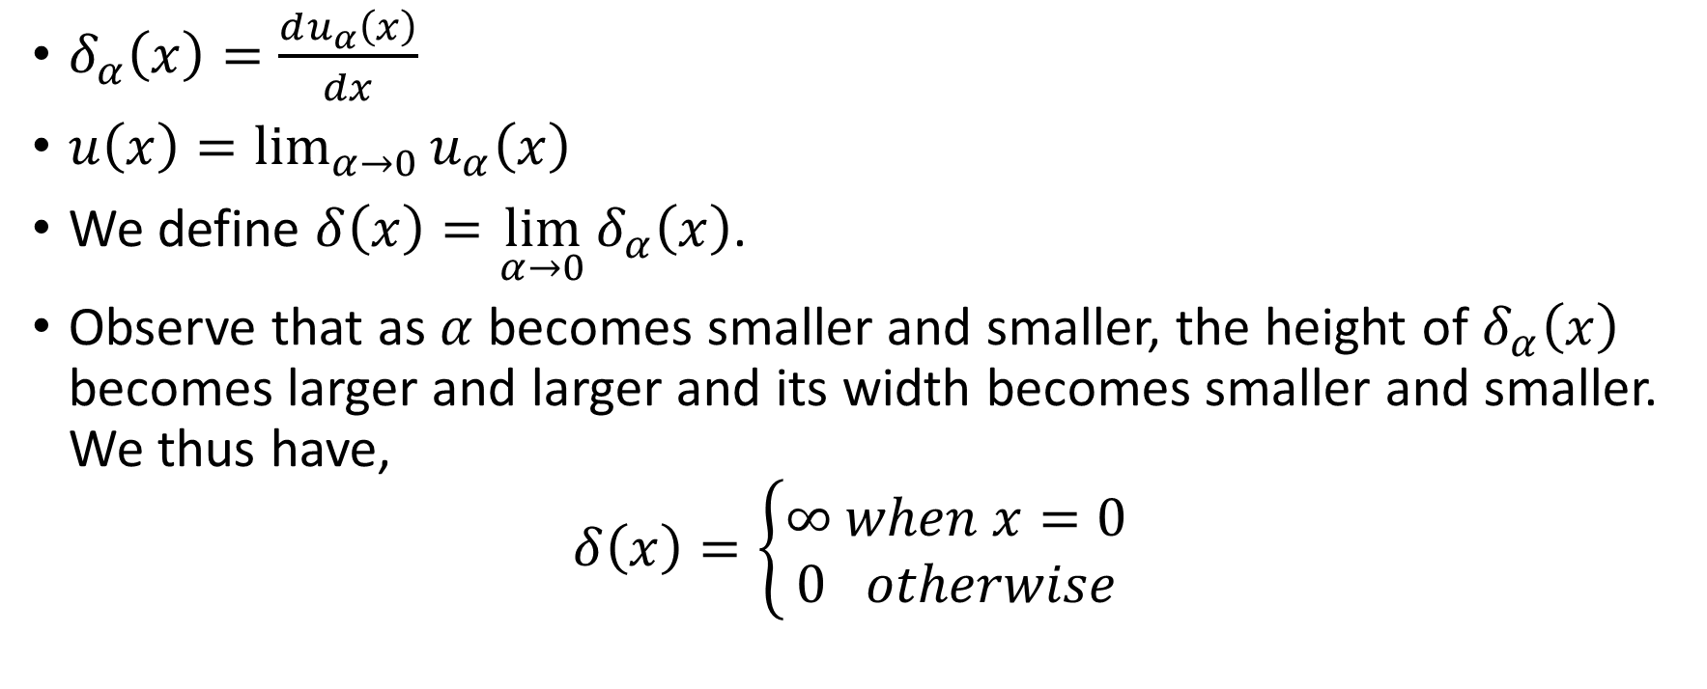
Some Relationships
$δ_{α}\left(x\right)=\frac{du_{α}\left(x\right)}{dx}$
$u\left(x\right)=\lim_{α→0}{u_{α}\left(x\right)}$
We define $δ\left(x\right)=\lim_{α→0}{δ_{α}\left(x\right)}$.
Observe that as $α$ becomes smaller and smaller, the height of $δ_{α}\left(x\right)$ becomes larger and larger and its width becomes smaller and smaller. We thus have,
$$δ\left(x\right)=\left\{\begin{matrix}∞ when x=0 \\ 0 otherwise\end{matrix}\right.$$

