Slide 1
Random Variable and its Probability Distribution

Slide 2
Random Variable
Given a sample space Ω, a random variable is defined as a function on Ω into the real line. In other words, a random variable assigns a real number to each possible outcome of Ω.

Slide 3
Example 1
E: Toss a coin thrice.
$Ω=\left\{HHH, HHT, HTH, THH, HTT, THT, TTH, TTT\right\}$.
Let X: Number of heads obtained in three tosses.
X(HHH) = 3, X(HHT) = 2, X(HTH) = 2, X(THH) = 2, X(HTT) = 1, X(THT) = 1, X(TTH) = 1, X(TTT) =0.
Here X is a random variable assuming the values 0, 1, 2, 3.

Slide 4
Example 2
E: Roll a die once.
$Ω=\{1,2,3,4,5,6\}$.
Let X(e) = e – 3.
X(1) = - 2, X(2) = - 1, X(3) = 0, X(4) = 1, X(5) = 2, X(6) = 3.
Here X is a random variable assuming the values -2, -1, 0, 1, 2, 3.

Slide 5
Example 3
E: Toss a coin until a Head appears.
$Ω=\{H,TH,TTH,TTTH,…\}$.
Let X: Number of tosses required to get the 1st Head.
X(H) = 1, X(TH) = 2, X(TTH) = 3, …..
Here X is a random variable assuming the values 1, 2, 3, …..

Slide 6
Example 4
E: Select a person at random from a group where each having height between 90 CM and 150 CM.
X: Height of the person selected.
Here X is a random variable that can assume an uncountably infinite number of values between 90 CM and 150 CM.

Slide 7
Discrete Random Variable
A random variable is said to be discrete if it can assume a finite number of values or countably infinite values.

Slide 8
Probability Distribution of a Discrete Random Variable
Let X be a discrete random variable assuming the values x₁, x₂, …, x_{n} (or x₁, x₂, …) with the corresponding probabilities p₁, p₂, …, p_{n} (or p₁, p₂, …) where $p_{i}=P\left(X=x_{i}\right)∀i$ such that $\sum_{i}{p_{i}}=1.$
The specification of the set of values of X together their corresponding probabilities define the discrete probability distribution of X.

Slide 9
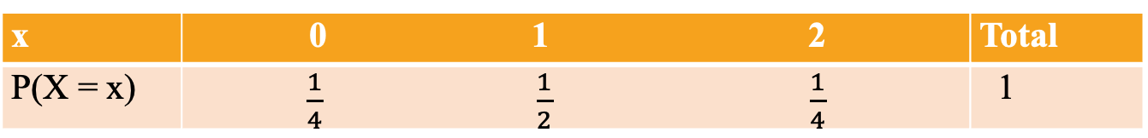
Example 1
E: Toss an unbiased coin twice.
Ω={HH, HT, TH, TT}
Let X: Number of heads obtained in two tosses.
Here X can take up the values 0, 1 and 2.
Now, P(X=0)=P(TT)=1/4,P(X=1)=P(HT or TH)=1/2,P(X=2)=1/4.
The probability distribution of X is then given by
x | 0 1 2 | Total
P(X = x) | $\frac{1}{4}$ $\frac{1}{2}$ $\frac{1}{4}$ | 1

Slide 10
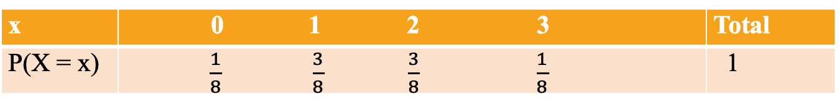
Example 2
E: Toss an unbiased coin thrice.
$Ω=\left\{HHH, HHT, HTH, THH, HTT, THT, TTH, TTT\right\}$.
Let X: Number of heads obtained in three tosses.
Here X can assume the values 0, 1, 2, 3.
Now, $P\left(X=0\right)=P\left(TTT\right)=\frac{1}{8}, P\left(X=1\right)=P\left(HTT or THT or TTH\right)=\frac{3}{8}, P\left(X=2\right)=P\left(HHT or HTH or THH\right)=\frac{3}{8}, P\left(X=3\right)=P\left(HHH\right)=\frac{1}{8}$.
The probability distribution of X is then given by
x | 0 1 2 3 | Total
P(X = x) | $\frac{1}{8}$ $\frac{3}{8}$ $\frac{3}{8}$ $\frac{1}{8}$ | 1

Slide 11
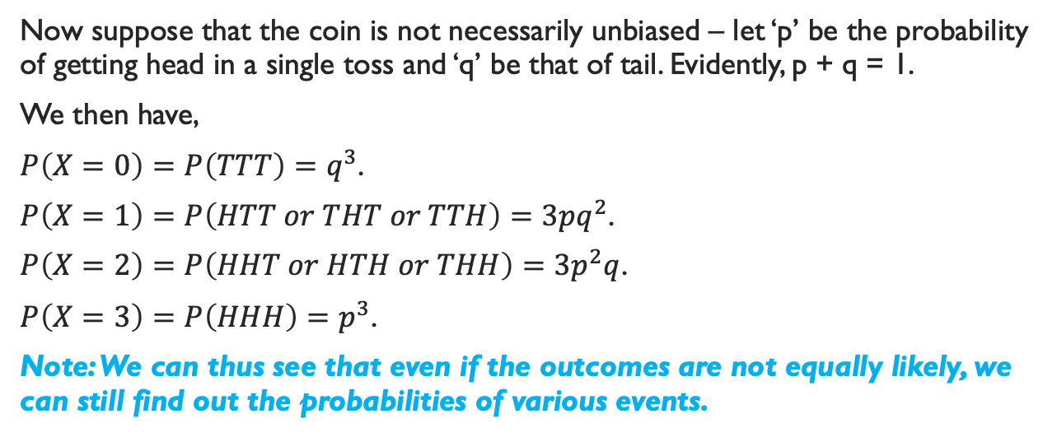
Example 2 (Continued)
Now suppose that the coin is not necessarily unbiased – let ‘p’ be the probability of getting head in a single toss and ‘q’ be that of tail. Evidently, p + q = 1.
We then have,
$P\left(X=0\right)=P\left(TTT\right)=q^{3}$.
$P\left(X=1\right)=P\left(HTT or THT or TTH\right)=3pq^{2}$.
$P\left(X=2\right)=P\left(HHT or HTH or THH\right)=3p^{2}q$.
$P\left(X=3\right)=P\left(HHH\right)=p^{3}$.
Note: We can thus see that even if the outcomes are not equally likely, we can still find out the probabilities of various events.

Slide 12
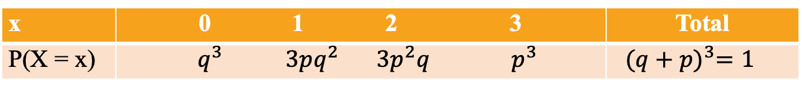
Example 2 (Continued)
Now, the probability distribution of X is given by
x | 0 1 2 3 | Total
P(X = x) | $q^{3}$ $3pq^{2}$ $3p^{2}q$ $p^{3}$ | ${(q+p)}^{3}=1$

Slide 13
Example 3
E: Toss a coin until a Head appears.
Let ‘p’ be the probability of getting head in a single toss and ‘q’ be that of tail.
$Ω=\{H,TH,TTH,TTTH,…\}$.
Let X: Number of tails preceding the the 1st Head.
Here X can assume the values 0, 1, 2, 3, …..
Here the probability distribution of X is given by
x | 0 1 2 3 ….. | Total
P(X = x) | $p$ $qp$ $q^{2}p$ $q^{3}p$ ….. | 1

Slide 14
Note
We thus see that even if the sample space is infinite, one can obtain the probabilities of different values of the random variable.

Slide 15
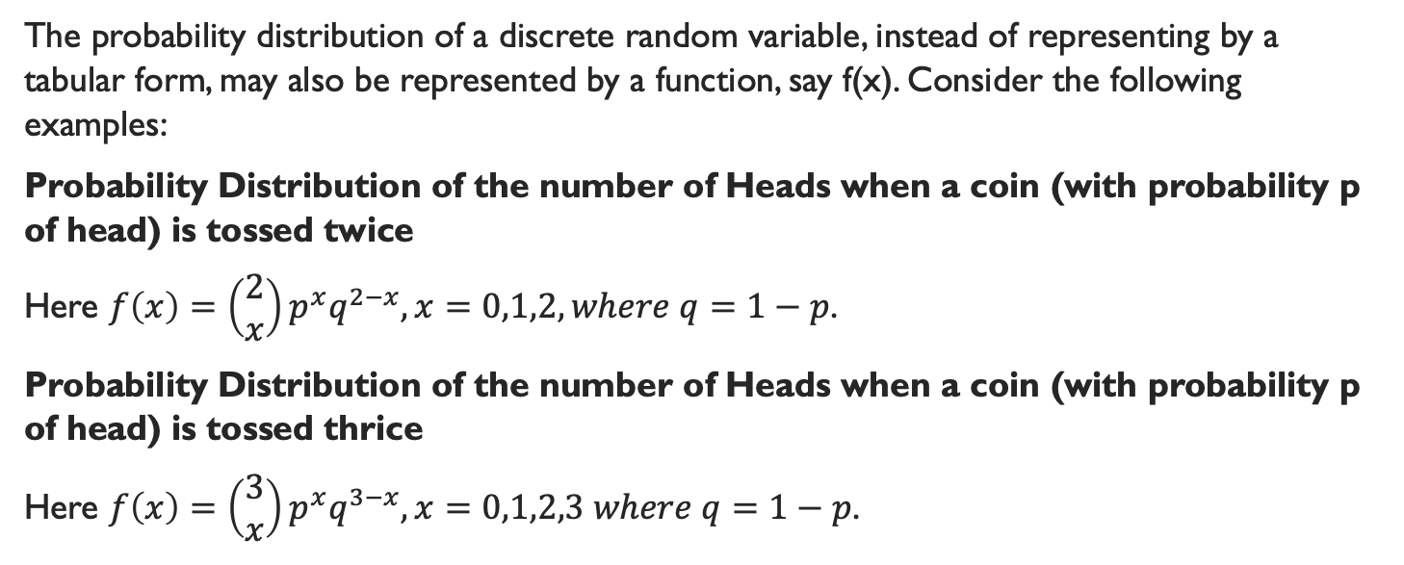
Alternative Representation of Probability Distribution of a Discrete Random Variable
The probability distribution of a discrete random variable, instead of representing by a tabular form, may also be represented by a function, say f(x). Consider the following examples:
Probability Distribution of the number of Heads when a coin (with probability p of head) is tossed twice
Here $f\left(x\right)=\left(\begin{matrix}2 \\ x\end{matrix}\right)p^{x}q^{2−x}, x=0,1,2, where q=1−p$.
Probability Distribution of the number of Heads when a coin (with probability p of head) is tossed thrice
Here $f\left(x\right)=\left(\begin{matrix}3 \\ x\end{matrix}\right)p^{x}q^{3−x}, x=0,1,2,3 where q=1−p$.

Slide 16
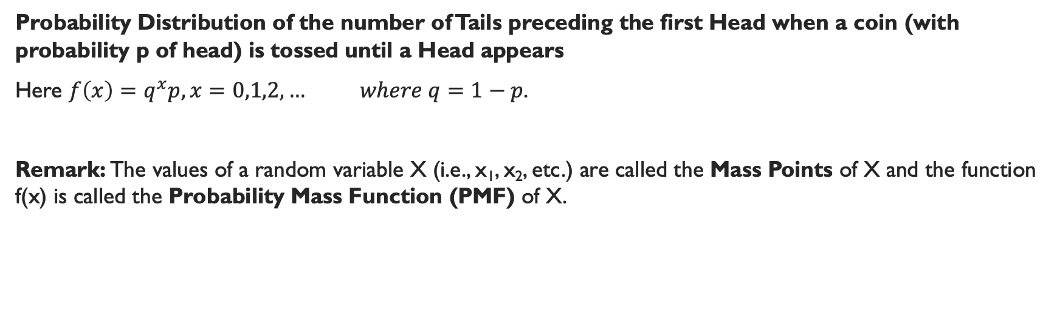
Alternative Representation of Probability Distribution of a Discrete Random Variable Contd.
Probability Distribution of the number of Tails preceding the first Head when a coin (with probability p of head) is tossed until a Head appears
Here $f\left(x\right)=q^{x}p,x=0,1,2,… where q=1−p$.
Remark: The values of a random variable X (i.e., x₁, x₂, etc.) are called the Mass Points of X and the function f(x) is called the Probability Mass Function (PMF) of X.

Slide 17
Probability Mass Function (PMF)
A function f(x) is said to be the PMF of a discrete random variable X if
$f\left(x\right)≥0 ∀x$
$\sum_{x}{f(x)}=1$
where $f\left(x\right)=P\left(X=x\right)∀x$

Slide 18
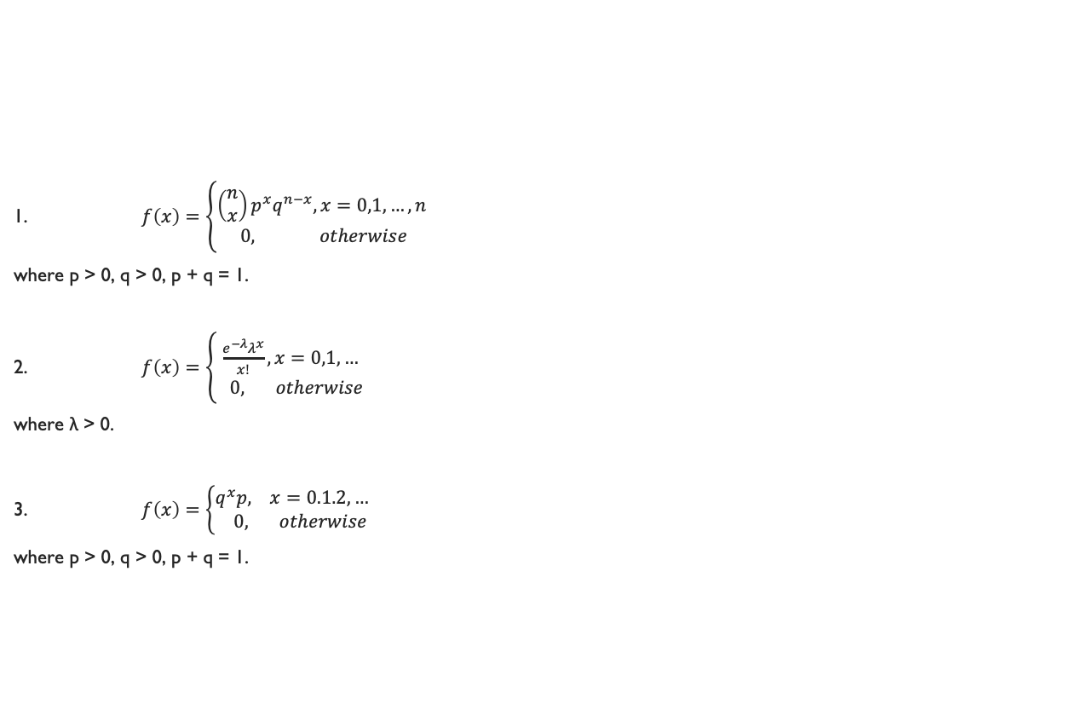
Question: Verify whether the following are PMF:
1. $f\left(x\right)=\left\{\begin{matrix}\left(\begin{matrix}n \\ x\end{matrix}\right)p^{x}q^{n−x}, x=0,1,…,n \\ 0, otherwise\end{matrix}\right.$
where p > 0, q > 0, p + q = 1.
2. $f\left(x\right)=\left\{\begin{matrix}\frac{e^{−λ}λ^{x}}{x!}, x=0,1,… \\ 0, otherwise\end{matrix}\right.$
where λ > 0.
3. $f\left(x\right)=\left\{\begin{matrix}q^{x}p, x=0.1.2,… \\ 0, otherwise\end{matrix}\right.$
where p > 0, q > 0, p + q = 1.

