Slide 1

Cloud Modernization Platform
March 2024

Slide 2
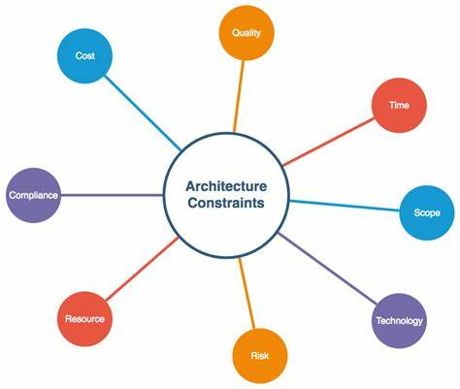

Business Problem and Main Objectives
Business Problem
A. Aging Architecture
The existing architecture for data is aging, presenting constraints in scalability, flexibility, and efficiency.
B. Performance Bottlenecks
Performance problems are encountered with the current infrastructure, affecting the speed and effectiveness of data processing and analysis.
C. Unexplored Data
Despite possessing a large amounts of data, ABC Corp is hindered from fully harnessing it for insights and decision-making due to various limitations within their existing setup.
Insert graphic here
Objectives
A. Develop a Scalable Infrastructure Data Platform
The goal of the initiative is to create a resilient and adaptable data platform hosted on the cloud. This platform will empower ABC Corp to surpass constraints linked to their outdated architecture and isolated operations by offering unified access to data across various entities within the organization.
B. Ingest Variety of Data Sources
The modern data platform must be capable of efficiently collecting data from various sources, including structured and unstructured data from internal systems, as well as external sources such as third-party vendors and partners. By aggregating a diverse range of data types, ABC Corp can obtain comprehensive insights into their business operations and customer behavior.
C. Leverage Common Infrastructure to Overcome Bottlenecks
The initiative aims to utilize a unified infrastructure to mitigate performance bottlenecks and decrease expenses.
Insert graphic here

Slide 3

Timeline
Deployment & Training:
4
Testing & Optimization:
Offer training and support to users, monitor usage and performance of the Modern Data Platform, and gather stakeholder feedback for ongoing optimization and enhancement
3
2
Implementation:
- Conduct thorough testing to ensure data accuracy and system performance.
- Optimize ETL processes and infrastructure for efficiency and scalability.
1
Discovery & Planning:
- Set up AWS infrastructure for data ingestion, processing, and visualization.
- Develop and deploy ETL processes and data pipelines.
- Configure data visualization tools and reporting dashboards.
- Develop a detailed project
plan outlining milestones, deliverables, nd resource requirements.
- Develop a clear vision, strategic
goals , high-level solution arch-
-itecture.

Slide 4









Services and Tools Used in AWs
Data Integration and Ingestion Tools
Data Storage and Processing Tools
EC2
Kinesis.
Firehouse
IAM
S3
Glue
Glue Catalog
Business Intelligence and Reporting Tools
Data Science and Analytics Tools
Athena
Sagemaker

Slide 5
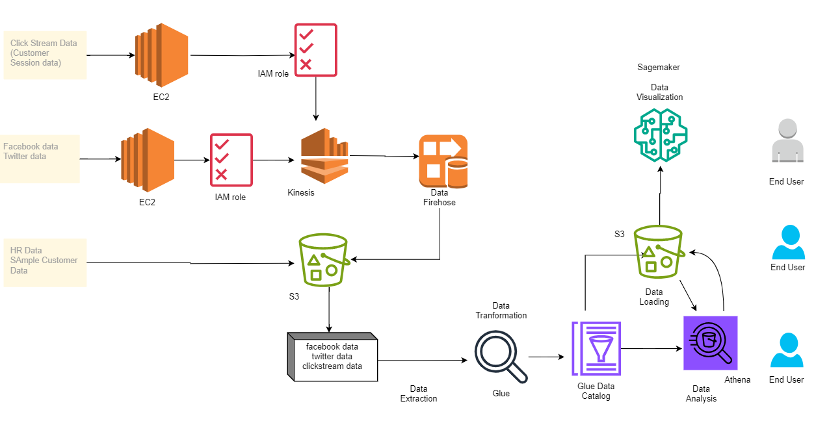
Architecture Diagram

Slide 6
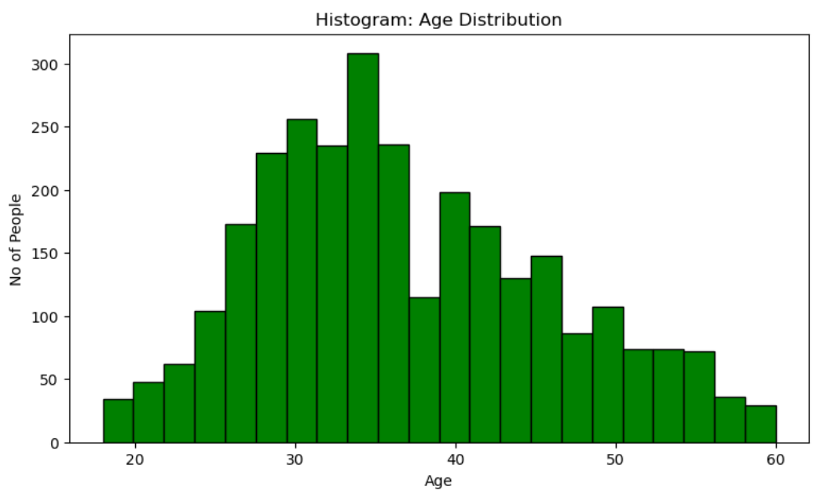
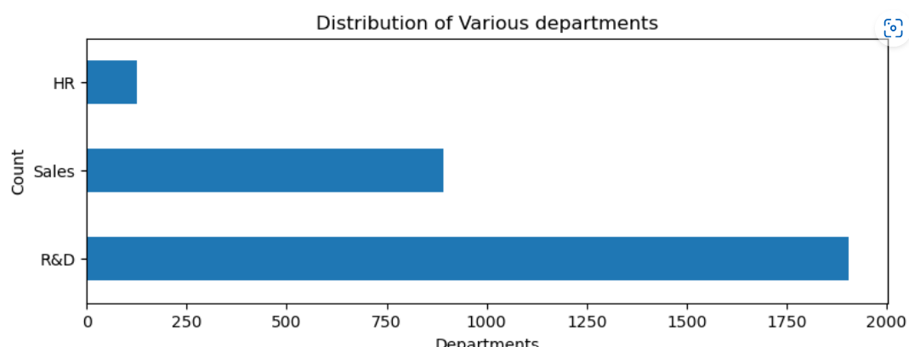
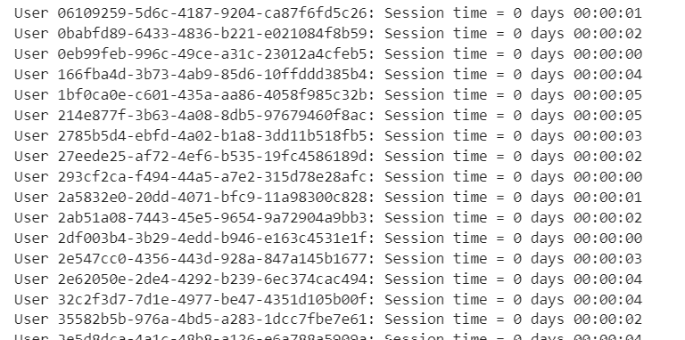
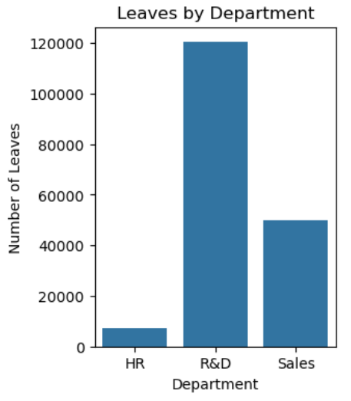
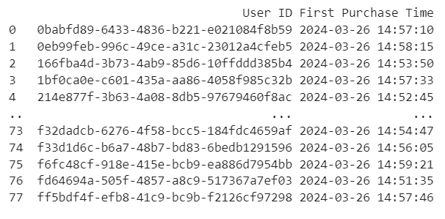
Analytics
First purchase time for each User
Session time of each user

Slide 7
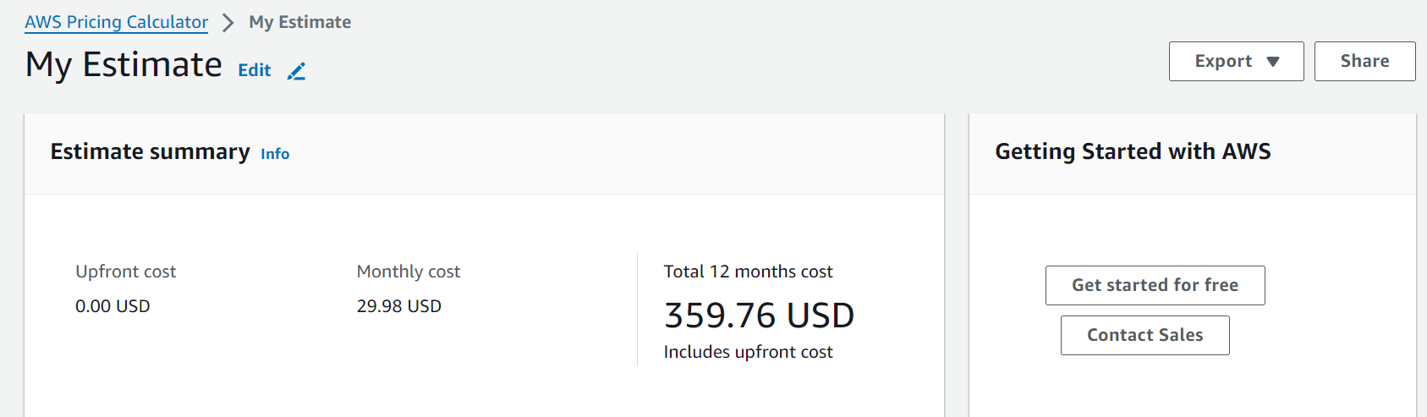
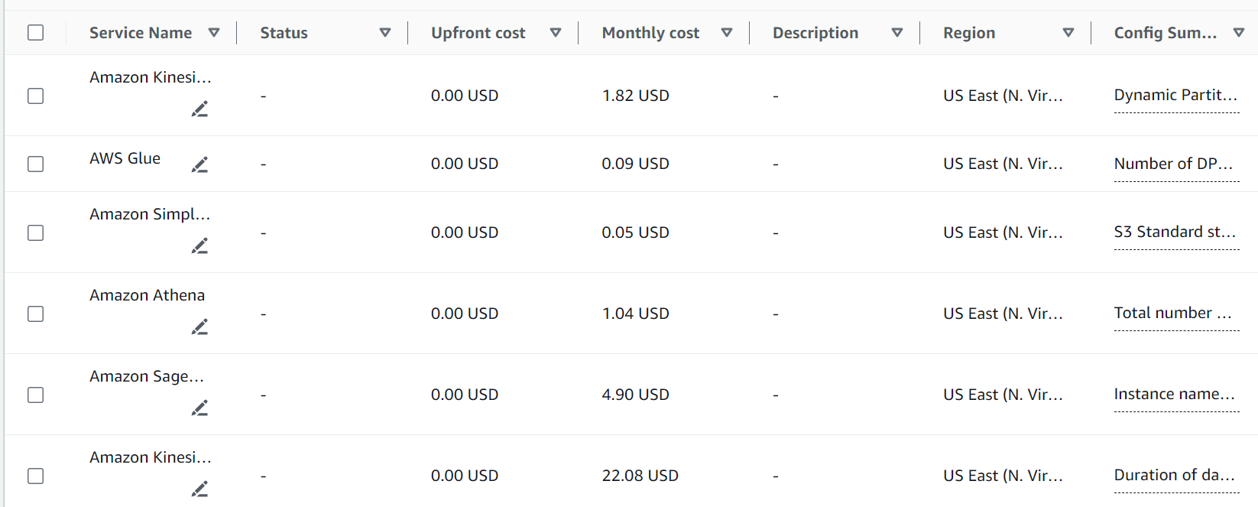
Cost Estimation
Using AWS Pricing Calculator, we had a rough estimate of the budget monthly and yearly.
Notes:
• Body Slide (Large text box)
• Goal: Provides ample text space for more detailed explanations.
• Required to Include: Header title; text; Incedo logo.
• Optionally include: Subheader.

Slide 8
Protocols for Communication
Utilize Project Management Tools:
Tool: Implement tools like Jira or Trello for task tracking and updates.
Usage: Assign tasks, set deadlines, and track progress in real-time.
Establish Clear Communication Channels:
Channels: Utilize Zoom for virtual meetings, and email for formal communication.
Dedicated Channels: Create dedicated channels for specific topics or teams to streamline communication.
Response Time Expectations:
Expectations: Define response time expectations for different communication channels.
Example: emails within 24 hours.
Document Decisions and Discussions:
Documentation: Maintain a centralized repository (e.g., Confluence) to document decisions, discussions, and meeting minutes.
Version Control: Ensure version control to track changes and updates accurately.
Notes:
• Body Slide (Large text box)
• Goal: Provides ample text space for more detailed explanations.
• Required to Include: Header title; text; Incedo logo.
• Optionally include: Subheader.

Slide 9
Client Stakeholder Management & Expectations
Regular Status Updates:
Frequency: Provide weekly status updates on project progress and milestones.
Medium: Share updates via email or conduct virtual meetings for in-depth discussions.
Clear Expectations Regarding Deliverables:
Detailed Deliverables: Provide a detailed breakdown of deliverables, including specific data sources integrated, ETL processes implemented, and analysis conducted.
Timeline Alignment: Align deliverables with project timelines to ensure timely completion.
Timelines and Potential Challenges:
Timelines: Clearly communicate project timelines, including milestones and key deadlines.
Challenges: Proactively identify potential challenges (e.g., data quality issues, technical constraints) and discuss mitigation strategies.
Active Participation and Feedback:
Actively encourage client stakeholders to participate in project activities, such as requirements gathering sessions, user acceptance testing, and feedback sessions and establish a feedback mechanism (e.g., regular feedback surveys, open-door policy) to solicit input and address concerns promptly.
Notes:
• Body Slide (Large text box)
• Goal: Provides ample text space for more detailed explanations.
• Required to Include: Header title; text; Incedo logo.
• Optionally include: Subheader.

Slide 10
Key Handshake Points:
Data Lifecycle Phases:
Data Ingestion: Acquire data from various sources.
Data Transformation: Processing data by performing ETL.
Data Modeling: Structure data for analysis.
Data Visualization: Present insights through visualizations.
Client Collaboration:
IT Integration: Coordinate with client IT teams for data access and system integration.
Finance Alignment: Ensure financial data integration and alignment with accounting practices.
Operations Coordination: Collaborate on operational data requirements and processes
Notes:
• Body Slide (Large text box)
• Goal: Provides ample text space for more detailed explanations.
• Required to Include: Header title; text; Incedo logo.
• Optionally include: Subheader.

Slide 11
Risk and Mitigation
Resource Constraint
Risk: Limited resources such as staff and expertise may lead to project delays or quality issues
Mitigation: Establish clear project scope and requirements from the outset and maintain regular communication with stakeholders to manage expectations and prevent scope expansion.
Data Quality Issues
Risk: Insufficient data quality can lead to incorrect conclusions and decision-making, demanding more time and resources for correction.
Mitigation: Set up standards for data quality and validation criteria along with introducing data cleansing and normalization protocols at the project's outset.
Technology Challenges
Risk: Challenges or constraints with chosen technologies can affect project schedules and expenses.
Mitigation: Perform comprehensive assessments of technologies before integrating them and execute a proof of concept to confirm the viability of technology selections prior to complete deployment.
Notes:
• Body Slide (Large text box)
• Goal: Provides ample text space for more detailed explanations.
• Required to Include: Header title; text; Incedo logo.
• Optionally include: Subheader.

Slide 12
Success Criteria:
Initial Module:
Successful migration to cloud platform.
Improved data availability and performance.
Adoption of BI reporting and analytics tools
Ongoing Program:
Stakeholder satisfaction with insights generated.
Improved decision-making based on data-driven insights.
Efficient handling of future data sources and requirements.
Continued optimization and scalability.
Notes:
• Body Slide (Large text box)
• Goal: Provides ample text space for more detailed explanations.
• Required to Include: Header title; text; Incedo logo.
• Optionally include: Subheader.

Slide 13
Q&A

Slide 14
Thank You
Submitted by Srilikhita
Vijay
Guru Siva
Ojasvi
Koushik

