Slide 1
Git
Why every developer should know it
Niko Infanto, Sam Stevens, Devin Kloos

Slide 2
What is Git?
Git is a very popular version control system created in 2005 by Linus Torvalds, the famous creator of the Linux operating system kernel. A staggering number of software projects rely on Git for version control, including commercial projects as well as open source.
Notes:
https://www.atlassian.com/git/tutorials/what-is-git/

Slide 3
Who uses Git?
Everyone, Microsoft - https://github.com/Microsoft
NodeJS - https://github.com/nodejs
Twitter Bootstrap - https://github.com/twbs/bootstrap
Ruby on Rails - https://github.com/rails
Notes:
GitHub's top 10 most popular projects http://www.computerworld.com/article/2473298/application-development/120001-GitHub-s-top-10-rock-star-projects.html#slide2
Explain:
Watch
Star
Fork
Code
Branches
ReadMe.md
Issues
Pull Requests
The best developer tools, now free for students
https://github.com/blog/1900-the-best-developer-tools-now-free-for-students

Slide 4
Git != GitHub
GitHub is a website where you can upload a copy of your Git repository. It is a Git repository hosting service, which offers all of the distributed revision control and source code management (SCM) functionality of Git as well as adding its own features. Although GitHub is the most popular there are some very good competitors:
https://bitbucket.org
https://about.gitlab.com
Notes:
“Development of the GitHub platform began on 1 October 2007. The site was launched in April 2008. (https://en.wikipedia.org/wiki/GitHub)”

Slide 5
Git + GitHub
GitHub can be thought of a programming social media. When GitHub is combined with Git, it creates a powerful system for sharing, collaborating, contributing to, and saving code, all within a version control system with user permissions.
Notes:
1. Publishing tool – provides the availability to post code to a general location that can be easily viewed and worked on by the general public.
2. Version control system – save a before copy of every change made, making it easy to rollback to previous versions.
3. Collaboration platform – provides the ability of others to pull code and provide requested changes, log issues, and provide feedback to improve code.

Slide 6
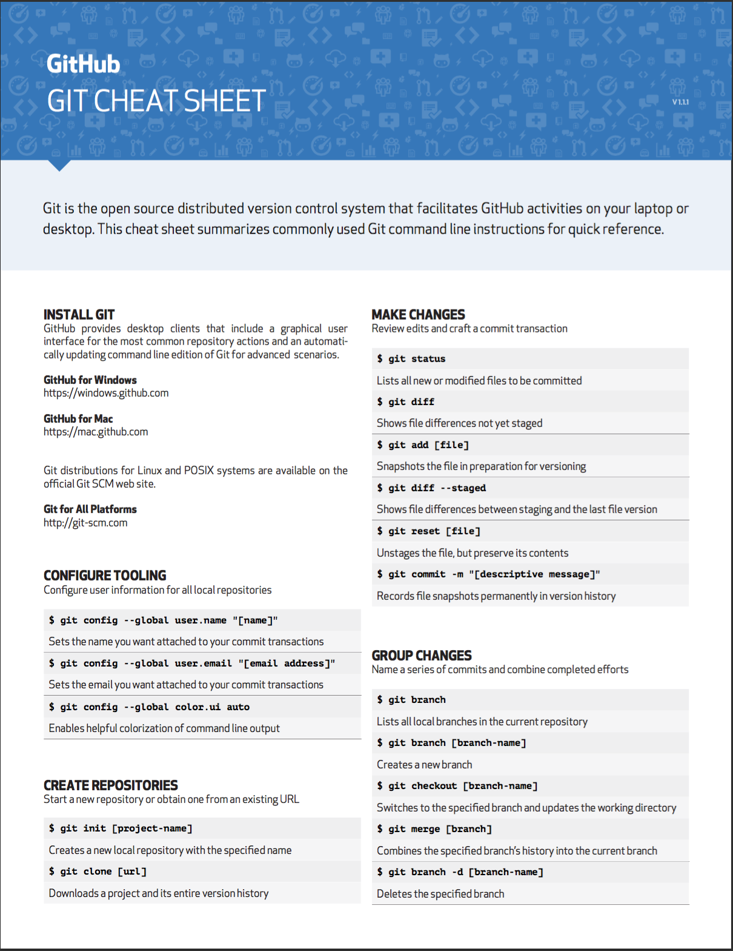
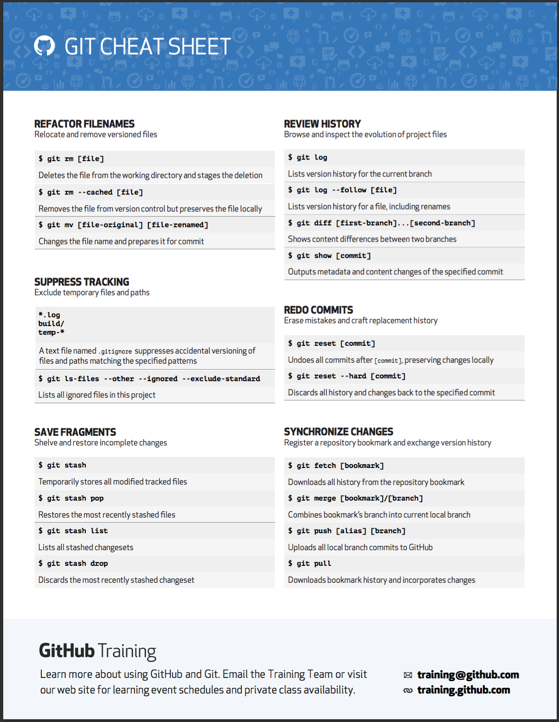

Slide 7
SSH (Secure Socket Shell)
SSH, also known as Secure Socket Shell, is a network protocol that provides users with a secure way to access a remote computer. SSH also refers to the suite of utilities that implement the protocol.
(Source: searchsecurity.techtarget.com/definition/Secure-Shell) SSH is native to UNIX systems (Mac and GNU/Linux) and can be used from the command line. There are a variety of popular desktop and mobile clients for all major operating systems including Windows, Mac, GNU/Linux) Popular ones include: Terminal, PuTTY, SecureCRT, JuiceSSH

