Slide 1
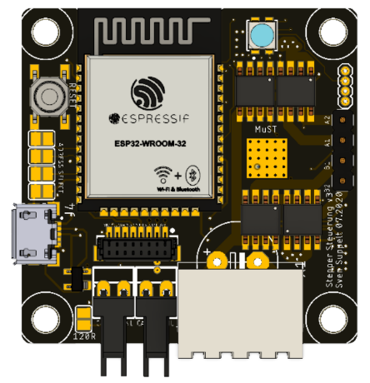


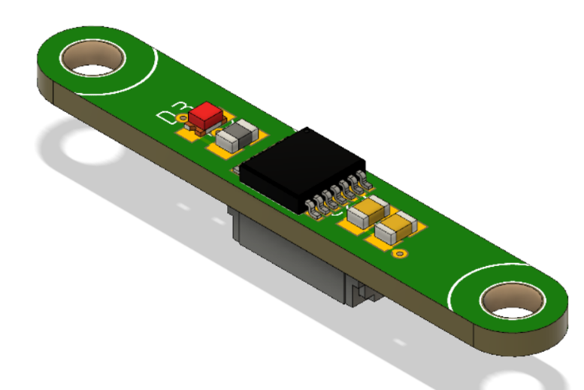
ESP_Master
ROS - PC
CAN
Rosserial
1MBaud
CAN
CAN
CAN
CAN
Ext. encoder
CAN

