Slide 1
Quantum Computing vs Cryptosystem
Sajjad Alsaffar
CSC534 Computer Security
Professor: Jeonghwa Lee
Department of Computer Science
Shippensburg University
01/06/2024
Notes:
Hello everyone. Today, I will be discussing the impact of quantum computing on cryptosystems. Let's begin with a brief overview of quantum physics and its evolution.

Slide 2
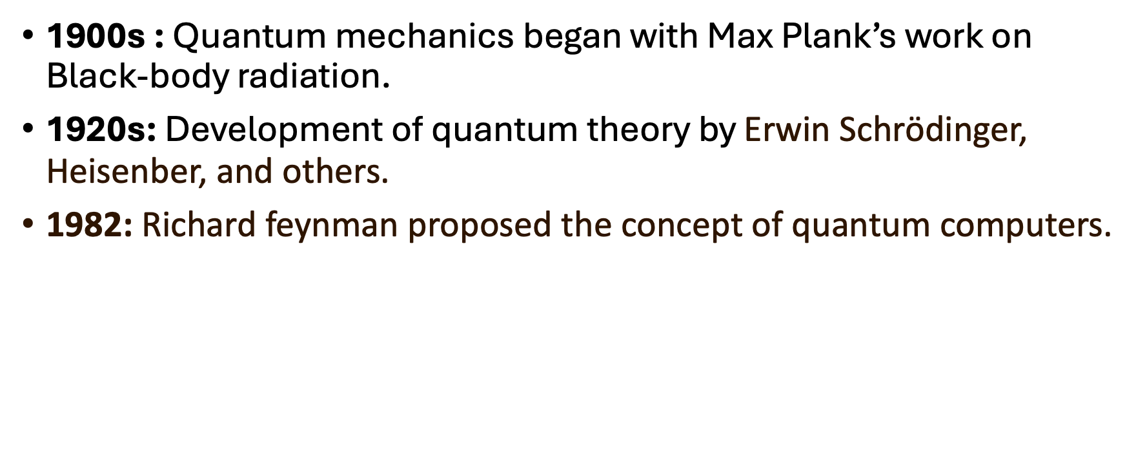
Quantum Physics Timeline
Notes:
Quantum mechanics started in the early 1900s with Max Planck’s work on black-body radiation, which describes how objects emit thermal radiation. It developed further in the 1920s with contributions from Schrödinger and Heisenberg, who formulated key principles of quantum theory. In 1982, Richard Feynman proposed the idea of quantum computers, which could solve problems classical computers struggle with.

Slide 3
Linking Quantum Physics to Computing
1980s: Richard Feynman and David Deutsch explored the idea of quantum computation.
1994: Peter Shor developed an algorithm for factoring integers on a quantum computer.
1996: Lov Grover introduced a quantum algorithm for database search
Notes:
In the 1980s, Feynman and David Deutsch explored quantum computation, the idea of using quantum mechanics to perform calculations. Peter Shor, in 1994, developed an algorithm for factoring integers on a quantum computer, demonstrating a potential to break widely used encryption. In 1996, Lov Grover introduced a quantum algorithm for database searches, showcasing the efficiency of quantum search methods.

Slide 4
Qubits and Superposition
Qubit: Basic unit of quantum information, analogous to a classical bit.
Superposition: A qubit can be in a state |0⟩, |1⟩, or any quantum superposition of these states:
|ψ⟩ = α|0⟩ + β|1⟩ with |α|^2 + |β|^2 = 1
Allows parallel computation on multiple states.
Notes:
Qubits are the basic units of quantum information, analogous to classical bits but with key differences. Unlike classical bits that are either 0 or 1, qubits can be in a state of 0, 1, or any superposition of these states, meaning they can exist in multiple states simultaneously. This property enables quantum computers to perform parallel computations, significantly enhancing their problem-solving capabilities.
TLDR superposition it can be everywhere between top and bottom

Slide 5
Entanglement and Quantum Gates
Entanglement: A phenomenon where qubits become linked, and the state of one qubit depends on the state of another.
Quantum Gates: Operations that change the state of qubits, such as the Hadamard gate (superposition) and CNOT gate (entanglement).
Notes:
Entanglement is a phenomenon where qubits become linked so that the state of one qubit directly affects the state of another, no matter the distance between them. Quantum gates, like the Hadamard gate, which creates superposition, and the CNOT gate, which generates entanglement, manipulate qubits to perform computations. These gates are fundamental operations in quantum computing.

Slide 6
Shor’s Algorithm
Efficiently factors large integers, breaking RSA encryption.
Classical difficulty: Factoring large numbers is computationally hard.
Quantum advantage: Shor’s algorithm runs in polynomial time, making RSA insecure against quantum attacks.
Notes:
Shor's algorithm can efficiently factor large integers, making RSA encryption vulnerable. RSA encryption relies on the difficulty of factoring large numbers, a task that classical computers find very hard. However, quantum computers can perform this task in polynomial time using Shor’s algorithm, posing a significant threat to current cryptographic systems.

Slide 7
Mathematical Demonstration
RSA relies on the difficulty of factoring large numbers.
Shor’s algorithm uses Quantum Fourier Transform (QFT) to find the period of a function, leading to efficient factorization.
This capability dramatically reduces the time required to break RSA encryption.
Notes:
Let's look at a simple example to understand how Shor's algorithm works in breaking RSA encryption. RSA security is based on the difficulty of factoring large numbers into their prime factors. For this example, we will factor the number 77.(N)
Shor's algorithm uses the Quantum Fourier Transform to efficiently find the period of a function. This period-finding is the key to breaking down the large number into its prime factors.

Slide 8
Example
Here's a simplified version of the process:
Choose a number a such that 1<a<N (for our example, let's choose a=2).
Compute a^x mod for different values of x until a repeating pattern (period) is found.
The period of this function helps determine the factors of N.

Slide 9
Python Demonsration
Give me 1 min to run the python file :)
Notes:
N= 77
P * q = 77
Even -1
Odd +1

Slide 10
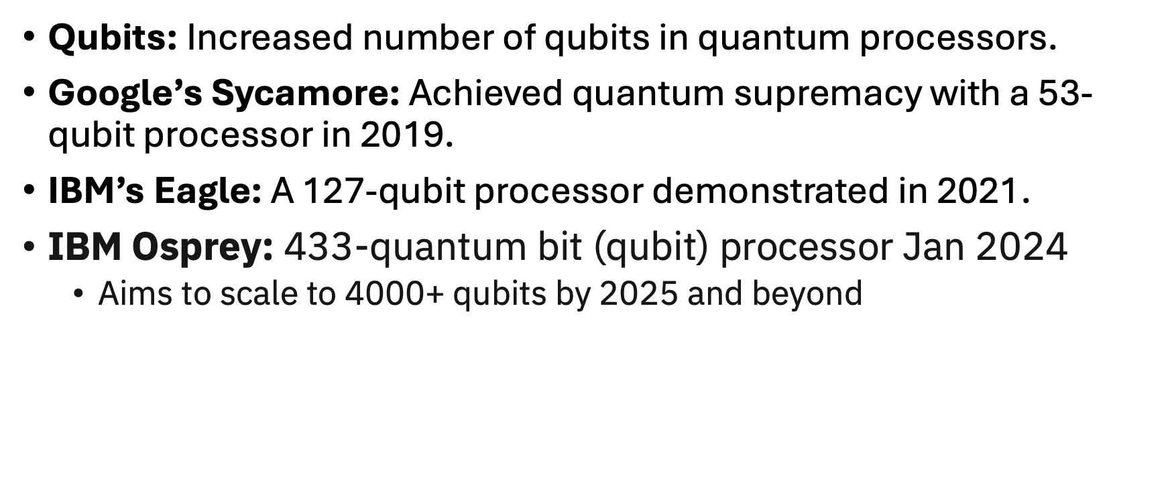
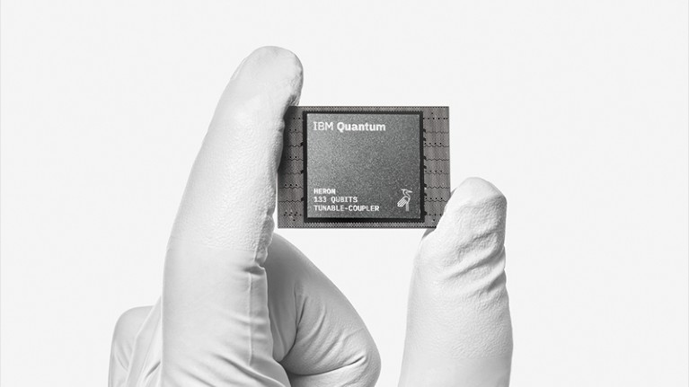
Recent Quantum Computing Progress
Castelvecchi, D. (2023, December 4). IBM releases first-ever 1,000-qubit quantum chip. Nature News. https://www.nature.com/articles/d41586-023-03854-1
Notes:
Recent advancements in quantum computing include increasing the number of qubits in processors. For example, Google’s Sycamore processor achieved quantum supremacy in 2019 with 53 qubits, performing a calculation faster than the most powerful classical computers. IBM’s Eagle, a 127-qubit processor demonstrated in 2021, represents another leap forward in quantum hardware.

Slide 11
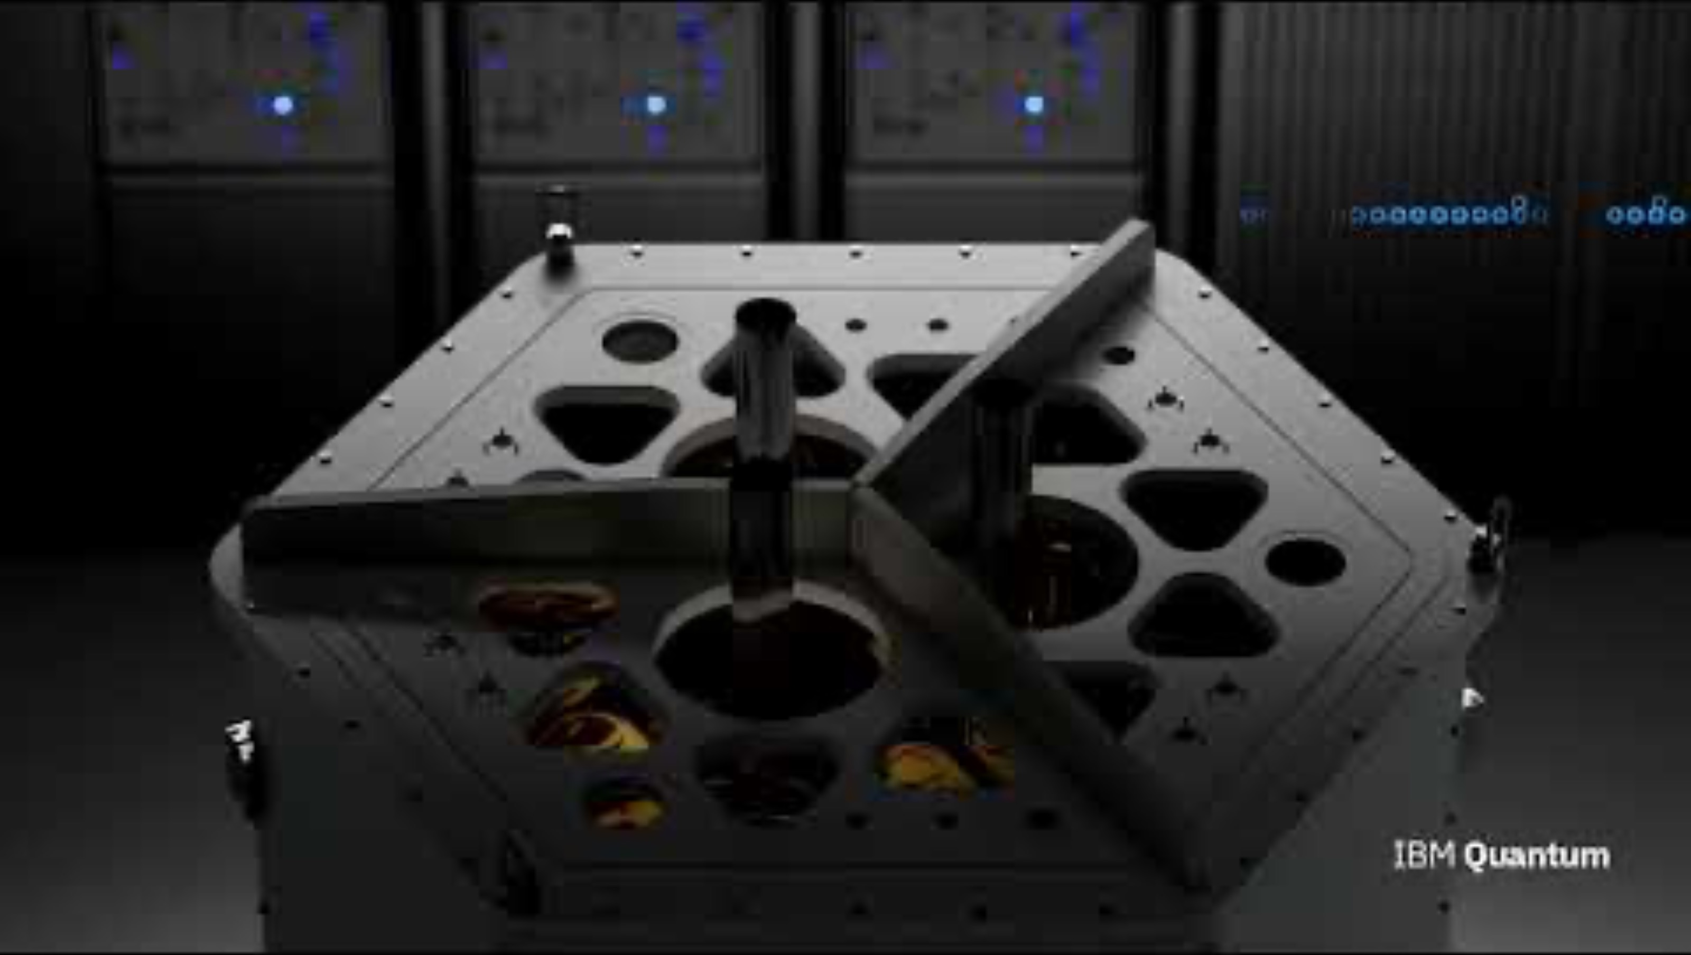

Slide 12
Quantum Computing Applications
Cryptography: Development of quantum-resistant algorithms.
Optimization: Solving complex optimization problems.
Material Science: Simulating molecular structures.
Notes:
Quantum computing has various applications. In cryptography, it aids in developing quantum-resistant algorithms that can withstand quantum attacks. It also helps solve complex optimization problems in fields like logistics and finance, and simulates molecular structures in material science, enabling discoveries in chemistry and materials engineering.

Slide 13
Conclusion
Quantum computing poses a significant threat to current cryptographic systems.
Post-quantum cryptography is essential for future security.
Continued advancements in quantum hardware and algorithms are crucial.
Notes:
In conclusion, quantum computing poses a significant threat to current cryptographic systems. Developing post-quantum cryptography is essential for future security. Continued advancements in quantum hardware and algorithms are crucial for progress in this revolutionary field.

Slide 14
References
Planck, M. (1901). “On the Law of Distribution of Energy in the Normal Spectrum”. Annalen der Physik, 4(3), 553-563.
Feynman, R.P. (1982). “Simulating Physics with Computers”. International Journal of Theoretical Physics, 21(6), 467-488.
Deutsch, D. (1985). “Quantum Theory, the Church-Turing Principle and the Universal Quantum Computer”. Proceedings of the Royal Society of London. Series A, Mathematical and Physical Sciences, 400(1818), 97-117.
Arute, F., Arya, K., Babbush, R., et al. (2019). “Quantum supremacy using a programmable superconducting processor”. Nature, 574(7779), 505-510.

