Slide 1








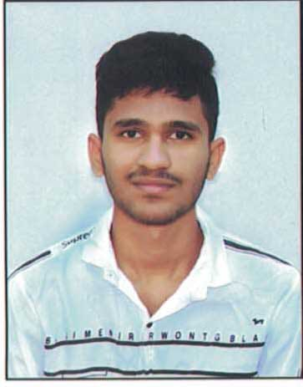


ICMLBDA 2023
3nd International Conference on
Machine Learning and Big Data Analytics
29-30th May 2023
Paper ID - 200
Predictive Analytics of Blood Donor Risk Assessment using Machine Learning Methods
Presented By:
Avula Sravan Reddy, Dr.Vijayalakshmi Kakulapati, Sundari Mani Teja, Acha Vamshi
Sreenidhi Institute of Science and Technology, Ghatkesar, Telangana, India

Slide 2
ICMLBDA 2023
Title: Predictive Analytics of Blood Donor Risk Assessment using Machine Learning methods
Introduction:
The primary way to satisfy demand is to have regularly occurring donations from healthy volunteers.
This project is mainly based on predicting analytics in the context of Blood Donor risk assessment .
Hence the need of blood and its transmission is the crucial subject of consideration.
Also many diseases are seen to be creped in our day to day life.
One of which can be instanced as Thalassemia. One that is affected by this disease also needs the transmission of the blood week by week.
In this project an effort has been made to identify Best Donor in order of their impact that affect the decision of a person to become a blood donor.
Paper ID-200 @ ICMLBDA 2023

Slide 3
ICMLBDA 2023
Title: Predictive Analytics of Blood Donor Risk Assessment using Machine Learning methods
Algorithms and Libraries used:
Linear Regression : To classify the data of donor, recipient details in the dataset on which the model is trained and tested.
Recurrent Neural Network : RNN is used to store the patient previous medical conditions to evaluate the risk in Blood Donation.
Numpy : It is used to take advantage of scientific functions
Jupyter Notebook : Platform used to develop the project
etc..,
Paper ID-200 @ ICMLBDA 2023

Slide 4
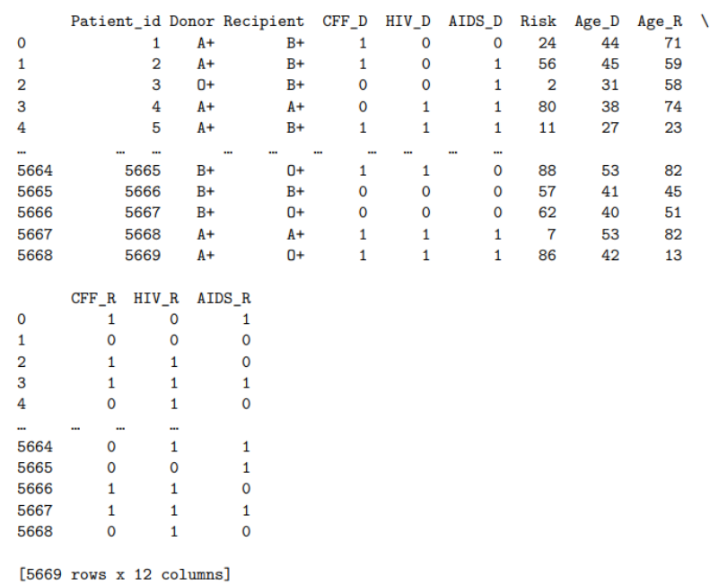
ICMLBDA 2023
Title: Predictive Analytics of Blood Donor Risk Assessment using Machine Learning methods
Data-set:
Paper ID-200 @ ICMLBDA 2023

Slide 5
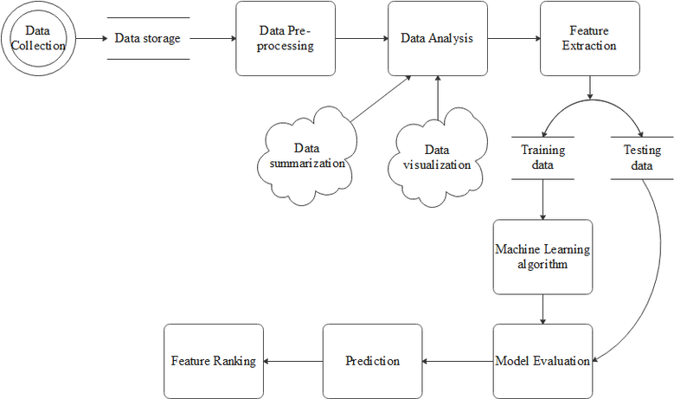
ICMLBDA 2023
Title: Predictive Analytics of Blood Donor Risk Assessment using Machine Learning methods
Project Flow:
Paper ID-200 @ ICMLBDA 2023

Slide 6
ICMLBDA 2023
Title: Predictive Analytics of Blood Donor Risk Assessment using Machine Learning methods
Achievements in this Project:
Efficient Blood Choosing for donation.
Decrease in Risk.
Healthy blood for operations.
Minimize the wastage of resources resulting from the collection of unsuitable donations
Paper ID-200 @ ICMLBDA 2023

Slide 7
ICMLBDA 2023
Title: Predictive Analytics of Blood Donor Risk Assessment using Machine Learning methods
Future Plans on this Project:
To Implement Image processing in this project to detect the diseases directly from the blood sample images and predict the possibility of the disease transfer in blood transfusion.
Integration with other healthcare systems
Paper ID-200 @ ICMLBDA 2023

Slide 8
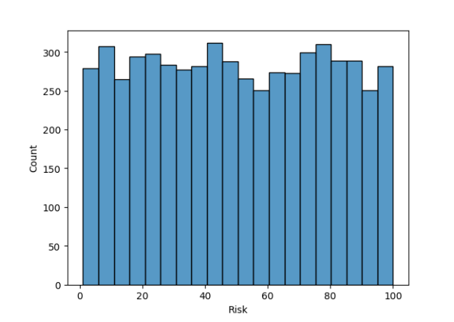
ICMLBDA 2023
Title: Predictive Analytics of Blood Donor Risk Assessment using Machine Learning methods
Risk Range from dataset:
Paper ID-200 @ ICMLBDA 2023

Slide 9
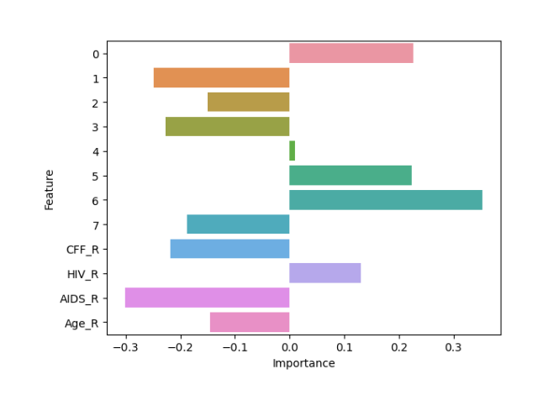
ICMLBDA 2023
Title: Predictive Analytics of Blood Donor Risk Assessment using Machine Learning methods
Plot on Importance of disease:
Paper ID-200 @ ICMLBDA 2023

Slide 10
ICMLBDA 2023
Title: Predictive Analytics of Blood Donor Risk Assessment using Machine Learning methods
Final Result :
Based on the given input of Recipient details( blood group, diseases, age, etc., ) the model will predict the best donor from the dataset as shown below :
Paper ID-200 @ ICMLBDA 2023

Slide 11
ICMLBDA 2023
Title: Predictive Analytics of Blood Donor Risk Assessment using Machine Learning methods
Conclusion:
Commercial blood donors are still the major source of blood to the hospital and they also have the highest prevalence of transfusion transmissible viral infections in this region thus constitute a major risk transmitting infections to potential recipients.
This project will definitely help in various blood transfusion cases like in surgeries ….
Paper ID-200 @ ICMLBDA 2023

Slide 12
ICMLBDA 2023
Title: Predictive Analytics of Blood Donor Risk Assessment using Machine Learning methods
References:
http://www.americasblood.org/donate-blood/blood-donation-101.aspx
https://figshare.com/articles/journal_contribution/Blood_Group_Antigens_C_Lub_and_P1_May_Have_a_Role_in_HIV_Infection_in_Africans/2735131
https://www.testing.com/what-you-need-know-about-blood-type-and-your-health/
Paper ID-200 @ ICMLBDA 2023

Slide 13
ICMLBDA 2023
Title: Predictive Analytics of Blood Donor Risk Assessment using Machine Learning methods
Thank You
sravanreddyavula@gmail.com
vijayalakshmik@sreenidhi.edu.in
manicharan621@gmail.com
vamshiacha761@gmail.com
Paper ID-200 @ ICMLBDA 2023

