Slide 1
Risk analysis in Blood donation
Group Number-15
Phase I Project Co-Ordinator: Dr.K.Vijaya Lakshmi
Group Members-
A. Sravan Reddy (19311A1207)
A. Vamshi(19311A1217)
S. Mani Teja (19311A1227)

Slide 2
contents
Abstract
Introduction
Existing System
Proposed System
Flow of Application
Technologies used
Code
Output
Applications
Advantages
Disadvantages
Conclusion
Future Scope

Slide 3
Abstract
Blood donation is a voluntary procedure that can help save lives. There are several types of blood donation. Each type helps meet different medical needs. Each year, millions of individuals require blood transfusions. During surgery, some people might need blood. Others are dependent on it as a result of an accident or a medical condition that calls for certain blood components. All of this is made possible via blood donations. All transfusions utilise blood from a donor because there is no blood substitute for human blood. Donating blood is risk-free. Since each donor uses brand-new, sterile disposable equipment, giving blood carries no risk of contracting a blood-borne infection. A pint (about half a litre) can be donated by most healthy persons without posing any health hazards. Your body replenishes the fluids lost as soon as a few days have passed since a blood donation. Your body then repairs the lost red blood cells after two weeks. We must employ Machine Learning to create this. This application will be developed in a Jupyter Notebook using Python. We intend to employ modules like Pandas, Numpy, and Keras. If we employ methods like Multilayer Perception and Linear Regression, this is feasible. Due of the topic's novelty, we intend to create our own dataset

Slide 4
introduction
The recognition and management of risk in donation process and blood product is critical to ensure donor and patient safety. A blood donation is a process whereby a person voluntarily has blood drawn to be used for future transfusions when in need at hospitals for treatment procedures that require them.
Blood donor selection is the first crucial step to ensure blood safety and reduces risk through the individuals with identified risks that may be associated with infection.
In this project, we try to build a foundation for using machine learning in defining Risk in Blood Donation.

Slide 5
Existing system
Availability of blood for recipients
Possible blood groups for blood transfusion
Quantity of blood to be donated

Slide 6
Proposed system
Calculation of Risk in each Donation
Various possible / Best blood group suitable for the reciepient

Slide 7
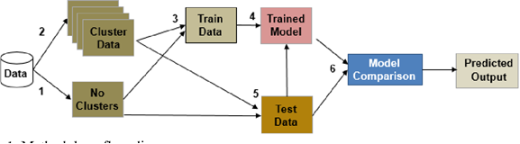
Flow of application

Slide 8
Technologies used
Python
Jupyter Notebook
Numpy
Pandas
Keras
Tensor flow

Slide 9
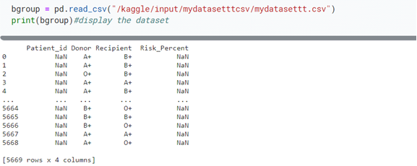
code
Importing dataset

Slide 10
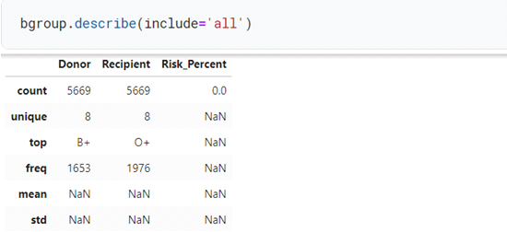
Describing dataset

Slide 11


Converting donor and recipient blood groups into Numerics

Slide 12
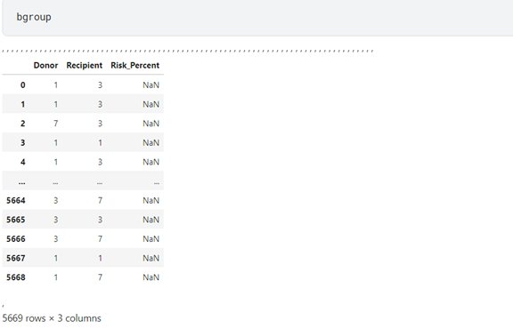
After converting

Slide 13
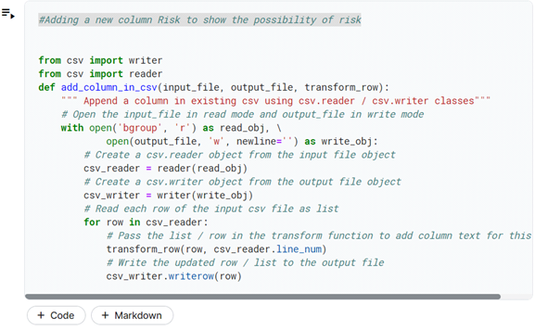
Adding Risk Column

Slide 14
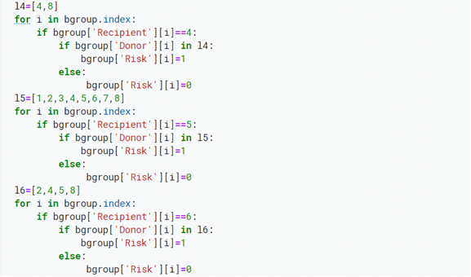
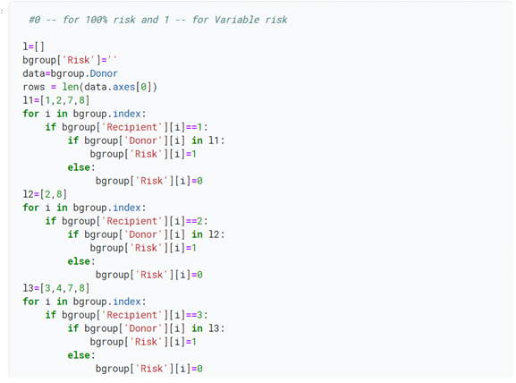
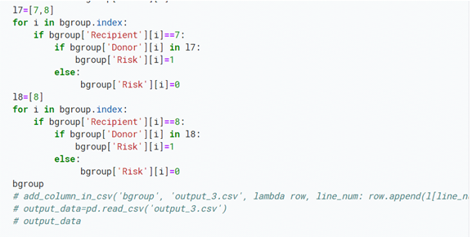
Categorizing Risks as 0's and 1's

Slide 15
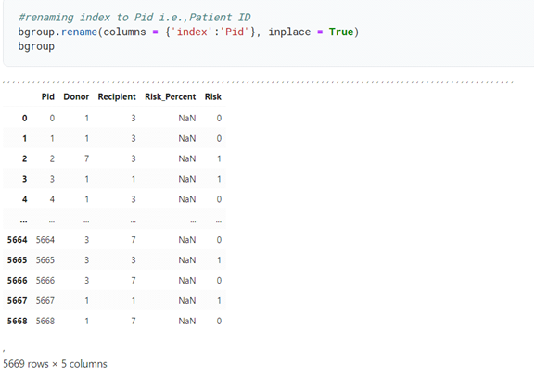
Output

Slide 16
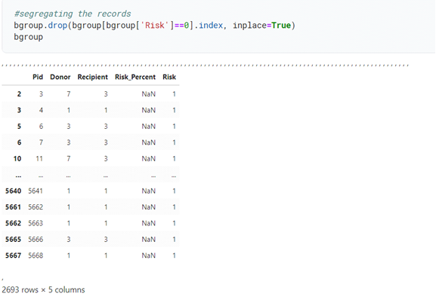
Segregating the Risks

Slide 17
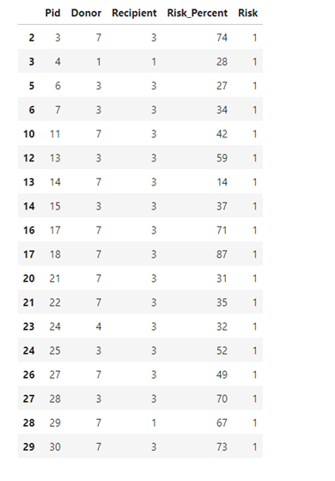

Assigning Random risks

Slide 18
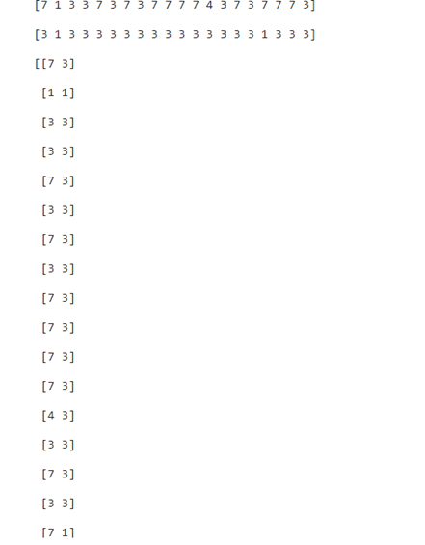
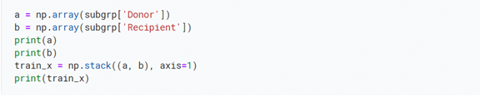

Converting into 2D arrays

Slide 19
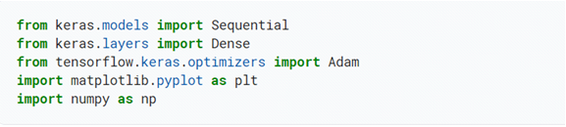
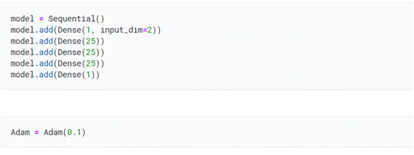
Importing keras and adding layers

Slide 20
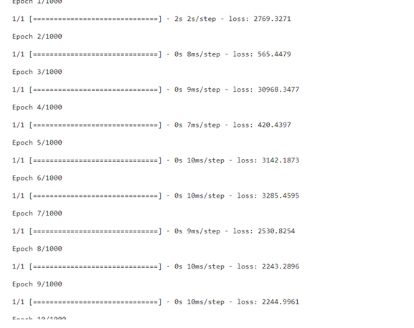
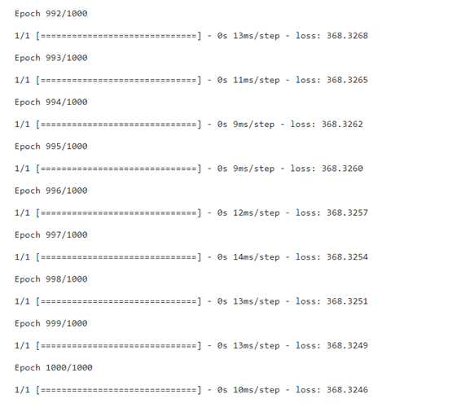

Running Epochs

Slide 21
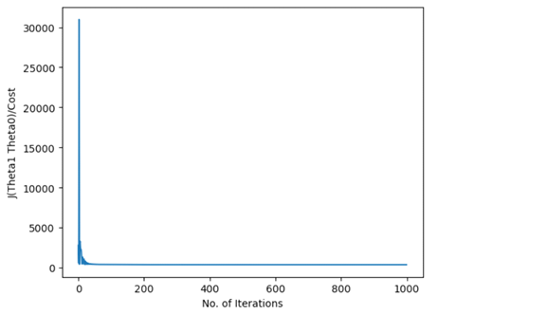
Plotting the epochs

Slide 22
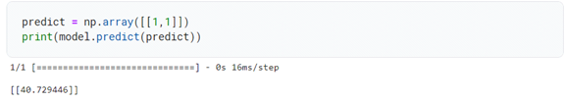
Output
Predicting the Risk

Slide 23
Applications
In Blood Banks
In Hospitals and Medical Camps
For Surgeries

Slide 24
advantages
Efficient Blood Choosing for donation
Decreasing Risk
Healthy blood for operations

Slide 25
Disadvantages
Possibility of Transfusion diseases
No proof of healthy blood from Donors

Slide 26
Conclusion
The main problem with blood donation is the lack of blood of a specific type, so can test machine learning algorithms to produce better results. And the problem of donor retention raises concern for blood centers. The choice of method in Blood Donor Selection is the most present. The main focus of this project has been analyzing the amount of risk while donating blood. To achieve this, we focused on first segmenting the records into various clusters which helped us in categorizing them into clustered and non-clustered data. The existing system has physical redundancies which would be solved by integrating machine learning techniques . We have implemented the MultiLayer perception algorithm for discovering the associations between the blood groups of donor and recipient . This appears to be very helpful for any organization especially medical organizations in the market place . The results of this study contributed to improving our understanding of what blood groups were suitable for donating to particular donors and helping blood agencies to predict potential blood donors, and improve recruitment efficiency with precision tactics to maintain the blood supply in emergencies.In conclusion, this project is rightfully seen as the possibility of finding an ideal donor would increase resulting in lower rates of transfusion related complexities.

Slide 27
Future scope
Looking at brighter outcomes of any project is very important, We believe this study could be a valuable extension to the academic literature in blood donation modelling .The scope of this project is exemplary, we can further develop a more visual approach to this project which comes with a user interface, which can be easily understood and used by the donors and recipients. It can be said that using an interactive Interface can be seen as a stepping stone for this project. On the other hand, we can optimize this algorithm based on different means . Also, increasing the amount data generated better frequent patterns and can be very helpful in maintaining the accuracy of the model. We can focus more upon providing the best suitable blood groups to recipients . as this approach would be carried out among more and more medical organizations across the globe. The ultimate goal of this project is to minimize the amount of risk errors while donating the blood.

Slide 28
Thank You !

