Slide 1

CHILD LABOUR-AT KURATOLI BAZAR
PRESENTED TO - MEHEDI HASAN
PRESENTORS
AHNAF ABDULLAH ZAYAD ( 21-45019-2)
MUSSA ALAM (21-45036-2)
SRABONE RAXIT (21-45038-2)
ASHIK AHAMED (21-45368-2)

Slide 2

PURPOSE OF OUR REPORT • Why we choose this topic • Our point of view towards them • Our focus point • Importance of our topic

Slide 3
Methodology
• Talking with child Labors
• Collecting field data
• Discussing with group member
• Analyzing those data
• Counting those data
• Plotting in excel sheet
• Making pie chart & graphs
• Preparing research document

Slide 4

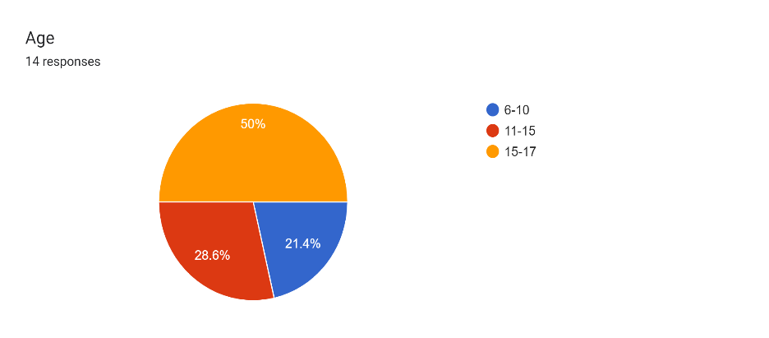
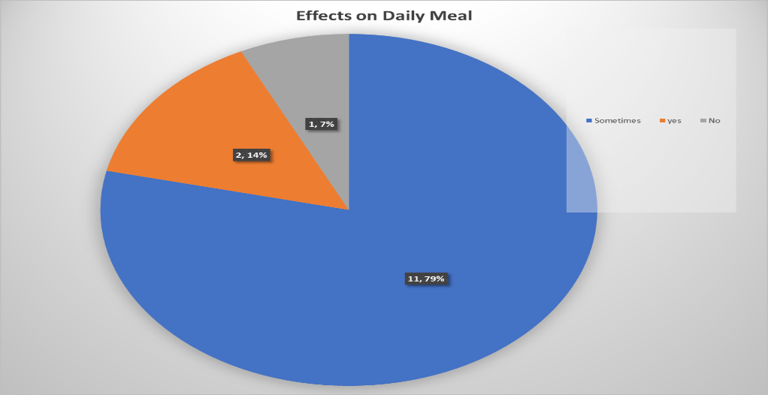
Findings

Slide 5
Recommendations
• Free school improvement for child labors.
• Awaring child labors about free schools.
• Explaining them the importance of education.
• Influence other people to do so.

Slide 6

THE END THANK YOU

